Slide 1

Explainable-Christmas
Marcos Jacinto - Madrid - Geowellex
Edwin Brown - UK - Optic Earth

Slide 2
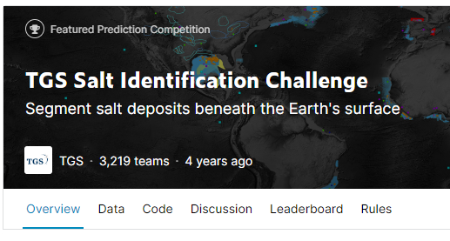
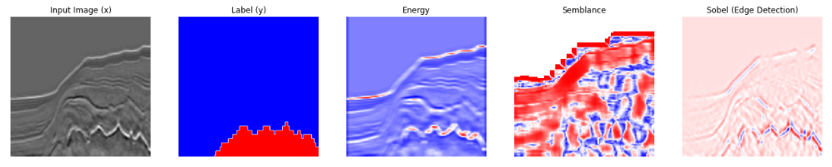
Intro to Idea
We used the TGS Salt Identification Challenge data along with a U-Net model trained from scratch using Tensorflow's library.
Seismic attributes were created from the seismic data.
Finally, we used Shap library to calculate SHAP values and obtain a measure of how important each feature (seismic data and attributes) is.

Slide 3
Attribute Generation
A set of seismic attributes were calculated from the original seismic section using the Bruges library.
Salt often has a different seismic character compared with other type of geological structures. Therefore, seismic attributes could offer some useful input features.

Slide 4
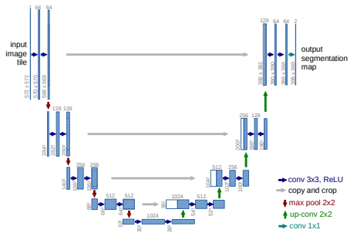
Model Summary
We used a U-Net model trained from scratch using Tensorflow's library.
During training, we used two NVIDIA GPUs* from the provided cluster.
*Thanks NVIDIA!
Ronnerberger et al. (2015)

Slide 5
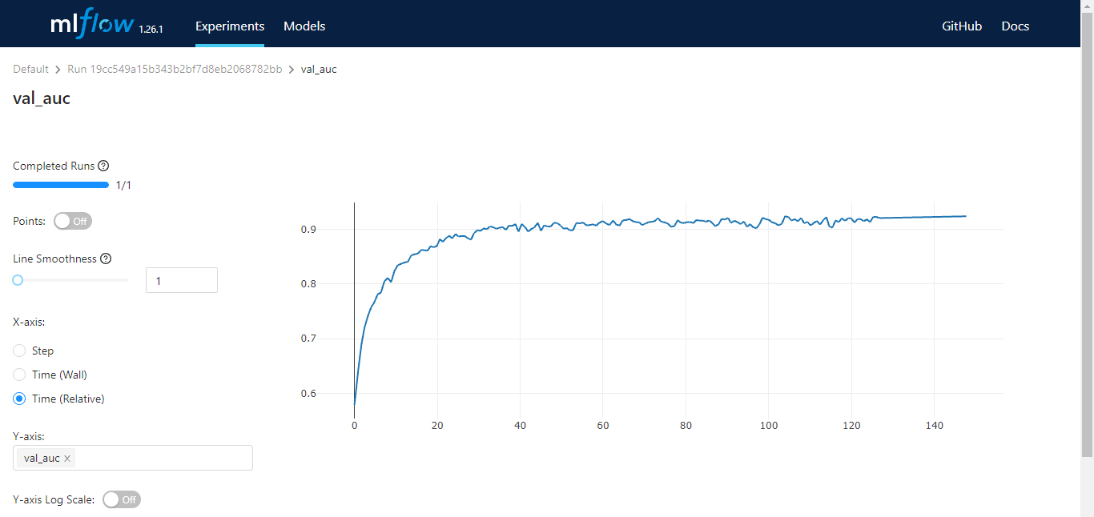
Model Training
Validation AUC: 92.4%
Validation Acc.: 88.8% Test AUC: 92.5%
Test Acc.: 87.7%

Slide 6
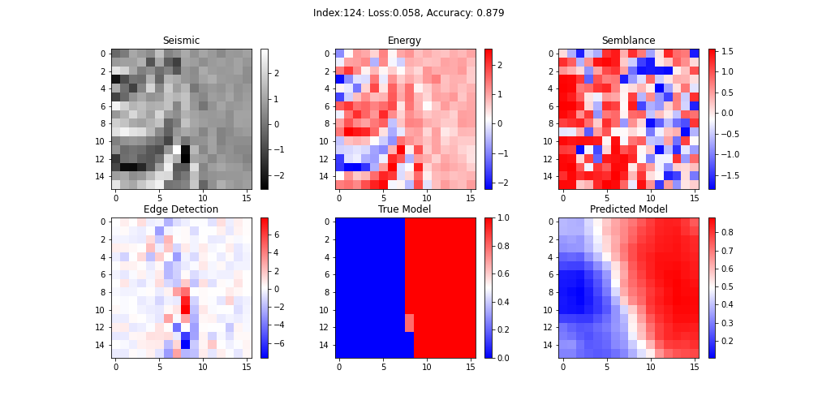
Model Evaluation
We had to reduce samples to 16x16

Slide 7
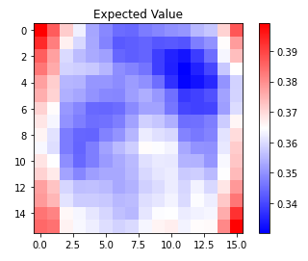
Shap Evaluation

Slide 8
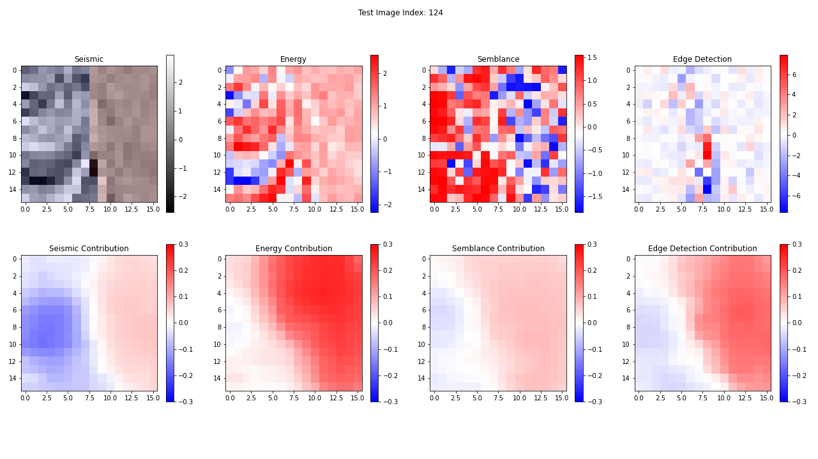
Shap Evaluation

Slide 9
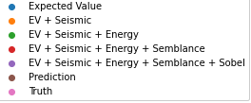
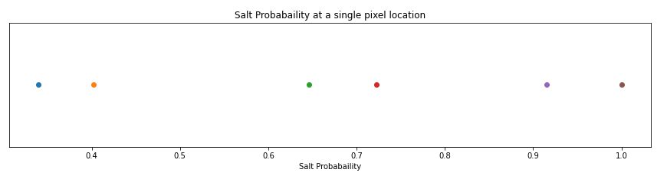
Shap Evaluation

Slide 10
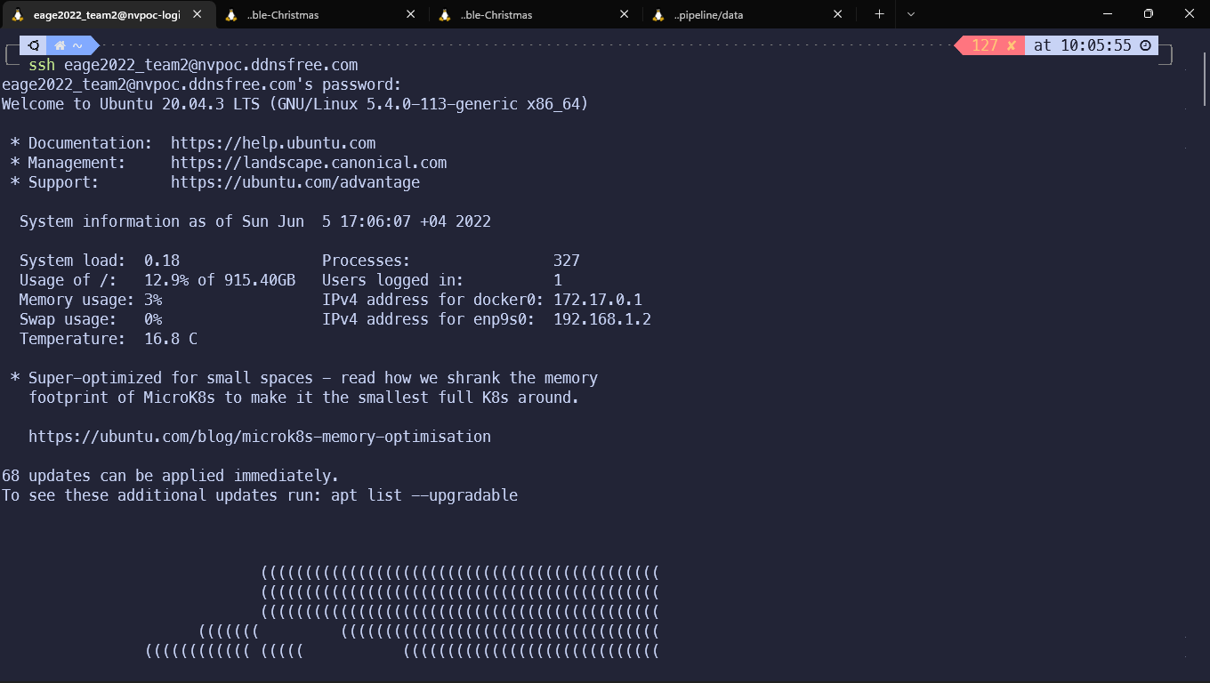
Challenges
Computing the SHAP values isn’t optimized yet to GPUs: had to reduce samples to 16x16
Using NVIDIA’s cluster

Slide 11
Conclusions & Further Work
Using SHAP to explain allowed us to:
Evaluate possible biases: all the attributes and the seismic data contribute to the predictions;
Complete data-driven approach;
Next steps:
Optimize a few parts of the code so it runs faster;
Reproducible pipeline and experiment tracking.

Slide 12
Food for thought. .
“Deep learning also makes problem-solving much easier, because it completely automates what used to be the most crucial step in a machine learning workflow: feature engineering. “
Francois Chollet, Deep Learning with Python, 2021

