Slide 1

Norne Field Dataset and Reservoir Simulation Forward Modelling Using PINO
ModulusMavericks
Jorge Nustes (Veridien)
Roderick Perez (OMV)
June, 10th, 2024

Slide 2
Net Zero Future
“Net zero means cutting carbon emissions to a small amount of residual emissions that can be absorbed and durably stored by nature and other carbon dioxide removal measures, leaving zero in the atmosphere.”
Net Zero Coalition | United Nations
Discovery
Evaluation
Development
Production
Abandonment
CCUS
EXPLORATION
PRODUCTION
STORAGE
5-10 years
15-30 years
100+ years
Cash Flow
Year

Slide 3
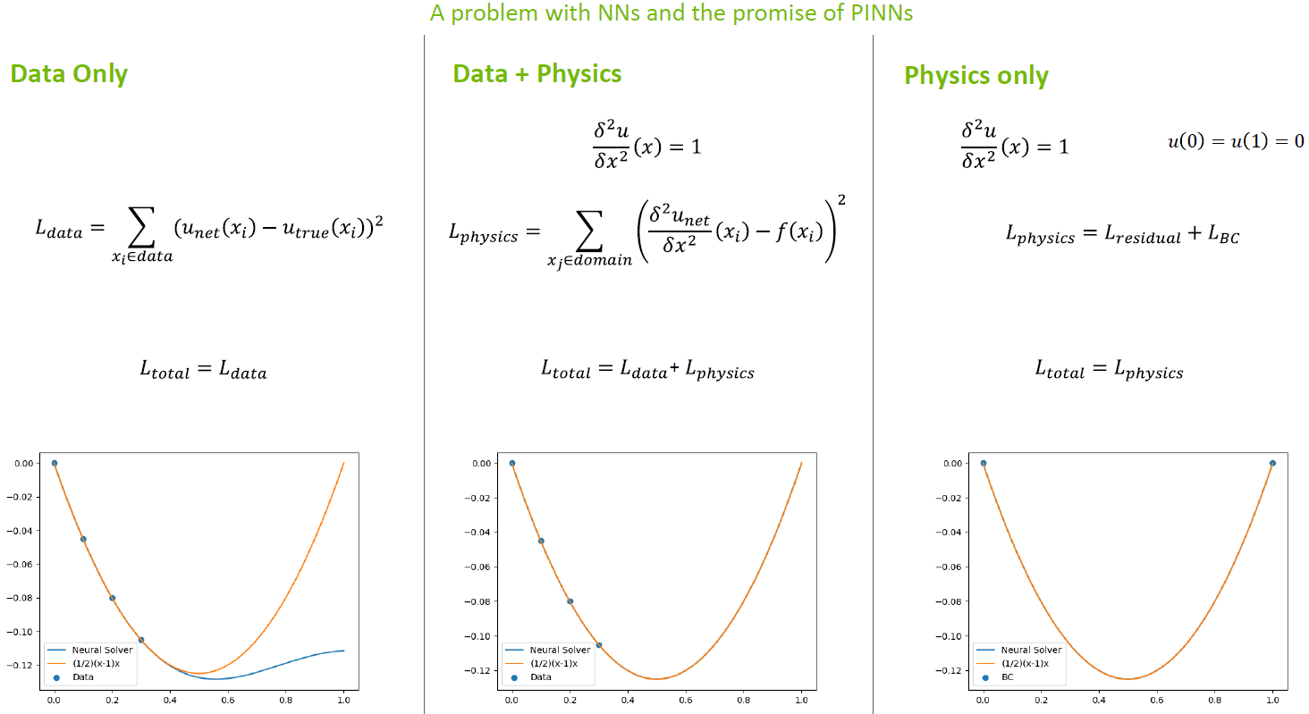
Physics Informed Neural Networks (PINNs)
(Nvidia DLI)

Slide 4
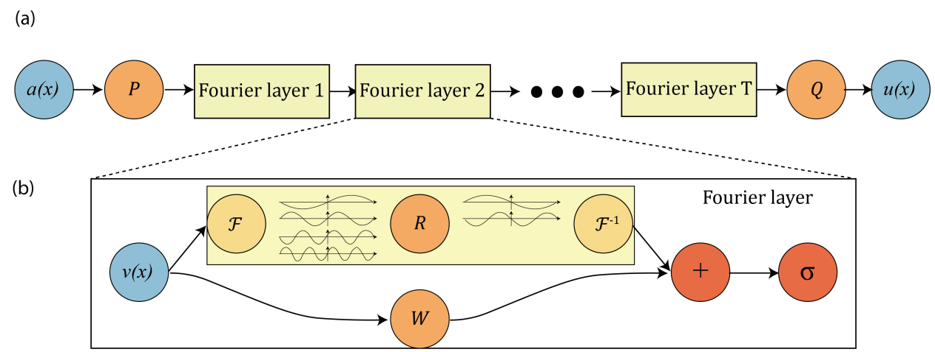
Fourier Neural Operator (FNO)
(Li, et al., 2020)

Slide 5
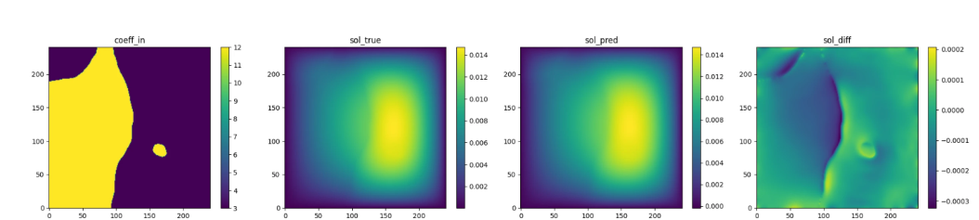
Physics Informed Neural Operator (PINO)
Combines the data-informed supervised learning in FNO with the physics-informed learning in PINNs.
(NVIDIA, DLI)
(Li, et al., 2021)

Slide 6
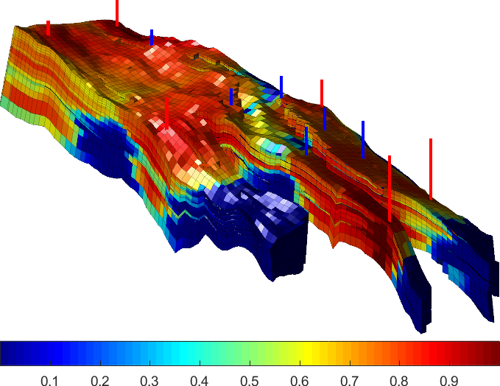
Norne Field
Model Dimensions: d, w, h = 22, 46, 112
Location: Norwegian Sea
Geological Setting: Production (Oil, Gas, Water): Oil production in the Norne field began in November 1997.
Initial Reservoir Model: The initial reservoir model consisted of 113,344 grid cells, with 44,927 active cells.
Notes:
The Norne Field dataset is a comprehensive collection of data from the Norne oil field, located in the Norwegian Sea. It includes detailed information on pressure, saturation, and other essential reservoir properties. This dataset provides an excellent basis for developing advanced simulation models that can predict reservoir behavior and optimize production strategies.

Slide 7

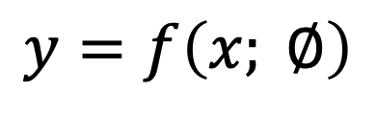

Executive Summary
Existing Code
History Matching
Inputs [5]:
Porosity
Permeability
Fault Transmissibility
Initial pressure
Initial saturation
Outputs of all time steps
Outputs [3]:
Pressure
Water saturation
Gas saturation
Proposed Code
[
[
Porosity
Perm.
[
[
Fault Trans.
…
=
…
$$x=R^{\left[Ne,1, d, h, w\right]}$$
$$y=f\left(x; ∅\right)$$
$$y=R^{\left[Ne,1, d, h, w\right]}$$
11
6
FUTURE STAGE OF PRESSURE, SATURATIONS BASED ON CURRENT STATE
Notes:
PINO is an advanced machine learning framework that integrates physical laws governing reservoir dynamics with data-driven neural networks.
Modulus current code
Edit FNO history matching to predict sequenatilly the new states given the current states ook forward
Change architecture t

Slide 8



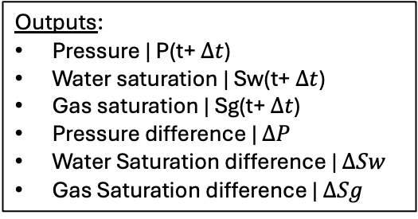
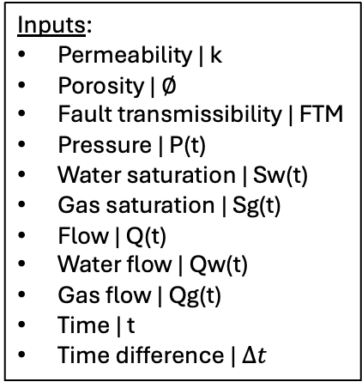
Surrogate Model
6 supervise outputs
[
* fixed
[
Porosity*
Perm.*
[
S_{after}
[
Fault Trans.
P_{after}
Sw_{after}
…
=
…
$$x=R^{\left[Ne,1, d, h, w\right]}$$
$$y=R^{\left[Ne,1, d, h, w\right]}$$
Inputs:
Permeability | k
Porosity | $∅$
Fault transmissibility | FTM
Pressure | P(t)
Water saturation | Sw(t)
Gas saturation | Sg(t)
Flow | Q(t)
Water flow | Qw(t)
Gas flow | Qg(t)
Time | t
Time difference | $∆t$
Outputs:
Pressure | P(t+ $∆t$)
Water saturation | Sw(t+ $∆t$)
Gas saturation | Sg(t+ $∆t$)
Pressure difference | $∆P$
Water Saturation difference | $∆Sw$
Gas Saturation difference | $∆Sg$
6
6 supervise outputs
11
+
t+ $∆t$ = future
Water equation
6 physic losses
t = current

Slide 9









Methodology
Initial Values
PINO
Grid
(Porosity, Perm, FTM)
Pressure
$t$+∆𝑡
t = 0
Grid
(Porosity, Perm, FTM)
Saturation
$$t$$
Pressure
𝑡
t+ $∆t$
Saturation
$t$+∆𝑡
* Constant
PINO
Grid
(Porosity, Perm, FTM)
Pressure
$t$+∆𝑡
t = 1
Grid
(Porosity, Perm, FTM)
Saturation
$$t$$
Pressure
𝑡
t+ $∆t$
Saturation
$t$+∆𝑡
* Constant
PINO
Grid
(Porosity, Perm, FTM)
Pressure
$t$+∆𝑡
t = T
Grid
(Porosity, Perm, FTM)
Saturation
$$t$$
Pressure
𝑡
t+ $∆t$
Saturation
$t$+∆𝑡
* Constant
Notes:
Due to (Hackathon) time constrains, we are assuming time zero, before the Norne Field started production, we have access to saturation and pressure data. This data will be used to train a Physics-Informed Neural Operator (PINO). This hybrid approach ensures the model respects the fundamental principles of reservoir behavior while leveraging historical data to enhance predictive accuracy.

Slide 10
Methodology Training the PINO Model
⁠Data Preparation: Extract pressure and saturation data from the Norne Field dataset. This data will be split into training and validation sets.
Model Architecture: The PINO model will be designed to incorporate the governing equations of reservoir simulation, such as the continuity equation, Darcy's law, and the equation of state for fluid flow.
Training: The model will be trained on the historical data, learning to predict pressure and saturation over time. The training process will involve minimizing the error between the model predictions and the observed data, while ensuring the physical laws are respected.

Slide 11
Methodology Validation
The trained PINO model will be validated using historical production data from the Norne Field. The validation process involves comparing the model's predictions with actual historical data to ensure accuracy. Key metrics for validation will include:
Pressure Profiles: Comparing predicted pressure distribution with historical measurements.
Saturation Levels: Evaluating the accuracy of predicted fluid saturation across the reservoir.
Production Rates: Matching the predicted oil, gas, and water production rates with historical data.

Slide 12
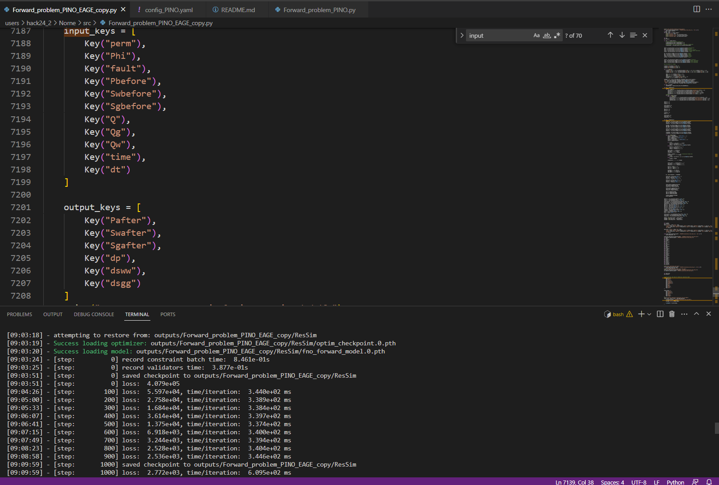
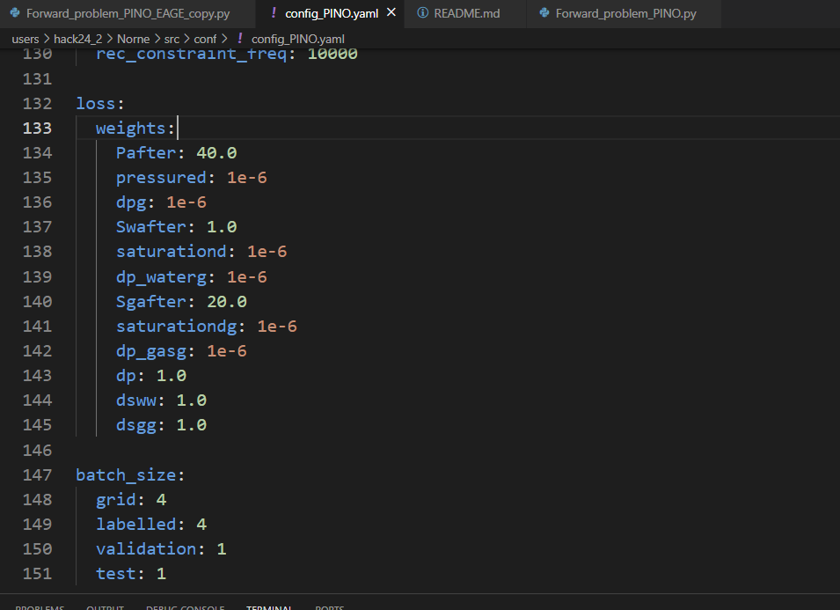
Code Snapshot
Training
.yaml file

Slide 13
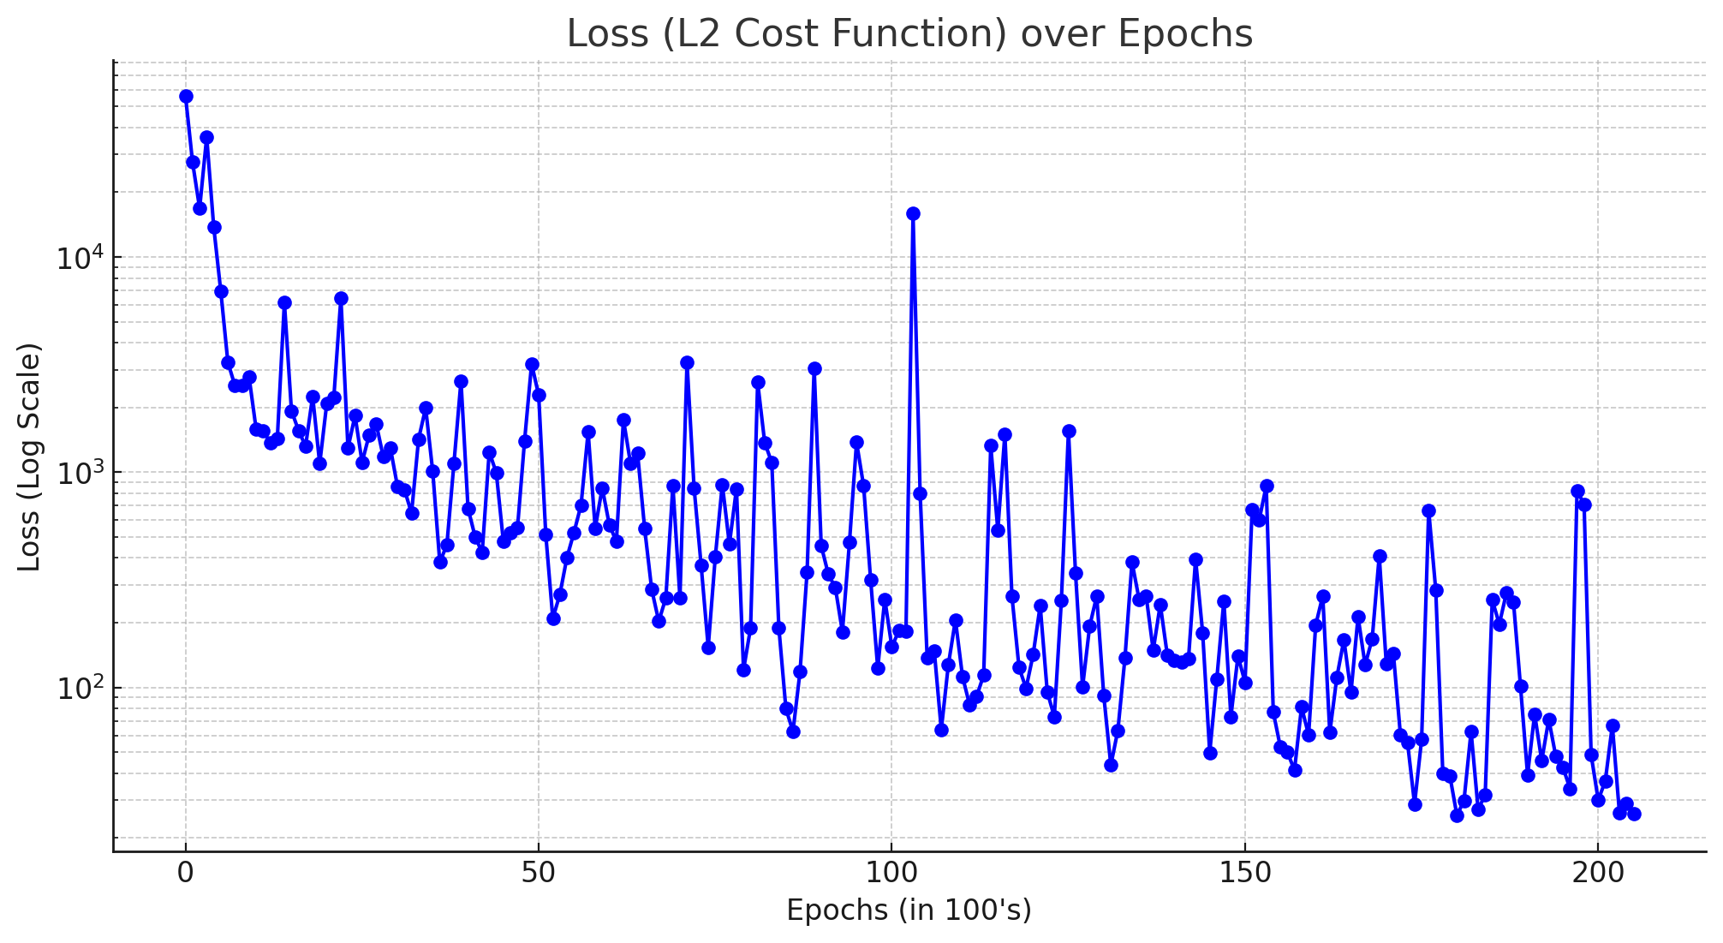
Results Trains for 100,000
Execution time: 30 secs/100 steps
30,000 secs = 8.3 hours
Numerical simulation = 6,000x (per scenario)

Slide 14
Potential Applications
Optimizing Well Placement
Once validated, the PINO model will be used to optimize well placement. The goal is to identify the best locations for drilling new wells to maximize production efficiency, enhance recovery rates, and at the same time, optimize CO2 injection after the production period. The optimization process will consider:
Production Maximization: Identifying locations with the highest potential for oil and gas extraction.
CO2 Injection: Evaluating the feasibility of injecting CO2 to enhance oil recovery and reduce carbon emissions.
Geomechanical Considerations: Ensuring the structural integrity of the reservoir is maintained during production and injection activities.

Slide 15
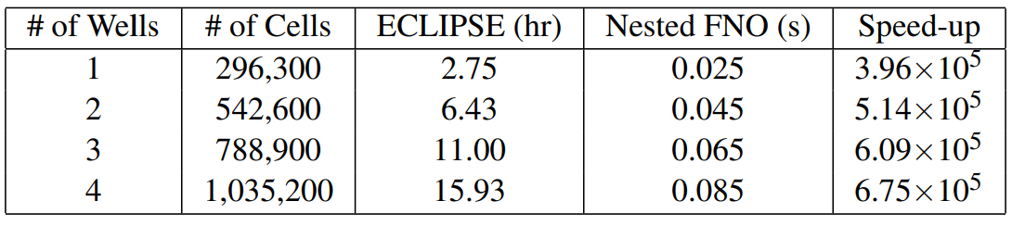
Future Steps
Geomechanical considerations
Reinforcement Learning
Optimizing well locations for CO2 injection
Use Transformers AFNO
Reference: Wenn (2023), Accelerating Carbon Capture and Storage Modeling using Fourier Neural

Slide 16

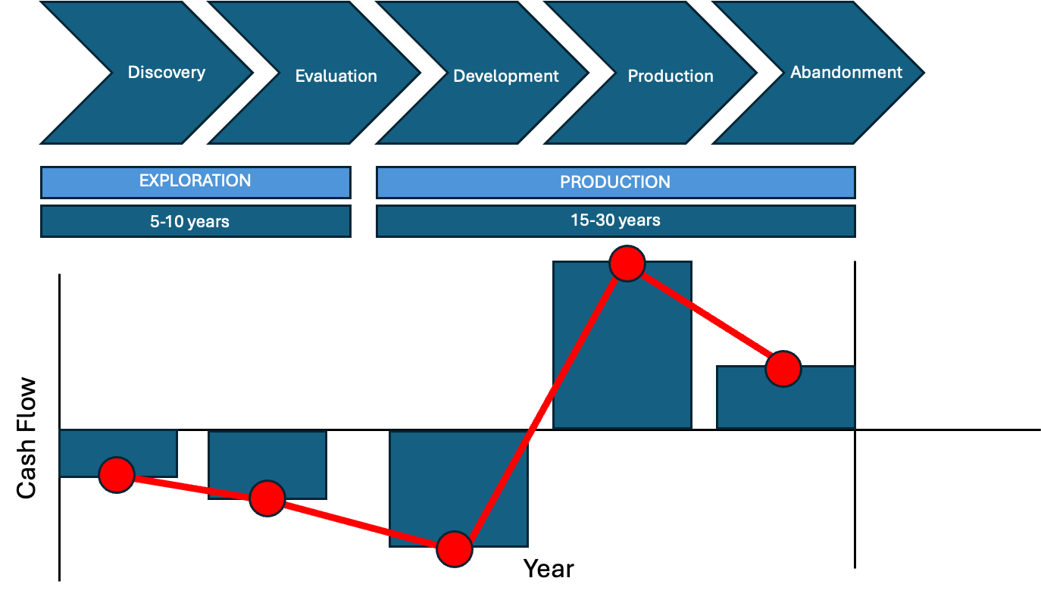



Conclusions
Reduce simulation scenario time and energy consumption
Speeds up predictions nearly 1000’s x compared to existing methods.
Reach Net – Zero goals

Slide 17
Thanks
Questions

Slide 18
Challenges
Conceptual:
Understand the problem and equations
From 3D geological model --> Tensor thinking
Technical:
Internet connection was unreliable
Short time to execute code (and QC results)
“Not because they are easy, but because they are hard”
John F Kennedy, Moon Speech - 1962

