Slide 1

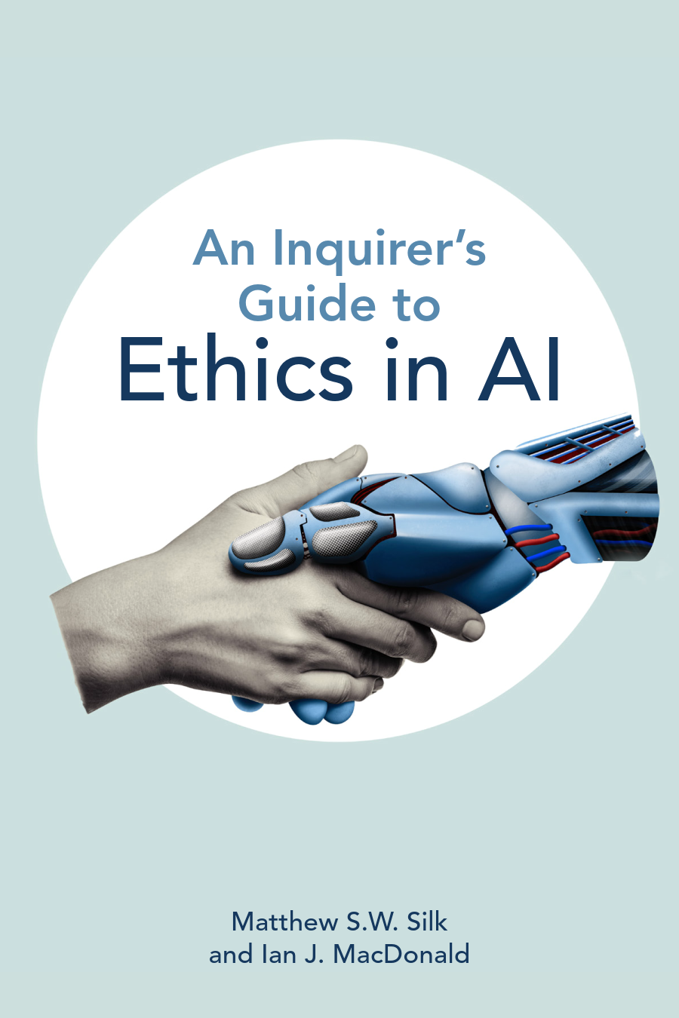
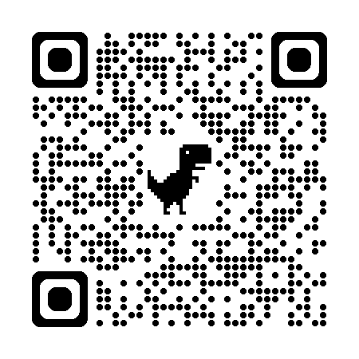
A Stakeholder-Relevant Approach to AI Literacy
Join the Ethics of AI Society!
Dr. Matthew Silk
Dr. Ian MacDonald

Slide 2
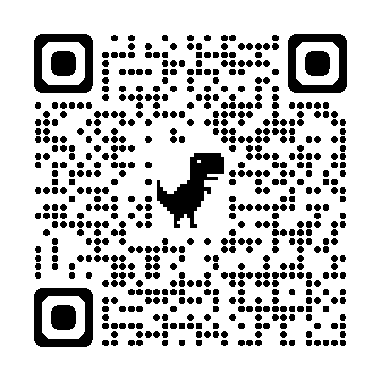
QR Link to Slides

Slide 3
AI Literacy
The ability to understand, evaluate, and responsibly use AI as tool.
AI is both a tool for accomplishing tasks and a source of information. We need to be literate in both respects.
Students
What should an AI literate person be capable of?
Educators
Administrators

Slide 4
Stakeholders: Who values what?
Students
Educators
Administrators
Values
Efficiency and time savings
Ability to probe/question freely
Fairness
Accuracy/reliability of results
Values
Efficiency and time savings
AI assistance
Verify learning achievement
Fairness/ transparency
Relative control of AI in classroom
AI Options
Value
Efficiency and time savings
Academic integrity
Innovation
Detecting AI-generated content
Accountability
Concerns
Efficiency and time savings
Ability to probe/question freely
Fairness
Accuracy/reliability of results
Concerns
Fairness (if AI used for grading)
Being overly restrictive/permissive
Unverifiable claims
False positive accusations
Concerns
Misapprehension/ misunderstandings of use
Unverifiable claims
False positive accusations
Fairness of AI used for administration

Slide 5
Misalignment Problem
Scenario: Student Uses AI on essay
Different legitimate priorities
Stakeholder | Priority
Student | Fairness/success
Instructor | Skill development/authorship
Administration | Integrity/Consistency
An AI Literacy framework should be:
Aware of stakeholder values
Informed about value conflicts

Slide 6
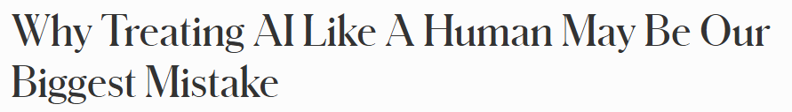
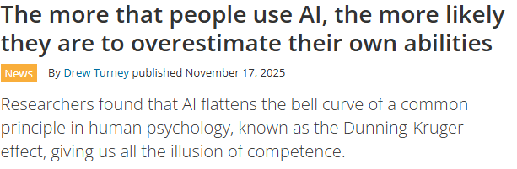
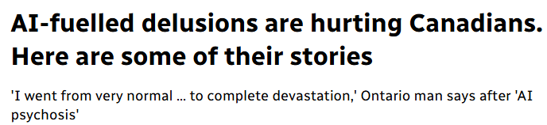
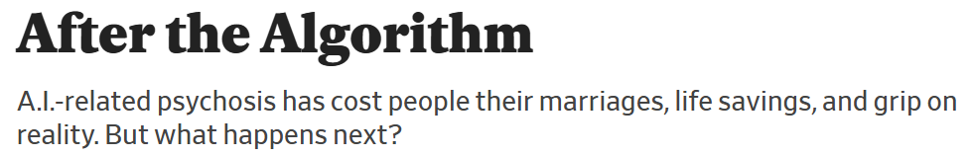
Who has what problems?
1. Misunderstanding/misuse of the tool
Overvaluing and misuse
2. Epistemic health:
Using AI can be epistemically harmful to knowledge production practices.
3. Mental health:
Using AI can be harmful to our mental health.

Slide 7
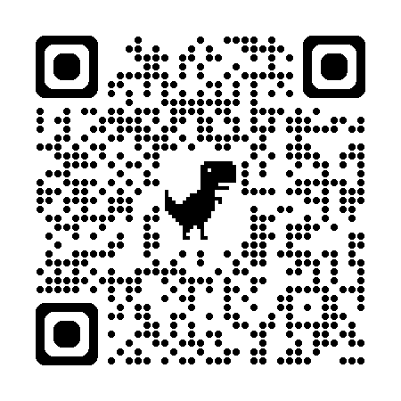
AI Literacy Framework:
Technical
Informational
Model Design
Accuracy
Consider model limitations
Evaluate accuracy of model output
Model Functionality
Discipline/Field Relevance
Discover model features
Disciplinary considerations
Privacy & Trust
Authorship
Scan for full handout
Evaluate impact of AI use
Determine human input

Slide 8
Applying the Framework
Authorship exercise
If using AI to assist with writing, create a log to track your ideas and intentions.
What is my aim with this project?
What ideas, arguments, or structure have I contributed independently?
When have I used AI in this project and for what specific purposes (brainstorming, editing, outlining, etc.)?
What parts of the work reflect my own understanding?
When have I accepted AI suggestions without modification?
Could I explain and defend this work without AI assistance?
In what ways am I retaining authorship of research?

Slide 9
From AI Anxiety to Clarity
Our framework offers:
Stakeholder understanding
Clearer and more informed judgment
Stronger Assignment Environments
Healthier Learning Environments
In response to confusion, uncertainty, and inconsistency, AI literacy should help educators respond with clarity, not panic.

