Slide 1
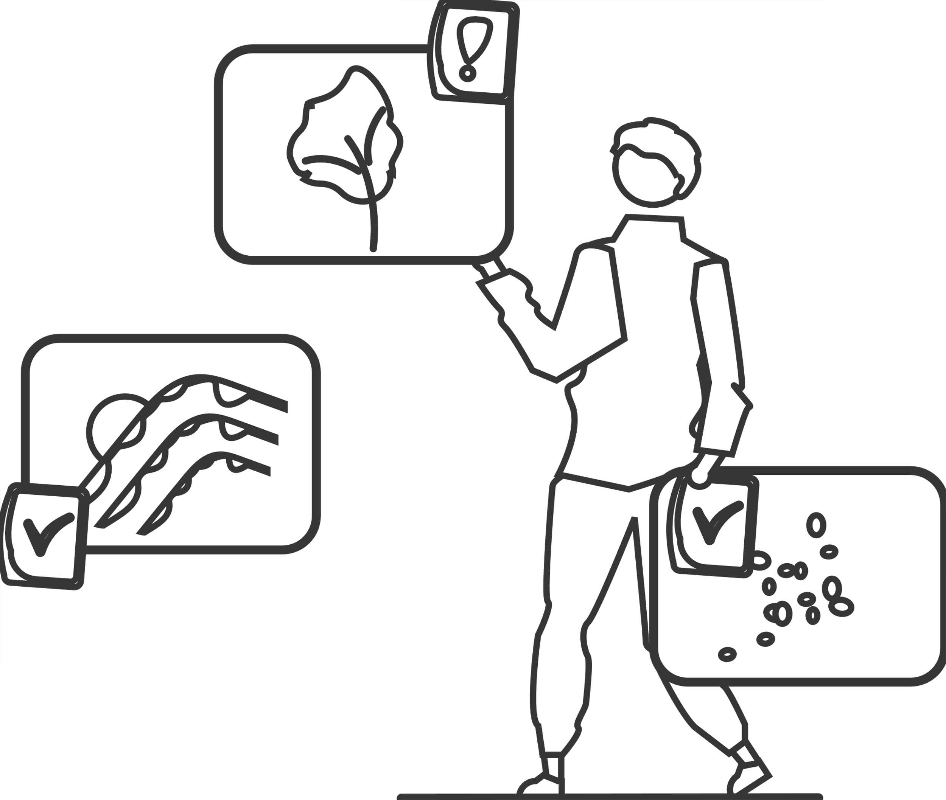
Project 2
Model in predicting TREFMXAV_U
Yishu Huang
11305865

Slide 2
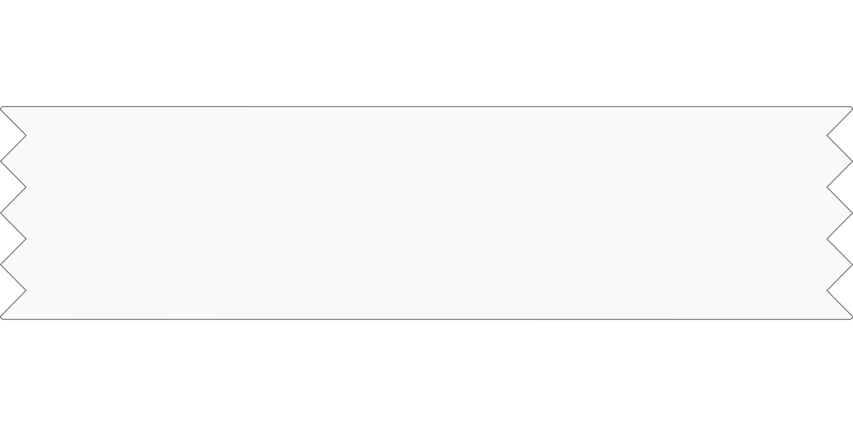
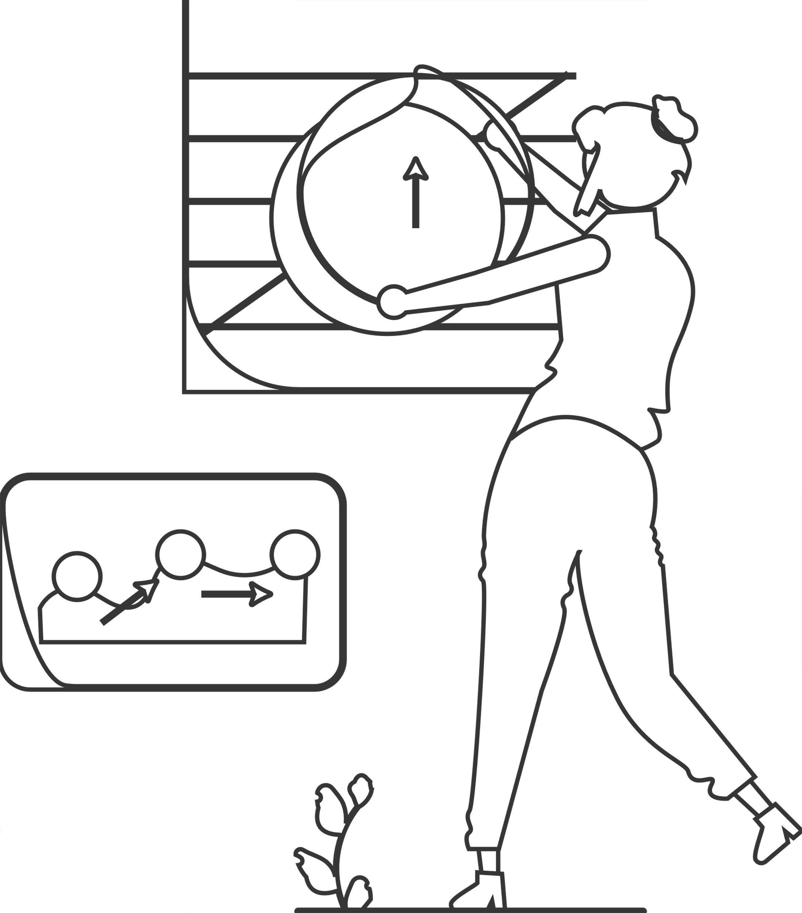
Contents
1.Data preprocessing
2.Model
3.Model assessment

Slide 3

PART-1
Data preprocessing

Slide 4
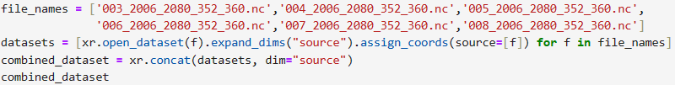
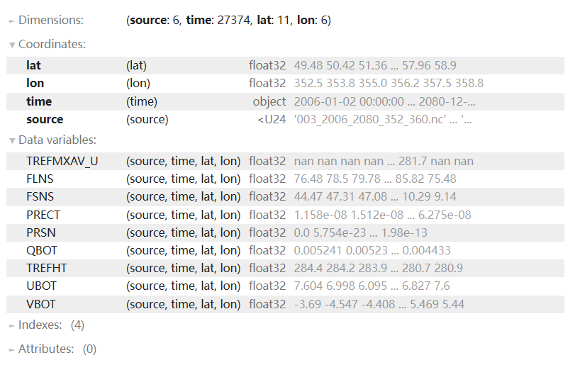
Data reading and merging

Slide 5
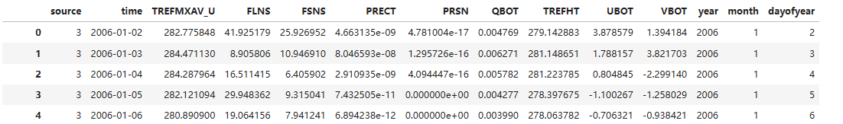
Find Manchester
Turn to dataflame
Split time into year, month, day of year

Slide 6
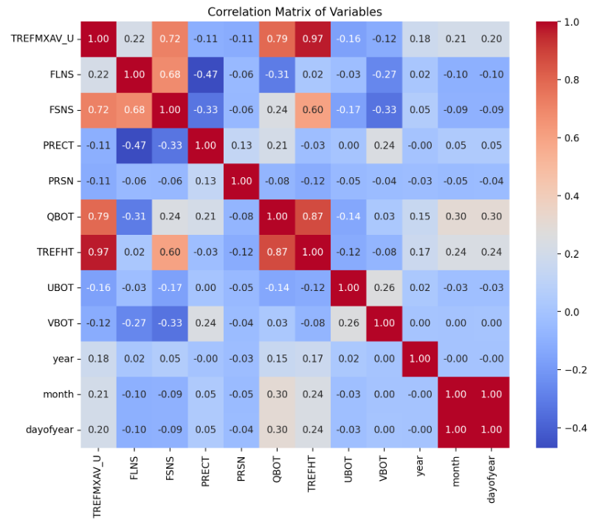
Correlation Matrix

Slide 7
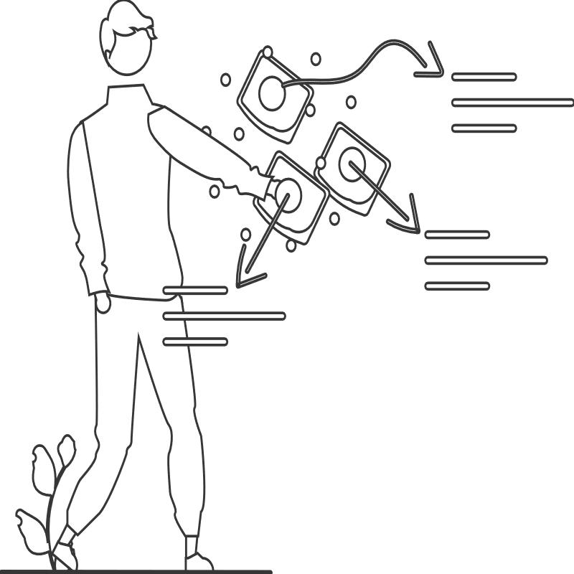
PART-2
Model

Slide 8

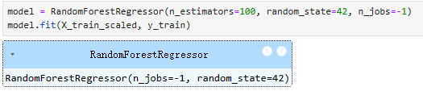

Feature Scaling
Split train and test
Try Ramdom Forest
Notes:
StandardScaler and MinMaxScaler
Data standardisation

Slide 9
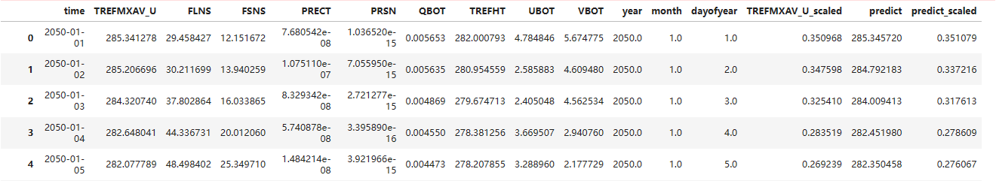
Feature Scaling
Split train and test
Try Ramdom Forest
Notes:
StandardScaler and MinMaxScaler
Data standardisation

Slide 10
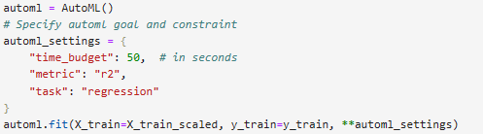
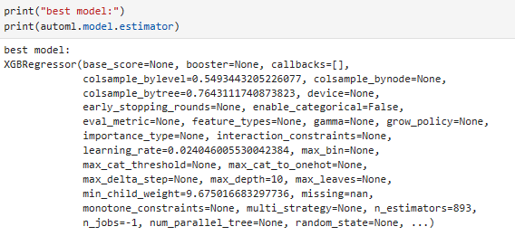
AutoML
Notes:
50second
not deside model
use r2 to assess

Slide 11

AutoML

Slide 12
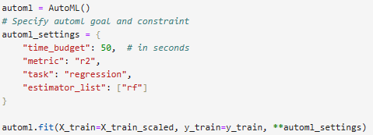
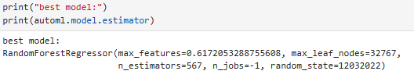
AutoML

Slide 13

AutoML

Slide 14

PART-3
Model assessment

Slide 15
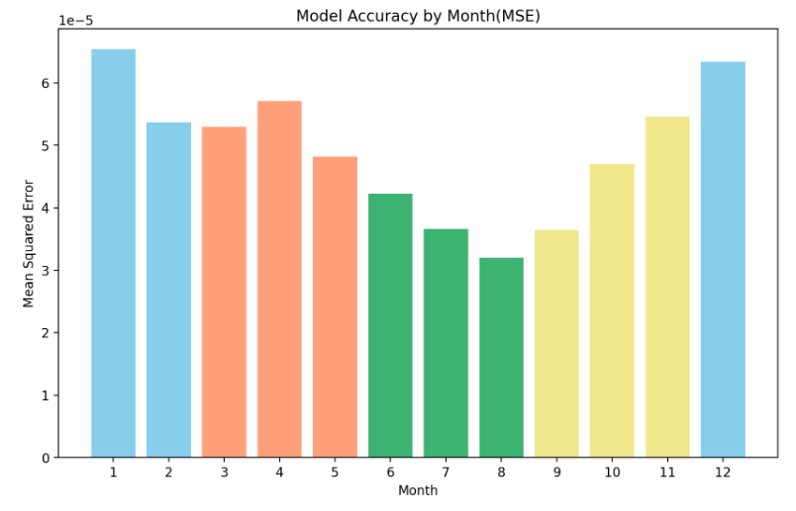
Notes:
group by month

Slide 16
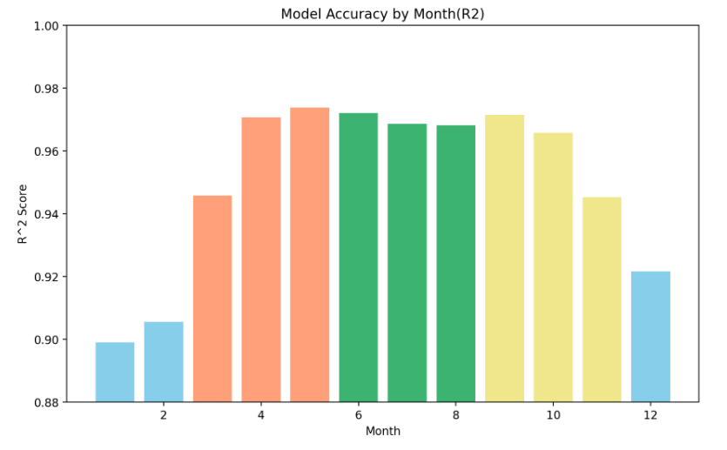

Slide 17
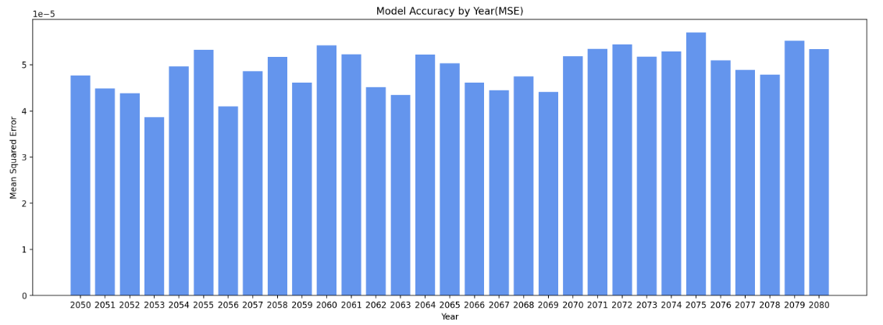

Slide 18
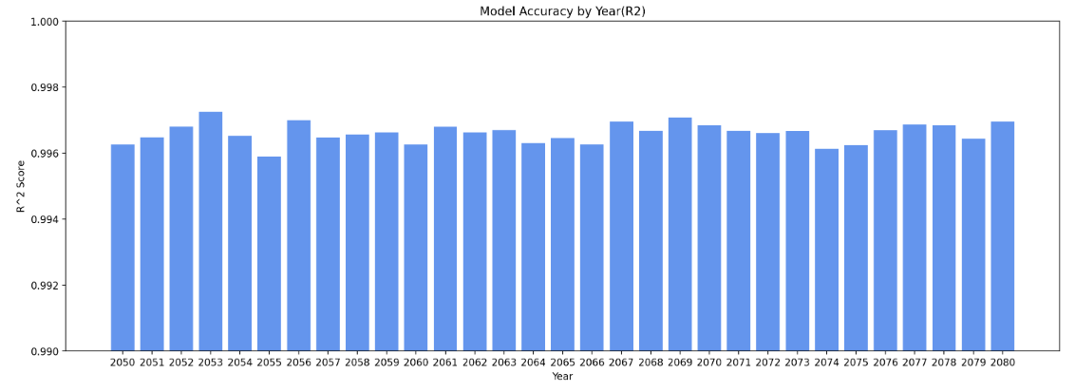

Slide 19
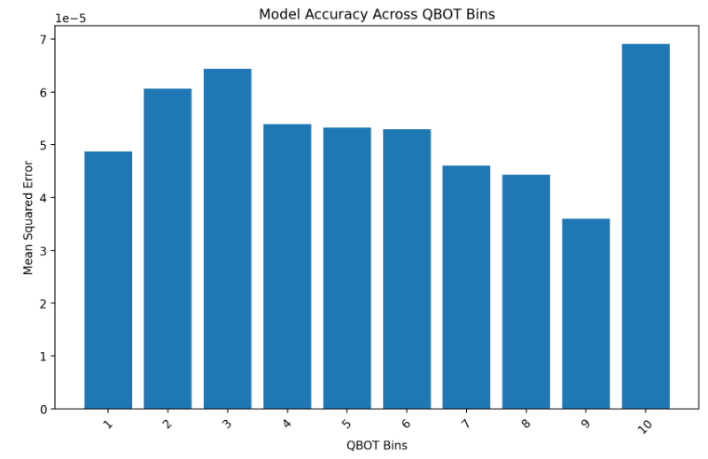

Slide 20
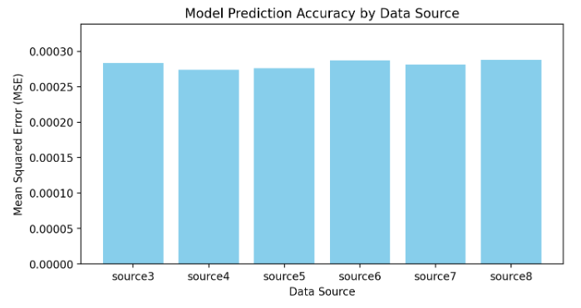
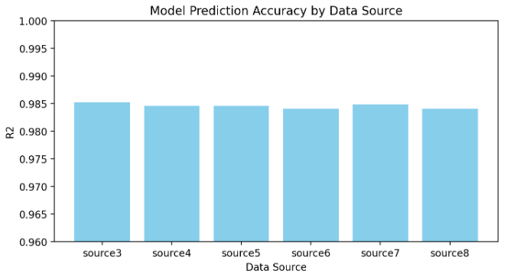

Slide 21


Try some other cities → not so good
AutoML R-squared: 0.8157015382538825
AutoML R-squared: 0.8118556719111485

Slide 22
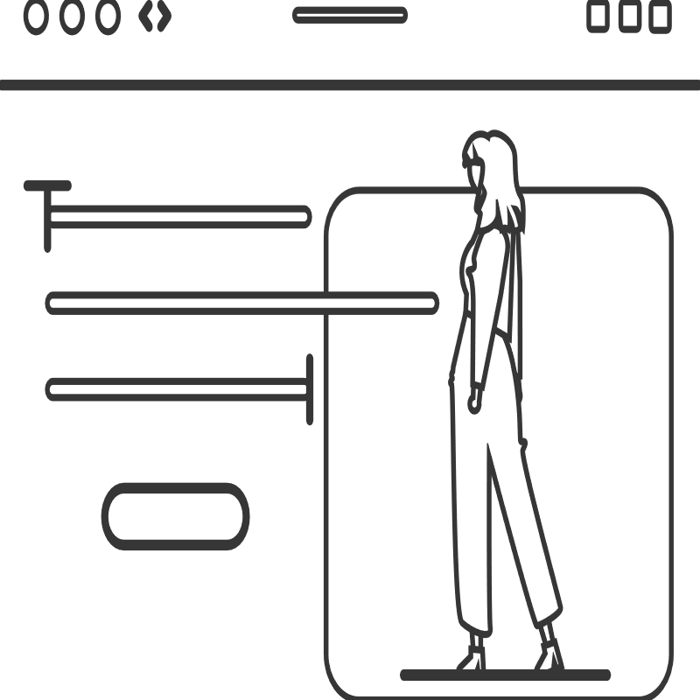
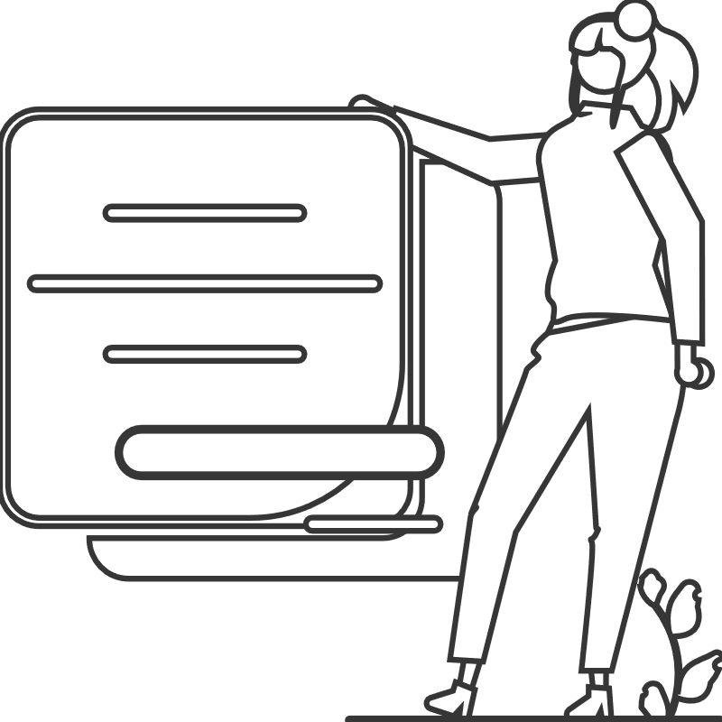
Thanks！

