Slide 1



Asset Management-Asset Life Cycle Unit
ALC (Maintenance Strategy) Section
RCM Analysis Final Report
Connaught Bridge Power Station
Generator Transformers
Analysis Date : 4th – 7th August 2025
Audit Session Date : 3rd October 2025
TS-RE:
Station’s Management:
Prepared by:
Ts. Wan Mohamad Erfan Bin Wan Mustafa
Sr. Engineer –RCM (Planning)
Date: 3rd October 2025
Checked by:
Ir. Ts. Dinishkaran Pillai,
Principal Engineer ( Maintenance Strategy )
Date: 3rd October 2025
Approved by:
Head of Maintenance
Date:

Slide 2

DISCLAIMER
The information contained in these documents is confidential, privileged and only for the information of the intended recipient and may not be used, published or redistributed without the prior written consent of TS-RE Unit.
The opinions expressed are in good faith and while every care has been taken in preparing these documents, TS-RE Unit makes no representations and gives no warranties of whatever nature in respect of these documents, including but not limited to the accuracy or completeness of any information, facts and/or opinions contained therein.
TS-RE Unit cannot be held liable for the use of and reliance of the opinions and findings in these documents.

Slide 3
Table of Contents Page
1. INTRODUCTION 1
2. RCM METHODOLOGY 5
3. ANALYSIS 6
4. CONCLUSIONS 12
5. RECOMMENDATIONS 13
6. REFERENCES 14
7. ATTACHMENT 15

Slide 4
1. INTRODUCTION
1.1 Background
Reliability Centered Maintenance (RCM) is one of the maintenance methodologies designed to optimize maintenance strategies implementation at all TNB Genco plants. TNB Generation / TNB Genco has been implementing RCM since 2004.
The RCM 5-Year Masterplan for TNB Genco was presented and approved by TNB Genco’s Chief Operation Officer Performance Review (COOPER) in March 2022. One of the agendas in the masterplan is for TNB Genco's to continue providing RCM facilitation service to all TNB Genco plants.
CBSB has requested the Maintenance Strategy Team in ALC Unit to conduct an RCM analysis on the Generator Transformers, to improvise the current maintenance practice.
This report will outline the outcome of the RCM analysis for Generator Transformers which was conducted on 4th – 7th August 2025.

Slide 5
1. INTRODUCTION
1.2 Team Members
Members who have contributed for this RCM analysis
System : Generator Transformers
Venue : TNB Kota Bharu
Analysis date : 4th – 7th August 2025
No | Name | Role
1 | Mohd Rosnan Bin Nasir | Facilitator 1
2 | Wan Mohmad Erfan | Facilitator 2
3 | Nik Ahmad Zareen Bin Nik Abd Wadood | Team Lead
4 | Muhd Fadhli | Participant
5 | Ahmad Syamil | Participant
6 | Fattah Amin | Participant
7 | Mohd Shazni Bin Halid | Participant
8 | Muhamad Syaffizat | Participant
9 | Mohd Zool Fadli Bin Che Rani | Participant
10 | Rozaimie Bin Aminuddin | Participant
11 | Supian Bin Yahuza | Participant
12 | Daeng Malibuk Bin Saadun | Participant
13 | Muhammad Faizul Bin Ariffin | Participant
14 | Muhamad Rahmat Bin Mat Hassan | Participant
15 | Mohd Khairuddin Bin Md Yusop | Participant

Slide 6
1. INTRODUCTION
1.3 Operating Context
Generator Transformers process flow and major parts
Primary Function:
To step up the generator output voltage (11–25 kV) to transmission grid voltage (110–765 kV or as specified).To provide electrical isolation between generator and transmission system.
To operate continuously with high reliability, supplying power to the transmission grid.
Reason of system selection: Common critical system.

Slide 7
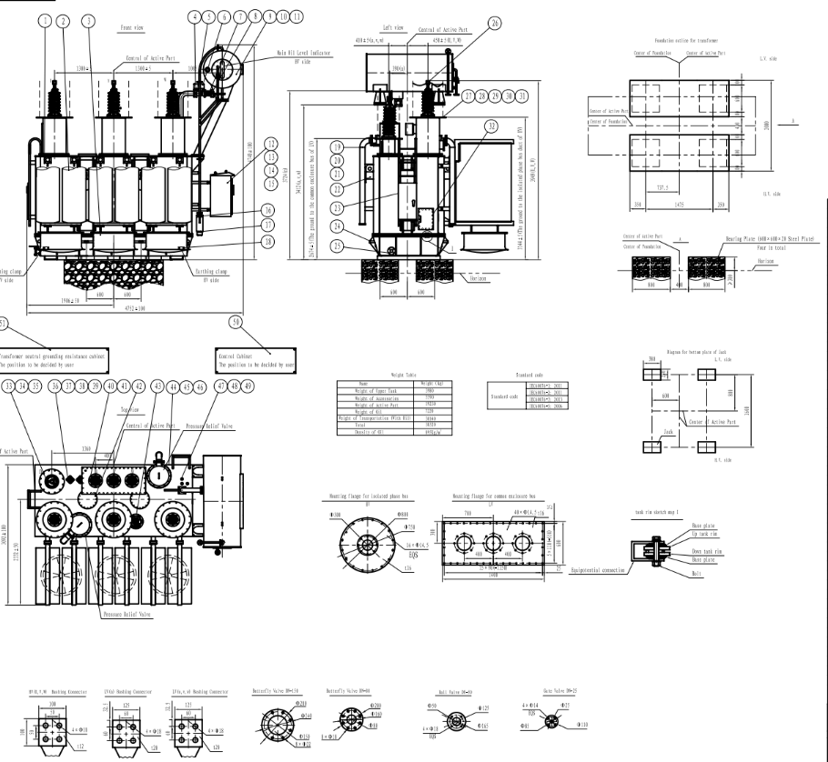
1. INTRODUCTION
1.4 System Boundary
The scope or limits of the RCM analysis for the Generator Transformers & list of the components in this system.
List of components
① Cooler fan
② Tap changer
③ Conservator tank
④ Bucholz relay
⑤ PRD
⑥ Current transformers

Slide 8
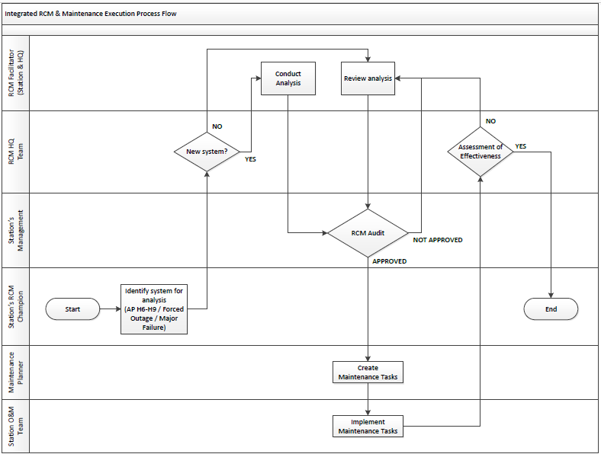
2. RCM METHODOLOGY
The process flowchart represents the steps involved in the RCM Methodology.
The RCM methodology consists of four steps:
Planning Step
RCM Analysis Facilitation Step
Audit Step
Implementation Step
The overall RCM Process is summarized in Diagram 1.
Implementation Step
RCM Analysis Facilitation Step
Audit Step
Planning Step
Diagram 1
RCM Methodology Process Flowchart
5

Slide 9
3. ANALYSIS
3.1 Comparison Between Existing & New Maintenance Plan
Current Maintenance Plan |  |  |  |  |  |  | RCM Recommended Maintenance Plan
No | Ref | Failure Mode | Proposed Task | Interval | Trade |  | No | Ref | Failure Mode | Proposed Task | Interval | Trade | Remarks
1 | 01-A-01 | Core insulation degraded | Perform Dissolve Gas Analysis (DGA) Perform Sweep Frequency Response Analysis (SFRA) Excitation current measurement | 6 months 10 Years 10 Years | CBSBELEC |  | 1 | 01-A-01 | Core insulation degraded | Perform Dissolve Gas Analysis (DGA) Perform Sweep Frequency Response Analysis (SFRA) Excitation current measurement | 6 months 8 Years 8 Years | CBSBELEC | No change
2 | 01-A-02 | HV or LV Winding open circuit | Winding resistance check | 10 years | CBSBELEC |  | 2 | 01-A-02 | HV or LV Winding open circuit | Winding resistance check | 8 years | CBSBELEC | No change
3 | 01-A-03 | Winding Paper Insulation deteriorate | Perform Dissolve Gas Analysis (DGA) | 6 months | CBSELEC |  | 3 | 01-A-03 | Winding Paper Insulation deteriorate | Perform Dissolve Gas Analysis (DGA) | 6 months | CBSELEC | No change
4 | 01-A-04 | Winding partial discharge | Perform partial discharge | 6 months | CBSBELEC |  | 4 | 01-A-04 | Winding partial discharge | Perform partial discharge | 6 months | CBSBELEC | No change
5 | 01-A-05 | Transformer oil quality degraded | Perform Dissolve Gas Analysis (DGA) | 6 months | CBSELEC |  | 5 | 01-A-05 | Transformer oil quality degraded | Perform Dissolve Gas Analysis (DGA) | 6 months | CBSELEC | No change
6 | 01-A-06 | HV Bushing Short to Ground | Perform thermography | 1 month | CBSBELEC |  | 6 | 01-A-06 | HV Bushing Short to Ground | Perform thermography | 1 month | CBSBELEC | No change
7 | 01-A-07 | HV Bushing Contamination | Perform cleaning | 10 years | CBSBELEC |  | 7 | 01-A-07 | HV Bushing Contamination | Perform cleaning | 8 years | CBSBELEC | No change
8 | 01-A-08 | LV Bushing Contamination | Perform cleaning | 10 years | CBSBELEC |  | 8 | 01-A-08 | LV Bushing Contamination | Perform cleaning | 8 years | CBSBELEC | No change
9 | 01-A-10 | HV Bushing Crack | Perform thermography | 1 month | CBSBELEC |  | 9 | 01-A-10 | HV Bushing Crack | Perform thermography | 1 month | CBSBELEC | No change
10 | 01-B-01 | Core deformation | Excitation current measurement | 10 years | CBSBELEC |  | 10 | 01-B-01 | Core deformation | Excitation current measurement | 8 years | CBSBELEC | No change
11 | 01-B-02 | Winding Deformation or Displacement | Perform Sweep Frequency Response Analysis (SFRA) | 6 months | CBSBELEC |  | 11 | 01-B-02 | Winding Deformation or Displacement | Perform Sweep Frequency Response Analysis (SFRA) | 6 months | CBSBELEC | No change
12 | 02-B-03 | Arcing due to Tap contact high resistance | Perform OLTC servicing / overhaul | 10 years | CBSBELEC |  | 12 | 02-B-03 | Arcing due to Tap contact high resistance | Perform OLTC servicing / overhaul | 8 years | CBSBELEC | No change
13 | 03-A-05 | Dehumidifier silica gel exhausted | Visual inspection (change in color) | 1 month | CBSBELEC |  | 13 | 03-A-05 | Dehumidifier silica gel exhausted | Visual inspection (change in color) | 1 month | CBSBELEC | No change
14 | 05-A-02 | Bucholz relay open circuit | Transformer Guard Test | 4 years | CBSBELEC |  | 14 | 05-A-02 | Bucholz relay open circuit | Transformer Guard Test | 4 years | CBSBELEC | No change
6

Slide 10
3. ANALYSIS
3.1 Comparison Between Existing & New Maintenance Plan
Current Maintenance Plan |  |  |  |  |  |  | RCM Recommended Maintenance Plan
No | Ref | Failure Mode | Proposed Task | Interval | Trade |  | No | Ref | Failure Mode | Proposed Task | Interval | Trade | Remarks
15 | 05-A-04 | Bocholz mechanism stuck | Transformer Guard Test | 4 years | CBSBELEC |  | 15 | 05-A-04 | Bocholz mechanism stuck | Transformer Guard Test | 4 years | CBSBELEC | No change
16 | 06-A-01 | Main tank PRD Limit switch stuck | Perform switch functional test | 4 years | CBSBELEC |  | 16 | 06-A-01 | Main tank PRD Limit switch stuck | Perform switch functional test | 4 years | CBSBELEC | No change
17 | 07-A-05 | Radiator fin dirty | Perform cleaning | 4 years | CBSBELEC |  | 17 | 07-A-05 | Radiator fin dirty | Perform cleaning | 4 years | CBSBELEC | No change
18 | 10-A-01 | Dial Type Temp (DTT) faulty | Do function test. If DTT fail the test, replace the DTT | 4 Years | CBSBELEC |  | 18 | 10-A-01 | Dial Type Temp (DTT) faulty | Do function test. If DTT fail the test, replace the DTT | 4 Years | CBSBELEC | No change
19 | 10-A-02 | Signal cable open circuit | Do function test. If test failed, check cable connection and re-tighten | 4 Years | CBSBELEC |  | 19 | 10-A-02 | Signal cable open circuit | Do function test. If test failed, check cable connection and re-tighten | 4 Years | CBSBELEC | No change
20 | 10-A-03 | Temperature probe faulty | Do function test. If test failed, check cable connection and re-tighten | 4 Years | CBSBELEC |  | 20 | 10-A-03 | Temperature probe faulty | Do function test. If test failed, check cable connection and re-tighten | 4 Years | CBSBELEC | No change
21 | 11-A-01 | Dial Type Temp (DTT) faulty | Do function test. If DTT fail the test, replace the DTT | 4 Years | CBSBELEC |  | 21 | 11-A-01 | Dial Type Temp (DTT) faulty | Do function test. If DTT fail the test, replace the DTT | 4 Years | CBSBELEC | No change
22 | 11-A-02 | Signal cable open circuit | Do function test. If test failed, check cable connection and re-tighten | 4 Years | CBSBELEC |  | 22 | 11-A-02 | Signal cable open circuit | Do function test. If test failed, check cable connection and re-tighten | 4 Years | CBSBELEC | No change
23 | 12-A-01 | Main tank body corroded | Perform visal inspection (observe for corrosion) | 1 month | CBSBELEC |  | 23 | 12-A-01 | Main tank body corroded | Perform visal inspection (observe for corrosion) | 1 month | CBSBELEC | No change
24 | 12-A-02 | Maintank LV cable box gasket worn out | Perform visal inspection (observe for corrosion) | 1 month | CBSBELEC |  | 24 | 12-A-02 | Maintank LV cable box gasket worn out | Perform visal inspection (observe for corrosion) | 1 month | CBSBELEC | No change
25 | 12-A-03 | Main tank welded joint cracked | Perform visal inspection (observe for corrosion) | 1 month | CBSBELEC |  | 25 | 12-A-03 | Main tank welded joint cracked | Perform visal inspection (observe for corrosion) | 1 month | CBSBELEC | No change
26 | 13-A-01 | OLTC PRD Limit switch stuck | Perform switch functional test | 4 years | CBSBELEC |  | 26 | 13-A-01 | OLTC PRD Limit switch stuck | Perform switch functional test | 4 years | CBSBELEC | No change
27 | 13-A-02 | Main tank PRD spring jammed | Perform PRD replacement | 10 years | CBSBELEC |  | 27 | 13-A-02 | Main tank PRD spring jammed | Perform PRD replacement | 8 years | CBSBELEC | No change
28 | 16-A-03 | OLTC Dehumidifier silica gel exhausted | Visual inspection (change in color) | 1 month | CBSBELEC |  | 28 | 16-A-03 | OLTC Dehumidifier silica gel exhausted | Visual inspection (change in color) | 1 month | CBSBELEC | No change
7

Slide 11
3. ANALYSIS
3.1 Comparison Between Existing & New Maintenance Plan
Current Maintenance Plan |  |  |  |  |  |  | RCM Recommended Maintenance Plan
No | Ref | Failure Mode | Proposed Task | Interval | Trade |  | No | Ref | Failure Mode | Proposed Task | Interval | Trade | Remarks
29 | 22-A-03 | Terminal box or local panel arcrylic cover crack or break | Perform visual inspection | 1 month | CBSBELEC |  | 29 | 22-A-03 | Terminal box or local panel arcrylic cover crack or break | Perform visual inspection | 1 month | CBSBELEC | No change
30 | 23-A-03 | Terminal box or local panel arcrylic cover break | Perform visual inspection | 1 month | CBSBELEC |  | 30 | 23-A-03 | Terminal box or local panel arcrylic cover break | Perform visual inspection | 1 month | CBSBELEC | No change
31 |  |  |  |  |  |  | 31 | 03-A-02 | Conservator tank drain valve leaked | Visual inspection (observe trace of oil at conservator tank) | 1 week | CBSBOPER | Added new
32 |  |  |  |  |  |  | 32 | 04-A-01 | Oil level gauge faulty | Ensure oil level gauge spare availability |  | CBSBELEC | Added new
33 |  |  |  |  |  |  | 33 | 05-A-01 | Bucholz relay badly leaked | Visual inspection (observe trace of oil at bucholz) | 1 week | CBSBOPER | Added new
34 |  |  |  |  |  |  | 34 | 05-A-03 | Glass Inspection window cracked | Visual inspection (observe trace of oil at bucholz) | 1 week | CBSBOPER | Added new
35 |  |  |  |  |  |  | 35 | 06-A-02 | Main tank PRD spring jammed | Perform PRD replacement | 8 years | CBSBELEC | Added new
36 |  |  |  |  |  |  | 36 | 07-A-02 | Radiator tube leaked | Visual inspection (observe trace of oil at radiator tube) | 1 week | CBSBOPER | Added new
37 |  |  |  |  |  |  | 37 | 07-A-03 | Radiator gasket failed | Visual inspection (observe trace of oil radiator) | 1 week | CBSBOPER | Added new
38 |  |  |  |  |  |  | 38 | 08-A-01 | Transformers oil circulating Pump bearing jammed | Perform abnormal noise monitoring at running circulating oil pump | 1 week | CBSBOPER | Added new
39 |  |  |  |  |  |  | 39 | 08-A-02 | Transformers oil circulating Pump mechanical seal damaged | Perform visual inspection (observe oil leak at circulating pump) | 1 week | CBSBOPER | Added new
40 |  |  |  |  |  |  | 40 | 16-A-01 | OLTC Conservator tank gasket leaked | Visual inspection (observe trace of oil at OLTC conservator) | 1 week | CBSBOPER | Added new
41 |  |  |  |  |  |  | 41 | 17-A-01 | Magnetic oil level gauge faulty | Ensure oil level gauge spare availability |  | CBSBELEC | Added new
8

Slide 12
3. ANALYSIS
3.1 Comparison Between Existing & New Maintenance Plan
Current Maintenance Plan |  |  |  |  |  |  | RCM Recommended Maintenance Plan
No | Ref | Failure Mode | Proposed Task | Interval | Trade |  | No | Ref | Failure Mode | Proposed Task | Interval | Trade | Remarks
42 |  |  |  |  |  |  | 42 | 18-A-01 | Grounding cable loose connection | Perform ohmic test | 4 years | CBSBELEC | Added new
43 |  |  |  |  |  |  | 43 | 18-A-02 | Grounding bushing broken | Perform ohmic test | 4 years | CBSBELEC | Added new
44 |  |  |  |  |  |  | 44 | 18-A-03 | Grounding copper conductor joint failed | Perform ohmic test | 4 years | CBSBELEC | Added new
45 |  |  |  |  |  |  | 45 | 19-A-01 | Neutral grounding copper conductor joint failed | Perform ohmic test | 4 years | CBSBELEC | Added new
46 |  |  |  |  |  |  | 46 | 19-A-02 | Neutral grounding bushing broken | Perform ohmic test | 4 years | CBSBELEC | Added new
47 |  |  |  |  |  |  | 47 | 21-A-01 | Foundation cracked | Perform visual inspection (observe for any foundation crack) | 6 monthly | CBSBSVFC | Added new
48 |  |  |  |  |  |  | 48 | 21-A-02 | Land sinking | Perform visual inspection (observe for any foundation crack) | 6 monthly | CBSBSVFC | Added new
49 |  |  |  |  |  |  | 49 | 21-A-03 | Differential settlement | Perform visual inspection (observe for any foundation crack) | 4 years | CBSBSVFC | Added new
50 |  |  |  |  |  |  | 50 | 25-A-01 | Filter damaged | Perform filter replacement | 4 years | CBSBELEC | Added new
51 |  |  |  |  |  |  | 51 | 26-A-02 | OLTC circulating pump damaged | Ensure OLTC circulating pump spare availability |  | CBSBELEC | Added new
52 |  |  |  |  |  |  | 52 | 27-A-01 | OLTC filter DP switch faukty | Ensure OLTC DP siwtch spare availability |  | CBSBELEC | Added new
53 |  |  |  |  |  |  | 53 | 28-A-01 | PLC program corrupted | Perform PLC program checksum test | 4 years | CBSBCNI | Added new
54 |  |  |  |  |  |  | 54 | 28-A-02 | PLC program corrupted | Perform PLC program backup | Everytime program changes | CBSBCNI | Added new
9

Slide 13
3. ANALYSIS
3.2 RCM Audit Session
The management of CBSB has audited the RCM analysis result & proposed additional tasks to be performed.
Venue : CBSB
Audit date : 3rd October 2025
List of Participants :
Auditors’ Comments
01-A-01: - SFRA interval changed to 8 years.
- Excitation current measurement
interval changed to 8 years.
01-A-02: Interval changed to 8 years.
01-A-07: Interval changed to 8 years.
01-A-08: Interval changed to 8 years.
01-B-01: yeaInterval changed to 8 rs.
01-B-02: Interval changed to 8 years.
02-B-03: Interval changed to 8 years.
13-A-02: Interval changed to 8 years.
06-A-02: Interval changed to 8 years.
21-A-03: Interval changed to 4 years.
No. | Name | Role | Position
1 | Ahmad Zukiman Bin Mohamad Hashim | Auditor | CBSB Management
2 | Muhammad Hafiizh Bin Draman | Auditor | CBSB Management
3 | Muhamad Nor Taufik bin Sahani | Auditor | CBSB Management
4 | Syed Ahmad Zaki bin Said Madeen | Auditor | CBSB Management
5 | Dinishkaran Pillai | Facilitator | HQ RCM Team
6 | Ramesh Kumar | Facilitator | HQ RCM Team
7 | Nublan Hakimi | Facilitator | HQ RCM Team
8 | Nik Ahmad Zareen Bin Nik Abd Wadood | Team Leader | CBSB
9 | Dzul Fadhli bin Mohd Husin Seria | Team Member | CBSB
10 | Mohd Shazni Bin Halid | Team Member | CBSB
11 | Aizuddin bin A Rahim | Team Member | CBSB

Slide 14
3. ANALYSIS
3.3 Summary of the RCM Analysis Result
From the RCM analysis, a total of 28 functions were analysed, 108 Failure Modes were evaluated & 54 maintenance tasks were proposed
A total of 30 tasks were found to be the same as the existing tasks already implemented by the station's maintenance teams.
The remaining 24 tasks are newly added.
 | Total Task | Task Executed | Pending Task
CBSBCNI | 2 | 0 | 2
CBSBELEC | 41 | 30 | 11
CBSBOPER | 8 | 0 | 8
CBSBSVFC | 3 | 0 | 3

Slide 15
4. CONCLUSION
The RCM analysis’s objective has been met with a total of 54 maintenance tasks
From this exercise, the objective of the RCM analysis has been met, where a more comprehensive & optimized maintenance strategy for Generator Transformers has been generated.
A total of 54 maintenance tasks for the Generator Transformers proposed by the team members.

Slide 16
5. RECOMMENDATION
Actions to be taken by station to further improve the operation & maintenance practices of the Generator Transformers .
The station management is recommended to endorse the list of the proposed Maintenance Tasks from this RCM analysis.
All approved maintenance tasks shall be uploaded into the ERMS Maintenance Plan Scheduling by the Maintenance Planner.
The daily maintenance task may not be suitable to be uploaded into the ERMS. Therefore, these maintenance tasks shall be captured through maintenance check sheet or operational logs.
The reliability of the Generator Transformers shall be assessed regularly (recommended on yearly basis during maintenance review process), particularly when failures occur in this system. If any failure occurs, this RCM analysis is required to be reviewed.

Slide 17
7. REFERENCES
004-2_Unit Transformer - General Arrangement

Slide 18
8. ATTACHMENT
Information Worksheet and Decision Worksheet

Slide 19
Thank you
Further clarification? kindly contact:
Wan Mohamad Erfan Bin Wan Mustafa
Senior Engineer (RCM - Planning)
Email: erfan.mustafa@tnb.com.my
Tel.: +60179761255

