Slide 1
Python Project Portfolio
-Ethan Angel

Slide 2
Part 1:
Design and Library setup

Slide 3
Skills
Achievements | Specifications
Develop Flowchart | N/A
Software Library Installation | Screenshot of software library installed

Slide 4
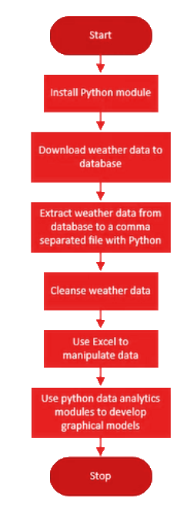
Flowchart
Created a flowchart including certain processes, such as:
Install python
Download weather data to a database.
Extract weather data from database into a comma separated file with python
Cleanse weather data
Use Excel to manipulate data
Use python data analytics modules to develop graphical models

Slide 5
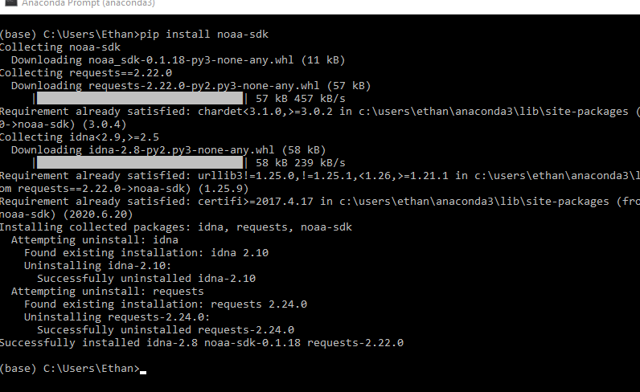
Software Inventory (Screenshots)
Included screenshot of NOAA-SDK library installed. Specifically, “Successfully installed noaa-sdk" of pip install command is visible in screenshot.

Slide 6
Part 2:
Downloading weather data

Slide 7
Skills
Achievements | Specifications
Code | Screenshot of code in Spyder with name, date, and zip code
Execution | Screenshot of Python console showing program ran successfully
Database file | Screenshot from Windows Explorer showing database file was created

Slide 8
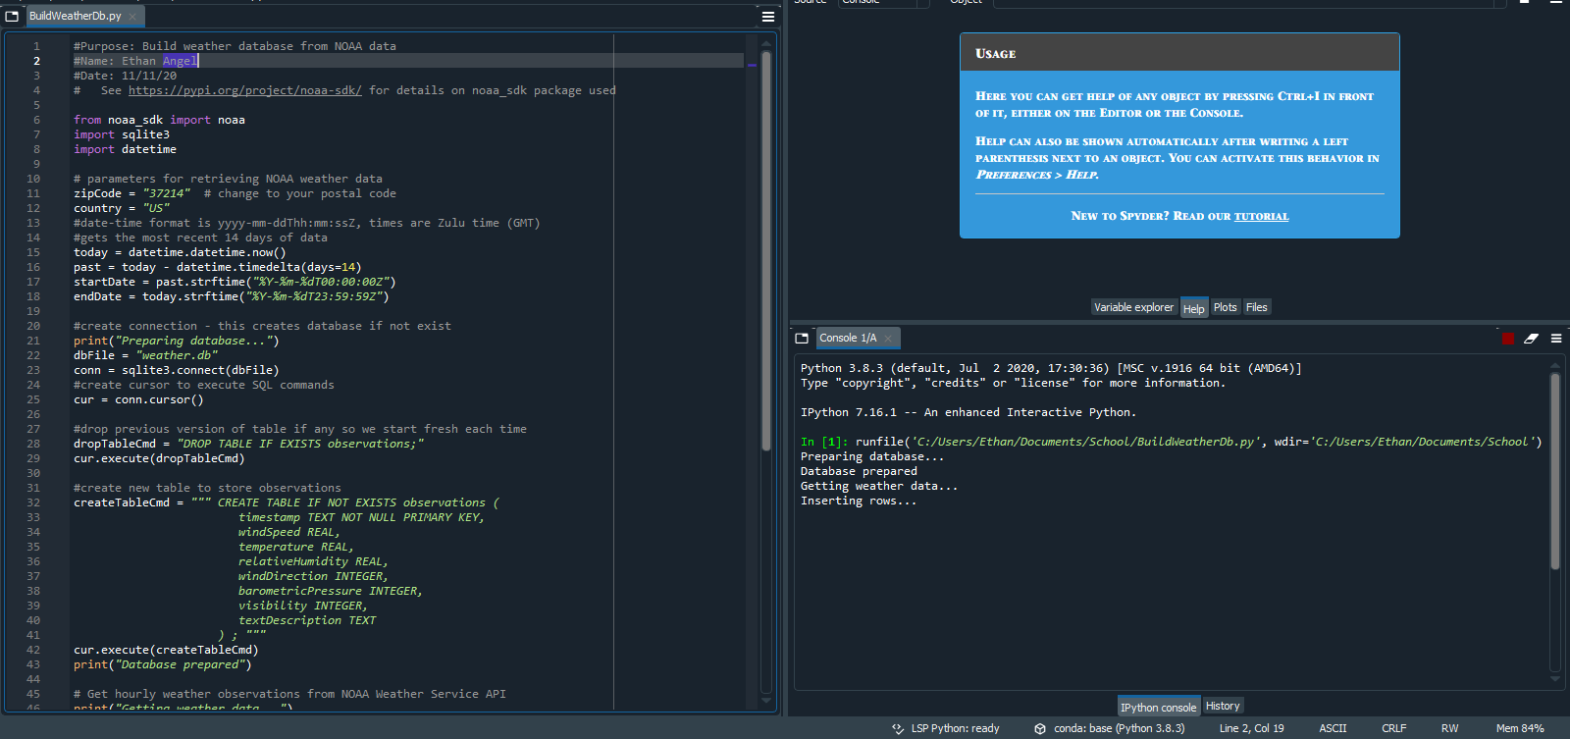
BuildWeatherDb.py Code (Screenshot)
Includes:
Screenshot of code in Spyder
ceis110

Slide 9
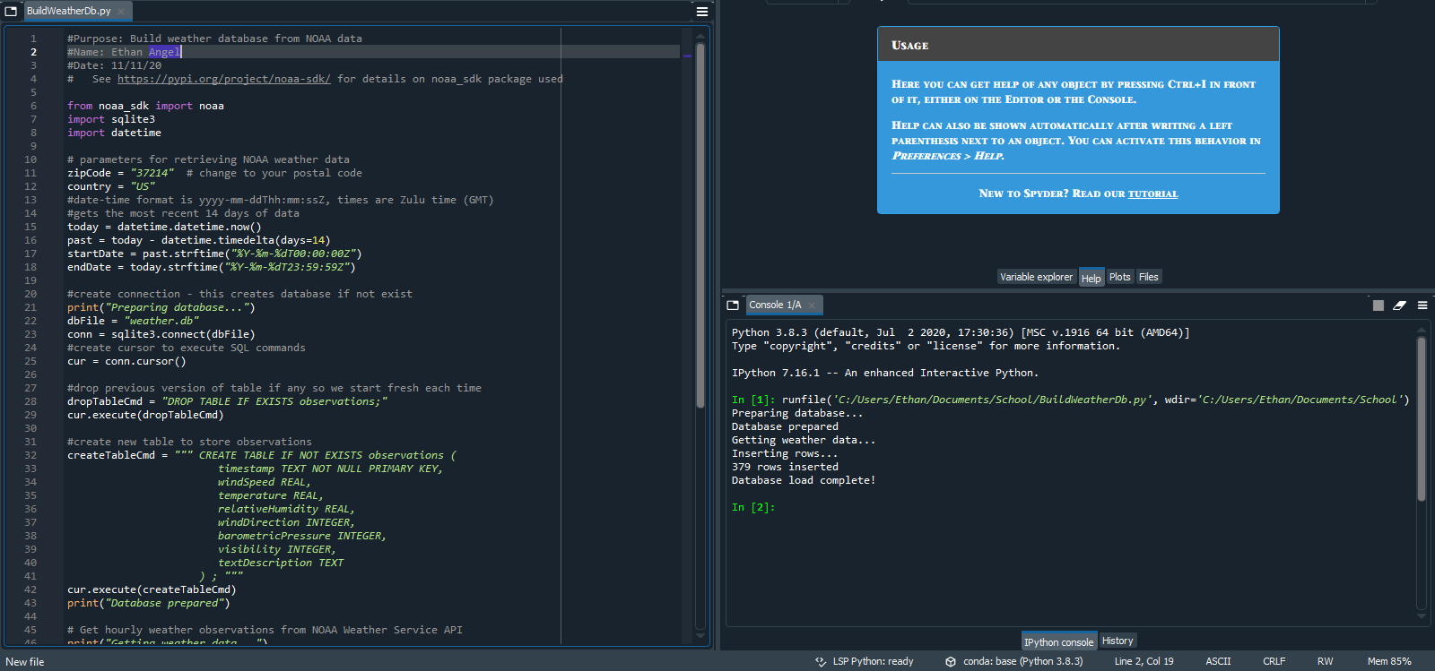
Python Console (Screenshot)
Screenshot of program output in Python console showing program executed successfully.

Slide 10
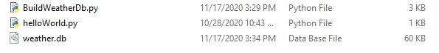
Weather.db File (Screenshot)
Screenshot of Windows Explorer showing database file Weather.db was created.

Slide 11
Part 3:
Querying the database with SQL

Slide 12
Skills
Achievements | Specifications
Query to retrieve all columns and rows | Screenshot of query and results
Query to retrieve lowest and highest temperature | Screenshot of query and results

Slide 13
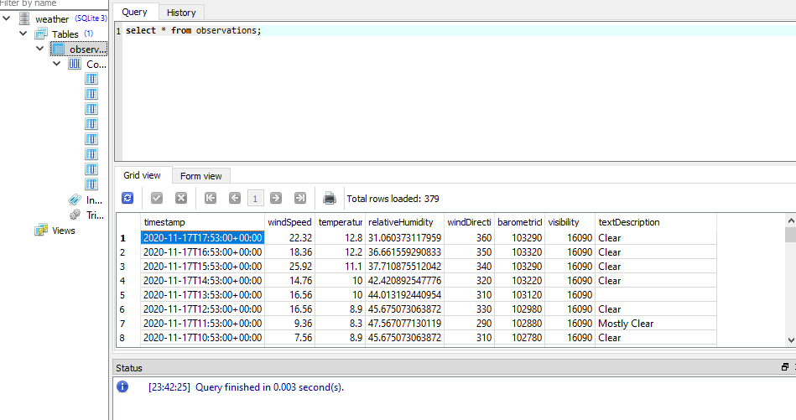
Query to retrieve all columns and all rows (Screenshot)
Screenshot of SQL query command and results.

Slide 14
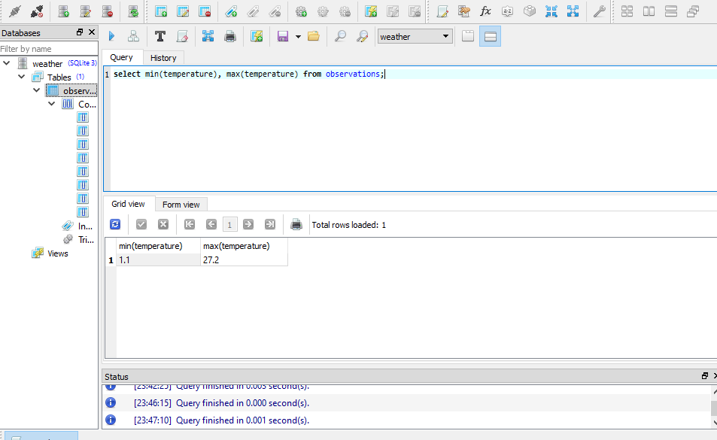
Query to retrieve lowest and highest temperatures (Screenshot)
Screenshot of SQL query command and results.

Slide 15
Part 4:
Querying and manipulating data with SQL and Python

Slide 16
Skills
Achievements | Specifications
Python code | Screenshot of code
Retrieve and convert data into CSV format | Screenshot of data in Excel file
Temperature and Humidity chart | Chart of data from database

Slide 17
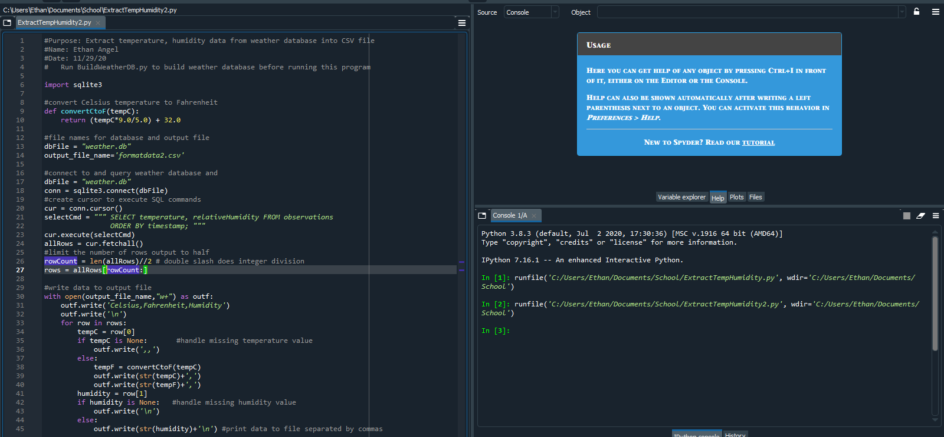
Python code (Screenshot)
ExtractTempHumidity.py code with name and date in comments.

Slide 18
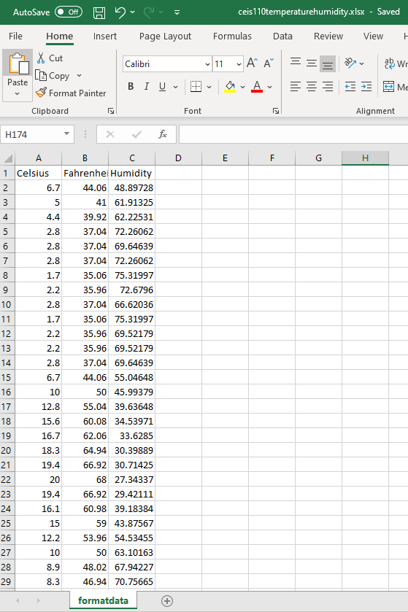
Retrieving and Converting Data to CSV Format (Screenshot)
Formatdata.csv file open in Excel showing 3 columns of data.

Slide 19
Temperature and Humidity Chart (Graph)
Excel chart based on temperature and humidity data from database.

Slide 20
Part 5:
Developing Graphical Models and Interpreting Results

Slide 21
Skills
Achievements | Specifications
Histogram | Picture/screenshot of plot from data with code
Box Plot | Picture/screenshot of plot from data with code
Analysis | Question, plot, and answer
Prediction | Prediction based on data

Slide 22
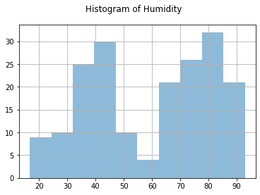
Histogram
Histogram and code used to generate it
#Purpose: Create a histogram of humidity data from the second period
#Name: Ethan Angel
#Date: 12/6/20
import pandas as pd
import matplotlib.pyplot as plt
df1 = pd.read_csv("formatdata.csv")
df2 = pd.read_csv("formatdata2.csv")
df2['Humidity'].hist(bins=10, alpha=0.5); plt.suptitle('Histogram of Humidity')
plt.show()

Slide 23
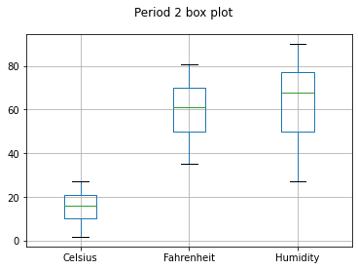
Box Plot
Box Plot and code used to generate it
#Purpose: Create box plot for period 2 data
#Name: Ethan Angel
#Date: 12/6/20
import pandas as pd
import matplotlib.pyplot as plt
df2 = pd.read_csv("formatdata.csv")
df2.boxplot(); plt.suptitle('Period 2 box plot')
plt.show()
print(df2.info())
print(df2.describe())
print("Median is ",df2.median())

Slide 24
Analysis
Questioning temperature variation via box chart,
“What is the variation in temperature over the course of Period 2?”
Answered by Chart:

Slide 25
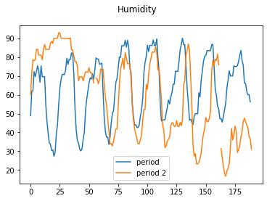
Prediction
The humidity trends in the same pattern over the course of multiple periods, as such, it is reasonable to assume it will continue trending in that same pattern for the foreseeable future.

Slide 26
Demonstrated Skills
Achievements | Specifications
Develop Flowchart | N/A
Software Library Installation | Screenshot of software library installed
Code | Screenshot of code in Spyder with name, date, and zip code
Execution | Screenshot of Python console showing program ran successfully
Database file | Screenshot from Windows Explorer showing database file was created
Query to retrieve all columns and rows | Screenshot of query and results
Query to retrieve lowest and highest temperature | Screenshot of query and results
Python code | Screenshot of code
Retrieve and convert data into CSV format | Screenshot of data in Excel file
Temperature and Humidity chart | Chart of data from database
Histogram | Picture/screenshot of plot from data with code
Box Plot | Picture/screenshot of plot from data with code
Analysis | Question, plot, and answer
Prediction | Prediction based on data

Slide 27
In Closing,
Many skills relevant to this field have been acquired and demonstrated. Please consider this moving forward.
-Ethan Angel

