Slide 1
Restaurant Seating Application
Ethan Angel

Slide 2
Restaurant Seating Application
This program will simply add, delete and adjust records in files.

Slide 3
IPO Chart
Input | Process | Output
guestName tableNum orderNum partySize | Save list to file Show seating Add/Remove occupancy of tables Show profits | seatingChart profitDisplay guestList

Slide 4
Sample Screens
Sample Screen 1
Menu
1) Add Seating
2) Remove Seating
3) View Seating List
4) View Profits
5) Close
Enter choice:
Sample Screen 2
Add Seating
Choose Table:
Number of Guests:
Reservation Duration:
Sample Screen 3
View Seating List
Seated Tables:
Guest Count:

Slide 5
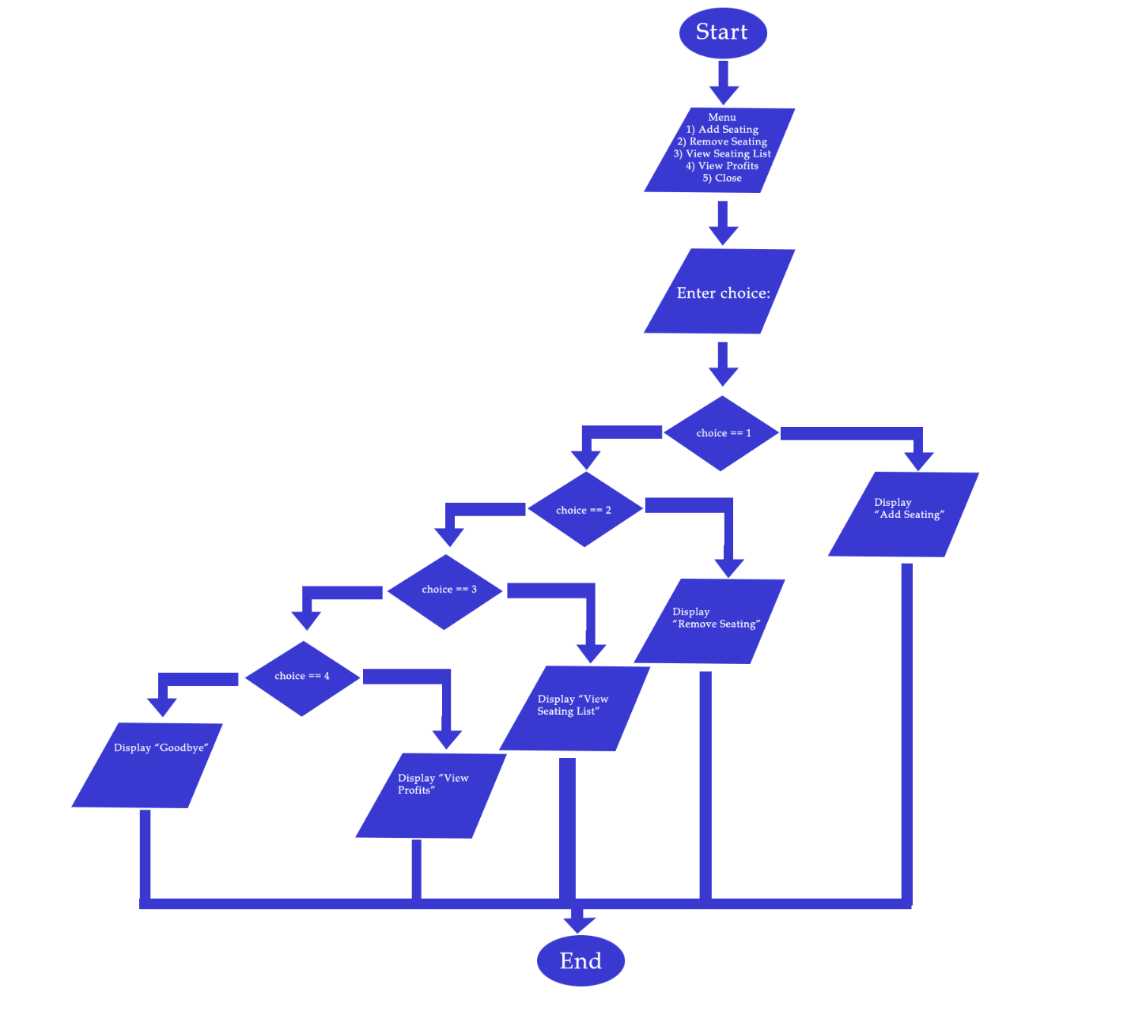
Flowchart

Slide 6
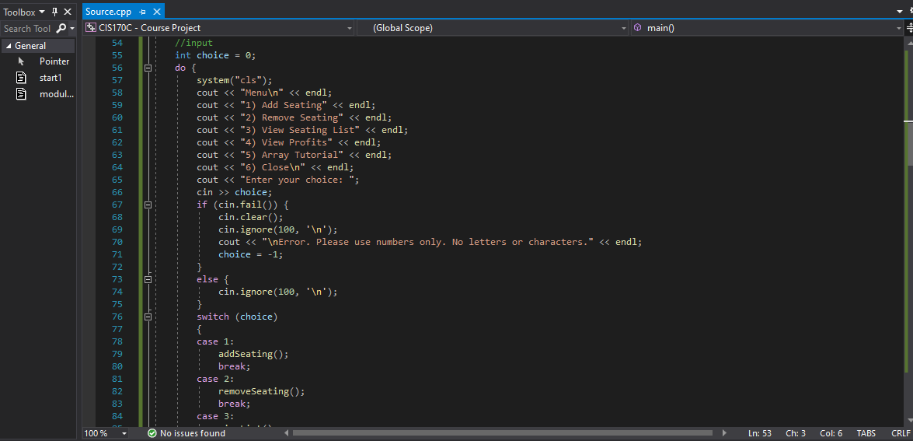
Input from User

Slide 7
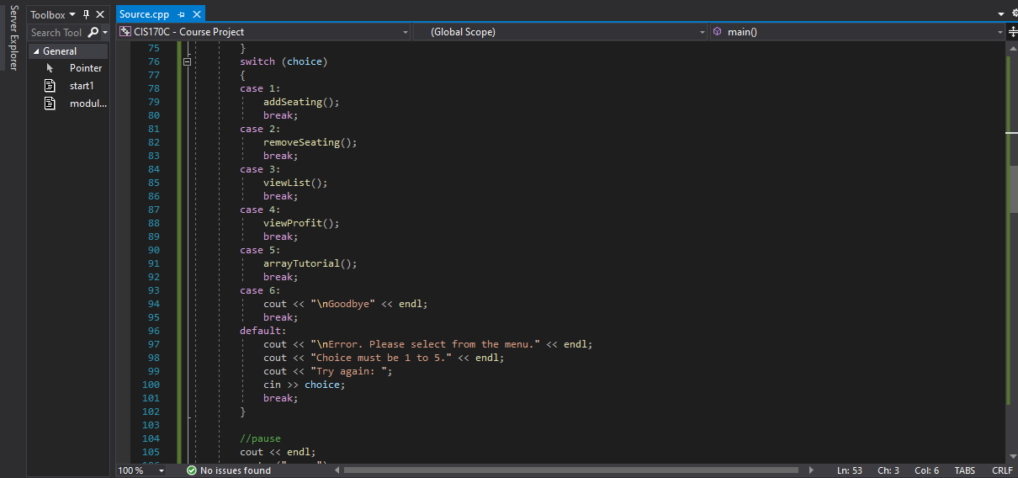
Conditional Expression

Slide 8
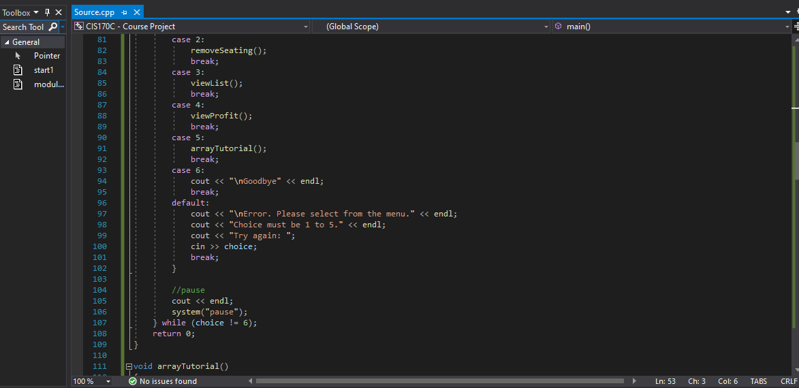
Menu Loop

Slide 9
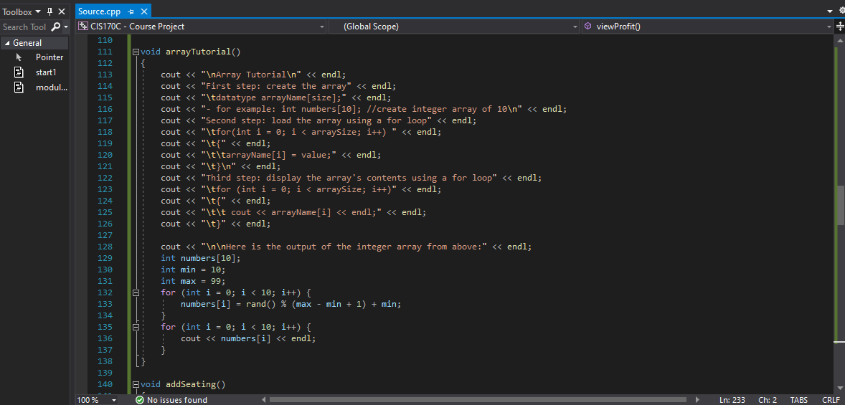
Arrays

Slide 10
Hierarchy Chart
Seating App
Password
Add Seating
Remove Seating
View Seating
View Profits
Array Tutorial

Slide 11
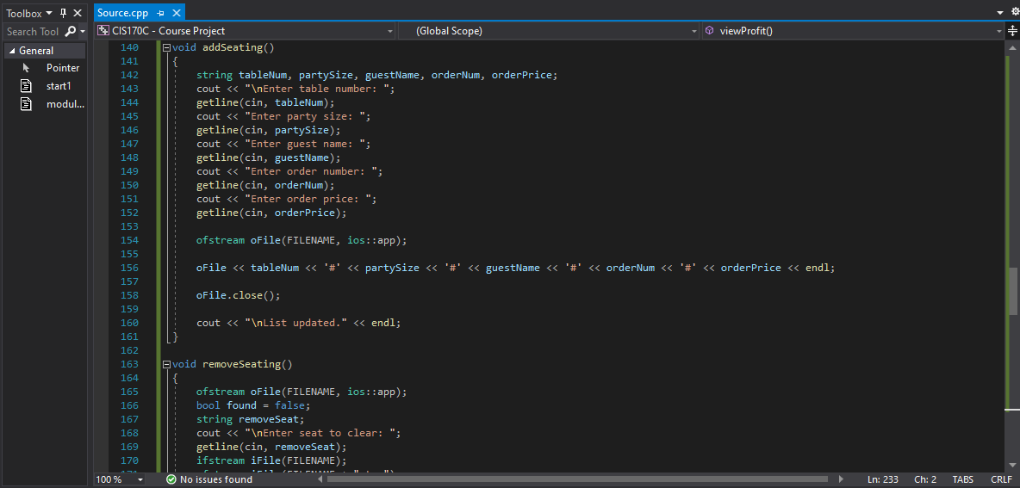
Functions/Modules

Slide 12

Save data to file

Slide 13
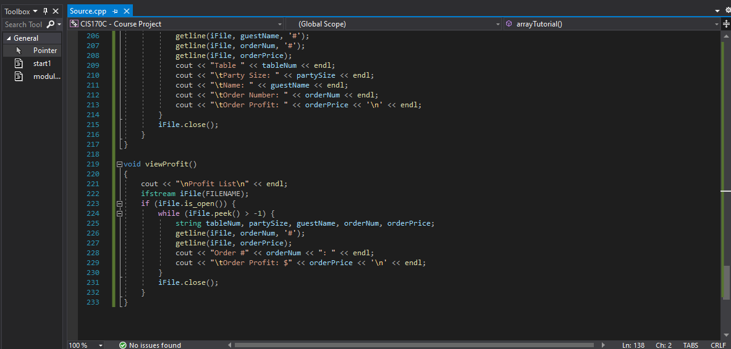
New Feature
The new feature added was the function to display accumulated profits.

Slide 14
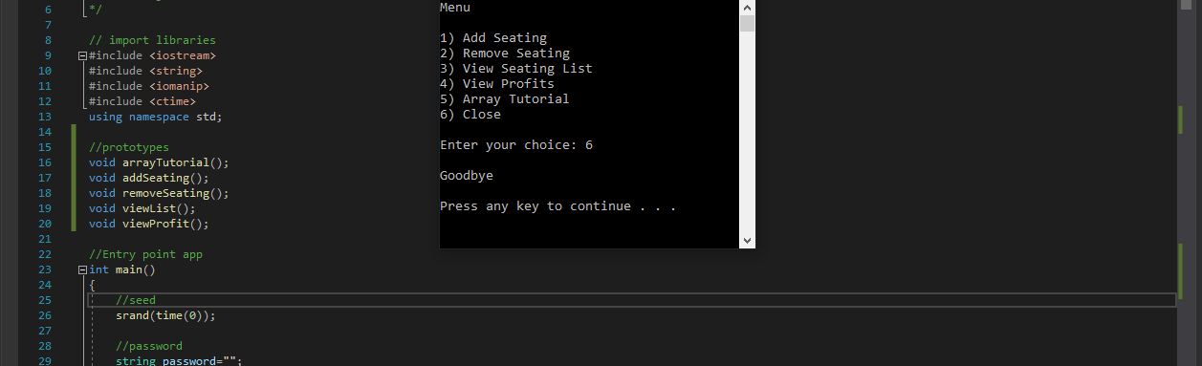
Running Program

Slide 15
Challenges Faced
The main challenge faced over the course of this project was the early stage of designing and organizing the program’s creation.

Slide 16
Conclusion
In conclusion, The Purpose of this project not only serves to demonstrate the usefulness of programming as a skillset, but also streamlines the difficulty of performing a mundane task, such as updating the seating arrangements for restaurant management.

