Slide 1
One potential step closer to higher resolution
des Georges/ASRC pipeline to use WARP picked and Cryosparc cleaned particle stack for a Relion3.1 Bayesian Polishing job
Dr. Emily Armbruster
she/her
Post-doc Research Associate, des Georges lab

Slide 2

My ideal SPA pipeline
WARP for particle picking, motion correction, and CTF estimation
Import particles into Cryosparc and clean particle stack
Convert data to Relion3.1 format to run Bayesian Polishing (and other jobs, like 3D Refine w/ symmetry relax or masked 3D classification)

Slide 3
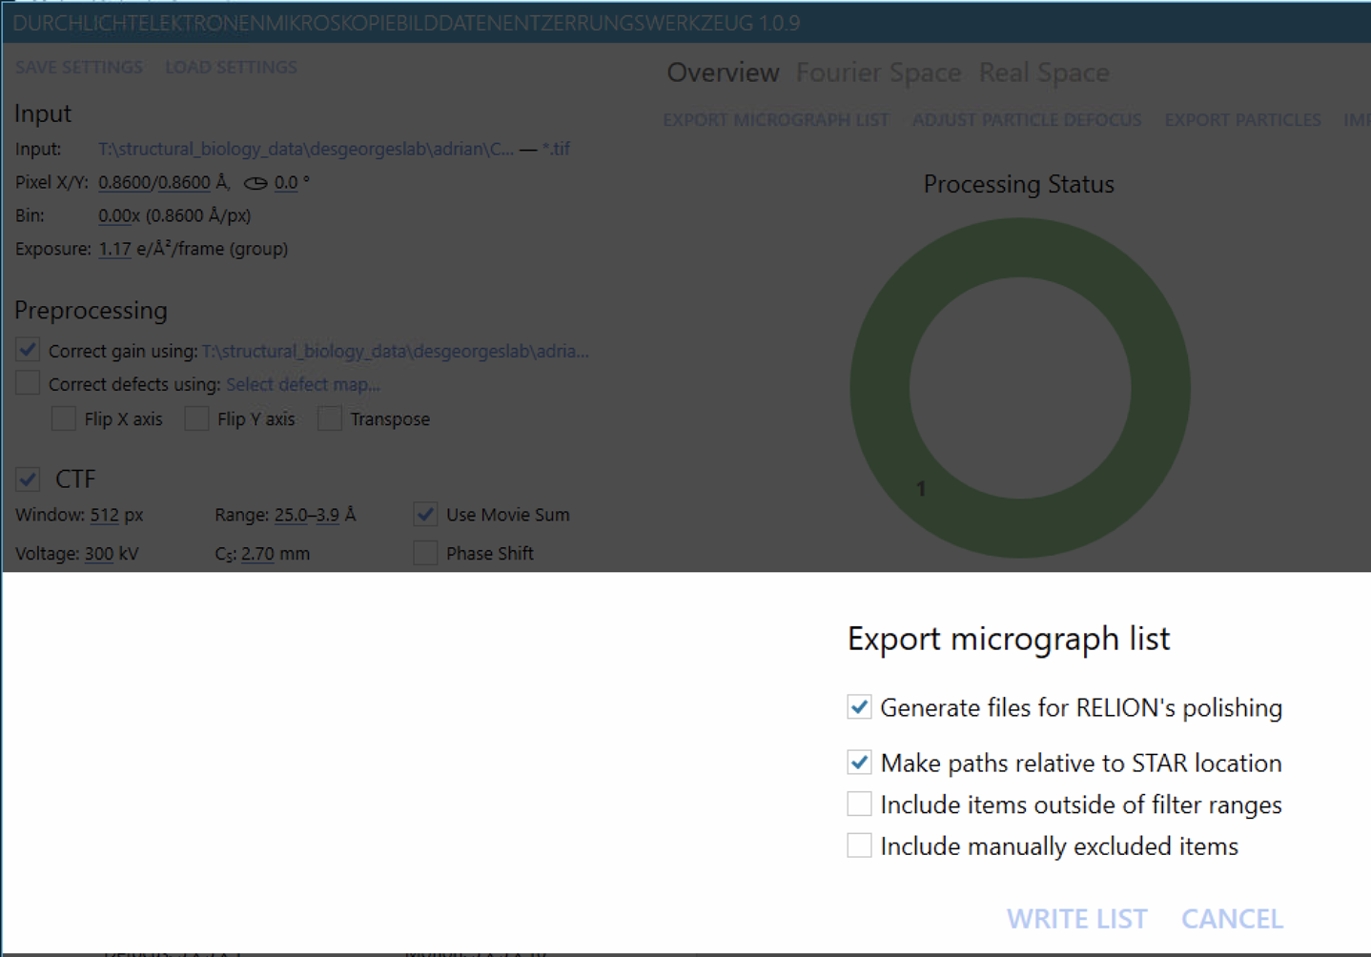

Export micrograph list from WARP
Make paths relative to STAR location
Check motion/*star files
Edit to point _rlnMicrographMovieName to *.tif files in original directory that WARP was run from using motion-star-editor
Note* if you do not make paths relative it does print full path, but in Microsoft format and must be converted to be read in linux.
Also, softlinking tifs to relion directory has not worked

Slide 4
Export micrograph list from WARP
Make paths relative to STAR location
You should add an optics table to the top of the star file as well as changing data_ of micrograph table to data_micrographs
Check and fix paths to be pointing to the correct files.

Slide 5
Make Relion job with proper directory formatting
-prompt relion from folder that WARP was prompted from. This is the folder with the original *tif movies
-if using multiple datasets, can make an entirely new directory, make new subdirectories of /motion and /average and /particles and soft link the contents of each dataset to these directories
Note 1) Properly situate Relion
start relion job here/motion/*.star files
start relion job here/average/*.mrc files
start relion job here/particles/*.mrcs files
Note 2) Multiple ways to softlink files in /subdirectories:
make a names.txt file that contains the entire path and names of the files you want to softlink, place file in directory that you want the softlinks in and run
>while read -r LINE; do ln -s $LINE ./;done <names.txt
or
from directory that you want the softlinked files in run
>ln -s path/to/original/files/*.[mrc or star or mrcs] -t .

Slide 6
Using Pyem to convert cryosparc particle stack to relion particle stack (des Georges lab specifics)
Step 1) go to your cryosparc folder/P#/J#/ and use cryosparc_PX_JX_00X_particles.cs
to use pyem, use user@10.20.0.201 and >conda active pyem
>csparc2star.py cryosparc_PX_JX_00X_particles.cs new.star
Step 2)
-if single dataset do star.py —copy-micrograph-coordinates path/to/warp/good_particles*. star (star with coordinates) new.star (input) new_withcoordinates.star (output)
>star.py —copy-micrograph-coordinates path/to/warp/good_particles*. star new.star new_withcoordinates.star
-if using multiple datasets, must manually make particle.star file from this new.star for each dataset (I use VSC for this). For each collection, copy micrograph coordinates for each datasets WARPdirectory/good_particles*.star file
Notes:
python /home/user/bin/startool.py run_data_final.star --replace_star _rlnMicrographMetadata=test_temp.star:_rlnImageOriginalName --write run_data_final_3.star

Slide 7
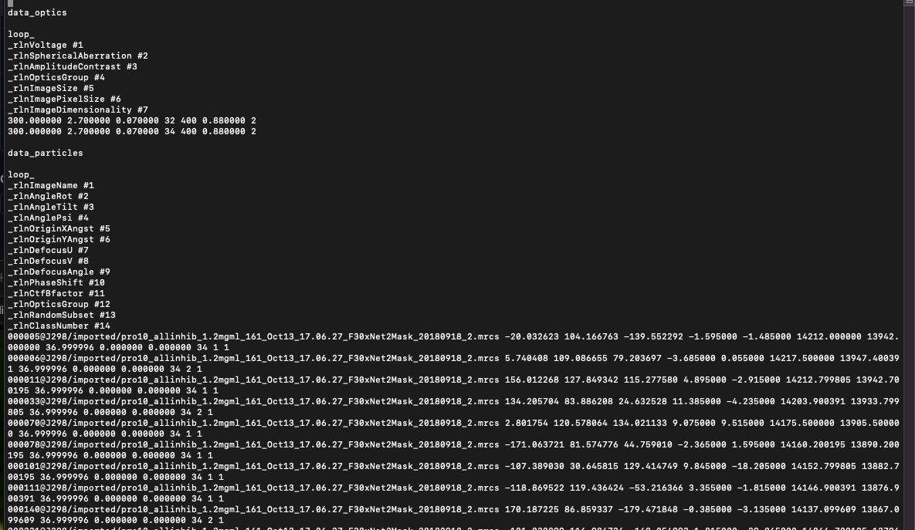
Using Pyem to convert cryosparc particle stack to relion particle stack
Step 1) example of output
Notes:
python /home/user/bin/startool.py run_data_final.star --replace_star _rlnMicrographMetadata=test_temp.star:_rlnImageOriginalName --write run_data_final_3.star

Slide 8
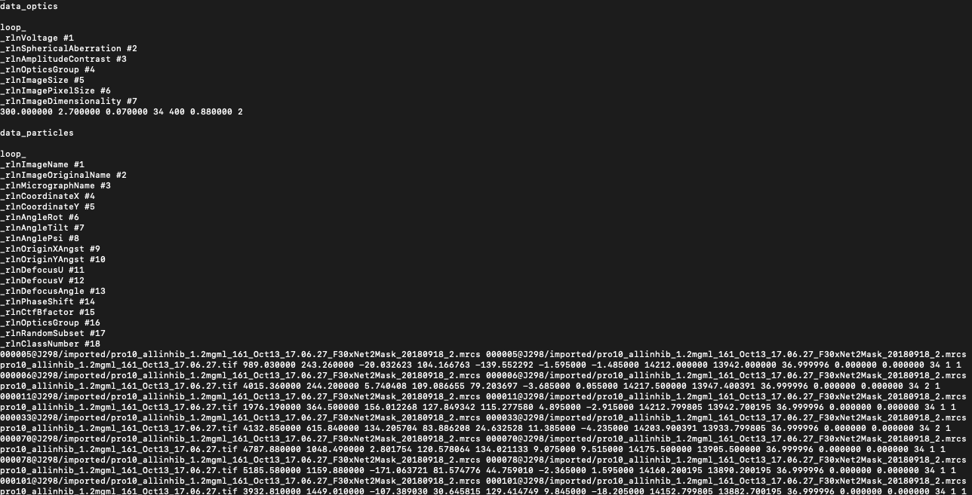
Using Pyem to convert cryosparc particle stack to relion particle stack
Step 2) example of output with coordinates added. Visually compare coordinates with coordinates from the good_particles*.star from WARP
Notes:
python /home/user/bin/startool.py run_data_final.star --replace_star _rlnMicrographMetadata=test_temp.star:_rlnImageOriginalName --write run_data_final_3.star

Slide 9
Using Pyem to convert cryosparc particle stack to relion particle stack
Step 2) editing of data_particles table
Notes:
python /home/user/bin/startool.py run_data_final.star --replace_star _rlnMicrographMetadata=test_temp.star:_rlnImageOriginalName --write run_data_final_3.star

Slide 10
Fix _rlnMicrographName column in particle.star
Pyem does not entirely properly write out useable particle.star files to use in this particular pipeline
_rlnMicrographName should go to the average/*.mrc files, not *.tif
I use Vim editing for this
Notes:
python /home/user/bin/startool.py run_data_final.star --replace_star _rlnMicrographMetadata=test_temp.star:_rlnImageOriginalName --write run_data_final_3.star

Slide 11
Fix _rlnMicrographName column in particle.star
Pyem does not entirely properly write out useable particle.star files to use in this particular pipeline
_rlnMicrographName should go to the average/*.mrc files, not *.tif
I use Vim editing for this
Note) I use startool.py to write new star files so I can keep each iteration when I change a particles.star file.
startool.py in strgpu2 can be used with
> python /home/user/bin/startool.py -commandshere
with startool.py—use (to choose data table) never worked well for me so had to # out optics table and manually put it back in for each file iteration
Notes:
python /home/user/bin/startool.py run_data_final.star --replace_star _rlnMicrographMetadata=test_temp.star:_rlnImageOriginalName --write run_data_final_3.star

Slide 12
Fix paths in particle.star
Pyem does not entirely properly write out useable particle.star files to use in this particular pipeline
Edit path in _rlnImageName and _rlnImageOriginalName to be proper for your directory setup
I use Vim editing for this
Notes:
python /home/user/bin/startool.py run_data_final.star --replace_star _rlnMicrographMetadata=test_temp.star:_rlnImageOriginalName --write run_data_final_3.star

Slide 13
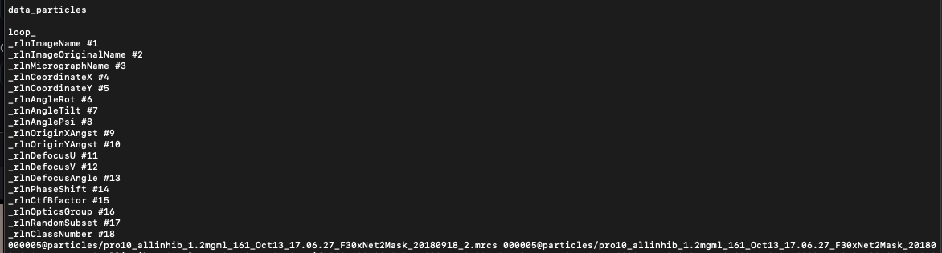
Fix paths in particle.star
Pyem does not entirely properly write out useable particle.star files to use in this pipeline
Edit path in _rlnImageName and _rlnImageOriginalName to be proper for your directory setup
I use Vim editing for this
Notes:
python /home/user/bin/startool.py run_data_final.star --replace_star _rlnMicrographMetadata=test_temp.star:_rlnImageOriginalName --write run_data_final_3.star

Slide 14
Considerations in running Bayesian Polishing in 3.1
If using multiple datasets, train and run Bayesian Polishing separately for each dataset
This can be done with a particles.star file that has all the data and using the WARP exported micrograph.star for each dataset
Need post-processed star file, sometimes I rerun particles in Refine 3D with symmetry relax and then post-processed that but this can be made with half maps (.mrc) and masks from cryosparc (below)
Relion post-processing of cryosparc volume - take these from the 3D refinement
cryosparc_P29_J1087_002_volume_map_half_A.mrc cryosparc_P29_J1087_002_volume_map_half_B.mrc cryosparc_P29_J1087_002_volume_mask_refine.mrc
and rename the halfmaps A and B, respectively, to
half1_*_unfil.mrc half2_*_unfil.mrc
Use these for postprocessing job that’s needed as an input for baysian polishing
Note* Bayesian Polishing may not improve resolution for all projects, but I believe the potential gain in resolution is worth the work to do this pipeline for each project you are working on

Slide 15
Acknowledgements
A huge thanks to Dominique Gutierrez for countless hours of help that she has provided Andres, Da, and I in this endeavor.
Thank you to Andres Cabezas and Da Cui for many discussions that were had in order to figure out this pipeline, each step we tried was helpful to figure out which where the necessary, successful steps to do.
Thanks for all the general lab support from des George lab and for keeping spirits up

Slide 16
Vim editing notes
insert mode and visual block mode are most commonly used here, as well as find and replace (:%s/x/y) and navigating to top (gg) and bottom (GG) of file

