Slide 1

StatVision
Eric Bridgens
BridgeEC@mail.UC.edu
Josh Dickens
DickenJD@mail.UC.edu
Sunny He
HeSW@mail.UC.edu
Kyle Willoughby
WillouKM@mail.UC.edu

Slide 2
Project Purposes
Project Goals
Effortless Statistics Search: Enable users to easily find statistics on their favorite teams and players through a simple search function.
Centralized Sports Data Platform: Provide a unified platform for accessing sports data across multiple leagues.
Real-Time Updates: Support real-time updates to keep users informed of the latest statistics.
Data-Driven Decision-Making: Facilitate informed decisions for fantasy sports players and analysts through accessible data.
Comprehensive Data Access: Allow users to retrieve both past and current sports data from all major leagues.
Efficient Search Functionality: Transform user input into optimized SQL queries for quick and accurate data retrieval.
Seamless API Integration: Utilize APIs to incorporate extensive data across all major sports leagues.
Engaging Data Visualization: Implement dynamic visualizations to present query results in an understandable and captivating format.

Slide 3
Project Abstract
Our project aims to develop a comprehensive sports tracker and analytics website that caters to a diverse range of users, including casual sports fans, fantasy sports players, and sports analysts. The platform enables casual fans to look up statistics on their favorite athletes and teams, keeping them updated on performance metrics in real-time. Fantasy sports players can access updated statistics on their rostered players to make informed decisions for their teams. Sports analysts will find it easy to access extensive sports data across different leagues for their projects. By integrating real-time data and advanced analytics, our platform bridges the gap between raw sports data and meaningful insights, serving the needs of all users.

Slide 4
User Stories
As a fan, I want to look up statistics on my favorite athletes and teams so I can stay updated on their performance.
As a sports analyst, I want to easily access sports data across different leagues for my projects.
As a fantasy sports player, I want to find updated statistics on players on my roster to create decisions for my fantasy team.

Slide 5
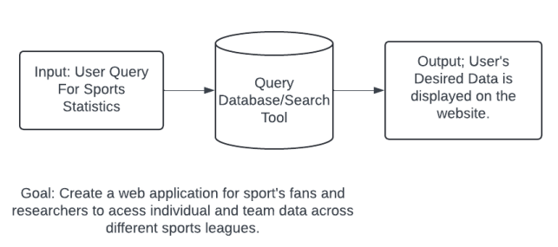
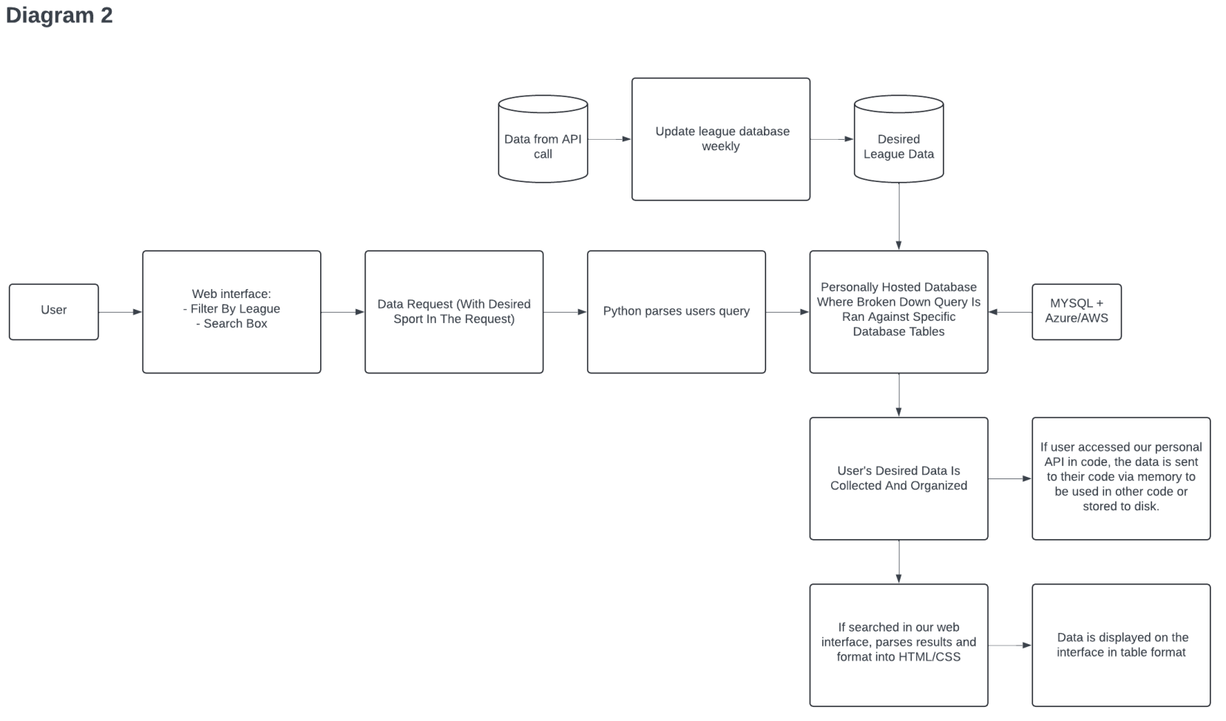
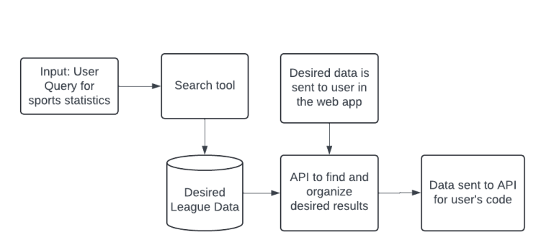
Design Diagrams
Diagram 0
Diagram 2
Diagram 1

Slide 6
Project Constraints
For this project, our team discovered that there are some financial limitations, and we intend to use any free or open-source tools when we can. We plan on using open-source APIs for pulling team and player data into our database. Some leagues, such as the NBA, offer an open-source API, however for some leagues we plan to use a 3rd party open-source API due to our financial limitations. We are also financially limited for hosting our website and database, so we are currently comparing costs between tools such as AWS and Azure, as well as other tools that offer student discounts/credits to determine which resource would best match our budget.
When dealing with player and team data from different sports leagues we will need to consider any legal restrictions that these leagues have on using their data. Some leagues, such as the MLB, have very strict policy when it comes to the rights to their digital property, so when finding open-source APIs for each league we will need to ensure that these tools comply with their respective leagues usage policies.

Slide 7
Current Progress
While we have not progressed to the stage of writing code, we have finished a full-stack design of our application from top to bottom, including more in-depth details such as target APIs to pull data from, where to store our data, and how to connect everything together properly.
We are now reaching the end of the design stage where we are reviewing our design for flaws and potential questions, to streamline the project's development going into next semester. The fine-tuned design will allow our project to follow a smooth development process, reducing the chances of errors, bugs, and other issues we would encounter due to a lack of preparation or knowledge.

Slide 8
Term Outlook
Complete research for data storage methods
Complete research for API options
Have working front end and UI
Designed the data organization
Documented database layout

Slide 9
Project Tasks
Database Design/ Management
Research best options for database to store player and team data - Josh
Design an organization technique for the data - Kyle
Implement data organization technique from design - Kyle
Document database and table layout using diagrams - Kyle
Write a script to access and pull professional sports league-wide data - Josh
Write a script to update player and team statistics on set frequency - Kyle
Backend Development
Design script to send user’s search to ChatGPT with our designed prompt to be organized into an accurate SQL query for the database - Josh
Write unit tests to ensure safety and correctness of back-end/middleware operations - Josh
Frontend Development
Design the layout of the frontend and user interface using html CSS, and JavaScript - Sunny
Research and develop functionality for users to input questions and receive relevant information - Sunny
Implement team/player filtering and sorting options for users to customize their search - Sunny
Design and implement frontend functionality for visualizing user’s desired data - Eric
Document frontend design with wireframes and user flows - Sunny
Test frontend functionality to ensure its ease of use for the user - Sunny
API Integration
Research API options for fetching user’s desired league data - Eric
Research best methods for accessing and storing previous and current league data - Eric
Research and test bringing data directly from API to frontend vs bringing data from updated database - Eric
Design functionality to take user’s search on webform and turn it into a SQL query for database - Josh
Document all API access methods and design API tests to use on an API Client Manager (Bruno, Postman) - Eric

Slide 10
Expected Demo
Expected Features to Highlight
User-friendly front end, and search filtering options
Data Retrieval from APIs and database
Data visualization
Expected Functionality
Users will be able to search for a single stat and receive their desired data in our format in real time.

