Slide 1
CE301 Challenge Week

Slide 2
Quick Summary of Background Reading
Full research summary on Jira and Gitlab.
I first researched the stable marriage problem and its solution. I learned that the Gale-Shapley algorithm can always find a solution to the problem. I then studied the steps of the algorithm.
I then looked at a variation of the stable marriage problem, namely one where there aren’t two groups, e.g., men and women, and every participant could be matched with each other. This is called the stable roommate problem. This problem could have no solution. I researched an algorithm given by Robert Irving.
I then investigated rental harmony. I learned the properties that a division assignment should carry, being envy-free, non-negative, and Pareto efficient.
I then dived into the many algorithms that tries to achieve rental harmony.
The first algorithm I looked at was by Francis Su. I saw how the algorithm works to achieve rental harmony. This algorithm gives allocations that are envy-free and non-negative. I then looked at some of the shortfalls of the algorithm, such as that is assumes people always prefer free rooms.
The next algorithm I researched was by Azriely and Shmaya. This algorithm allows for the capacity of a room to be greater than 1. The algorithm has similar problems to the one by Su.

Slide 3
Quick Summary of Background Reading
The next set of algorithms I investigated are cardinal versions. Every member of the group must submit a valuation for each room.
I looked at the meaning of utilitarian allocations, and how to implement them.
I looked at a total of 6 different algorithms, each with their own pros and cons.
An algorithm by Brams and Kilgour achieves non-negative, Pareto efficient allocations. They developed a procedure called the Gap Procedure, where in the event of a maxsum allocation that is greater than the total cost, room prices are lowered based on the gap of those prices and the next lowest valuations. However, the allocations are not envy-free.
An algorithm by Haake, Raith, and Su has a unique property called the Compensation Procedure. This procedure compensates envious partners, and thus achieves results that are envy-free. However, the results are not non-negative.
A market-oriented approach by Abdulkadiroglu and Sonmez and Unver uses a continuous auction to increase prices on over-demanded rooms while reducing prices of under-demanded rooms. This results in envy-free allocations, that could also be negative.
An algorithm by Sung and Vlach uses a maxsum allocation but finds the minsum price vector. Actions are performed based on the minsum vector. If the minsum is over the total cost, no solution is envy-free and non-negative. This algorithm allows for different results based on the user’s preference.
Mash, Gal, Procaccia and Zick use data from the Spliddit website to build an algorithm that is envy-free and preferred by users. They devise an allocation that is maximin. This maximizes the minimum utility of a participant. This algorithm was devised with user satisfaction in mind, separating it from previous algorithms. Results could be negative.
Procaccia, Velez and Yu present a version of the maximin approach that contain budget constraints.
Next, I looked at strategyproofness. I saw how in most algorithms, a user can gain by giving false evaluations.

Slide 4
Project Context
Splitting things is a very common occurrence.
Goods such as rent or tasks commonly need to be split among a group, such as when house mates rent a house together.
This is empathized by the fact that Spliddit, a service used to allocate goods, has attracted more than 100,000 users (as of July 2017).
However, splitting things in a way that doesn’t leave at least someone upset is very difficult.
Rental harmony algorithms are made to try to solve this problem; split goods between people in a way that doesn’t cause resentment.
Even so, since people are very different to each other, it seems unrealistic to expect one single rental harmony algorithm to work on everyone.
Having a service that first gauges how a group prefers to allocate resources, and then matching an algorithm to that preference, seems like a much more sensible option.

Slide 5
Project Objectives – Overall Goals
Website aiding users to achieve a ‘fair’ distribution of goods among themselves.
Multiple harmony algorithms will be included, and an algorithm will be selected for use based on user’s requirements.
Questionnaire included in the website will determine user’s requirements.
The website will contain a section educating users about the various rental harmony algorithms used in the website.
The website will contain a user account system to store user’s preferences and previous distribution results.
Clean, responsive website design, with an intuitive user interface.

Slide 6
Project Objectives – User Experience Timeline
User will enter the website.
They will be prompted with two choices, to distribute something or to learn.
If they wish to distribute something, they will then be presented with all the goods they can split among their group.
The user will be prompted to log in or continue as a guest.
They then will be able to create a group and add accounts to that group. Guests will have a unique ID.
A general questionnaire will then appear. Users will answer questions, and those answers will be used to select an appropriate allocation algorithm.
The group leader (the person who created the group) will input information of the goods to distribute.
The group members will receive a prompt to complete a personal questionare and assign values to each good.
The users will then each receive their allocations. This information is saved to their account.
This process provides an intuitive and quick way of allocating goods.

Slide 7
Project Objectives – Technical Information
Platform - Responsive website.
Responsiveness allows users to use the website on any device.
Technologies I plan to use:
HTML5, CSS3, JS – Standard technologies used in web development.
ReactJS – Open-source, front end, JavaScript library that is one of the leading frameworks used in industry. This is the main technology that I plan to use to build the website. JSX is a syntax extension for JavaScript; it is included with ReactJS.
Node.js – Open-source server environment. Used to simulate a client server website without it being live, i.e., on the internet. Node.js npm is a package manage used to download and install JavaScript libraries (such as ReactJS).
Redux, React-Redux – Open-source JavaScript library that is used to store states for JavaScript applications. React-Redux allows Redux to be used with ReactJS. This is used to make React state management infinitely easier.
Bootstrap – Open-source CSS framework used to create responsive, mobile-first websites. Contains classes used to style HTML elements.
Google Firebase – Firebase is a huge toolset used for app development. In the absence of a sever, I will use a small subset of Firebase features. Firebase will be used as a database, security service, authentication service, and host.

Slide 8
Project Risks
My website will give goods allocations to users in real life situations. Thus, this poses the risk that users will not see the given allocations as fair. Hopefully, the questionnaire given at the start of the process will reduce this risk.
As briefly touched upon during the background research summary, users could mislead their given values. In other split websites, users don’t know about the algorithms used, thus reducing this risk. However, my website will feature a learning tool, which significantly increases the risk of fraudulent valuations. One mitigation is that users won't be able to see other people’s valuations, hopefully reducing this risk.
Another risk is one that comes with modern web development, the use of many open-source libraries and frameworks. This poses a risk due to these libraries being constantly updated. If the libraries used aren’t updated (both the version I use and the libraries themselves), then vulnerabilities and exploits can aggregate in my website. I plan to mitigate this by using as little libraries as possible, and by using the stable version of each library.
A risk comes with having a user account system that stores user information, it could be hacked into. Compromised account will have all their data stolen, which is a big risk for users.

Slide 9
Project Implementation Plan
Project can be split up into three parts; front-end, rental harmony algorithms, and backend.
Front-end – Deals with website design, and the user interface, i.e., what the user will interact with.
Algorithmic side – The various algorithms in my project that will deal with goods allocation. This will make up the bulk of the project.
Back-end – This will be deal with information storage, authorization, and hosting.

Slide 10
Project Implementation Plan
Order of completion:
Most of the front-end will be built first. Design, user input, navigation, ect.
Next the algorithms will be implemented, with the inputs inputted manually.
The back-end will be constructed and any databases and authentication services built.
Finally, the front-end will be linked with the all the other parts. The algorithms will have their inputs come from the user interface, and their outputs will be fed back into the front-end. The back-end services will be linked with the front-end.
At this stage, the project will be fully functional, with the only remaining work being to make any adjustments to the look of the website (CSS).

Slide 11
Project Implementation Plan – deliverables to be achieved by week 11
By week 11 – The front-end section will be fully complete:
All (React) components made, all user interaction and navigation added, basic design settled.
React-Redux fully implemented and ready to be used (state can be managed).
Questionnaire fully implemented, connected to Redux, and ready to be implemented with the back-end.
UI and components for the user account system implemented.
Everything that a user will interact with will be made.

Slide 12
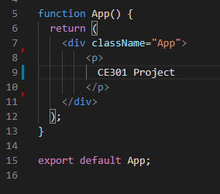
Technical Achievements (so far)
Using npm create-react-app, I have installed React, set up a Node.js server, and have a basic web page with a title on local host.
This App function is the base of any React application. I will use this base to start building the front-end of my application.

Slide 13
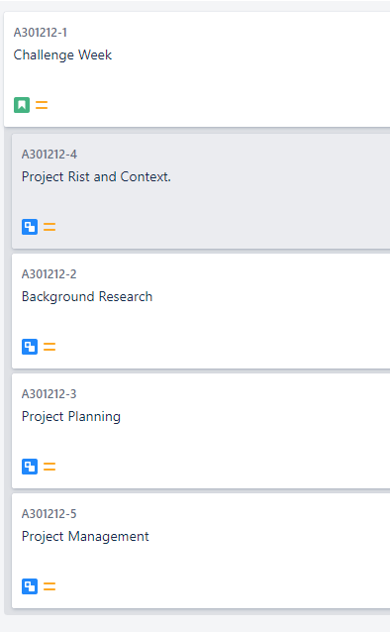
Project Management – Use of Jira
I have used Jira during this challenge week to keep track of my workflow.
Each aspect of the challenge week is its own separate sub-task.
This allows for easy monitoring of the progress of the challenge week deliverable.

Slide 14
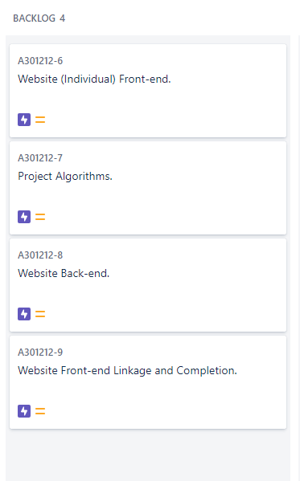
Project Management – Use of Jira
I have created 4 epics on Jira that encompass the whole project.
The completion of all these epics will mean that the project is finished.
Each epic describes a big part of the whole project and will be used as goals.

Slide 15
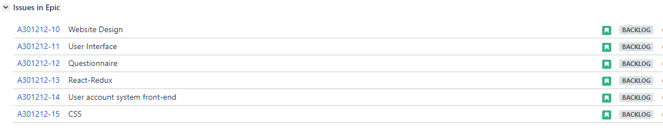
Project Management – Use of Jira
Each epic is made up of multiple stories, which will be completed one at a time.
Each story is one part of the epic, with the epic being completed when all the stories are.
This makes completing the epic much more understandable.
The progress of an epic is also easily monitorable.

