Slide 1
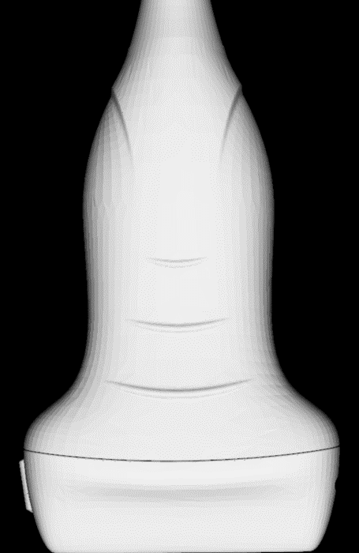
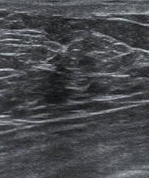
IN-PLANE NEEDLE INSERTION
Click on “Generate new target” button to display a target point and trajectory on the ultrasound image.
Target trajectory
Target point

Slide 2
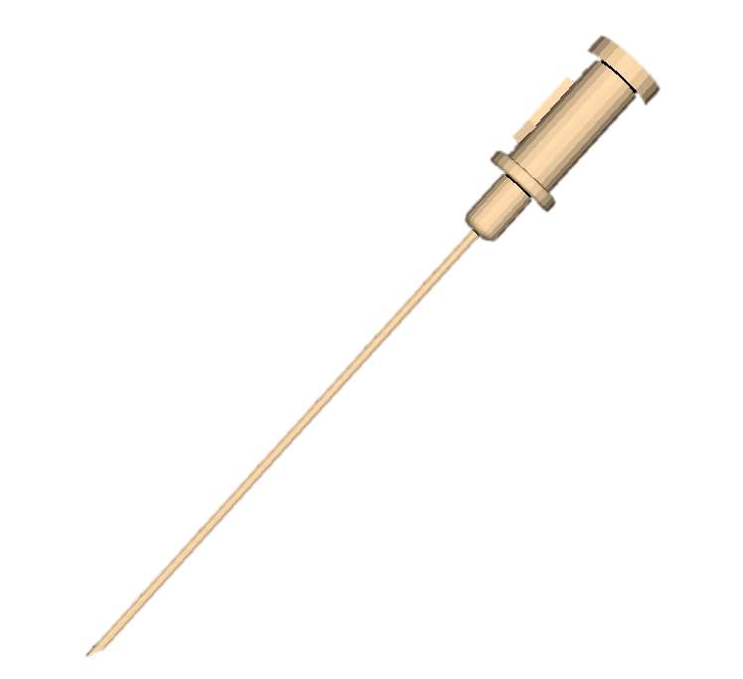
IN-PLANE NEEDLE INSERTION
Click on the “Start” button to start recording tracking and imaging data.

Slide 3
IN-PLANE NEEDLE INSERTION
Insert the needle following the indicated trajectory and reach the target point displayed in the image.

Slide 4
IN-PLANE NEEDLE INSERTION
Insert the needle following the indicated trajectory and reach the target point displayed in the image.
The needle should be maintained within the ultrasound image plane during the entire insertion.
Do not deviate the needle tip from the target trajectory

Slide 5
IN-PLANE NEEDLE INSERTION
Insert the needle following the indicated trajectory and reach the target point displayed in the image.
The needle should be maintained within the ultrasound image plane during the entire insertion.
Do not deviate the needle tip from the target trajectory

Slide 6
IN-PLANE NEEDLE INSERTION
Extract the needle following the insertion trajectory.
Click on the “Stop” button to stop the recording.
Click on the “Save” button to save the recording.

