Slide 1
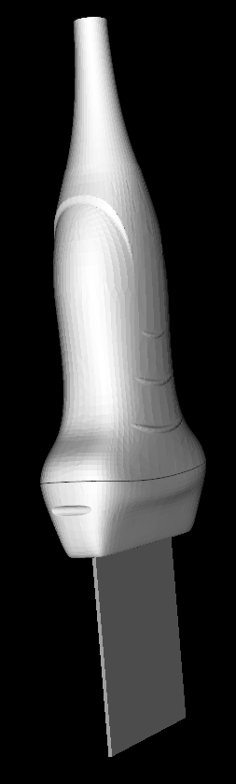
OUT-OF-PLANE NEEDLE INSERTION
Click on “Generate new target” button to display a target point on the ultrasound image.
Target point

Slide 2
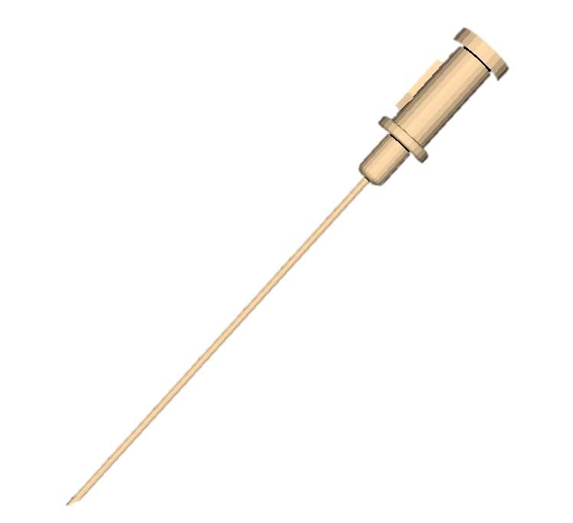
OUT-OF-PLANE NEEDLE INSERTION
Click on the “Start” button to start recording tracking and imaging data.

Slide 3
OUT-OF-PLANE NEEDLE INSERTION
Insert the needle and reach the target point displayed in the image.

Slide 4
OUT-OF-PLANE NEEDLE INSERTION
Insert the needle and reach the target point displayed in the image.
The needle should intersect the ultrasound plane as close as possible to the target point in the image.

Slide 5
OUT-OF-PLANE NEEDLE INSERTION
Extract the needle following the insertion trajectory.
Click on the “Stop” button to stop the recording.
Click on the “Save” button to save the recording.

