Slide 1

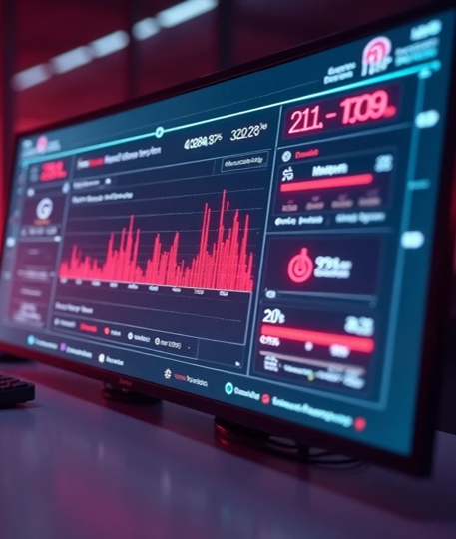


Development

Slide 2
Monitoring

Slide 3
Deployment

