Slide 1

Splunk Features
Ingest Data
Ingest Data
Process of collecting data from various sources

Slide 2

Indexing
Indexing
Organizing data for efficient searching

Slide 3

Searching
Searching
Finding specific data within the indexed data

Slide 4

Analysis
Analysis
Examining data to derive insights

Slide 5
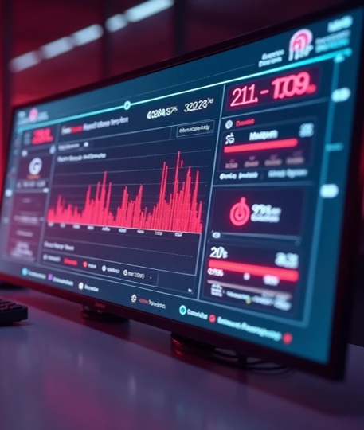
Visualization
Visualization
Presenting data in a graphical format

