Slide 1
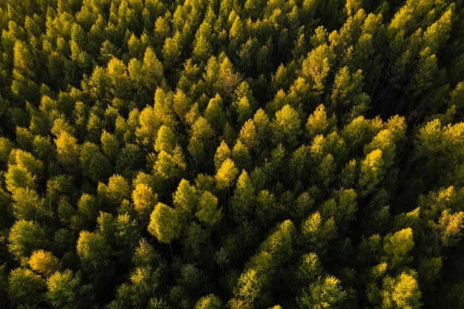

Splunk Presentation
Summer 2025

