Slide 1
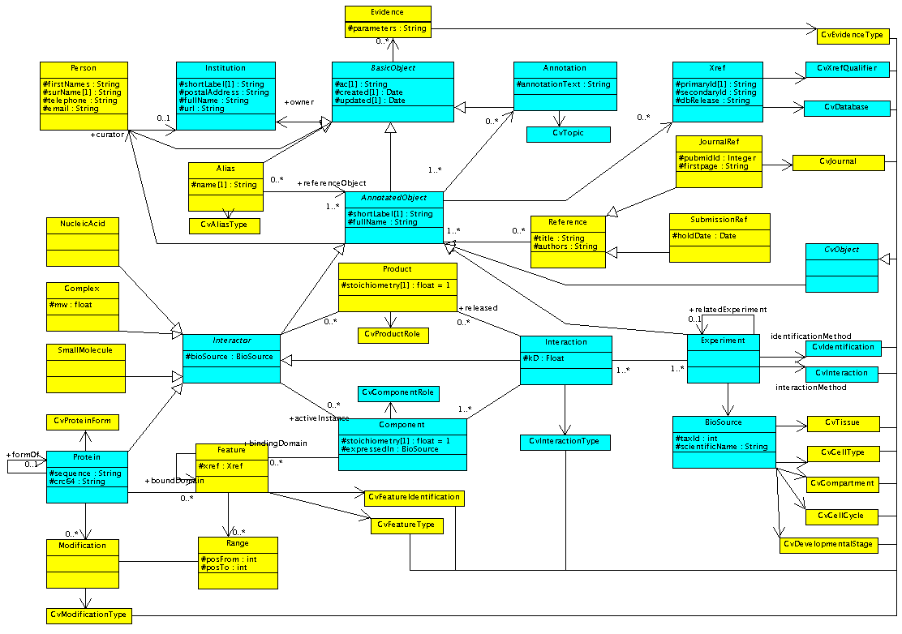
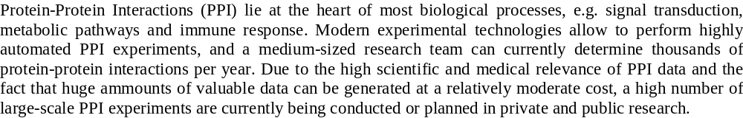

IntAct-
An Open Standard and Software
for Protein-Protein Interaction Data
Henning Hermjakob¹, Luisa Montecchi-Palazzi⁹, Chris Lewington¹, Dan Wu¹, Martin Vingron², Bernd Roechert³, Peter Roepstorff⁴, David Sherman⁵, Alfonso Valencia⁶, Hanah Margalit⁷, John Armstrong⁸, Rolf Apweiler¹
EMBL Outstation - European Bioinformatics Institute (EBI), Hinxton, Cambridge CB10 1SD, UK
Introduction
Protein-Protein Interactions (PPI) lie at the heart of most biological processes, e.g. signal transduction, metabolic pathways and immune response. Modern experimental technologies allow to perform highly automated PPI experiments, and a medium-sized research team can currently determine thousands of protein-protein interactions per year. Due to the high scientific and medical relevance of PPI data and the fact that huge amounts of valuable data can be generated at a relatively moderate cost, a high number of large-scale PPI experiments are currently being conducted or planned in private and public research.
Due to the complex nature of biological processes, and bias of the experimental techniques,
each research group can still only generate a partial picture of the actual biological system.
One approach to increase the scientific value of protein interaction data is to combine the data from several experiments to gain a more complete and more reliable overall picture. But this combination is currently very labour-intensive, if not impossible, as no widely accepted data standard and no centralised resources for PPI data exist. Practically each group generating PPI data develop their own systems for storage, analysis and visualisation. Apart from the duplication of work, this results in a high degree of fragmentation and incompatibility between different PPI data sets.
IntAct objectives
The aims of the IntAct project are to
define a standard for the representation and annotation of protein-protein interaction data,
provide a public repository,
populate the repository with experimental data from project partners and curated literature data,
provide modular analysis tools, and
provide portable versions of the software to allow installation of local IntAct nodes.
IntAct data model
The IntAct data model has been designed to flexibly accommodate data from very simple representations, e.g. pairs of gene names, to highly structured data, e.g. multi-protein complexes with known binding domains and modifications.
To maximise data standardisation, controlled vocabularies are defined and used wherever possible.
See Fig. 1, conceptual IntAct class diagram in UML.
IntAct software
The IntAct software is Java-based and allows easy local installation. IntAct is an open-source project and follows open standards wherever possible. IntAct is based on a relational database and an object-relational mapping. We will provide implementations for at least two relational database systems, Oracle and a freely available system, e.g. Postgres. An overview of the IntAct software architecture is given below:
Applications: Browse/Edit/Analyse
Synchronisation
Web Framework: Struts
XML load/unload
Object layer
Object-relational mapping: Jakarta OJB
DB adaptor
DB adaptor
...
Oracle
Postgres
...
Fig. 1: Conceptual IntAct class diagram in UML : Implemented : Impl. by 12/2002 : Inheritance
International synchronisation
The long-term objective of the IntAct project is to cooperate with other protein-protein interaction data providers to provide a central, synchronised resource for PPI data, similar to the EMBL/GenBank/DDBJ cooperation for nucleotide data.
A first step towards this aim is being coordinated by the Proteomics Standards Initiative of the Human Proteome Organisation, see
http://www.ebi.ac.uk/Information/meetings/psi.html
Call for participation
IntAct aims to develop an open, widely accepted community standard, and we are grateful for any comments and contributions from you.To access the current, pre-release code base, and to participate in the further development of the data model and the IntAct software, please visit
http://www.ebi.ac.uk/intact/
or contact
intact-dev@ebi.ac.uk
The IntAct consortium
¹Max-Planck-Institute for Molecular Genetics, Berlin
²European Bioinformatics Institute, Hinxton, UK
³Swiss Institute of Bioinformatics, Geneva
⁴University of Southern Denmark, Odense
⁵University of Bordeaux
⁶National Center for Biotechnology, Madrid
⁷The Hebrew University, Jerusaleml
⁸Glaxo Research and Development Ltd, Stevenage, UK
⁹University Tor Vergata, Rome (associated)
URL www.ebi.ac.uk/intact/
Email intact-dev@ebi.ac.uk
Telephone +44(0) 1223 494671
Fax +44(0) 1223 494468

