Slide 1
IntAct Curation Interface
Interactive Mockup
MIMIx
2010/03/11

Slide 2
Curation Workflow
Scope = MIMIx
Bulk creation
Feature
(new)
Publication
(wizard)
Publication
(edit)
Experiment
(edit)
Interaction
(edit)
Participant
(edit)
Feature
(edit)
CV
(search)
Organism
(search)
Interactor
(search)
CV
(edit)
Organism
(edit)
Interactor
(edit)
Interactor
(wizard)

Slide 3
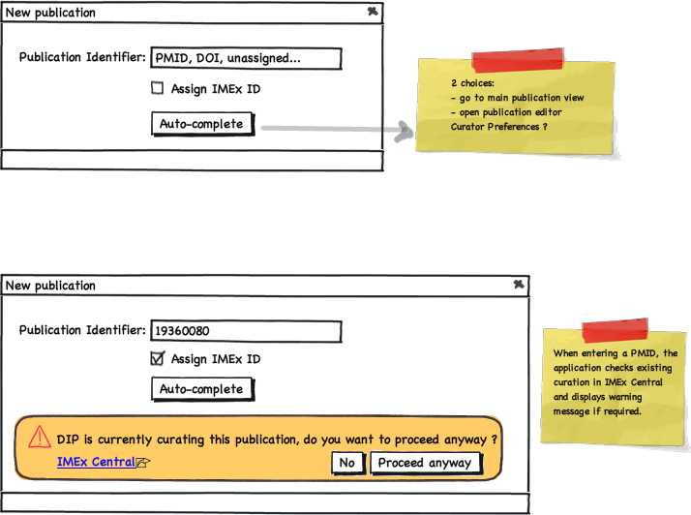
back
feedback

Slide 4
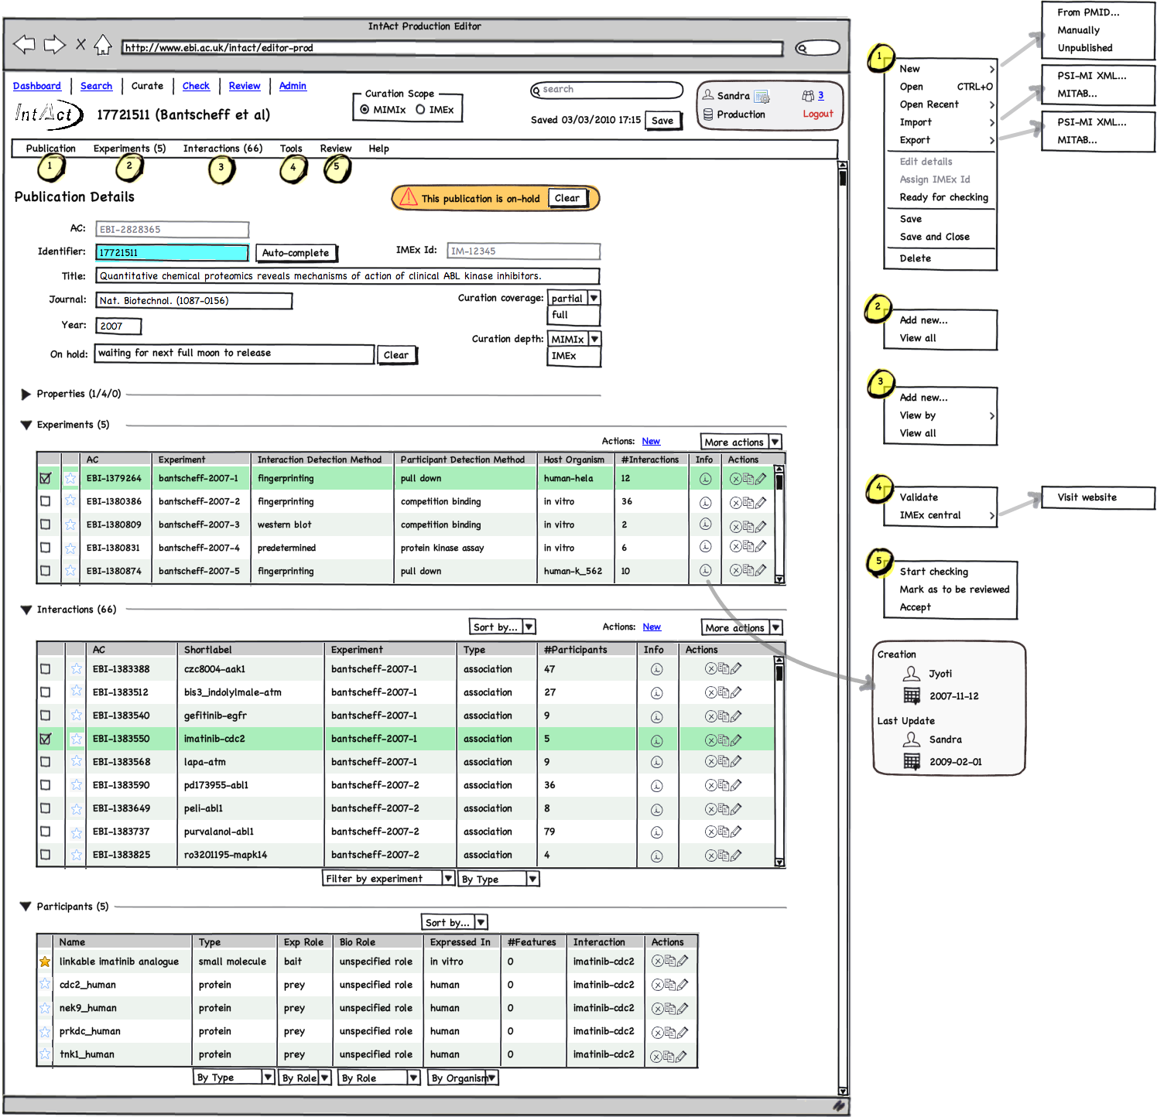
back
Publication
feedback

Slide 5
back
feedback

Slide 6
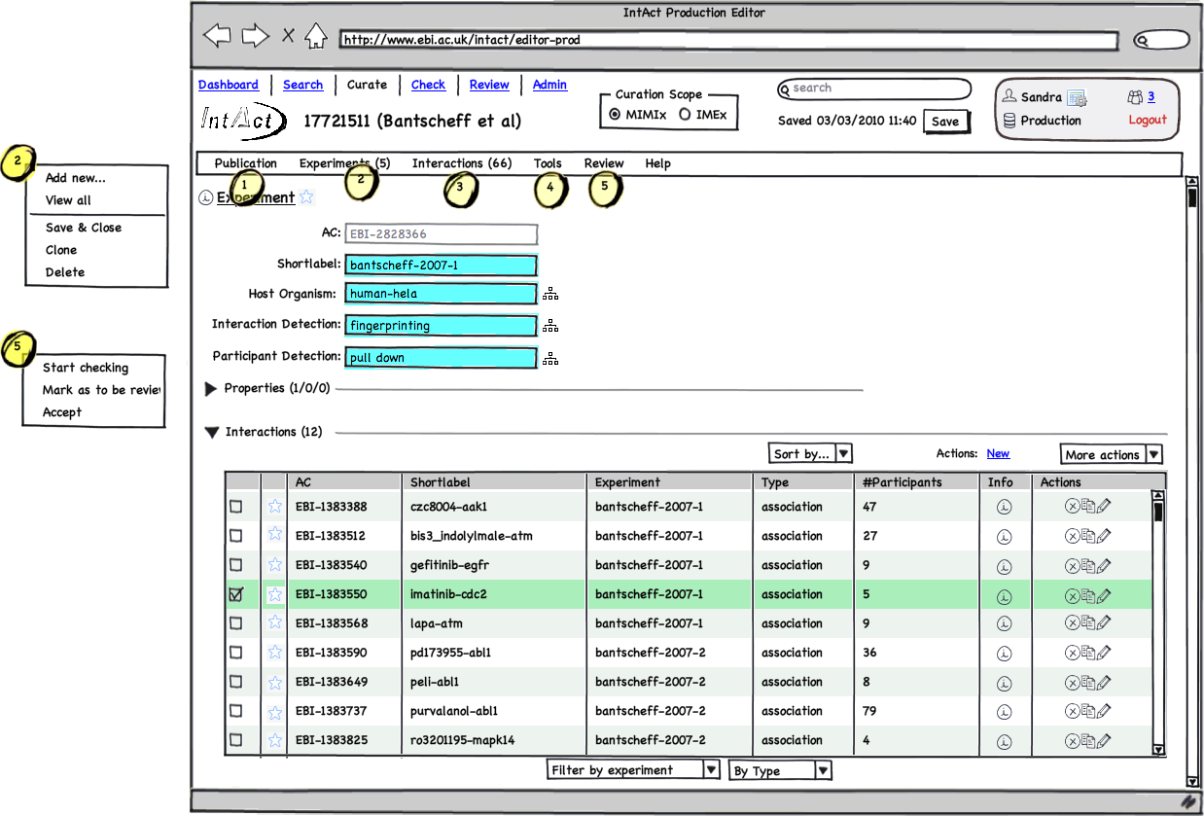
back
Experiment
feedback

Slide 7
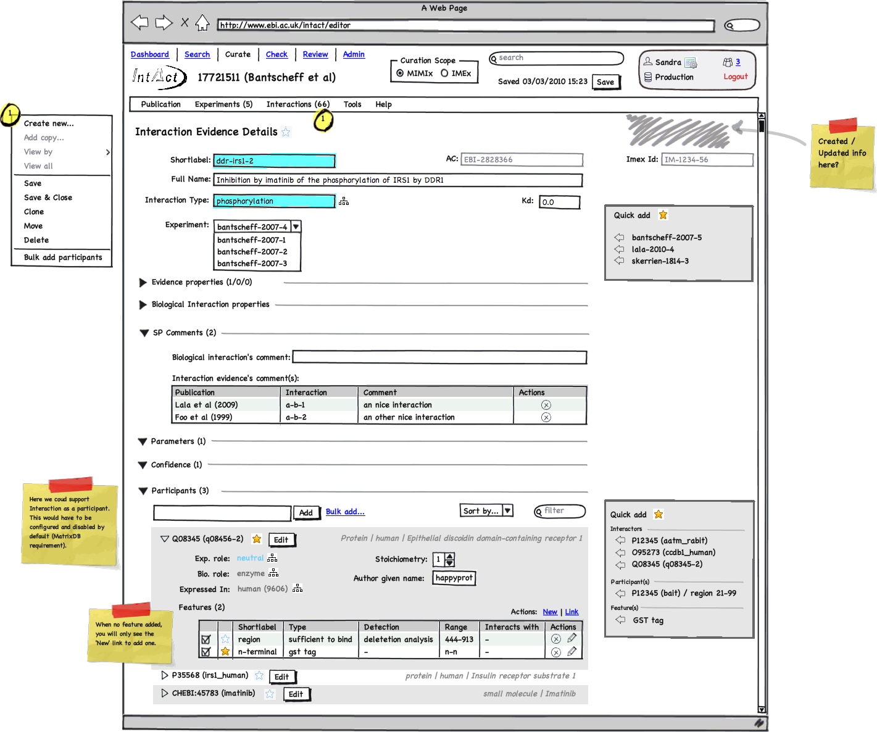
back
Interaction
feedback

Slide 8
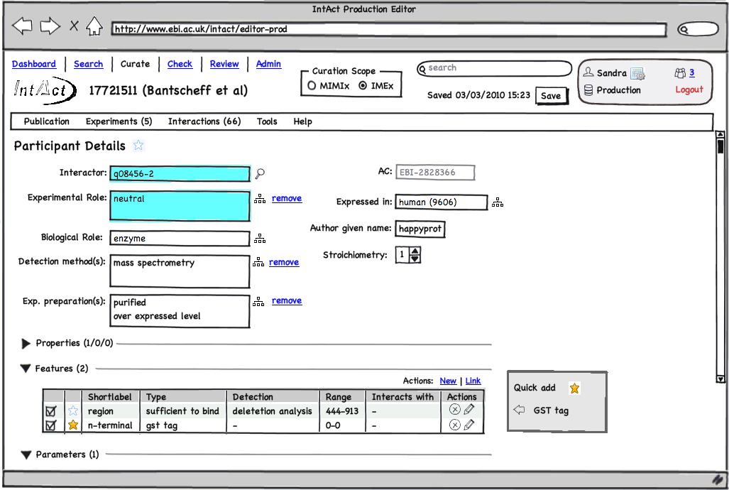
back
Participant
feedback

Slide 9
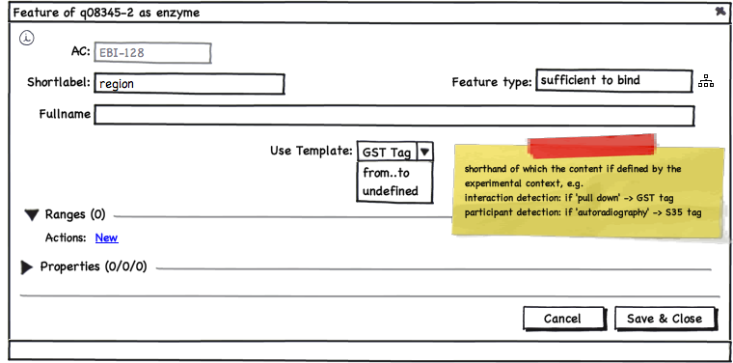
back
Feature (create)
feedback

Slide 10
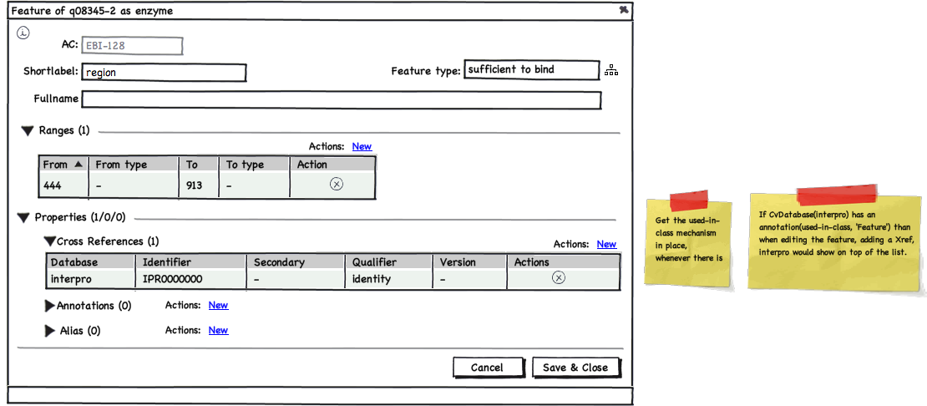
back
Feature (edit)
feedback

Slide 11
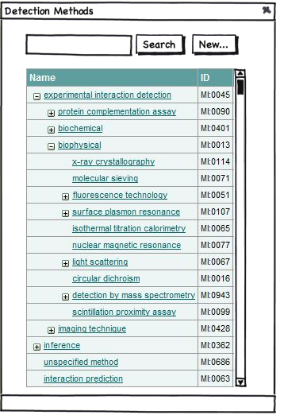
back
Controlled Vocabularies (search)
feedback

Slide 12
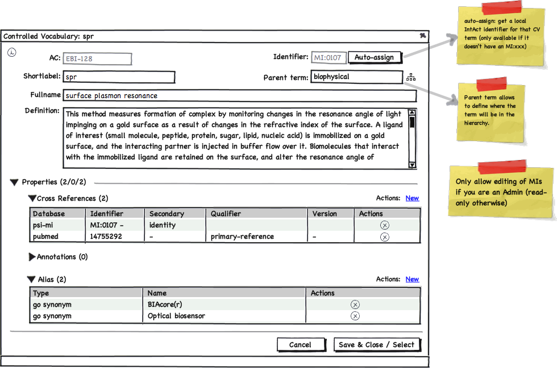
back
Controlled Vocabularies (edit)
feedback

Slide 13
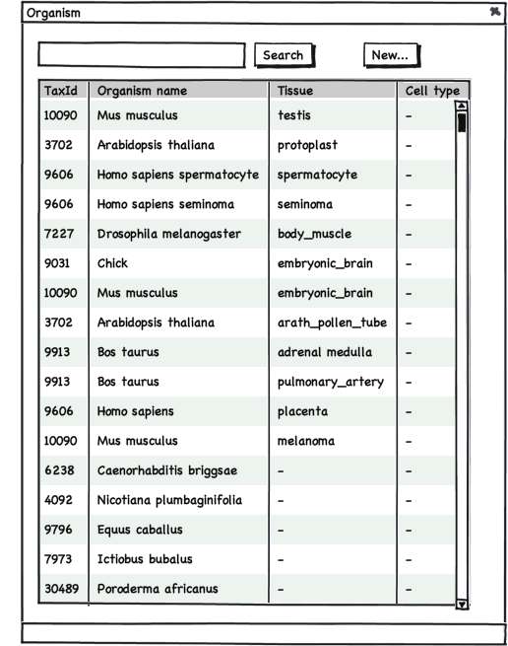
back
Organism (search)
feedback

Slide 14
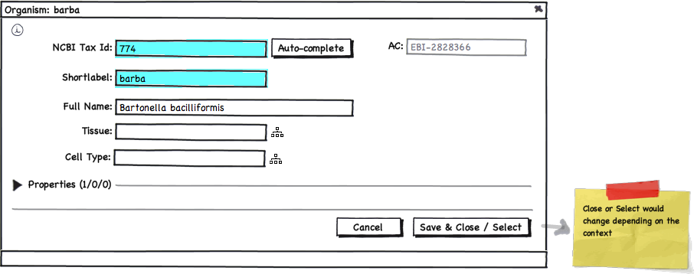
back
Organism (edit)
feedback

Slide 15
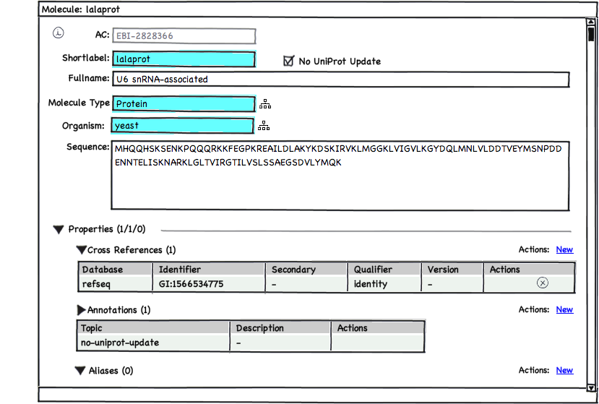
back
Molecules (NOT from UniProt)
Next
feedback

Slide 16
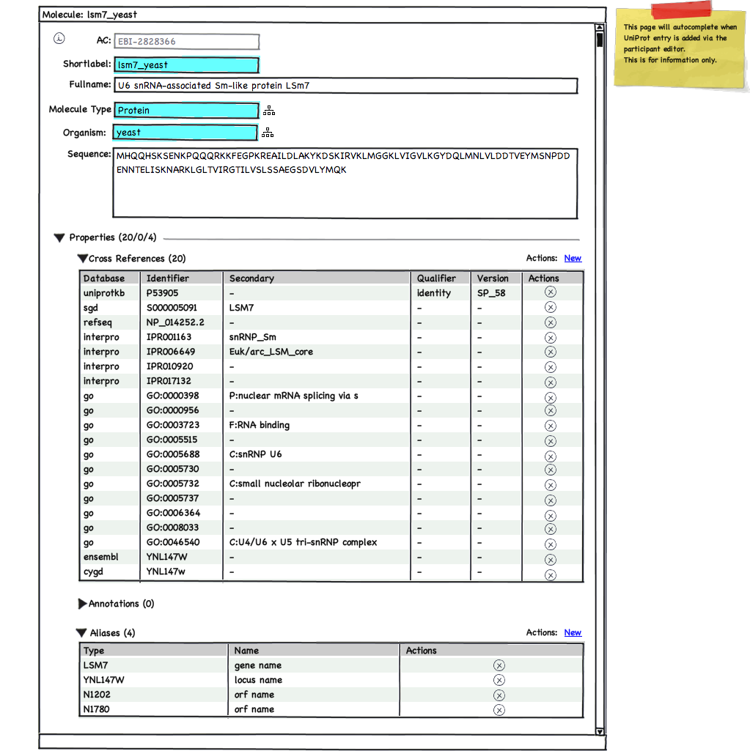
back
Molecules (from UniProt)
Previous
feedback

Slide 17
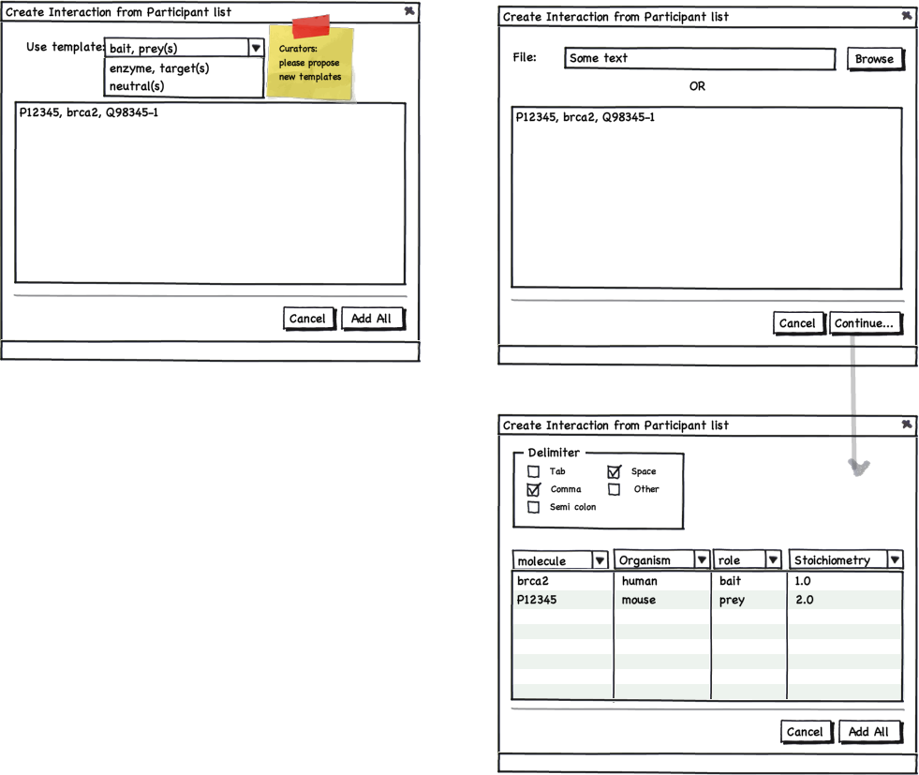
back
Bulk add participants (1/2)
Next
feedback

Slide 18
back
Bulk add participants (2/2)
This tools allows a user to load an Excel spreadsheet and to specify what each column is so that the data can be loaded automatically.
Note: similar to loading an interaction network from a table in Cytoscape
Previous
feedback

Slide 19
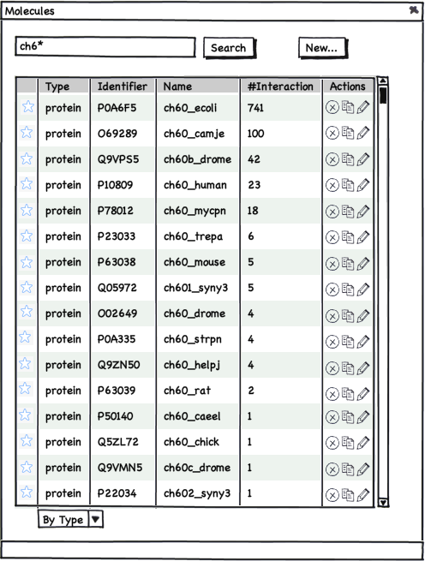
back
Interactor (search)
feedback

Slide 20
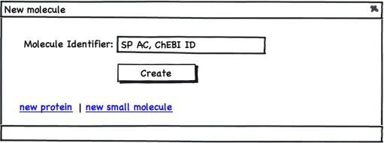
back
Interactor (wizard)
feedback

