Slide 1
CS 301: HPC
Comparison of sorting algorithms
Mauli Shah - 201501132 Advisor: Dr. Bhaskar Chaudhary
Ekta Bhoraniya - 201501402 DAIICT

Slide 2
Serial Algorithm:
Selection Sort: This algorithm first finds the smallest element in the array and swaps it with the element in the first position, then find the second smallest element and swaps it with the element in the second position, and continues in this way until the entire array is sorted.Two for loops are used for this purpose. Each element of the outer loop is compared to all the elements of the inner for loop and then its correct position is found by counting the number of elements less than it and is placed there. Time complexity=O(N²)
QuickSort:QuickSort is a Divide and Conquer algorithm. It picks an element as pivot and partitions the given array around the picked pivot.This algorithm divides the list into three main parts : Elements less than the Pivot element, Pivot element(Central element), elements greater than the pivot element.The pivot is localized to all the subarrays formed. Time complexity=O(N Log N)

Slide 3
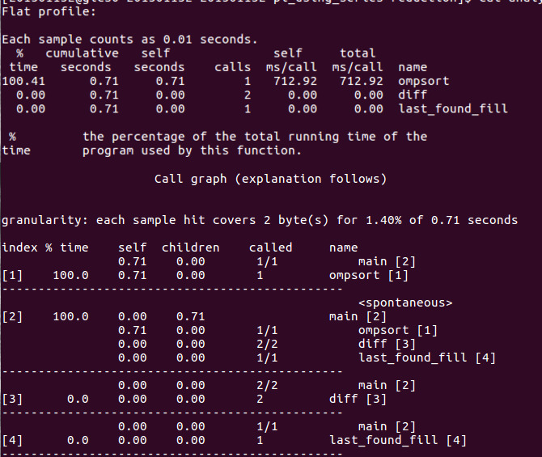
Profiling Information
Selection Sort:
For input size 1000.
Using gprof

Slide 4
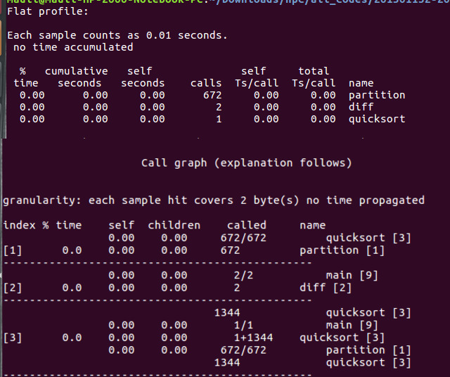
Profiling Information
Quick Sort
Input Size: 1000
Using gprof

Slide 5
Parallelization Strategy
Selection Sort: The clause #pragma omp parallel for is used to parallelize the outer for loop through which the array is divided into subarrays.The array is shared by all the threads.
Quick Sort: we used the clause pragma omp task and single nowait in order to parallelize the code. we parallelize the code for large inputs(>10³). Firstly partition method will be called by a single thread and then tasks will be divided among the threads. whenever a thread encounters a task construct,a new task is generated. The task construct is placed where array is divided into two parts. Threads sort that individual array and finally merge all subarrays for final output.

Slide 6
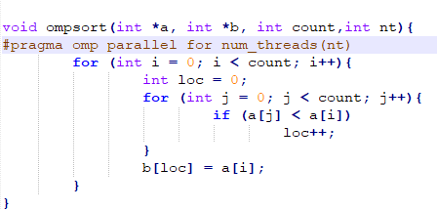
Parallelized Part of the code
In case of selection sort following part is parallelized

Slide 7
Algorithm Quick Sort:
The steps are:
Pick an element, called a pivot, from the array.
Partitioning: reorder the array so that all elements with values less than the pivot come before the pivot, while all elements with values greater than the pivot come after it (equal values can go either way). After this partitioning, the pivot is in its final position. This is called the partition operation.
Recursively apply the above steps to the sub-array of elements with smaller values and separately to the sub-array of elements with greater values.
The base case of the recursion is arrays of size zero or one, which are in order by definition, so they never need to be sorted.

Slide 8
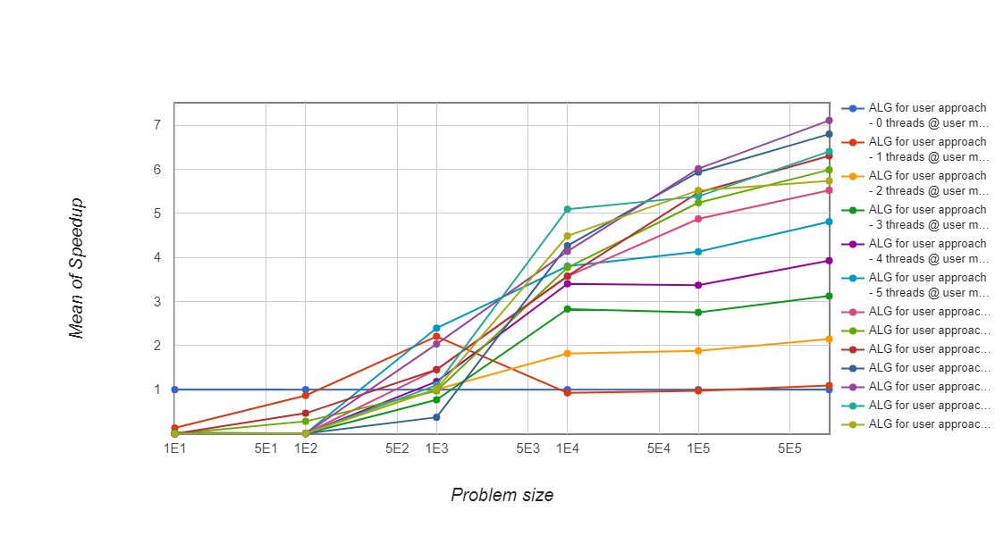
Speedup of Selection Sort

Slide 9
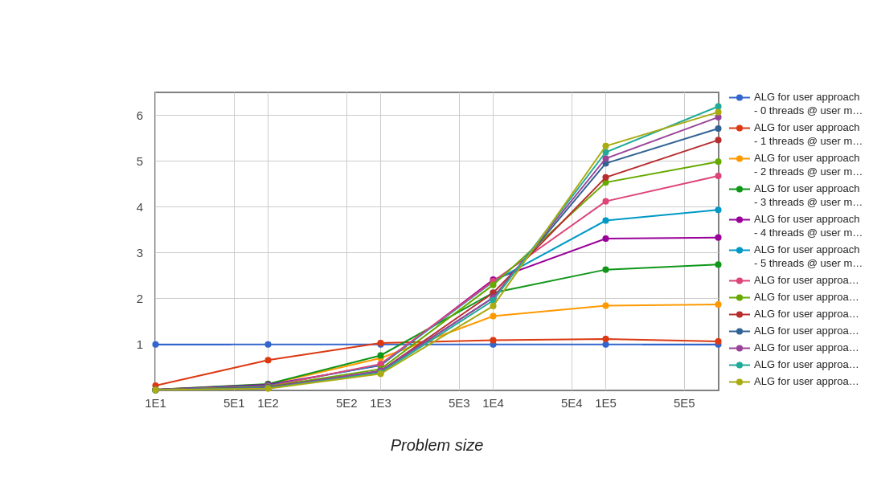
Speedup of QuickSort

Slide 10
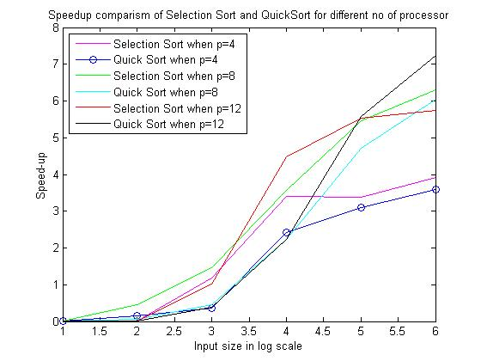
Speed-up Comparison
Here the Speedup of Selection Sort and QuickSort are compared for 4,8,12 number of processors.

Slide 11
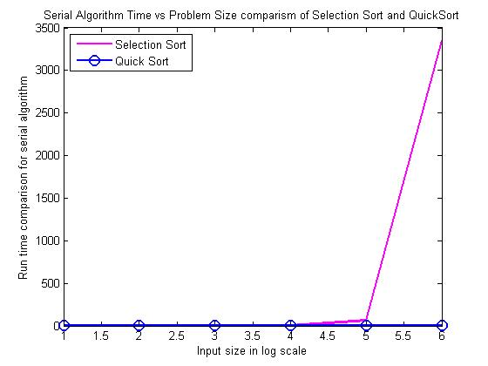
Execution Time Serial Algorithm
In case of Serial implementation of Algorithm for Selection Sort and QuickSort.
From the graph it is clearly seen that for higher input sizes that algorithm of O(NlogN) is better than O(N*N).

Slide 12
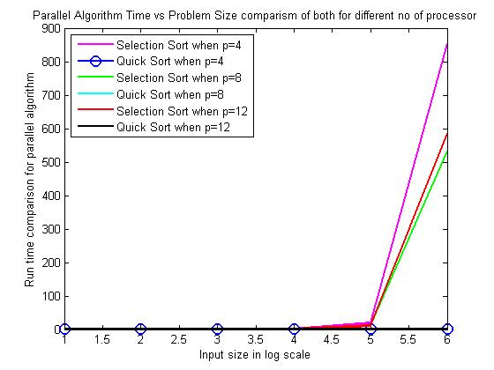
Execution Time for fixed number of processor
In case of Parallel Algorithm for number of processors equal to 4,8 and 12 comparison is shown

Slide 13
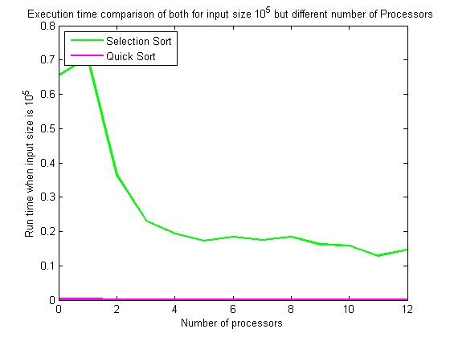
Execution time for fixed input size
Here the input size is fixed and equal to 10^5 and the excution time vs number of processor is plotted.
It can be seen that as the number of processor increases the execution time decreases.
In case of QuickSort as the input size increases the number of task formed increases due to which there is a slight increase in the execution time because of creation of task and fetching it from the pool of tasks if the number of tasks exceeds the input size.

Slide 14
Important Analysis - Selection Sort :
For small input sizes the number of computations increases the communications doesn't increase that much.At this point the overhead is majorly because of the creation of threads.But as the input size increases there is an increase in communication time thus making communication overhead come into picture.
No load balancing related issue because each thread has to sort equal number of elements

Slide 15
Important Analysis - Quick Sort :
Here array is divided into two parts, left and right. Threads will sort that small array part. So there will be independent part of array to sort for each thread. So, there will not be any dependency.
As we used task, it generate new task when thread encounters it.Then it may choose to execute the task immediately or defer its execution until a later time.If task execution is deferred, then the task is placed in a pool of tasks. A thread that executes a task may be different from the thread that originally encountered it.
As work division depends on pivot there is problem of load balancing.

