Slide 1

Dungeons and Dragons creatures and re-calculating difficulty.
By Ethan Bredall

Slide 2
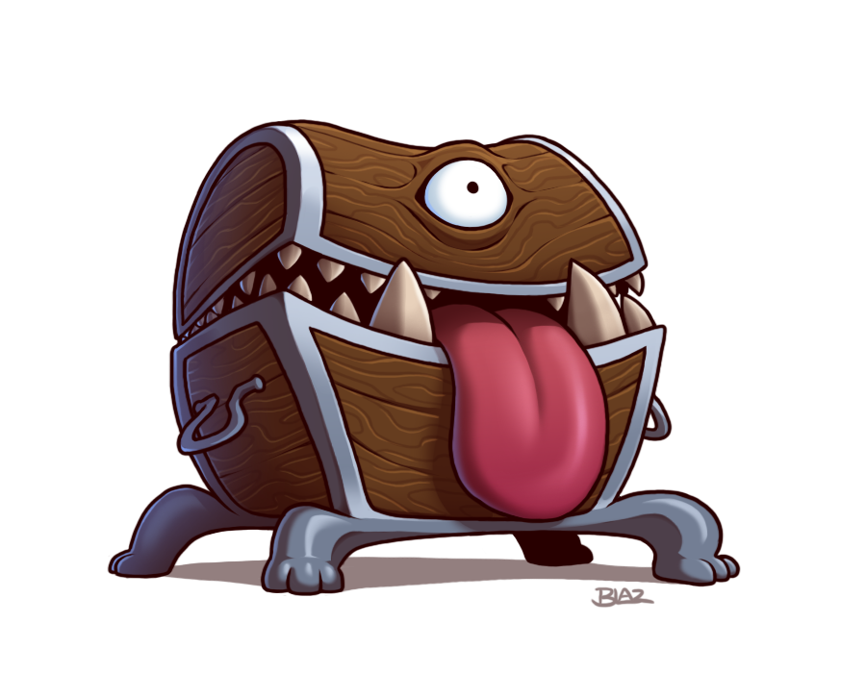
The Purpose of this Project.
The purpose of this project is to ideally create a more usable method of cataloging creatures in the tabletop role playing game Dungeons and Dragons Fifth Edition, based on difficulty in an "encounter" as the game calls it. I believe it would be interesting to see what the hardest to defeat and weakest to defeat enemy is within their original difficulty ratings.

Slide 3
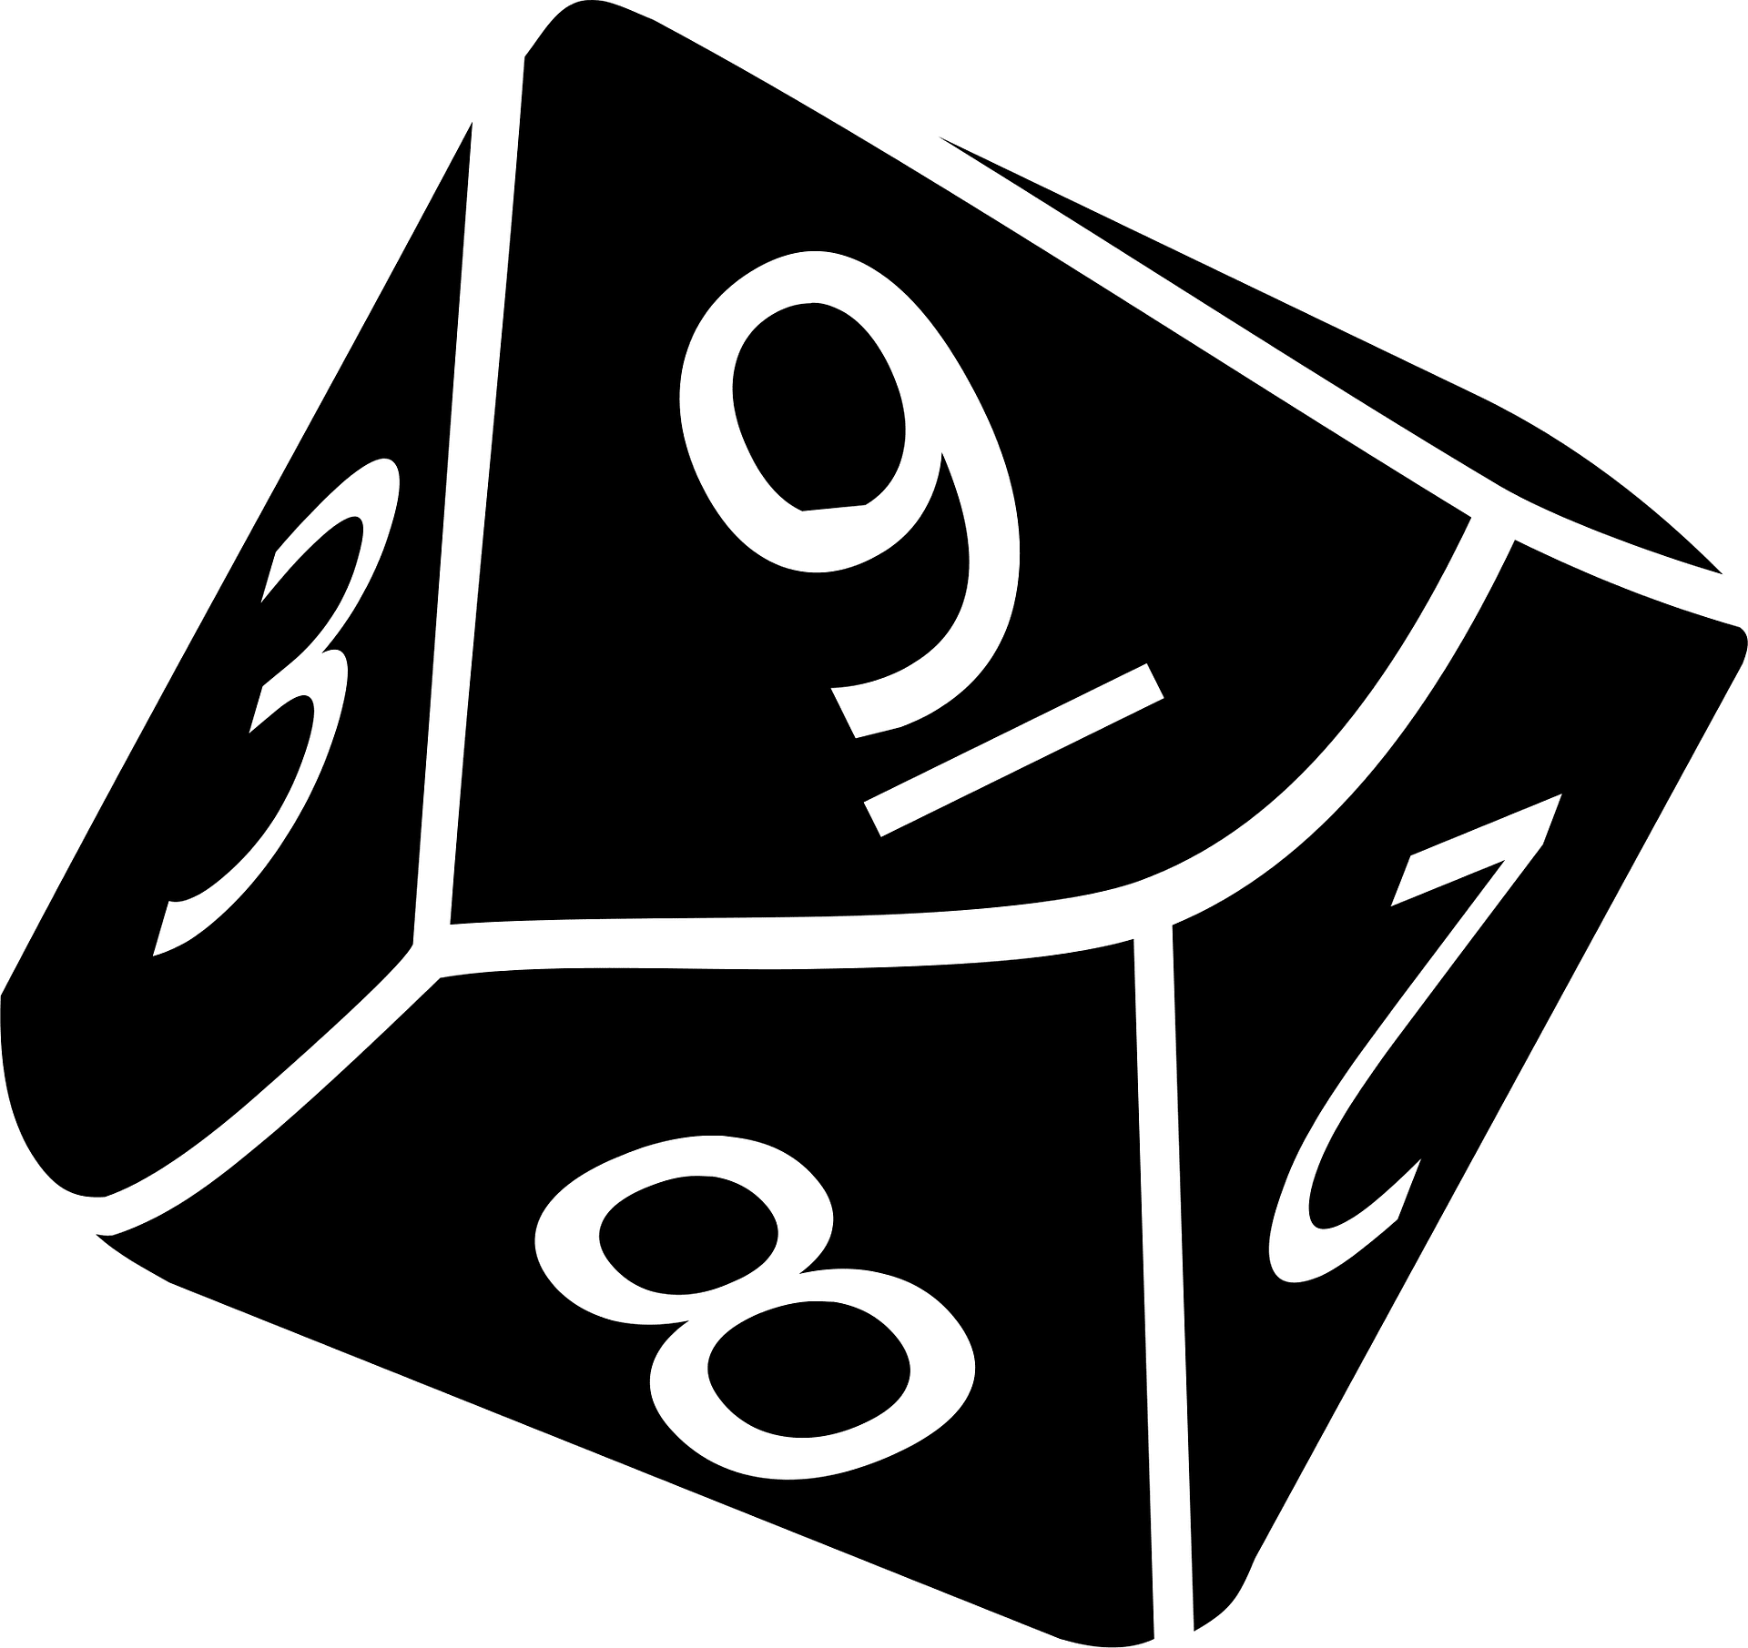
Data concerning 324 different creatures in Dungeons and Dragons
The data I was utilizing was rather messy
There was unnecessary information in many columns
Columns were sometimes joined together when they should not have been
The original data from the csv file consisted of 324 entries spread across seven columns.
These columns were “Name”, “Size”, “Race and alignment”, “HP”, “Armor”, “Speed”, and “Challenge rating”.
Much of the data needed alterations to be made into more usable information
Two of the columns, “Race and alignment” as well as “Speed” needed to be split into two different columns each.
“HP”, “Armor”, “Speed”, and “Challenge rating” all had unnecessary information that needed to be removed using the gsub function.
The “Size” column needed to be ordered as factors

Slide 4

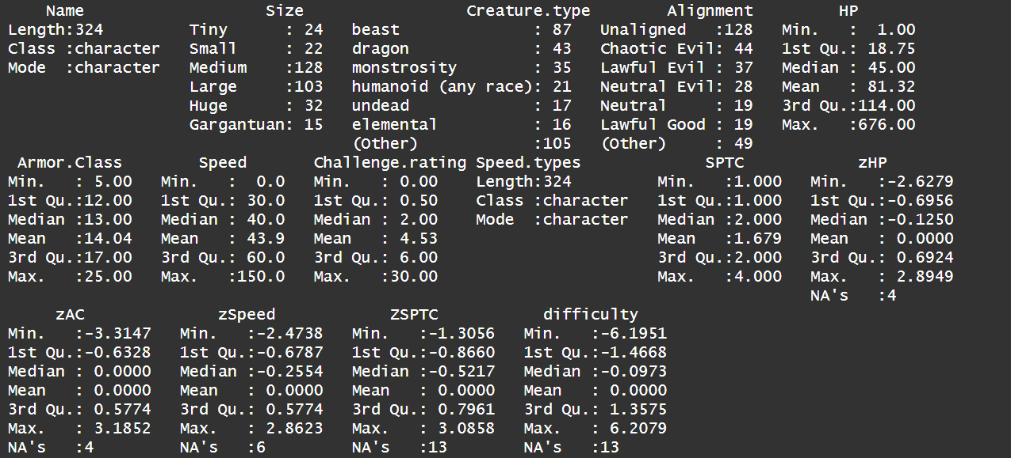
Interesting statistics or groupings
The summary was created after data tidying to be functional and not simply be 324 entries under all columns with no usable information.
I believe the most interesting data originates from within the “HP” column. This column also has one of the two most blatant high outliers in the data set from my observations, this being the “HP” of a creature called the “Tarrasque”. This creature has the highest “Challenge rating” in the entire data set and is intended by the game designers to be the strongest creature in this list. It has well over 100 more “HP” than the creature below it in “HP”.

Slide 5
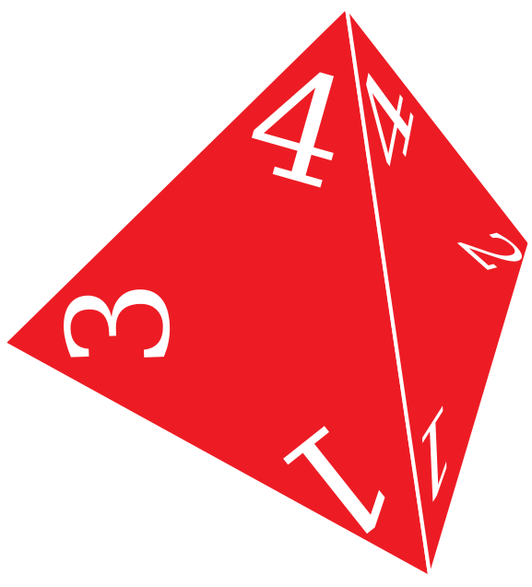
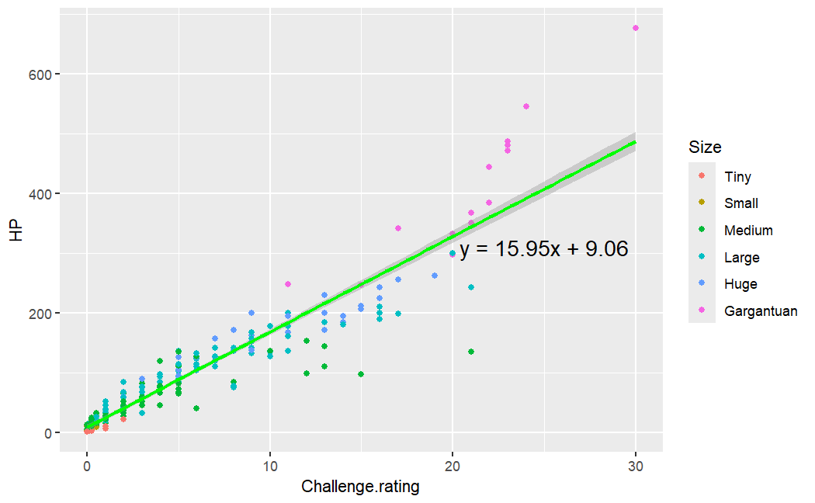
Visual Analysis
Personally, I believe this is the most interesting and useful chart regarding the data I analyzed. Here it shows the correlation between “HP” and “Challenge rating”, as well as a regression line, and colors indicating what “Size” each case is.
Here you can see most of the major outliers in terms of “HP”, and how most of the time they are in the largest “Size” grouping. Additionally, you can see the clear trend of the more difficult a creature is, the more likely it is to have a higher “HP” value. What is interesting is some of the high “Challenge rating” creatures that have rather low “HP” values, the two “Medium” creatures visible in the chart are the “Lich” and the “Solar”, who are poorly represented by this data, as it does not include their abilities or damage output.

Slide 6
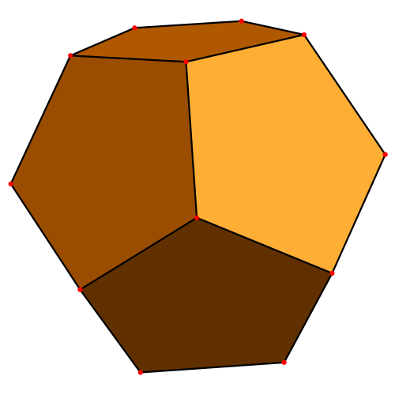


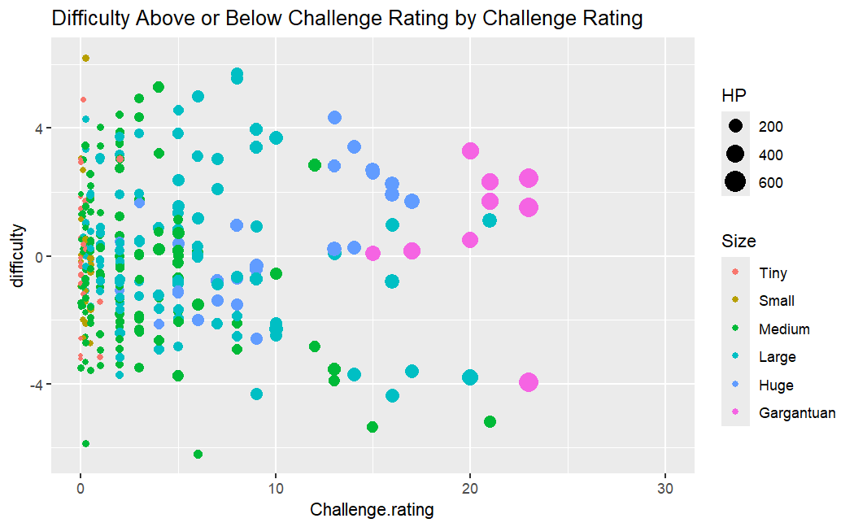
Difficulty within a creature’s “Challenge rating”
A “Challenge rating” is the level in which a creature is meant to be encountered/fought by a group of four players of average equipment for that point in the game.
This chart shows the grouped Z-Score (how many standard deviations away from the mean something is) of each creature. This, in theory would be able to be categorized as strength above or below the average creature of that “Challenge rating”
From what I found, the strongest creature within it’s “Challenge rating” based on this metric is the “Flying Sword”, which I would have to agree with, looking at it’s actual statistics for the game, it is well above other creatures in it’s “Challenge rating”. This contrasts with what I found to be the weakest, being the “Mage”, however the “Mage” has many abilities and information that is not included in this data frame, that likely it is skewing the information. After looking at it’s statistics for the game, the mage is still quite a weak creature for it’s “Challenge rating”.

Slide 7

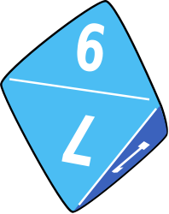
Results
What I discovered is that by my metrics, around 90 creatures out of this 324 listed can be considered above their official difficulty rating in difficulty, while about 96 are on the opposite side, and can be considered a little too for their official difficulty rating. This metric however is not perfect as it doesn't include things such as spell casting or damage output. Something that was interesting I found was that the namesake creature of the game, the dragon, at almost all ages, is drastically above the other creatures within their challenge rating. This honestly makes perfect sense, as Dungeons and Dragons has stated before that they will sometimes make a game object much stronger than it's similarly leveled counterparts because of how iconic it is.
I think overall this project was mostly a success, as I was able to identify what I now consider to be the strongest creature in the game for it’s “Challenge rating”, in the future it’d likely be ideal to include things such as damage per every round of the game, or even something much simpler such as just the number of abilities a creature has. This would allow for a more robust and complex data analysis to be more accurate.

Slide 8
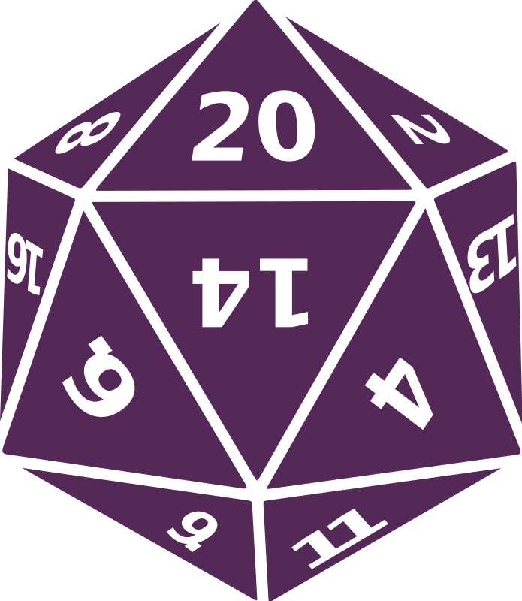
References
"Dice RPG." Wikimedia Commons, 22 Nov. 2021, https://commons.wikimedia.org/wiki/File:Dice_rpg.png.
"Die Silhouette." Creazilla, https://creazilla.com/media/silhouette/7979771/die.
"D4 Four-Sided Die." Openclipart, https://openclipart.org/detail/228621/d4-four-sided-die.
"Dice Clipart." Creazilla, https://creazilla.com/media/clipart/3152319/dice.
Blazbaros. "Chester the Mimic." DeviantArt, 20 Feb. 2020, https://www.deviantart.com/blazbaros/art/Chester-the-Mimic-827963711.
"Dragon Silhouette." Openclipart, https://openclipart.org/detail/222202/dragon-silhouette.
"Purple D20." Wikimedia Commons, 28 Oct. 2018, https://commons.wikimedia.org/wiki/File:Purple_d20.png.
"Dungeons & Dragons 5E Tools." 5e Tools, https://5e.tools/index.html.
Gomes, Patrick. "Dungeons and Dragons 5e Monsters Dataset." Kaggle, https://www.kaggle.com/datasets/patrickgomes/dungeons-and-dragons-5e-monsters.
"Wizard Clipart." Creazilla, https://creazilla.com/media/clipart/60139/wizard.ClipartCottage.
"Pirate Sword 02." DeviantArt, 15 Mar. 2014, https://www.deviantart.com/clipartcotttage/art/Pirate-Sword-02-440196913.
"Uniform Truncated Small Stellated Dodecahedron." Wikimedia Commons, 24 Sept. 2016, https://commons.wikimedia.org/wiki/File:Uniform_truncated_small_stellated_dodecahedron.svg.

