Slide 1
Example of DEA on wheat production data
A. Skrypnyk E. Bukin
National University of Life and Environmental Science of Ukraine

Slide 2
Arable land area of farms with the different form of ownership in 2013

Slide 3
Profit from crops production per 1 ha in the agricultural farms of Ukraine

Slide 4
Problem statement and purpose
Reasoning:
Efficiency measurement in Ukrainian agriculture is one of the most underexplored subjects.
Drivers hidden behind changing efficiency are still a subject to debates.
Goals:
To perform efficiency analysis on the production data from Ukraine
Explore and deepen knowledge of DEA application
Perform second stage DEA analysis to identify factors affecting efficiency.

Slide 5

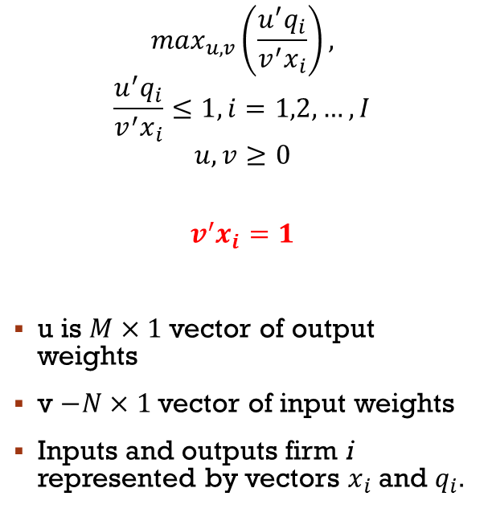
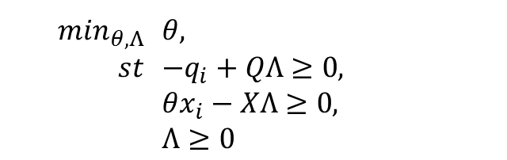
DEA – Theory behind
$$\max_{u,v}\left(\frac{u^{′}q_{i}}{v^{′}x_{i}}\right),$$
$$\frac{u^{′}q_{i}}{v^{′}x_{i}}≤1,i=1,2,…,I$$
$$u,v≥0$$
$$v^{′}x_{i}=1$$
u is $M×1$ vector of output weights
v $−N×1$ vector of input weights
Inputs and outputs firm i represented by vectors $x_{i}$ and $q_{i}$.
Multiplicative form of DEA:
$$\max_{u,v}(u^{′}q_{i})$$
$$v^{′}x_{i}=1$$
$$u^{′}q_{i}−v′x_{i}≤0$$
$$u,v≥0$$
Dual solution:
$\min_{θ,Λ}$ | $θ$,
$st$ | $−q_{i}+QΛ≥0$,
 | $θx_{i}−XΛ≥0$,
 | $Λ≥0$

Slide 6
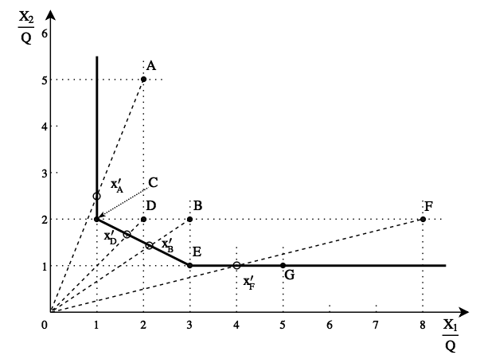
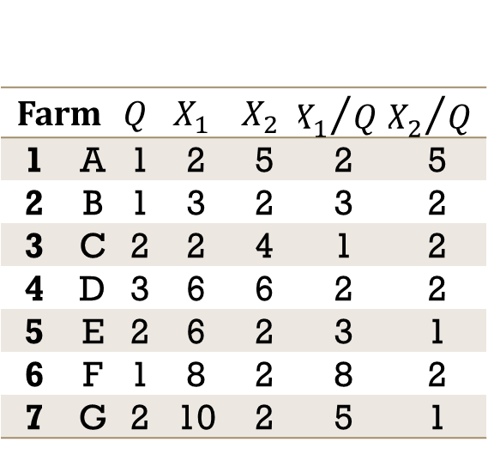
Simple DEA example
Farm |  | $$Q$$ | $$X_{1}$$ | $$X_{2}$$ | $${X_{1}}/{Q }$$ | $${X_{2}}/{Q }$$
1 | A | 1 | 2 | 5 | 2 | 5
2 | B | 1 | 3 | 2 | 3 | 2
3 | C | 2 | 2 | 4 | 1 | 2
4 | D | 3 | 6 | 6 | 2 | 2
5 | E | 2 | 6 | 2 | 3 | 1
6 | F | 1 | 8 | 2 | 8 | 2
7 | G | 2 | 10 | 2 | 5 | 1

Slide 7
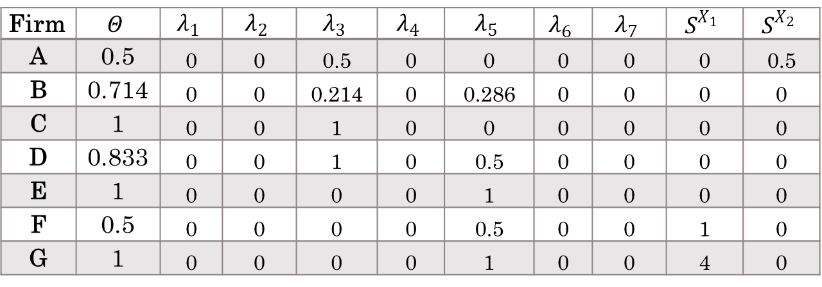
Simple DEA results
Firm | $$Θ$$ | $$λ_{1}$$ | $$λ_{2}$$ | $$λ_{3}$$ | $$λ_{4}$$ | $$λ_{5}$$ | $$λ_{6}$$ | $$λ_{7}$$ | $$S^{X_{1}}$$ | $$S^{X_{2}}$$
A | 0.5 | 0 | 0 | 0.5 | 0 | 0 | 0 | 0 | 0 | 0.5
B | 0.714 | 0 | 0 | 0.214 | 0 | 0.286 | 0 | 0 | 0 | 0
C | 1 | 0 | 0 | 1 | 0 | 0 | 0 | 0 | 0 | 0
D | 0.833 | 0 | 0 | 1 | 0 | 0.5 | 0 | 0 | 0 | 0
E | 1 | 0 | 0 | 0 | 0 | 1 | 0 | 0 | 0 | 0
F | 0.5 | 0 | 0 | 0 | 0 | 0.5 | 0 | 0 | 1 | 0
G | 1 | 0 | 0 | 0 | 0 | 1 | 0 | 0 | 4 | 0

Slide 8
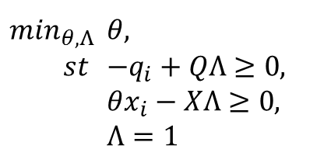
Wheat producers example
Data used
Farm-level data collected with the form 50sg in 2012.
1 Output
Wheat production in center
6 Inputs
Land (Ha)
Seeds
Fertilizers
Services
Gas/oil
Labor
Capital
Model
Simple DEA with the Variable return to scale assumption.
$\min_{θ,Λ}$ | $θ$,
$st$ | $−q_{i}+QΛ≥0$,
 | $θx_{i}−XΛ≥0$,
 | $Λ=1$

Slide 9
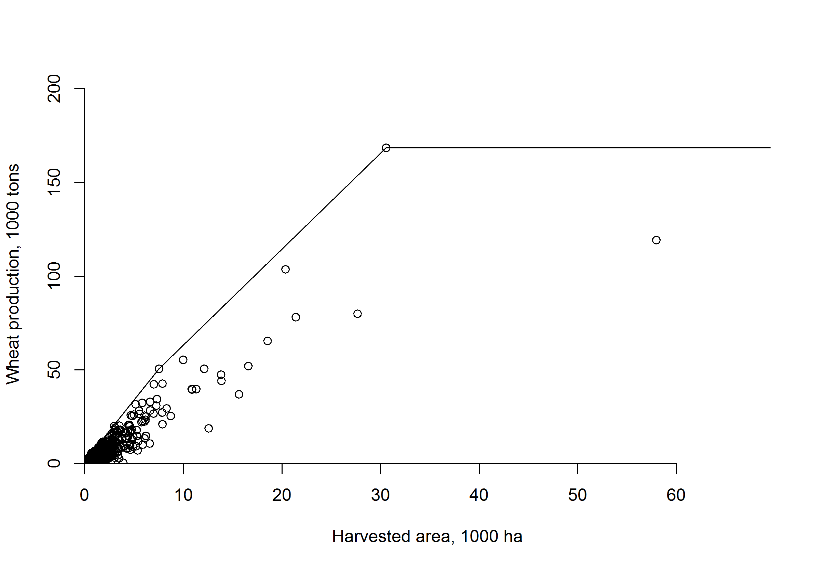
Production frontier with the VRS

Slide 10
Performance indicators of wheat production in selected enterprises (EFF VRS > 75%)
№ | Area. ha | Costs. (1000) UAH | Production. Centner | Variable scale effect | Yield. c/ha
1 | 1 | 6.0 | 30.0 | 1 | 30
2 | 1 | 2.1 | 29.0 | 1 | 29
3 | 1 | 8.5 | 49.0 | 1 | 49
4 | 1 | 4.2 | 31.0 | 1 | 31
5 | 1 | 3.4 | 20.0 | 1 | 20
…
371 | 607 | 1,866.1 | 13,469.0 | 0.875 | 22.19
372 | 607 | 4,545.0 | 40,265.0 | 1 | 66.33
373 | 607 | 2,310.0 | 23,138.0 | 1 | 38.12
374 | 610 | 3,033.3 | 36,042.0 | 0.814 | 59.09
375 | 614 | 3,727.8 | 32,022.0 | 0.794 | 52.15
…
612 | 20351 | 77,102.4 | 1,036,902.0 | 1 | 50.95
613 | 21415 | 122,328.0 | 781,734.0 | 1 | 36.50
614 | 27681 | 128,552.5 | 798,837.0 | 1 | 28.86
615 | 30568 | 156,564.0 | 1,684,710.0 | 1 | 55.11
616 | 57965 | 209,486.0 | 1,193,236.0 | 1 | 20.59

Slide 11
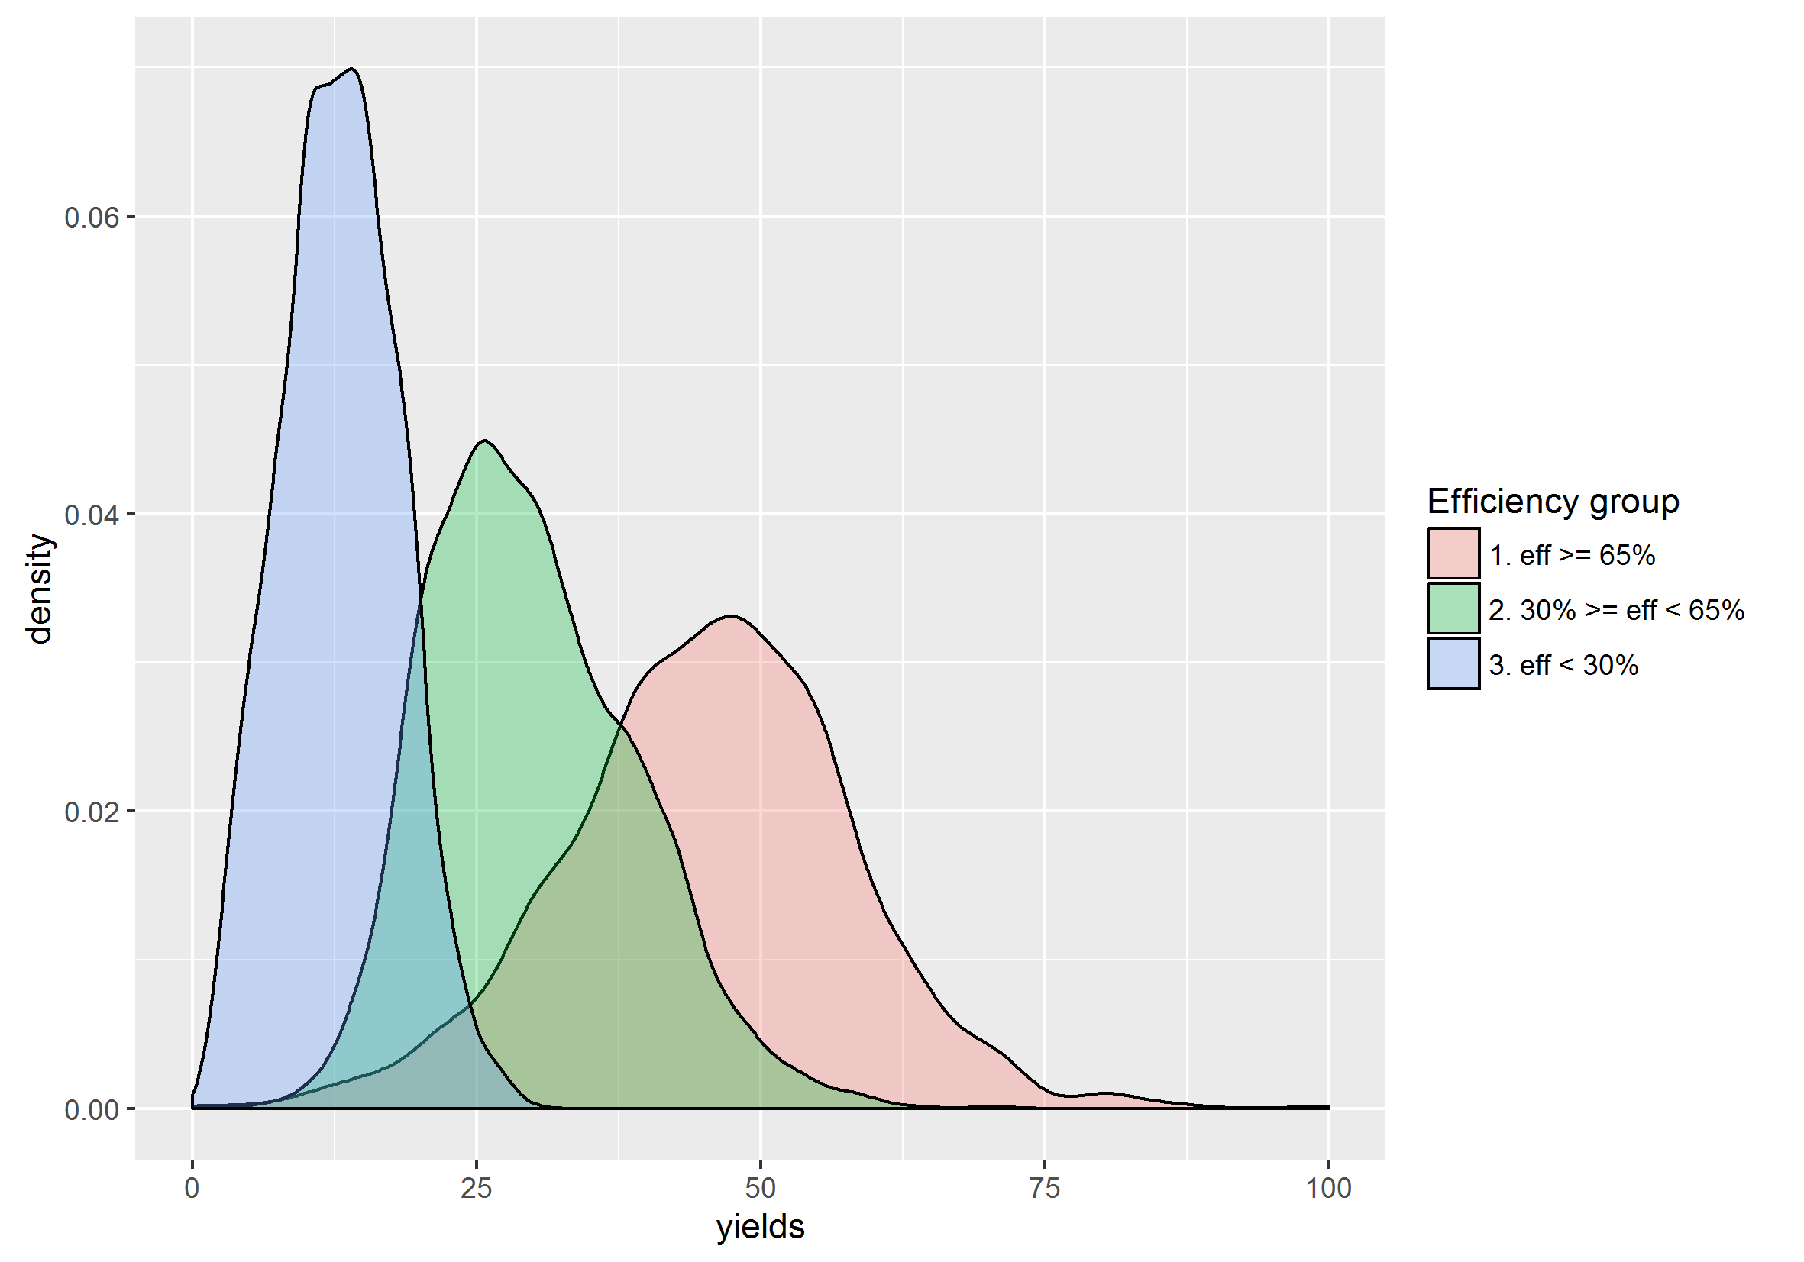
Distribution of yieds based on efficiency

Slide 12
Second stage DEA analysis
Base on the linear regression
Dependent Variable
Technical Efficiency with Variable return to scale
Independent Variables:
Yield interacting with Area

Slide 13
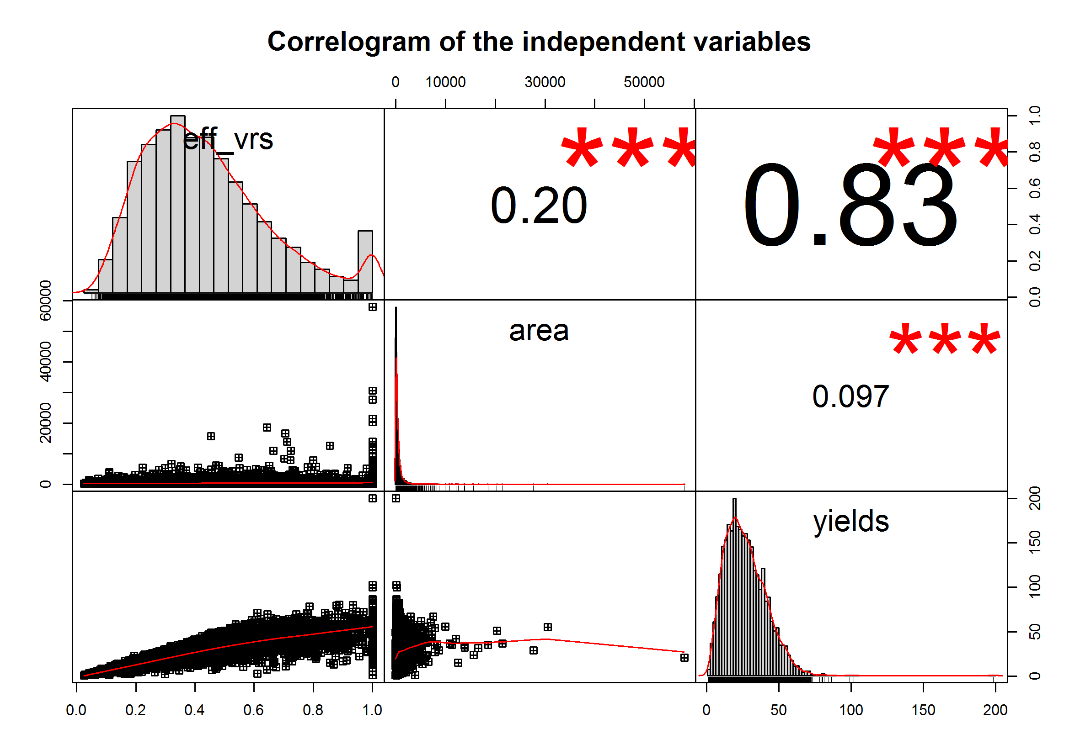
No Multicollinearity problem

Slide 14
Regression results
Call:
lm(formula = eff_vrs ~ yields * area, data = s_stage_data)
Residuals:
Min 1Q Median 3Q Max
-1.57552 -0.05994 -0.02315 0.03188 0.90886
Coefficients:
Estimate Std. Error t value Pr(>|t|)
(Intercept) 7.866e-02 3.194e-03 24.632 < 2e-16 ***
yields 1.246e-02 1.068e-04 116.630 < 2e-16 ***
area 9.376e-06 2.910e-06 3.221 0.00128 **
yields:area 3.931e-07 8.522e-08 4.613 4.05e-06 ***
---
Signif. codes: 0 ‘***’ 0.001 ‘**’ 0.01 ‘*’ 0.05 ‘.’ 0.1 ‘ ’ 1
Residual standard error: 0.1167 on 7192 degrees of freedom
Multiple R-squared: 0.7088, Adjusted R-squared: 0.7087
F-statistic: 5835 on 3 and 7192 DF, p-value: < 2.2e-16

Slide 15
Conclusions
Increasing size of the area dedicated to wheat has a low effect on production efficiency
There is a yields association with efficiency. Increase in technical efficiency of one crop production is associated with an increase of yields.
There is no optimal area size for area dedicated to one crop and of the farm.
The number of enterprises reduces exponentially with increasing arable land size.
The vast majority of agricultural enterprises demonstrated unprofitable results or results with the lowest profit

