Slide 1
Cloud Service Tunnel
Websocket/tcp socket converter/ by chia

Slide 2
Why Cloud tunnel?
Enable connectivity between Cloud apps and 3rd party on-premise services. But what are those services?
Create a no network-barrier environment for ISV/End User.
Allow Predix PaaS to govern all outbound resources. Lucrative business.
Reduce the network . Let SDN talks.
Notes:
Any call will resolve in opening a caller’s address in order to receive a response from callee.

Slide 3
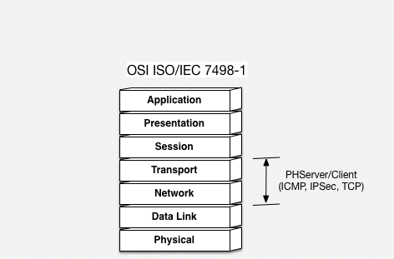
OSI Layer Model

Slide 4
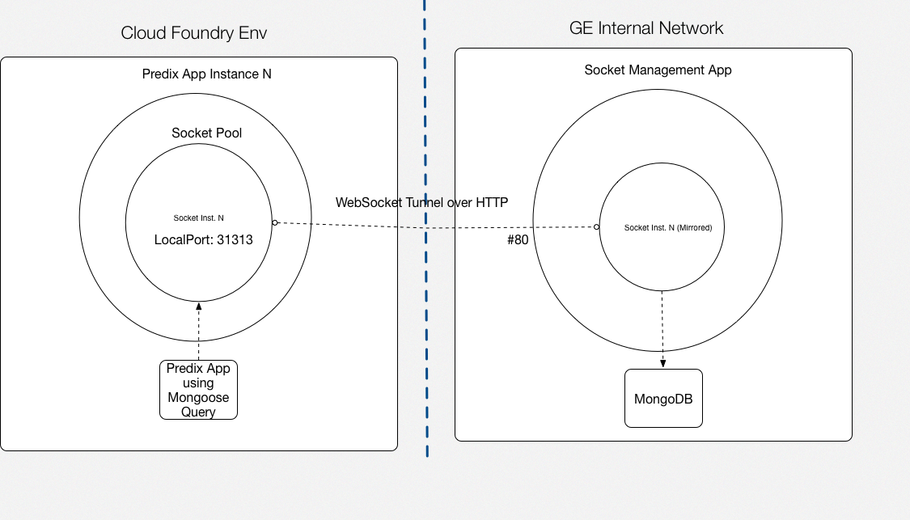
Rationale
Notes:
----- Meeting Notes (4/18/16 18:03) -----
HAProxy could open the port to public. and predix can access to the 3.x network.

Slide 5
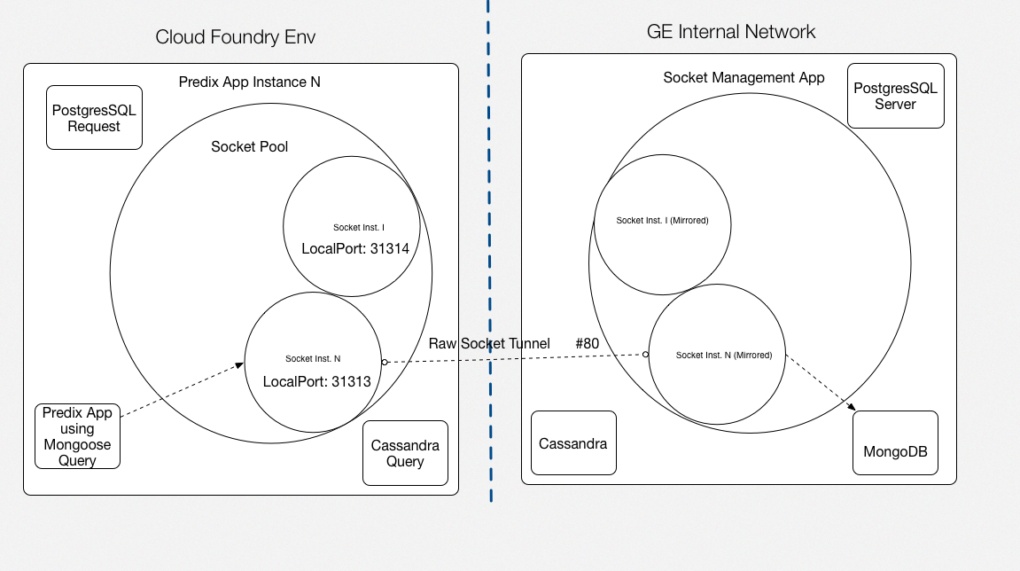

Slide 6
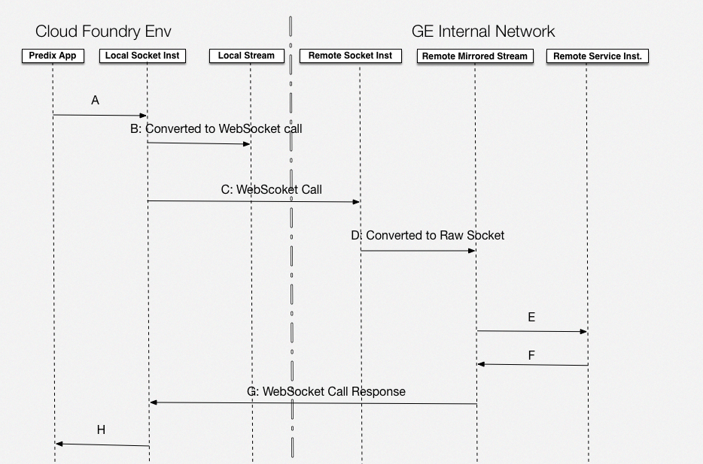

Slide 7
Demo / Poc
Created Mongo instance on both server and client end.
Establish the client tunnel.
Establish the server tunnel.
Test the Mongo instance w/ Mongo CLI from the Client.
Cloud Foundry Deployment.
Browser PoC.
Notes:
Any call will resolve in opening a caller’s address in order to receive a response from callee.

Slide 8
Project resources
Original:
https://github.build.ge.com/212359746/ph-tcp-tunnel (Contact Prasad/Chia for access)
Forked:
https://github.build.ge.com/200018017/ph-tcp-tunnel-1
Demo:
https://predix-cs-portal.run.asv-pr.ice.predix.io/listcats (List of rows)
https://predix-cs-portal.run.asv-pr.ice.predix.io/addcat/<name>/<type> (Add row)

Slide 9
Q & A
Next step.

