Slide 1
Challenge #6: Infectious Swarm!
By Yang Wu,Chuang Ding, Deepshikha Moolchandani​, Zhenyang Wu​ & Diana Bayoumi

Slide 2
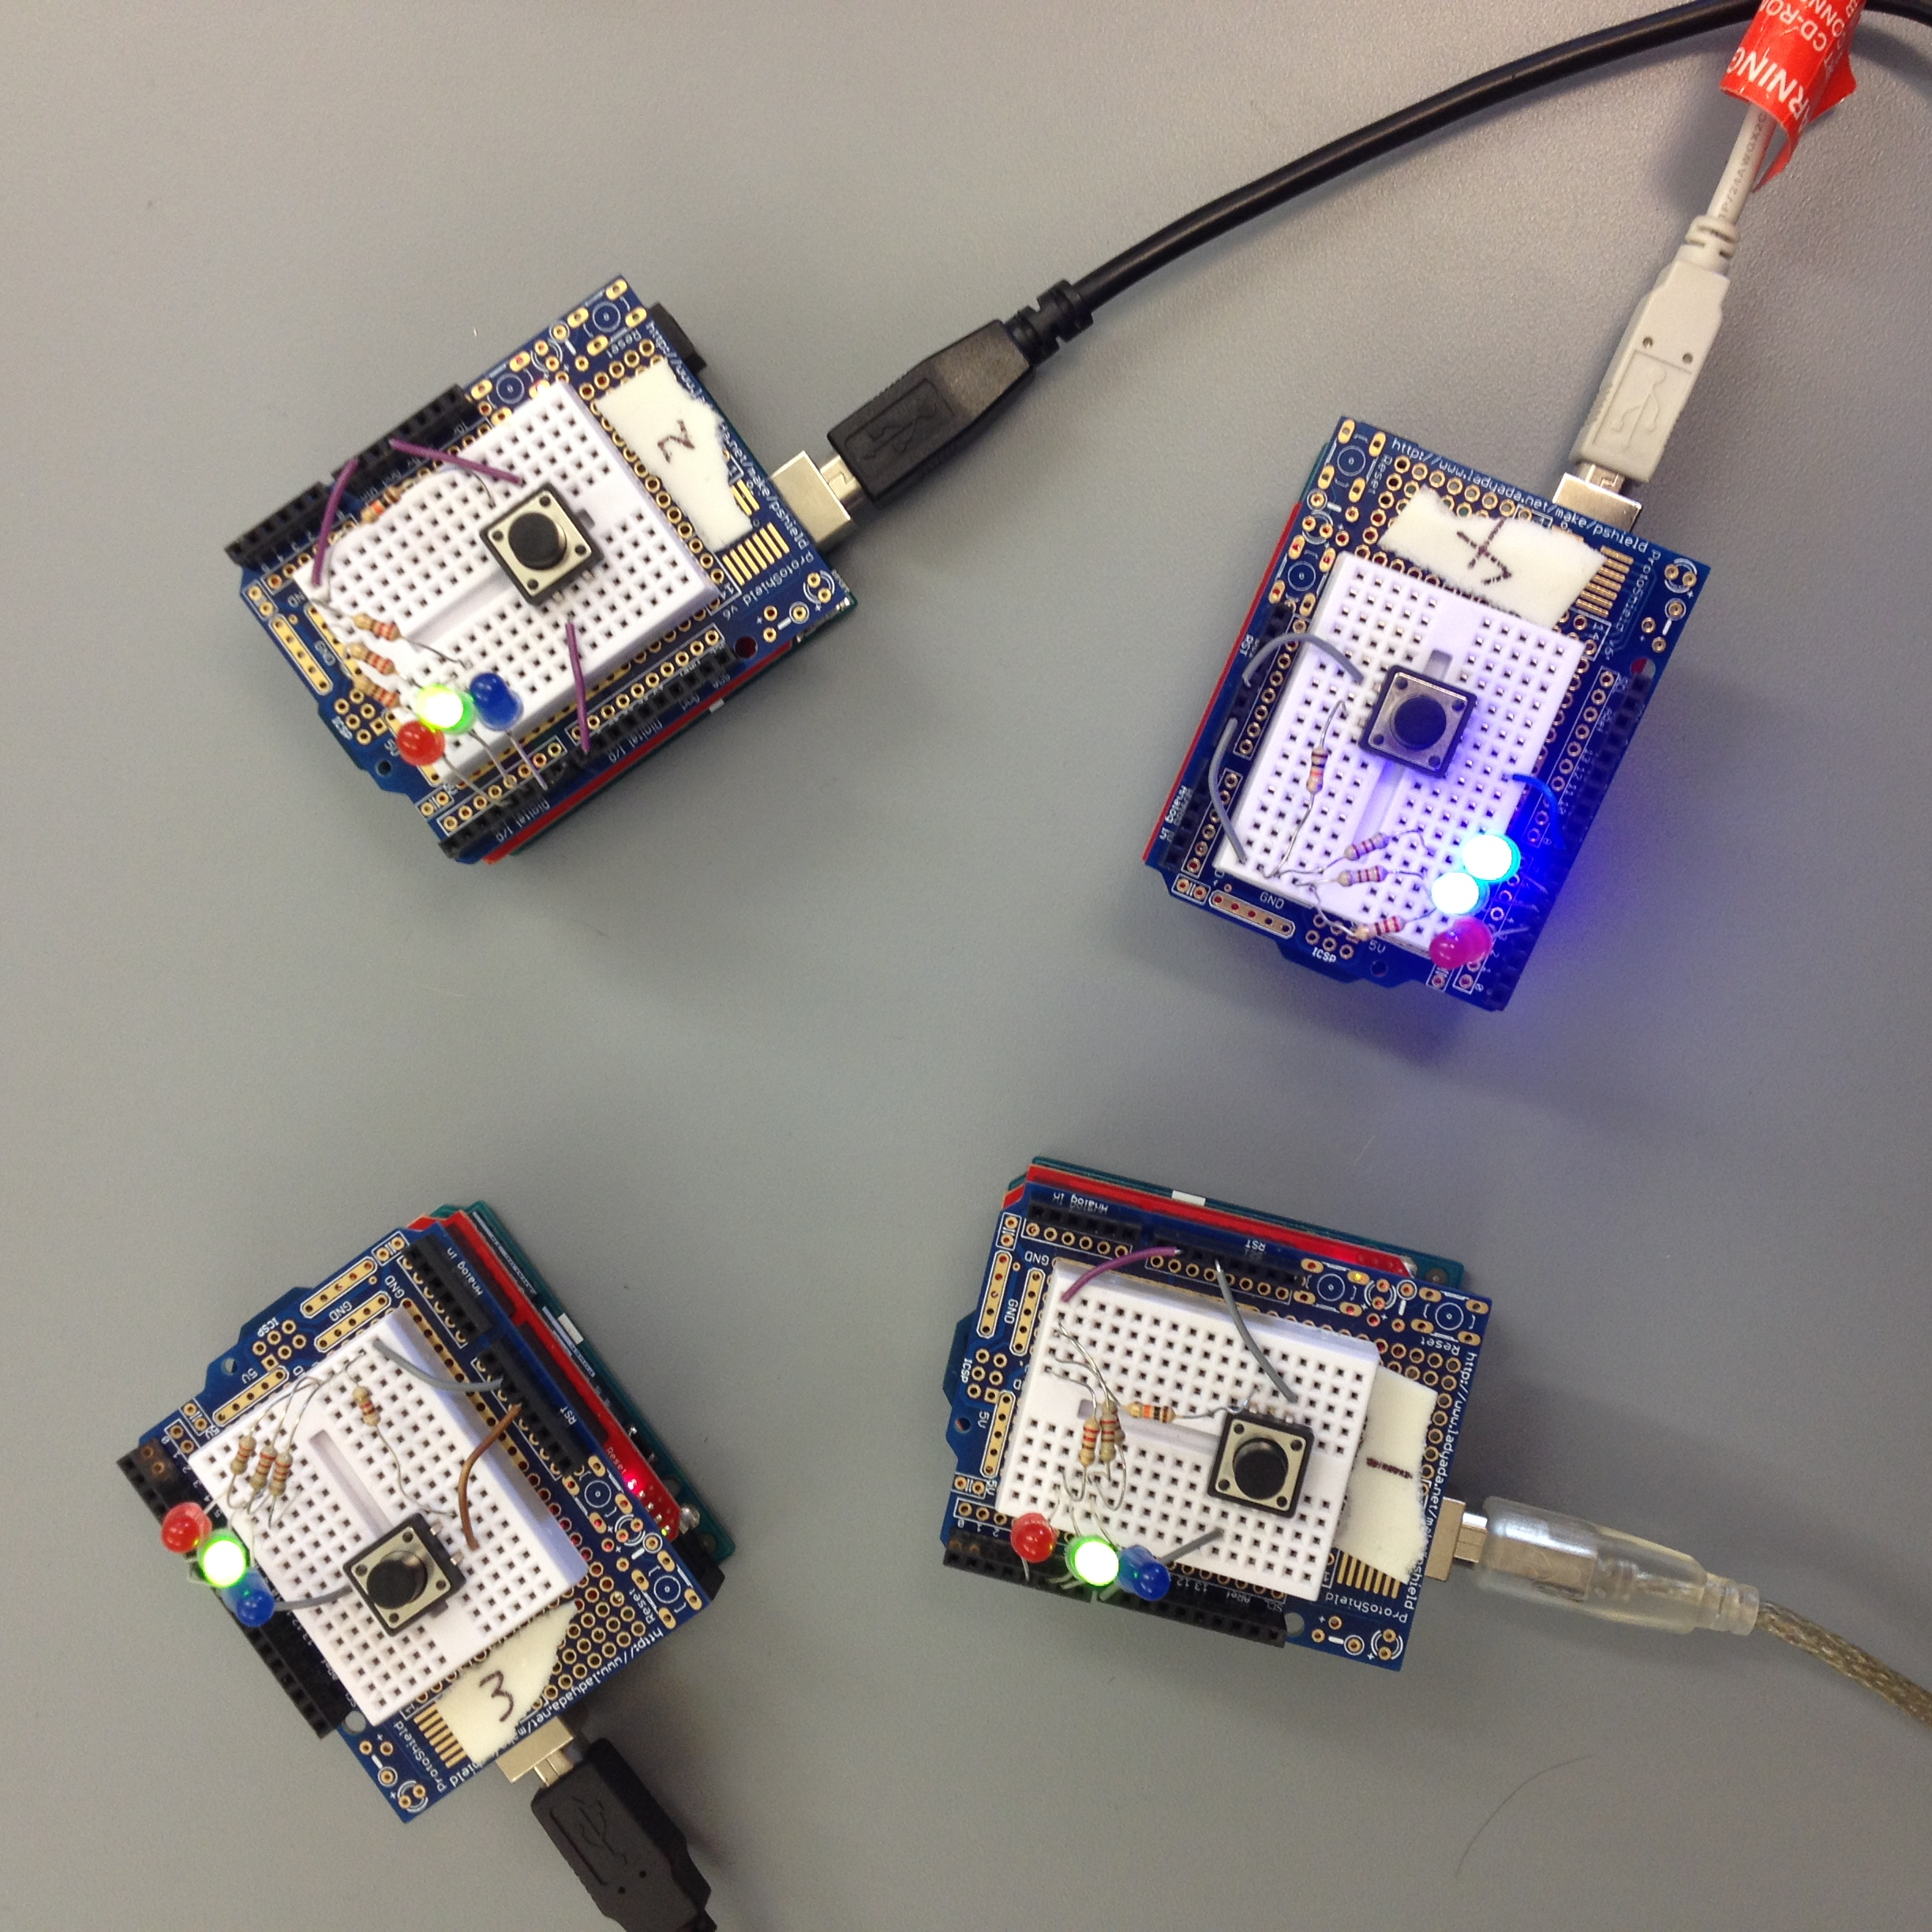
Structure
We used 4 Arduino with xbee:
The blue LED means it’s the leader.
The green one means it’s healthy.
The red LED will light up when it is infected.

Slide 3
DESIGN DECISIONS
1. Bully Algorithm
– Each process knows the ID and status of every other
process
– Communication is reliable
• A process initiates an election if it just recovered from
failure or it notices that the leader has failed.
2. AT Mode
-Simple
-Transparent

Slide 4
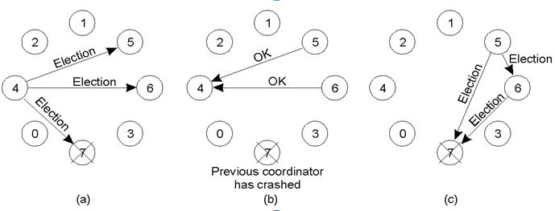
DATA FLOW
Add a new Arduino or Remove the current leader will start an election.
Each Arduino will send their ID.If the received ID is larger than its own ID, it will help send the higher ID.
All the arduino will send their status: infected or healthy.

Slide 5
Challenges
Delay Time
The election time is 3 seconds if the leader crashed or a new candidate join in.
The reaction time is 3-4 seconds after pressing the button
Try API Mode
Figure out why sometimes the xbee missed some packets

