Slide 1
Challenge #6: Infectious Swarm!
By Yang Wu,Chuang Ding, Deepshikha Moolchandani​, Zhenyang Wu​ & Diana Bayoumi

Slide 2
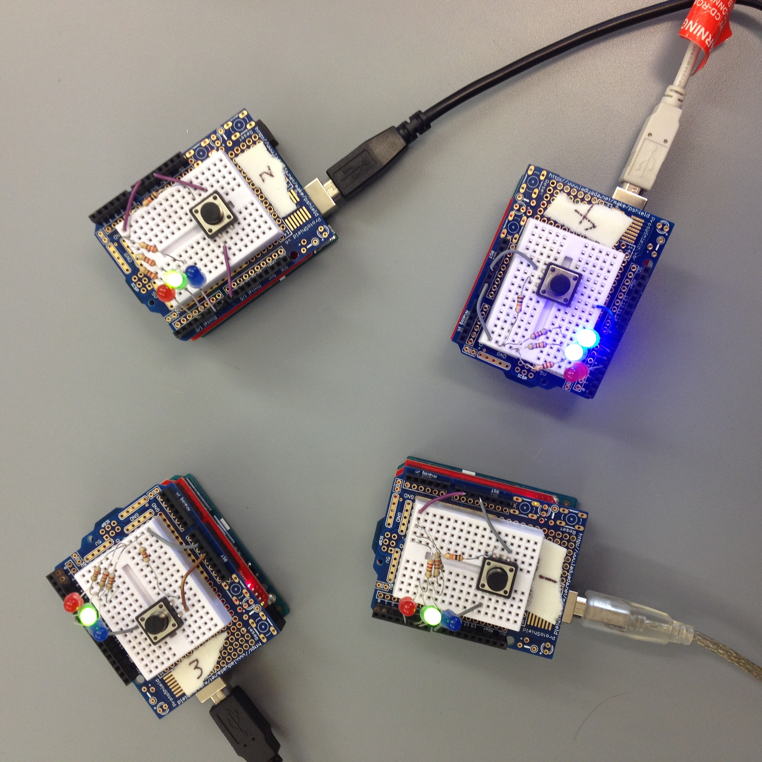
Structure

Slide 3
DESIGN DECISIONS
1. Bully Algorithm
– Each process knows the ID and status of every other
process
– Communication is reliable
• A process initiates an election if it just recovered from
failure or it notices that the leader has failed.
2. AT Mode
-Simple
-Transparent

Slide 4
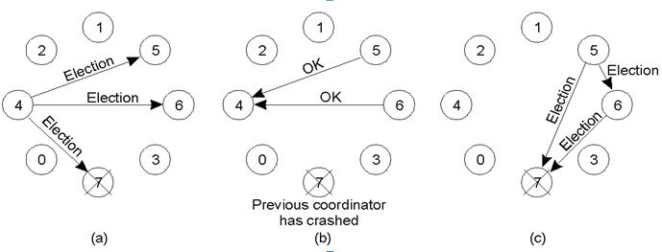
DATA FLOW

Slide 5
Challenges
Delay Time
The election time is 3 seconds if the leader crashed or a new candidate join in.
The reaction time is 3-4 seconds after pressing the button
Try API Mode
Figure out why sometimes the xbee missed some packets

