Slide 1

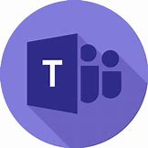






Chat Channels
Enterprise WeChat
Microsoft Teams Bot
WeChat Integration Service
Internet
Human Agent
Chat Service
Azure Cloud
AI Chatbot Service
Application Gateway
WeChat Connector
Teams Connector
Speech Recognition
Service
Azure Bot Services
Natural Language
Processing Service
Storage/data/configuration
Agent Chat Support Platform
Chatbot App
MySQL Database
CosmosDB Database
Redis Cache
Storage Container
Administration/Analysis
PowerBI Reporting & Analysis
Chatbot Admin Portal

