Slide 1
Data Analysis made easy with the ENES Climate Analytics Service (ECAS)
Sofiane Bendoukha, Donatello Elia, Fabrizio Antonio, Sandro Fiore, Tobias Weigel
April 10, 2019 @ EGU 19
SC1.22
Dissemination level: Public

Slide 2

Useful links
Training materials
https://github.com/ECAS-Lab/ecas-training
ECASLab / JupyterHUb
ECASLab @ DKRZ https://ecaslab.dkrz.de
ECASLab @ CMCC https://ecaslab.cmcc.it
Ophidia framework documentation
http://ophidia.cmcc.it/documentation/users/index.html
28.03.2019
1

Slide 3

ENES Climate Analytics Service (ECAS)
ECAS is part of the EOSC-HUB service catalogue
Server-based
Computation @ CMCC or DKRZ instances
Avoid data transfer (download)
User-friendly
ECASLab provides a JupyterHub server
Interactive computation (programming) based on Jupyter Notebooks
ECAS supports different Auth* providers
Local and external AAI providers supported (LDAP, B2ACCESS, EGI Check In)
Additional AAI providers can be integrated if needed
28.03.2019
1

Slide 4
Data available
ECAS provides data access via ESGF
Coordinated Regional Climate Downscaling Experiment
~ 100 Tbyte Cordex
Coupled Model Intercomparison Project 5
~ 1.2 Pbyte CMIP5 Data
Coupled Model Intercomparison Project 6
~ 250 Tbyte CMIP6 Data from the 1PByte published
Other Data pools can be mounted on demand
MPI Grand ensemble (MPI - GE)
28.03.2019
1

Slide 5
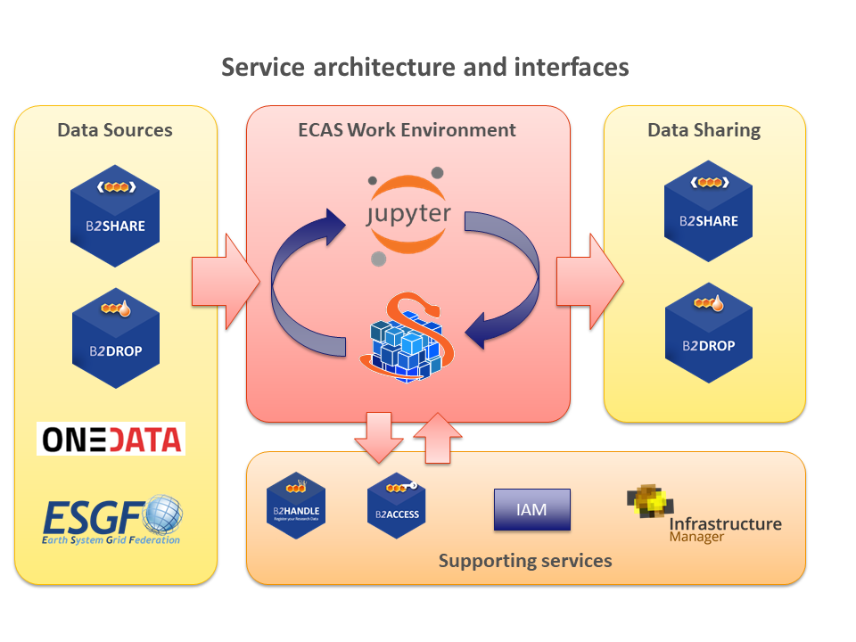
ECAS in a Nutshell
28.03.2019
1

Slide 6
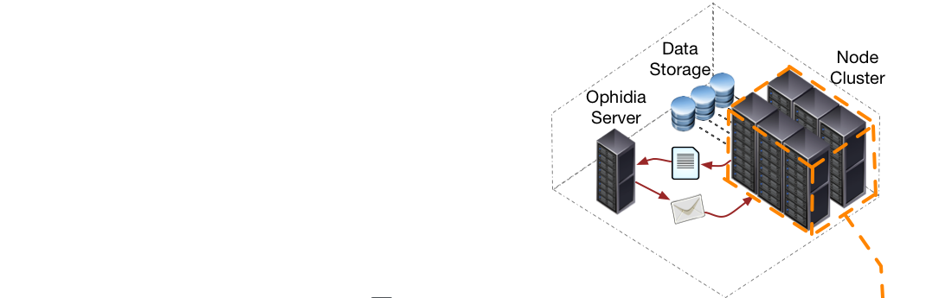
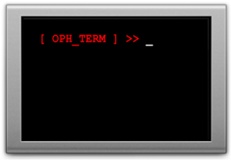
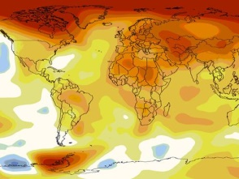
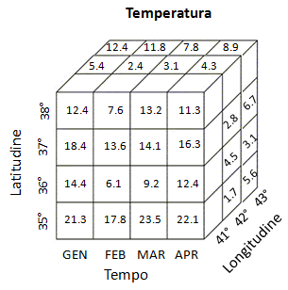

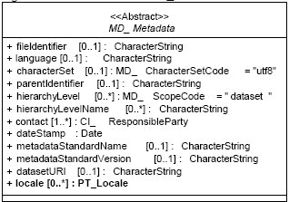
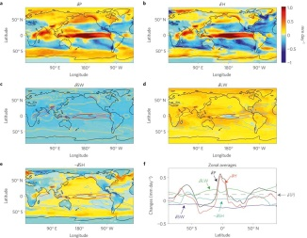


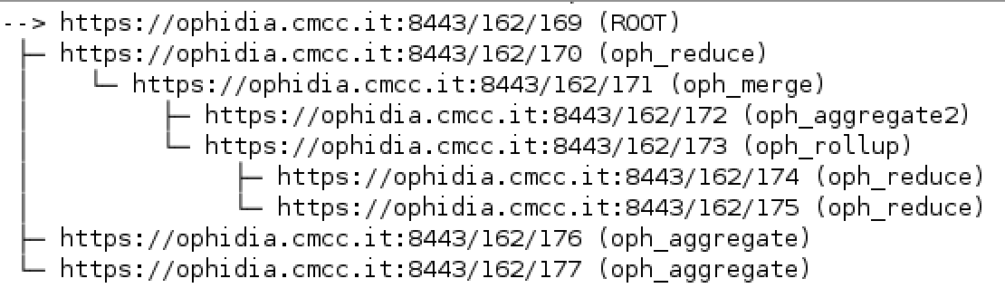
Server-side paradigm and datacube abstraction in Ophidia
Oph_Term: a terlminal-like commands interpreter serving as a client for the Ophidia framework
Ophidia framework: declarative, parallel server-side processing
Through the oph_term the user run (“send”) commands (“operators”) to the Ophidia framework to manipulate datasets (“datacubes”)
User metadata information
Metadata provenance
System metadata of the datacube (size, distribution, etc.)
28.03.2019
1

Slide 7
Array based primitives (about 100)
Ophidia provides a wide set of array-based primitives to perform data summarization, sub-setting, predicates evaluation, statistical analysis, compression, etc.
Primitives come as plugins and are applied on a single datacube chunk (fragment)
They are provided both for byte-oriented and bit-oriented arrays
Primitives can be nested to get more complex functionalities
Compression can be a primitive too
New primitives can be easily integrated as additional plugins
28.03.2019
1

Slide 8
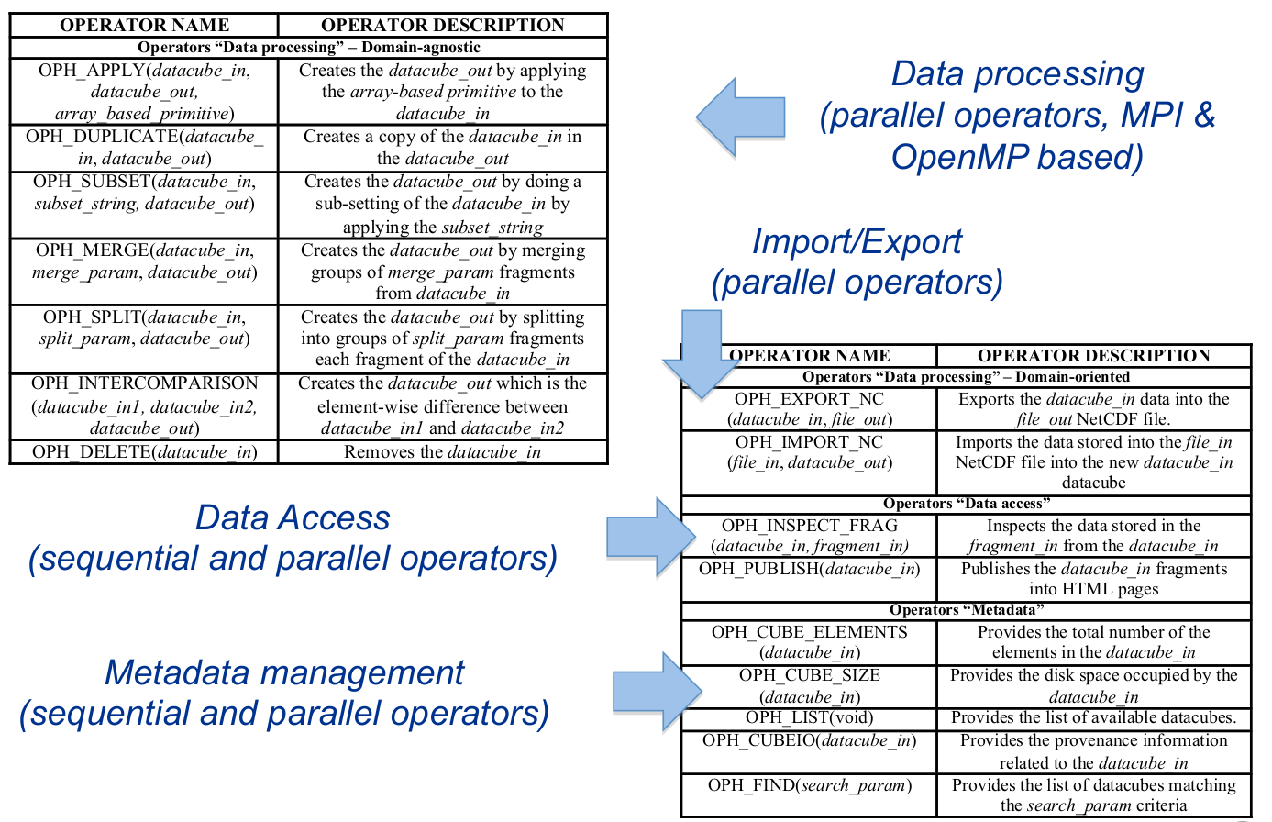
Ophidia operators
28.03.2019
1

Slide 9
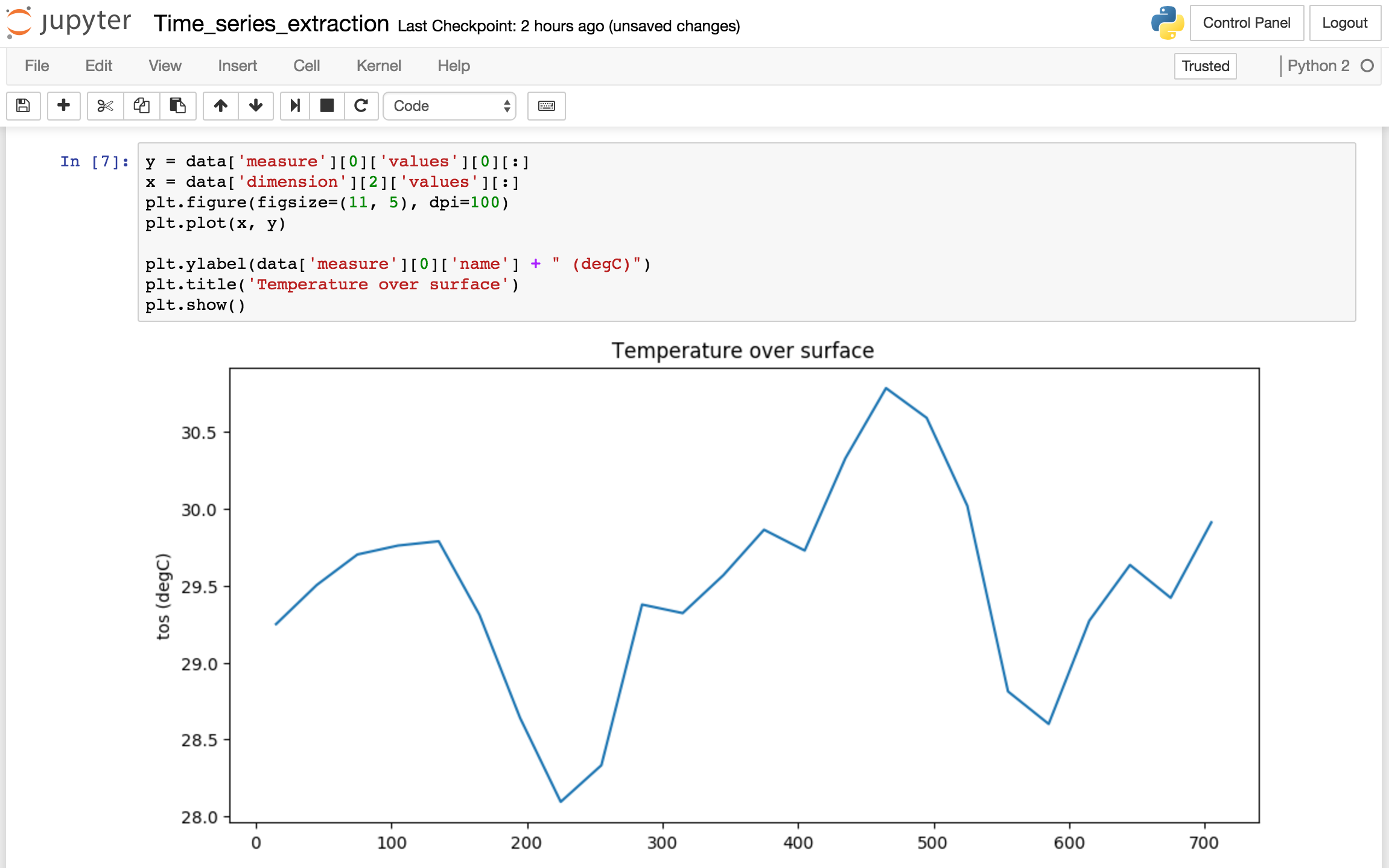
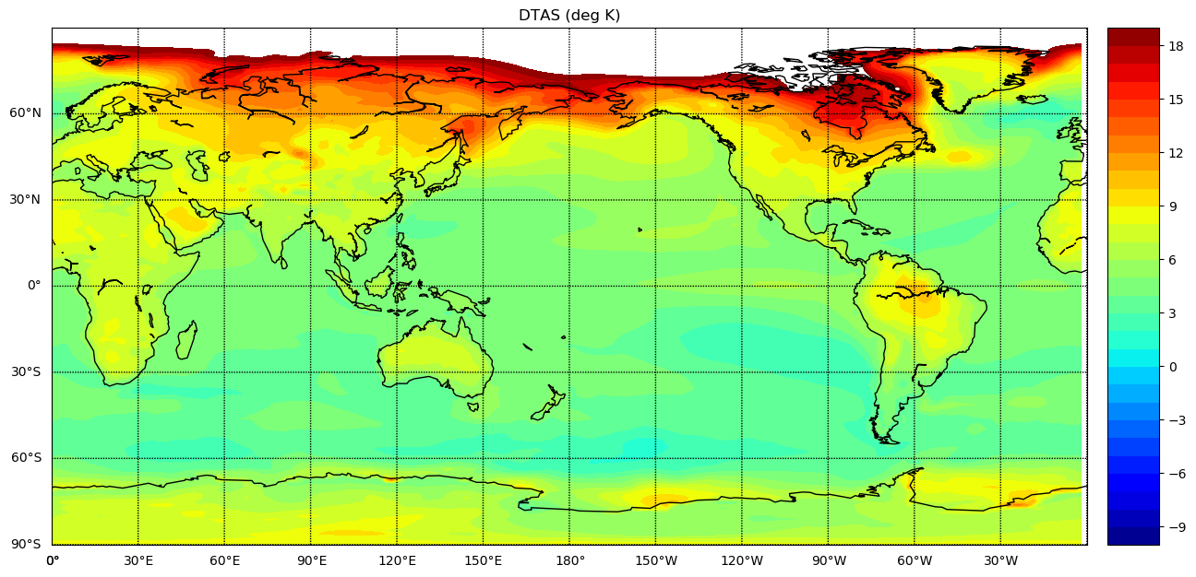
ECASLab
Provides a user-friendly scientific data analysis environment deployed at CMCC and DKRZ based on ECAS
28.03.2019
<number>

Slide 10
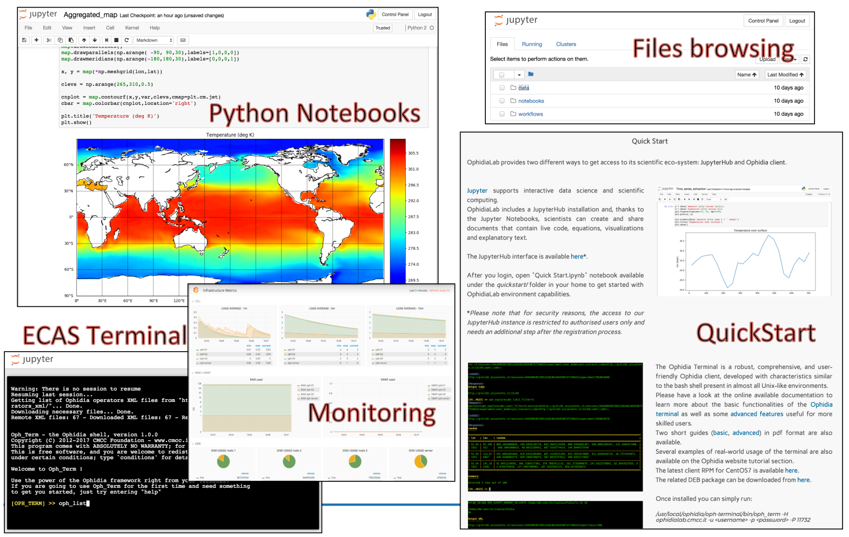
ECASLab
Source: Sandro Fiore
28.03.2019
<number>

Slide 11
Sofiane Bendoukha bendoukha@dkrz.de
Donatello Elia donatello.elia@cmcc.it
Fabrizio Antonio fabrizio.antonio@cmcc.it

Slide 12
Useful links
Training materials
https://github.com/ECAS-Lab/ecas-training
ECASLab / JupyterHUb
ECASLab @ DKRZ https://ecaslab.dkrz.de
ECASLab @ CMCC https://ecaslab.cmcc.it
Ophidia framework documentation
http://ophidia.cmcc.it/documentation/users/index.html
28.03.2019
<number>

