Slide 1
Data Analysis made easy with the ENES Climate Analytics Service (ECAS)
Sofiane Bendoukha, Donatello Elia, Fabrizio Antonio, Sandro Fiore, Tobias Weigel, Alessandro D‘Anca
April 10, 2019 @ EGU 19
SC1.22
Dissemination level: Public

Slide 2

Useful links
Training materials
https://github.com/ECAS-Lab/ecas-training
ECASLab / JupyterHub
ECASLab @ DKRZ https://ecaslab.dkrz.de
ECASLab @ CMCC https://ecaslab.cmcc.it
Ophidia framework documentation
http://ophidia.cmcc.it/documentation/users/index.html
03.01.-0001
<number>

Slide 3


ENES Climate Analytics Service
ECAS is part of the EOSC-HUB service catalogue
ECAS enables scientific end-users to perform data analysis experiments
Server-based
Computation @ CMCC or DKRZ
Avoid data transfer (download)
Improved reusability of data and workflows (FAIR approach)
ECAS supports different Auth* providers
Local and external AAI providers supported (LDAP, B2ACCESS, EGI Check In)
Additional AAI providers can be integrated (e.g. INDIGO IAM)
05.04.2019
<number>

Slide 4
Data overview
ECAS provides data access via ESGF
Coordinated Regional Climate Downscaling Experiment
~ 100 Tbyte Cordex
Coupled Model Intercomparison Project 5
~ 1.2 Pbyte CMIP5 Data
Coupled Model Intercomparison Project 6
~ 250 Tbyte CMIP6 Data from the 1PByte published
Other Data pools can be mounted on demand
MPI Grand ensemble (MPI - GE)
data collection exposed in the Federated Data Archive (e.g. through OneData)
05.04.2019
<number>

Slide 5
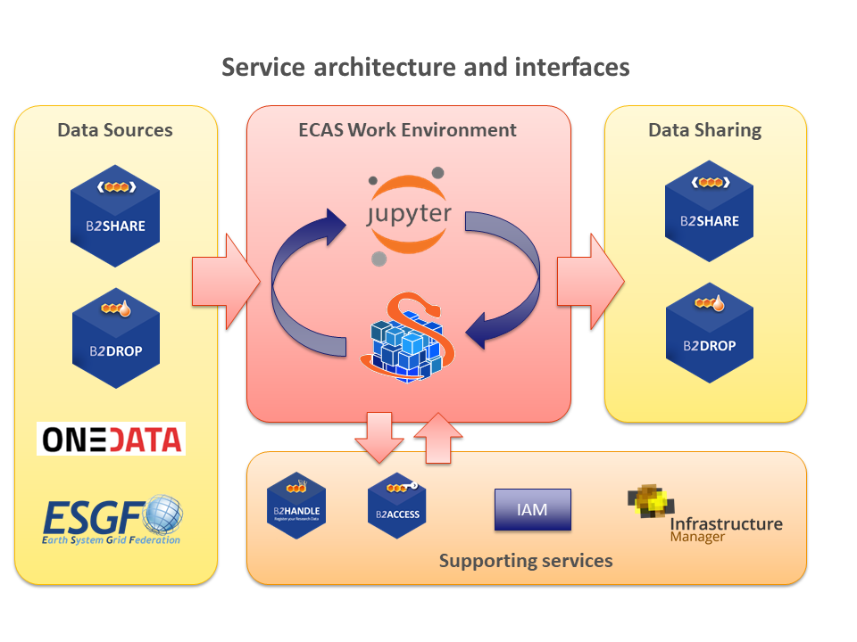
ECAS in a Nutshell
05.04.2019
<number>

Slide 6
Ophidia framework overview
The Ophidia framework addresses big data challenges for eScience
support for declarative, parallel, server-side data analysis exploiting parallel computing techniques
end-to-end mechanisms to support complex experiments and large processing workflows on scientific multi-dimensional datacubes
Ophidia supports both batch & interactive data analytics
More than 50 datacube-oriented operators are available, including: data reduction and subsetting, data intercomparison, metadata and provenance management, time series analysis with array-based primitives
A wide set of (low-level) array-based primitives (over 100) to perform, e.g. data summarization, algebraic expressions, predicates evaluation, statistical analysis
Support for complex workflows and Python applications execution
05.04.2019
<number>

Slide 7
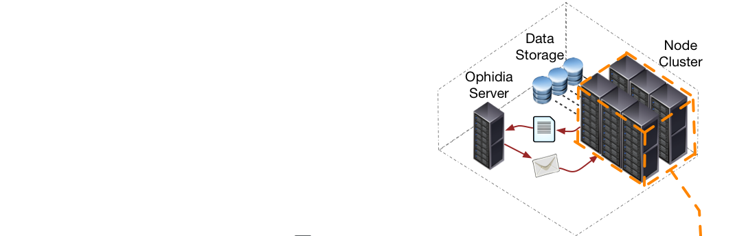
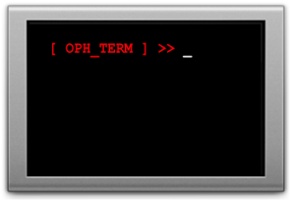
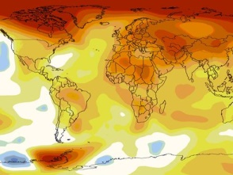
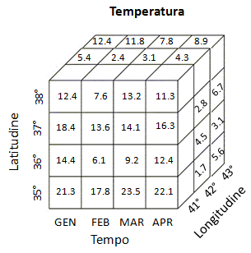

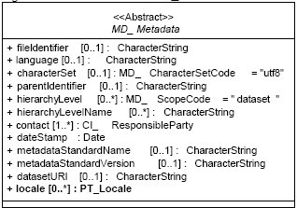
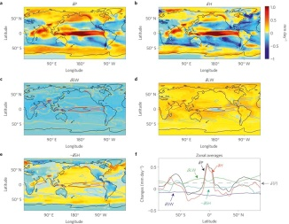


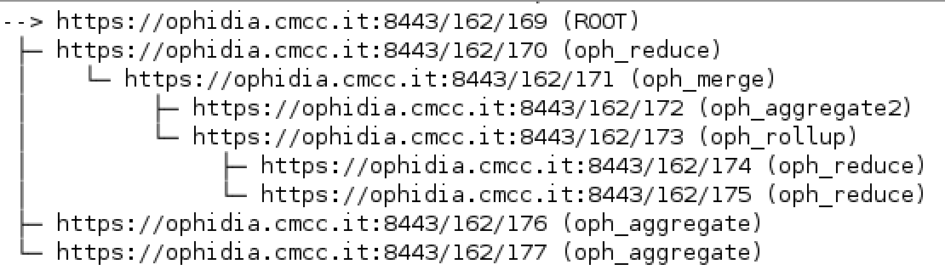
Server-side paradigm and datacube abstraction in Ophidia
Oph_Term: a terminal-like commands interpreter serving as a client for the Ophidia framework
PyOphidia: a Python interface for datacube management & analytics with Ophidia
Ophidia framework: declarative, parallel server-side processing
Through oph_term/PyOphidia the user run (“send”) commands (“operators”) to the Ophidia framework to manipulate datasets (“datacubes”)
User metadata information
Metadata provenance
System metadata of the datacube (size, distribution, etc.)
05.04.2019
<number>

Slide 8
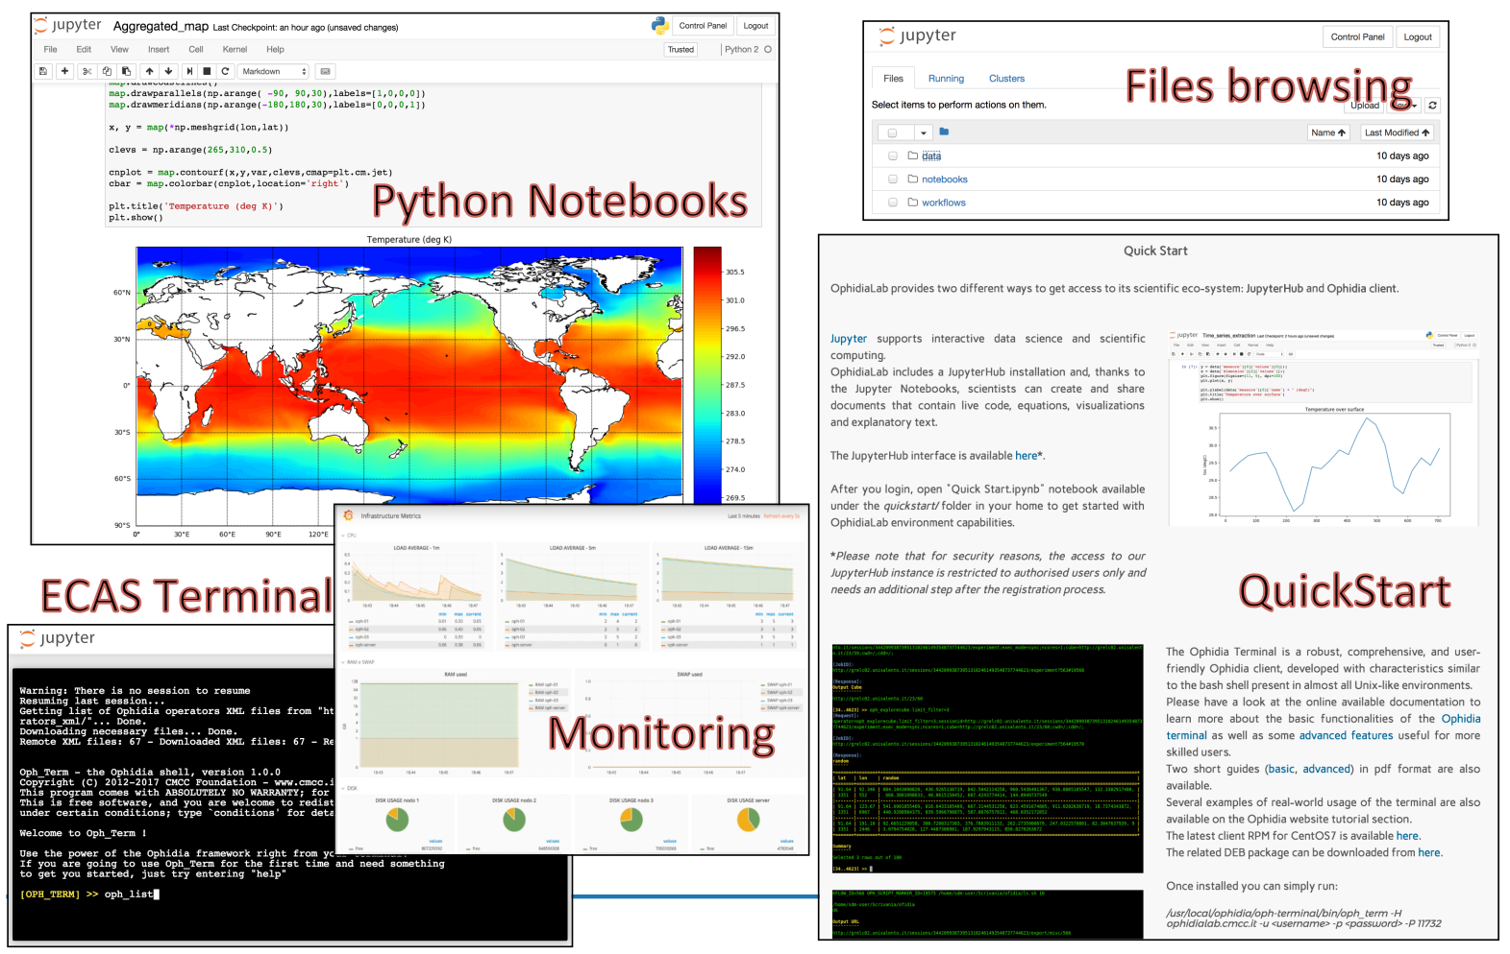
ECASLab
Source: Sandro Fiore
05.04.2019
<number>

Slide 9
Sofiane Bendoukha bendoukha@dkrz.de
Donatello Elia donatello.elia@cmcc.it
Fabrizio Antonio fabrizio.antonio@cmcc.it

Slide 10
Useful links
Training materials
https://github.com/ECAS-Lab/ecas-training
ECASLab / JupyterHUb
ECASLab @ DKRZ https://ecaslab.dkrz.de
ECASLab @ CMCC https://ecaslab.cmcc.it
Ophidia framework documentation
http://ophidia.cmcc.it/documentation/users/index.html
05.04.2019
<number>

Slide 11
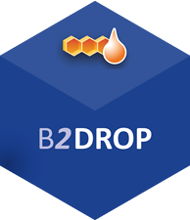


Data sharing with ECAS
Share your results with your team or with researchers from a broader community
Post-processing Datasets
Notebooks
Cloud-based storage services integrated within ECAS
B2DROP online storage for external colloborators as well as for collaborators who uses B2DROP too. Keep data synchronized and up-to-date.
B2SHARE store and publish research data from diverse contexts. Data assigned a Persistent Identifier for better findability.
DataHub (OneData) a global data access solution for eScience.
05.04.2019
<number>

Slide 12
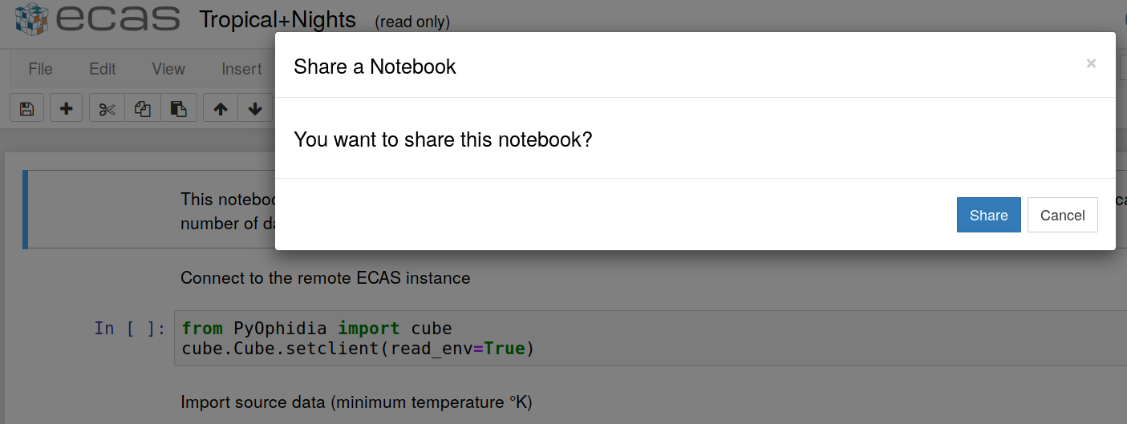
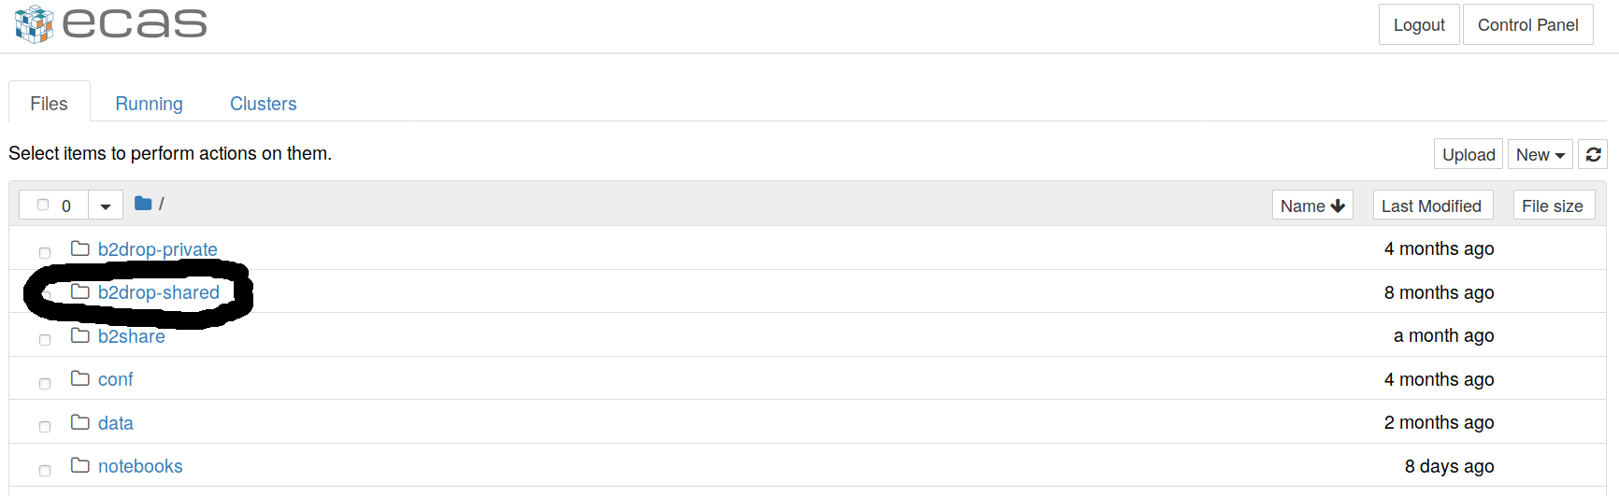
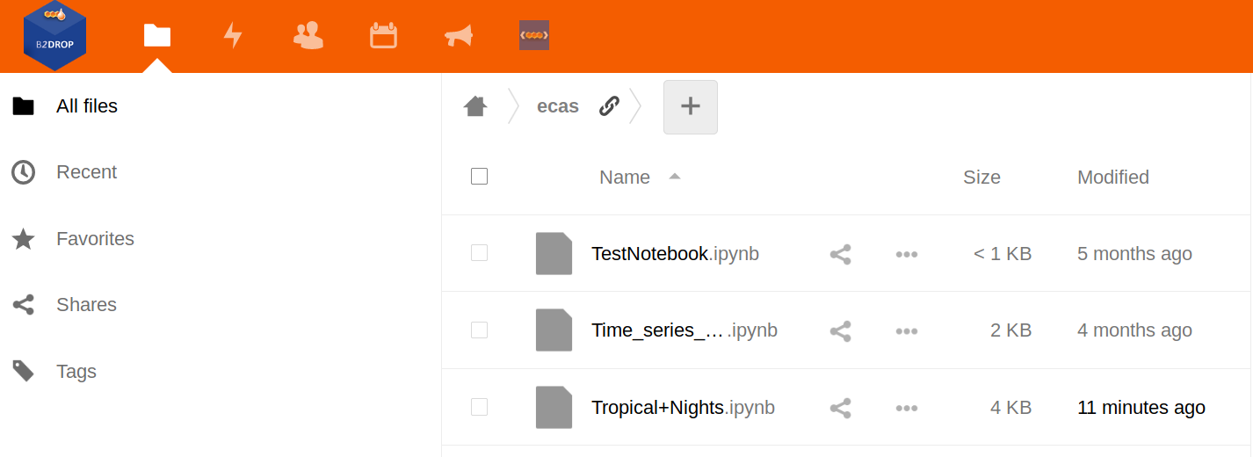
B2DROP shared
https://b2drop.eudat.eu/s/gDyJjMeJ2Xiapwi
Jupyter extension
B2DROP Web site
05.04.2019
<number>

Slide 13
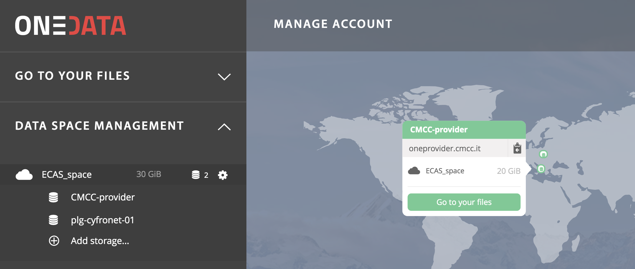
OneData &ECAS
Check the notebook here for more details
05.04.2019
<number>

