Slide 1
Model Statistical Verification
Stephane Chamberland and Ron McTaggart-Cowan
Version 1.0
RPN-A Benchmark Group
15 October 2012

Slide 2

Contents
Need for evaluation of the results
  Vendor-side evaluation
  Previous strategies
Development of the Statistical Verification Package (SVP)
  Statistical approach
  SVP outputs
  SVP documentation
Generation of “expected” results for benchmark
  Results from 15 km YEC samples
  Limitations of full benchmark runs

Slide 3
Evaluation Requirements
We need to ensure that forecasts will not be degraded by GEM integrations on the proposed architecture
We cannot ask for forecast/analysis cycles to be run by the vendors for Arcad-type scoring
We need to be able to say that the results from the vendor are “close enough” to those that we expect:
  The platform is capable of reproducing the current results
  The vendor has not used optimizations / code changes that invalidate the results of the integrations
We need to be able to do this on both large and small domains to allow vendors to test their optimizations
The ability to test bitwise-different runs for “closeness” would also be very useful for model development in general

Slide 4
Current Analysis
In the last benchmark, a heuristic was used to assess validity:
      assert ( S1 <= max(2, 0.04*step) )
The S1 score (Teweles and Wobus 1954) is sensitive errors in regions with weak predicted and observed gradients (Thompson and Carter 1972) and is no longer widely used
ECMWF appears to be using an RMS-based validity assessment after 12 h of integration:
      assert ( RMS < 0.1*RMS_{o} )
It is unclear whether these assessments assertions are sufficient to guarantee that the results will be “close” to expected values

Slide 5
Statistical Approach
Instead of relying on heuristics, it is possible to create a range of acceptable (“close”) values and to determine how well a new result fits into this “cloud” of acceptable points:
  A metric (or set of metrics) need to be determined that reduce the dimensionality of the problem to a reasonable level (in this case, 1 dimension is used)
  The range of acceptable metrics (called “test statistics”) needs to be established based on a set of integrations that are deemed “close enough” to be considered equally acceptable
  The set of integrations needs to be large enough to cover the acceptable portion of test statistic space
The goal of this technique is to determine whether a model integration is drawn from the acceptable test statistic population to within a certain degree of confidence (generally 95% or 99%)

Slide 6
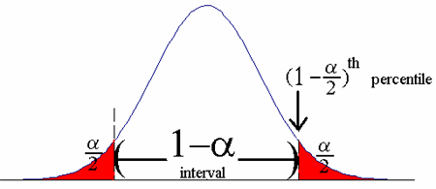
Statistical Approach
Frequency
Example of a normally-distributed test statistic, with the PDE generated by multiple integrations to cover the acceptable test statistic space. The blue value (an example testing integration) falls with in the α confidence interval while the orange value is outside of it, and would therefore be identified as a failure. (Background image from onlinecourses.science.psu.edu.)
Test Statistic Value
The only subjective parts of this verification are:
  The selection of the test statistics
  The selection of the preturbations used to generate the range of acceptable values
  The selection of confidence intervals of the pass/fail assertions (usually 95% or 99%)

Slide 7
Test Statistics
The test statistics are chosen based on the recommendations of Wigley and Santer (1990):
  T1: A “grand means” test to check that the new integration has not introduced a bias
  NT1/NT5: A pair of highly sensitive pointwise difference significance tests run at the 99% and 95% levels, respectively
  R: A spatial correlation test that ensures that features are well-represented in the new integration
Each of these test statistics can be computed for any field or lead time, with the mean position and spread of the resulting PDE dependent on the state variables selected for the calculations

Slide 8
Statistical Verification Package (SVP)
A utility has been developed to help with the generation of the statistical analysis and evaluation of new integrations
The SVP has two primary components:
  sverif_prep: uses a bootstrapping technique to compute the PDEs of the test statistics from a set of grids
  sverif_eval: compares the results of a single integration with the range of acceptable values (PDE computed in the “prep” step)
Vendors will be given a low-level component of sverif_eval and the results of the “prep” step that we have run on the data generated during benchmark development
With this information, they will be able to tell if their integrations fall within our range of acceptable values

Slide 9
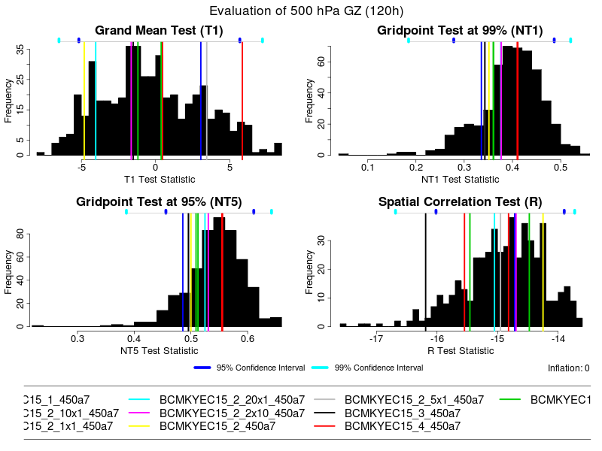
SVP Results
Results from the SVP for a set of 10 tests (see legend) based on 500 mb day-5 heights. The background histograms define the PDEs of the test statistics, while the coloured vertical lines are the test integrations. In this case, the shown integrations were used to develop the range of acceptable values, so the Type 1 error rate (2/40) is correct for the 95% significance level.
The SVP outputs a set of test statistic plots, with the values of the statistics for new integrations superposed
User-specified confidence intervals are plotted for reference
For vendors, access to the lower levels of the SVP provides test statistic and pass/fail test results only

Slide 10
SVP Documentation
A more thorough description of the statistical techniques and use of the SVP is available at:
  https://wiki.cmc.ec.gc.ca/wiki/Sverif
Both a user's guide and technical documentation for the package are available
The documentation is intended to serve for the use of the SVP outside the benchmarking project (i.e. during regular model development)

Slide 11
Generation of “Acceptable” Range
A set of equally-acceptable solutions are required to define the range of acceptable test statistics
The more thoroughly the acceptable range of values is sampled, the more accurate the test will be (i.e. the confidence intervals will be correctly defined)
For small sample sizes, the resampling bootstrap technique is know to underestimate variability
A parameteric bootstrap option (“inflation”) has been added to counteract this collapse in variability, but it loses sensitivity as it increases the “acceptable” range of values
There are two important questions:
  How should the acceptable solutions be generated?
  How many members should there be in the set of acceptable solutions?

Slide 12
Generation of “Acceptable” Range
There are currently five members planned for the GY and LU benchmarks:
  Unmodified (vanilla) build
  Unmodified build + an initial bitflip
  New build without multiply/add fusion
  New build without multiply/add fusion and without accelerated math libraries
  New build using the cmake build system
Tests in 15 km and 25 km GY integrations suggest that these modifications create an acceptable level of spread
The expense of these integrations means that we cannot expect to have very many runs available to fill in the acceptable test statistic space

Slide 13
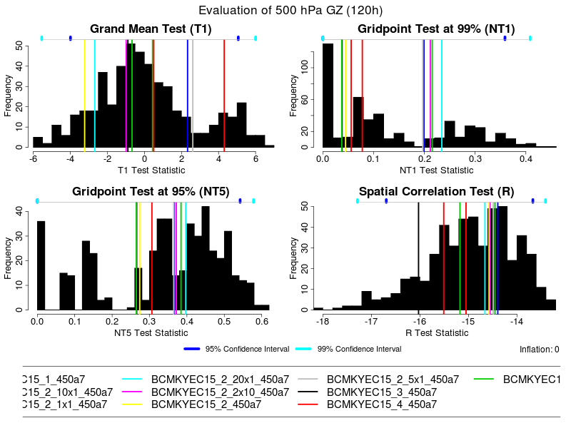
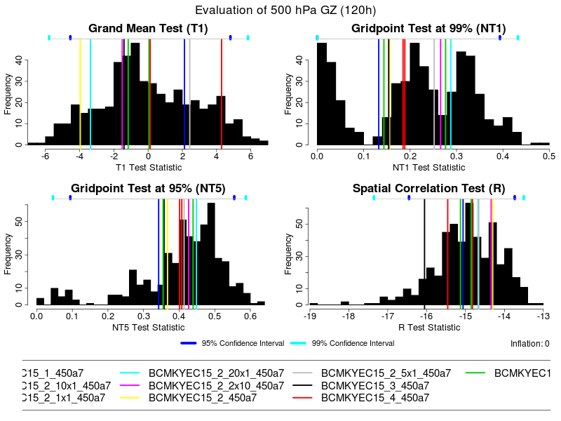
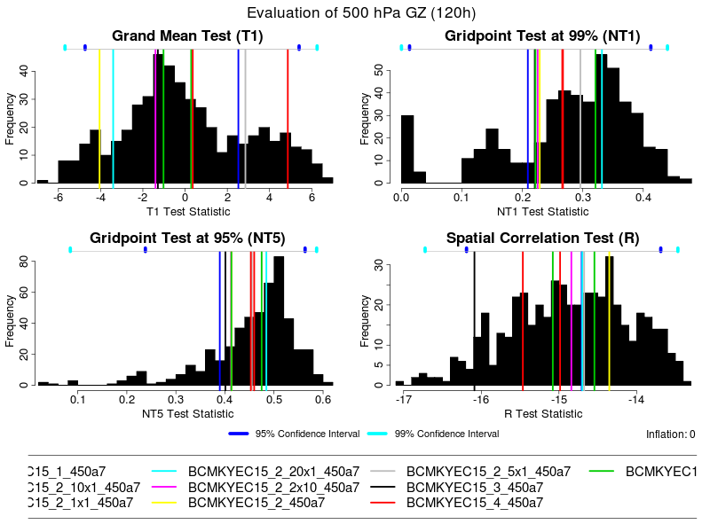
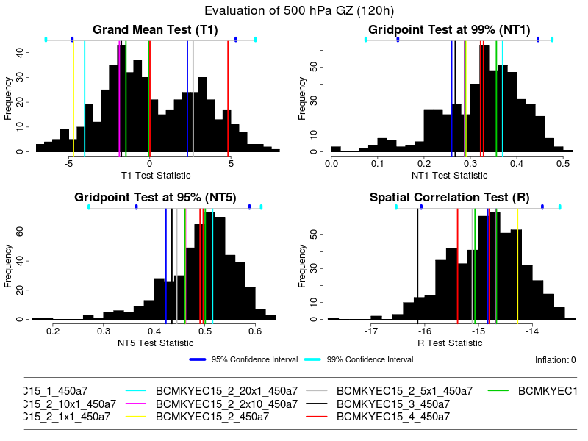
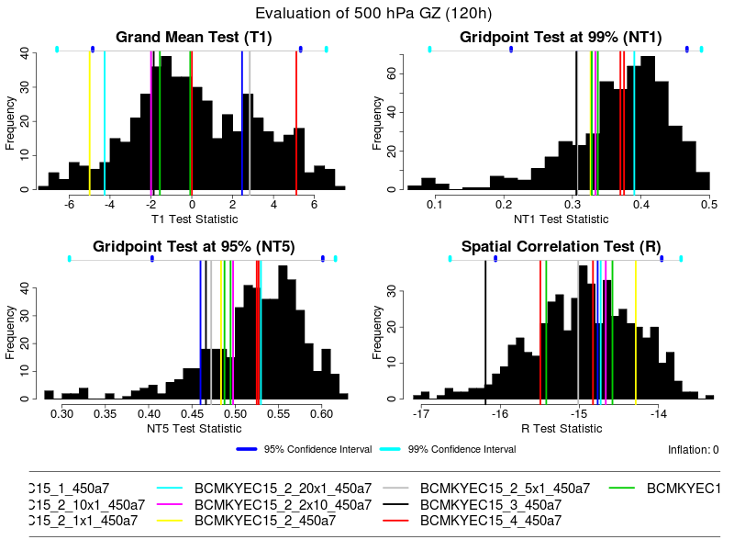
How many member is enough?
5
6
7
8
9
10
Results for ten 15 km GY integrations, with the basic runs successively augmented by additional bit-flip initializations.
The NT1/NT5 statistics seem most sensitive to small sample sizes, and require 8-10 members to get a stable PDE

Slide 14
How many members is enough?
Although the PDEs of sensitive statistics are unrealistic for small sample sizes, the important elements of the confidence intervals are relatively insensitive
If eight members are required, and ten are desirable, 3-5 additional runs are needed
Since timing is not important for these runs (only the forecast grids will be used), they can be run on reduced topologies to eliminate the need for additional dedicated time slots
All smaller debugging configurations should employ at least 10 member samples

Slide 15
Next steps for verification
The pass/fail conditions need to be decided upon:
  e.g. must pass at least 2/4 tests
The 3-5 additional benchmark runs are needed for the precomputed statistics (GY and LU)
Sets of integrations are required for the debugging configurations sent to vendors
Procedure must be tested on runs performed on a different platform and/or with different compilers
Statistics need to be generated and included with the package sent to vendors
Verification tool needs to be included in the package

Slide 16
References
Teweles Jr., S., and H. B. Wobus, 1954: Verification of prognostic charts. Bull. Amer. Meteor. Soc., 35, 455-463.
Thompson, J. C. and G. M. Carter, 1972: On some characteristics of the S₁ score. J. Appl. Met., 11, 1384-1385.
Wigley, T. M. L. and B. D. Santer, 1990: Statistical comparison of spatial fields in model validation, perturbation and predictability experiments. J. Geophy. Res., 95, 851-865.

