Slide 1






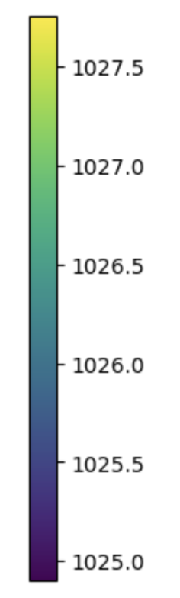


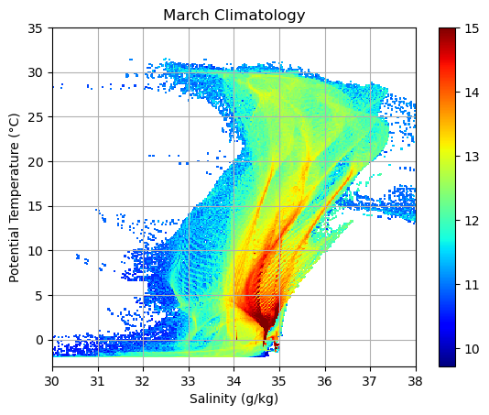
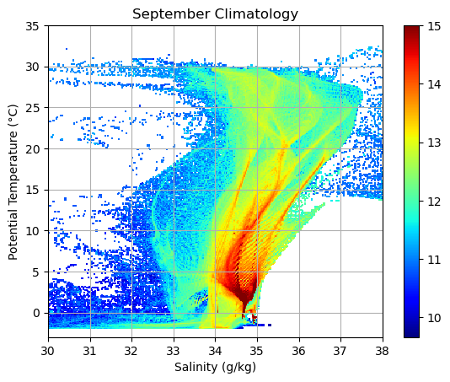
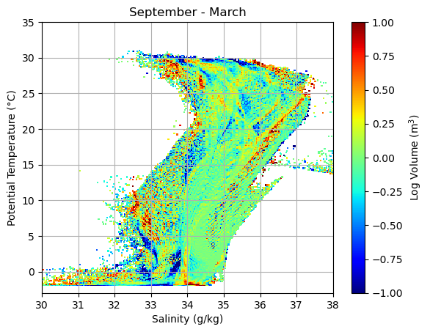
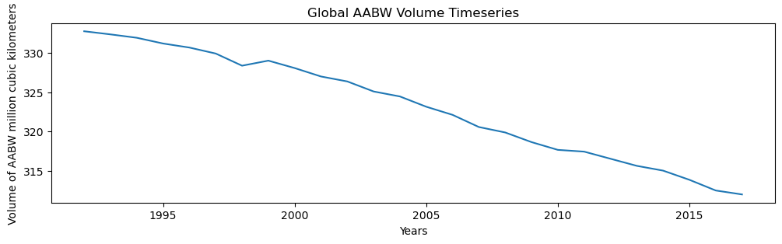
ECCO Representation of Water Masses
Isba Keshwani, Sarah Zhang
WMW: water-mass women, women of mode waters, women of water mass, etc…
Overview
Understanding how ECCO represents water masses, specifically Antarctic Bottom Water (AABW), and whether recent Antarctic extremes are captured in ECCO.
Products, Resources Used
• ECCO V4r4: density, temperature, salinity, grid products
• ecco_v4_py (and Ian), ecco_access
• ECCO hack week tutorials, OSS
Antarctic Surface Density: 1992 (Feb. - Oct.)
AABW
AABW ranges from θ = -0.8 ℃ to 2 ℃ and salinity of 34.6 to 34.7 g/kg. We calculated the volume of ocean water within this range from our volumetric TS plot. Then, repeated the calculation from 1992 to 2017.
Global volumetric temperature & salinity: 1992-2017 averages in March, September, and March subtracted from September, respectively. Volumes (m³) are represented in log scale.
Future Work
• Plot the ECCO temperature, salinity along an ocean transect (ex. recreate WOCE A16)
• Validate AABW volume derivations with observations/other model outputs
• Explore High Salinity Shelf Water production using ECCO
Challenges Faced
• Calculating/understanding volume of ocean using MITgcm grid
• Identifying where AABW waters were
• Calculating AABW volume by constraining temp and salinity

