Slide 1

A new mark, a new voice,
a new website.
The Transformation Edge · for board approval
Presented by Dr Michaels Aibangbee and Pastor Osas Aibangbee
Notes:
We are asking the board to approve three things tonight: the new symbol, the typography, and the new website before it replaces the Wix site. Everything you will see has been built and measured, not mocked up.

Slide 2

WHAT WE ARE ASKING FOR
Three approvals
1
The symbol
A2 Architectural Threshold, and the masterbrand it belongs to.
2
The typography
Fraunces for headings, Inter for everything else. Both open licence.
3
The website
Approval to move off Wix and go live on the new site.
Notes:
Three separate decisions. The board can approve all three, or approve the brand and hold the website until the outstanding items on slide 12 are closed.

Slide 3

WHY CHANGE
What was wrong with the old mark
The circle was decoration. It added no meaning and shrank everything inside it.
The monogram read EGDE left to right. English readers read left to right first.
Five elements competed, and none could stand alone as an icon.
The palette was cool and flat, reading corporate rather than warm.
The old mark
There was no reversed, single-colour, dark-mode or app-icon version.
Notes:
These are not matters of taste. The EGDE reading is a defect in a mark that has to carry a family of organisations, and the missing variants meant every new use needed a workaround.

Slide 4
THE SYMBOL
A2 Architectural Threshold
Two planes standing apart, with the way through between them.
No letterform, so it cannot be misread.
No containing circle, so it never shrinks inside its own frame.
One colour, always. Deep Slate on light, porcelain reversed on dark.
The gap is the threshold. It is never closed up to look tidier.
Notes:
The name comes from the supplied masterbrand suite. The idea is a threshold: the way through is already open. That is the vision and the tagline in one form, without stating either.

Slide 5
IT WORKS EVERYWHERE
Legible at every size
16px
24px
32px
48px
96px
144px
The old lockup was illegible below about 90px. This holds at 16px, which is the size of a browser tab.
Notes:
The build refuses to render the mark below 16px, so it cannot be set too small by accident.

Slide 6
COLOUR
Warmth the old palette did not have
Deep Slate
Heritage Slate
Ember
#303847
#4B576E
#E46F3C
The identity
Carried forward
Accent, never text
Ember Accessible
Porcelain
Ink
#A94722
#F6F5F2
#171D24
Accent when it is text
The page ground
Body text
Notes:
Ember is the one people will want to overuse. It fails contrast as text, so there is a second, darker cut for words. The rule is that ember stays under five per cent of any composition.

Slide 7
TYPOGRAPHY
A serif that sounds like a congregation
A vision to impact nations.
Fraunces · headings only
The welcome desk is just inside the main entrance. Tell them it is your first Sunday and someone will walk you in.
Minimum sizes
Navigation 14px
Body 16px
12px labels only, never for safeguarding, privacy or giving
Inter · body, navigation, buttons, labels, legal
Both typefaces are open licence. No fee, no renewal, no per-domain licence to track.
Notes:
The 12px rule came out of the typography review and it changed real pages: the crisis support numbers, the privacy notices and the giving page were all set too small and have been raised.

Slide 8
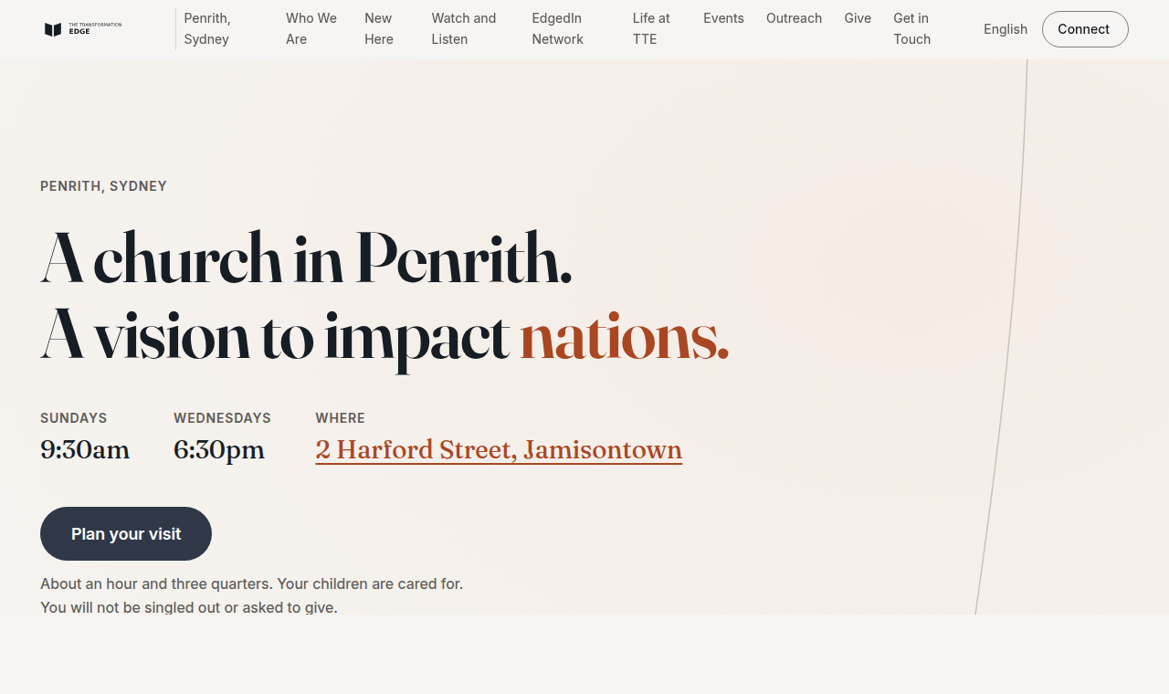
THE WEBSITE
One page, one job
Who, where, when and one action, above the fold.
No carousel, no autoplay, no pop-up.
A first-time visitor can answer "should I come" in under a minute.
Notes:
This is the built site, not a mock-up. Every screenshot in this deck is a real page rendered from the real code.

Slide 9
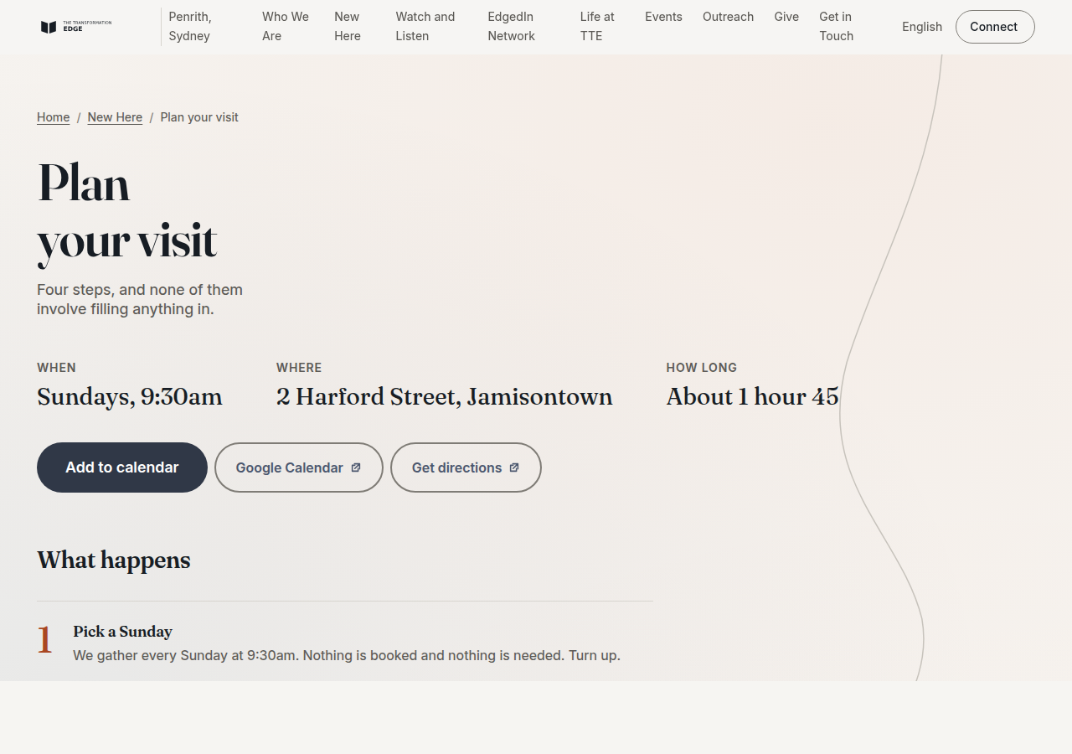
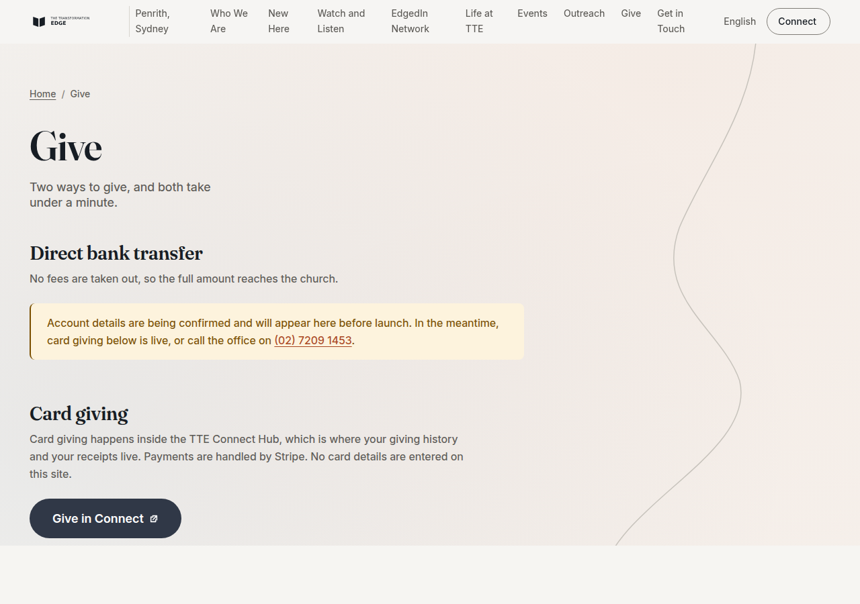
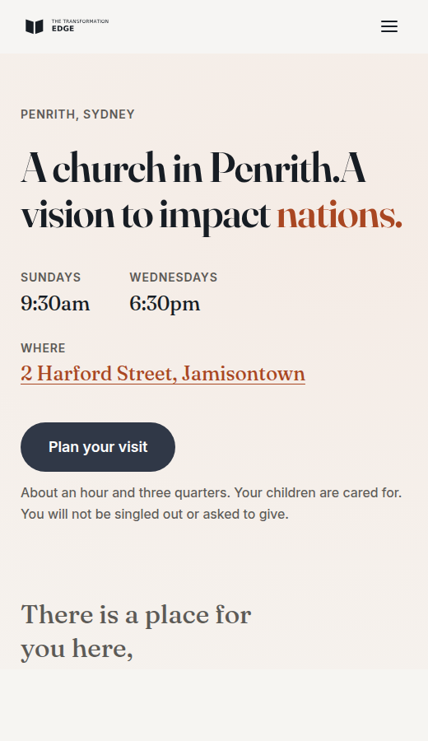
THE WEBSITE
The pages that do the work
Plan your visit
Give
On a phone
Four steps to a calendar invite and a name to look for.
Two methods. Receipts explained honestly.
Built for a mid-range Android on mobile data.
Notes:
Plan your visit and Give are the two pages that carry the most weight. Giving is deliberately plain: no urgency, no guilt, and it states clearly that church giving is not tax deductible.

Slide 10
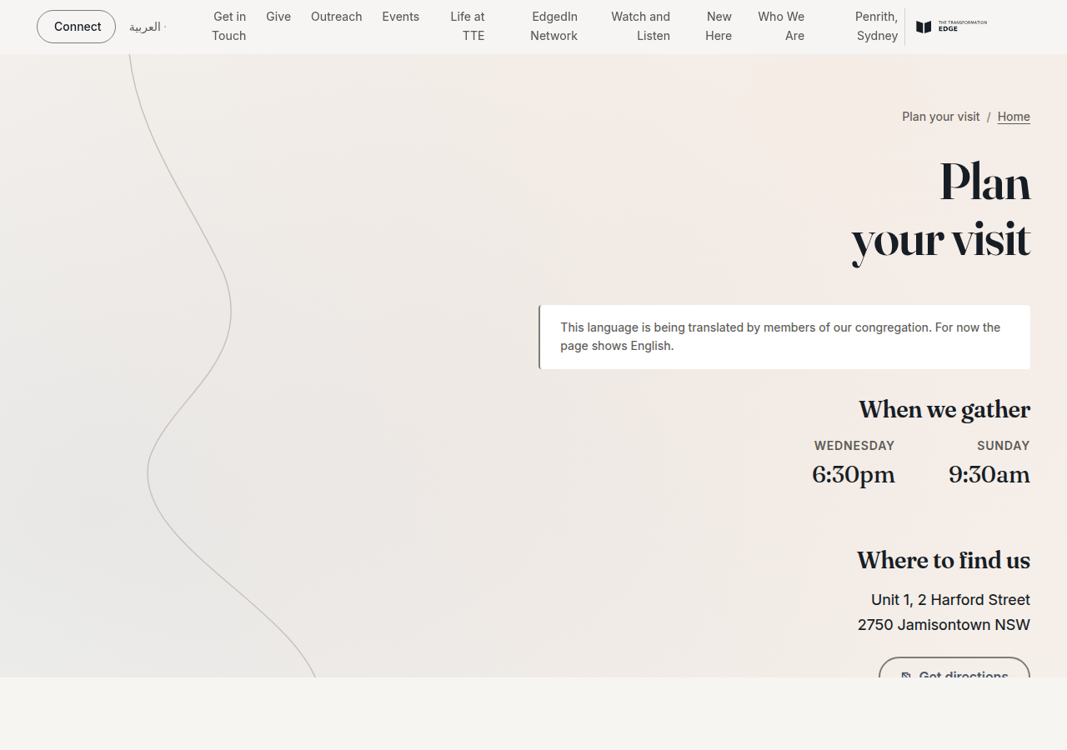
OUR COMMUNITY
Seven languages, including Arabic
English · 简体中文 · العربية · हिन्दी · Kiswahili · 日本語 · 한국어
Arabic reads right to left, so the entire layout mirrors. The mark does not.
Each language loads only its own typeface.
Nothing machine-translated is published. A language stays unlisted until a member of the congregation has reviewed it.
Notes:
We need one named reviewer per language. That is the only thing standing between us and publishing them, and it is a job for people already in the congregation.

Slide 11
MEASURED, NOT CLAIMED
How it performs
100
1.8s
52
<$25
Accessibility score
Load time on 4G
Colour pairs tested
Hosting per month
Including the Arabic page
Budget was 2.0s
All pass WCAG 2.2 AA
Down from the Wix plan
These are checked automatically every time anyone changes the site. If a change breaks accessibility or slows the page past budget, it cannot be published.
Notes:
The point is not the numbers themselves, it is that they are enforced. Standards that are not enforced last about six weeks.

Slide 12
BEING STRAIGHT WITH YOU
What is not finished
Decisions we need from you
Bank details for the Give page. A reviewer for each language. Who approves the weekly notice. Where photo consent records are kept.
Waiting on Connect
Events and sermons come from the Connect Hub. Until its data feed exists, they are entered by hand. The site works either way.
Photography
Every image is a real photograph of this congregation, or it is not published. None have been taken yet. A shot list is ready for one Sunday.
Before we switch the domain
Every old Wix address has to redirect. That list needs exporting from the current site.
Notes:
None of these block approving the brand. The bank details and the redirect list are the two that block going live.

Slide 13
What we are asking the board to approve
The A2 Architectural Threshold symbol and the masterbrand around it.
Fraunces and Inter as the typefaces, both open licence.
Moving the website off Wix, subject to the four items on the previous slide.
A Change is Inevitable
Notes:
If the board approves tonight, the brand is final and the remaining work is operational. We would aim to switch the domain once the redirect list and the bank details are confirmed.

