Slide 1



Slide 2
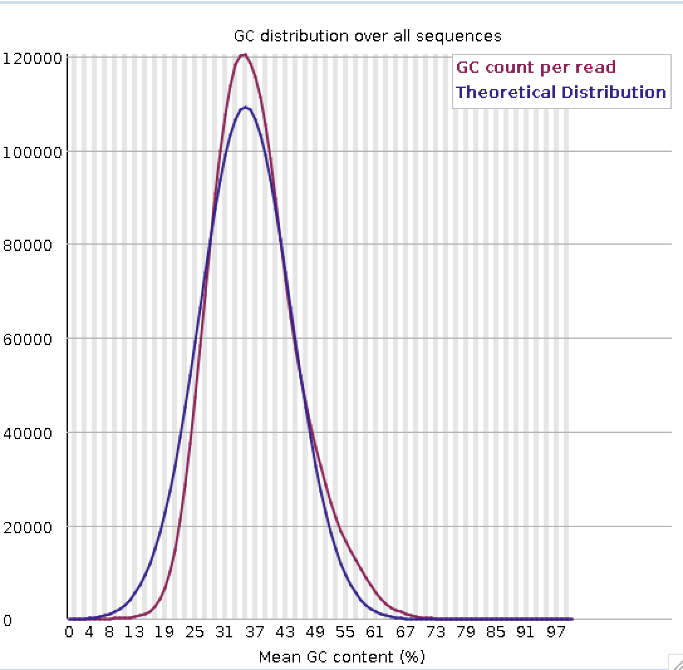

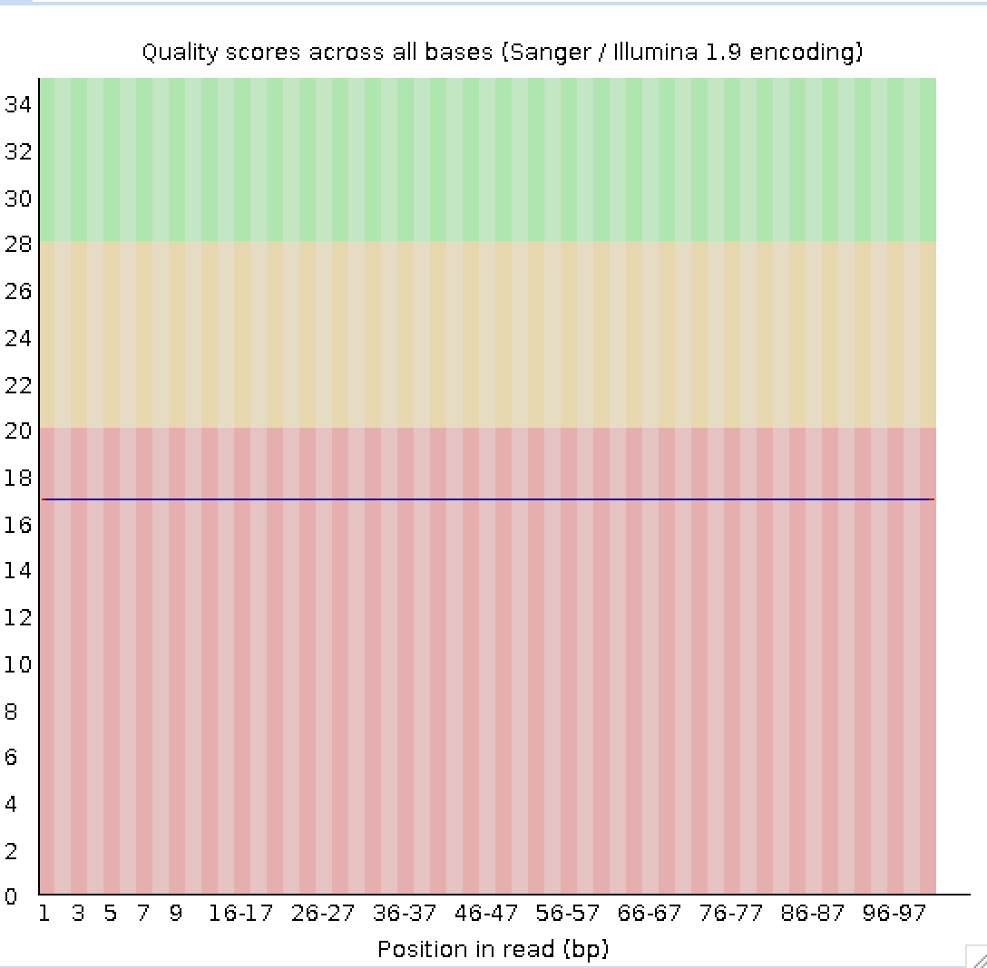

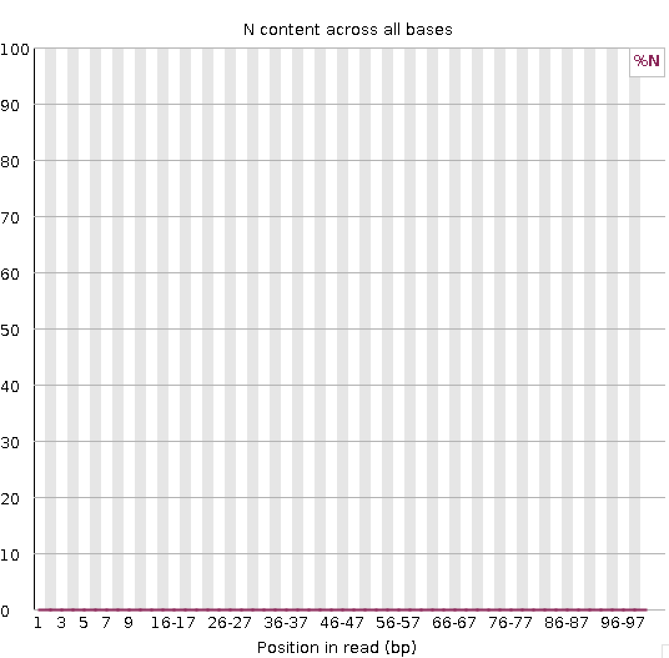
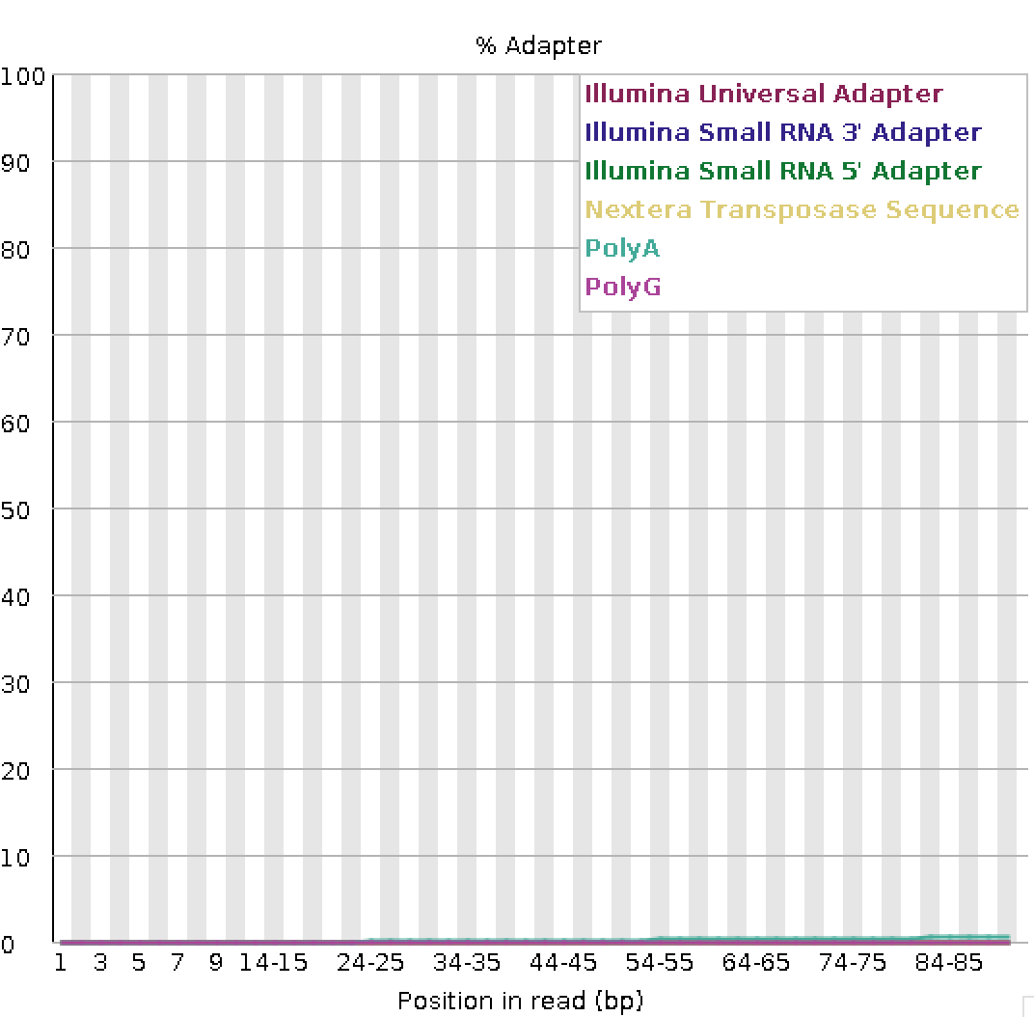

HS7_R1
HS7_R2
GC distribution
Quality Score across all bases
N content across all bases
Adapter Content

Slide 6






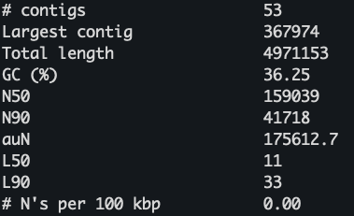
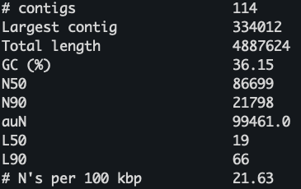
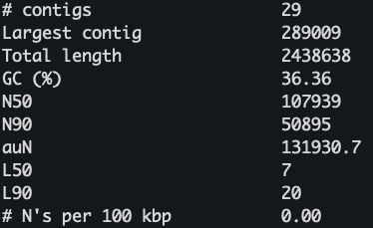
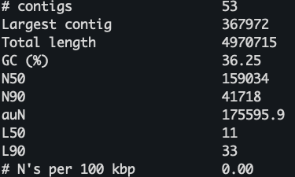
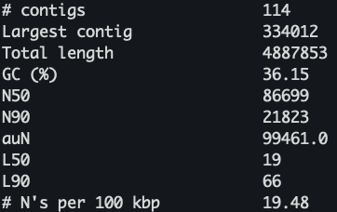
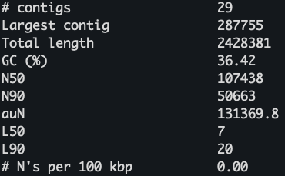
a)
Raw assembly
Post Pilon assembly polishing
MaSuRCA
HybridSPAdes
DBG2OLC + SPAdes
b)
Raw assembly
Post Pilon assembly polishing
MaSuRCA
HybridSPAdes
DBG2OLC + SPAdes

Slide 7
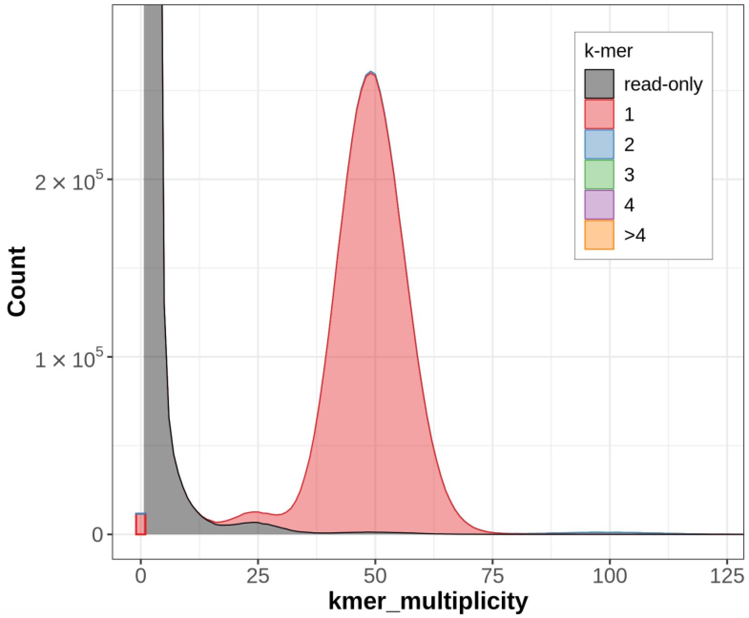
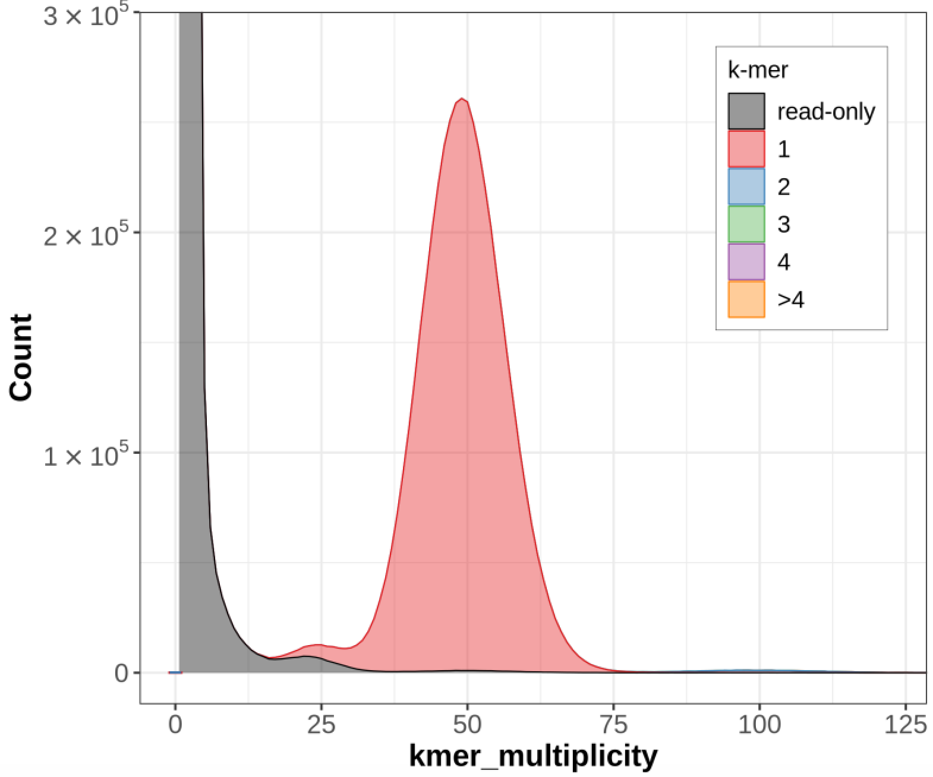
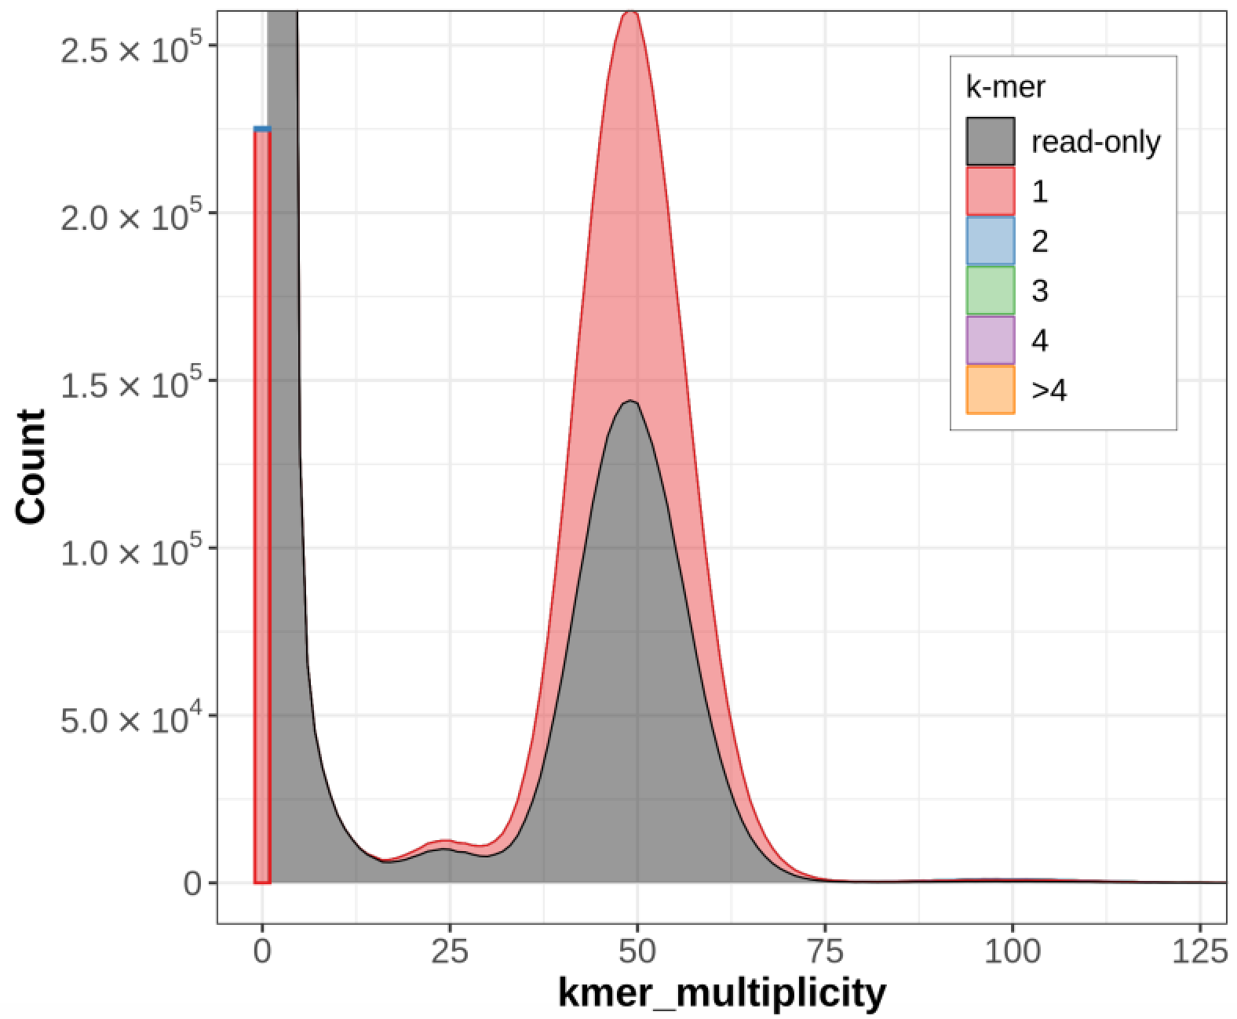

a)
MaSuRCA
HybridSPAdes
DBG2OLC + SPAdes
b)
MaSuRCA
HybridSPAdes
DBG2OLC + SPAdes

