Slide 1


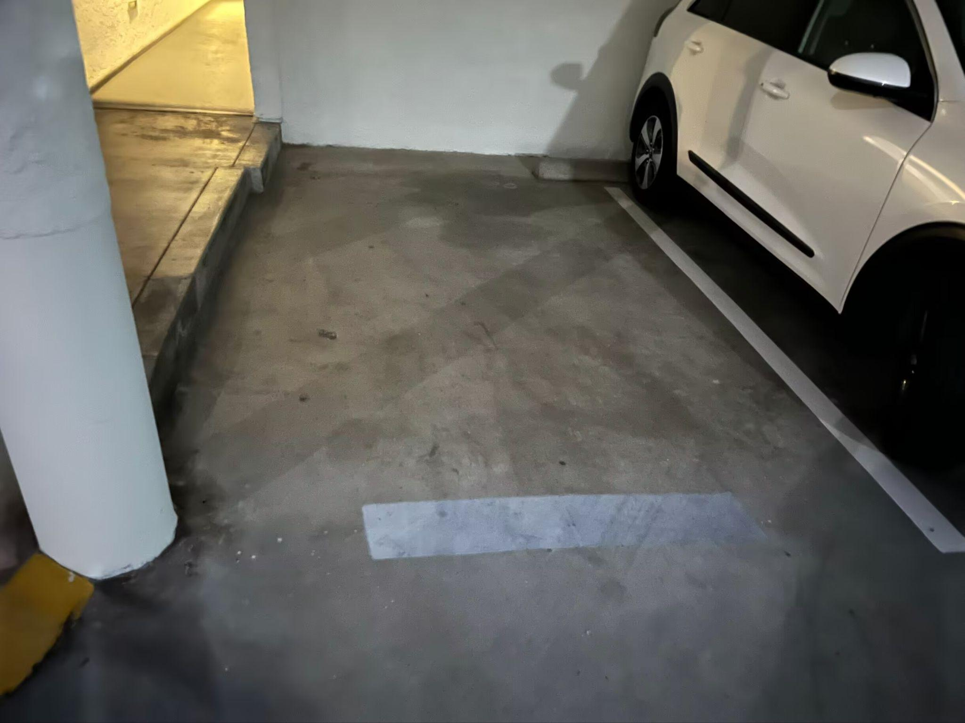
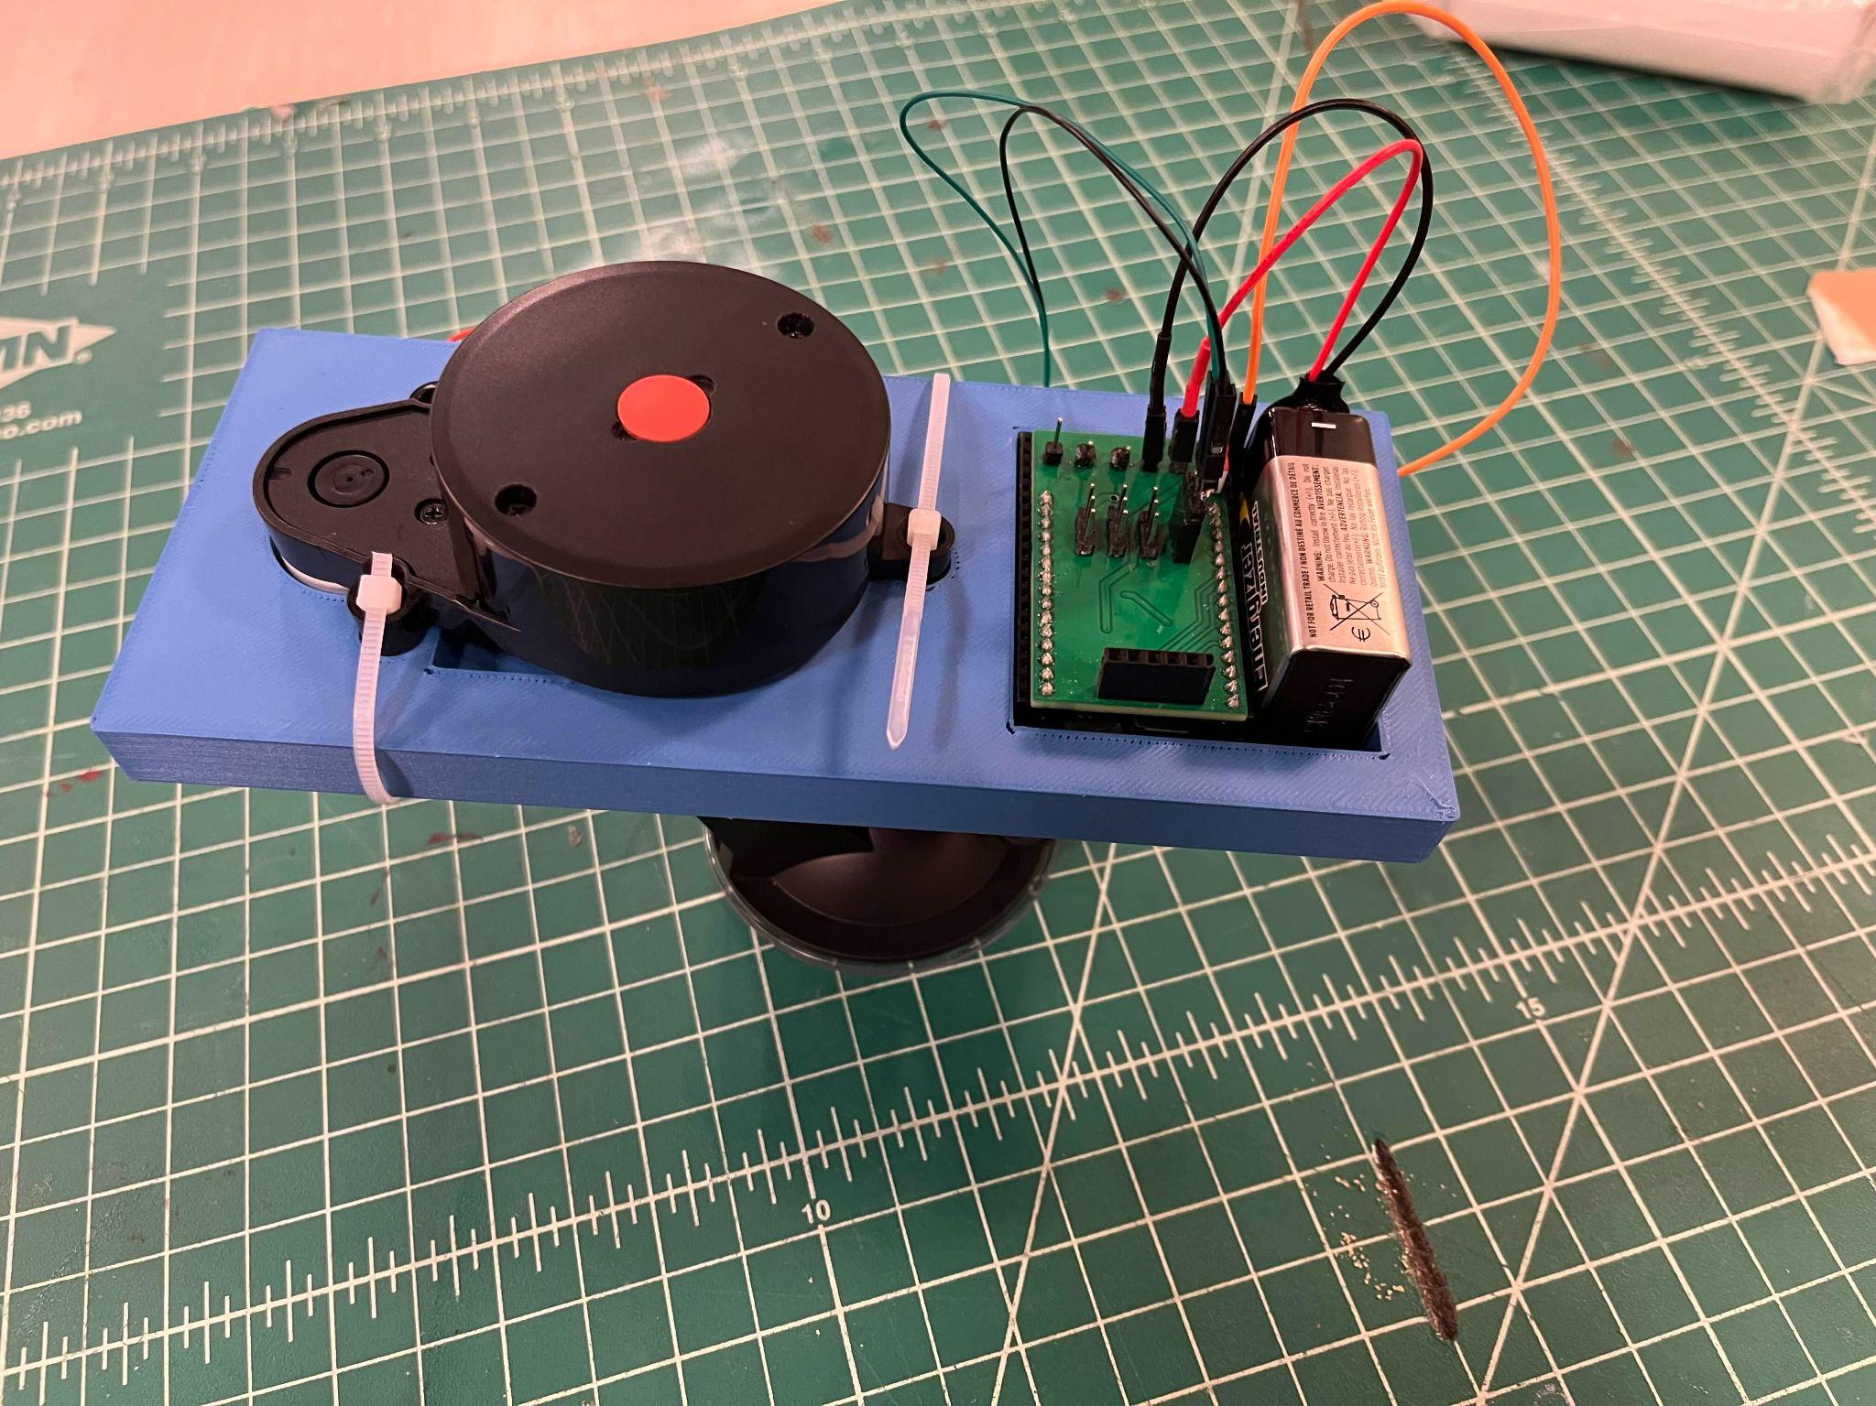
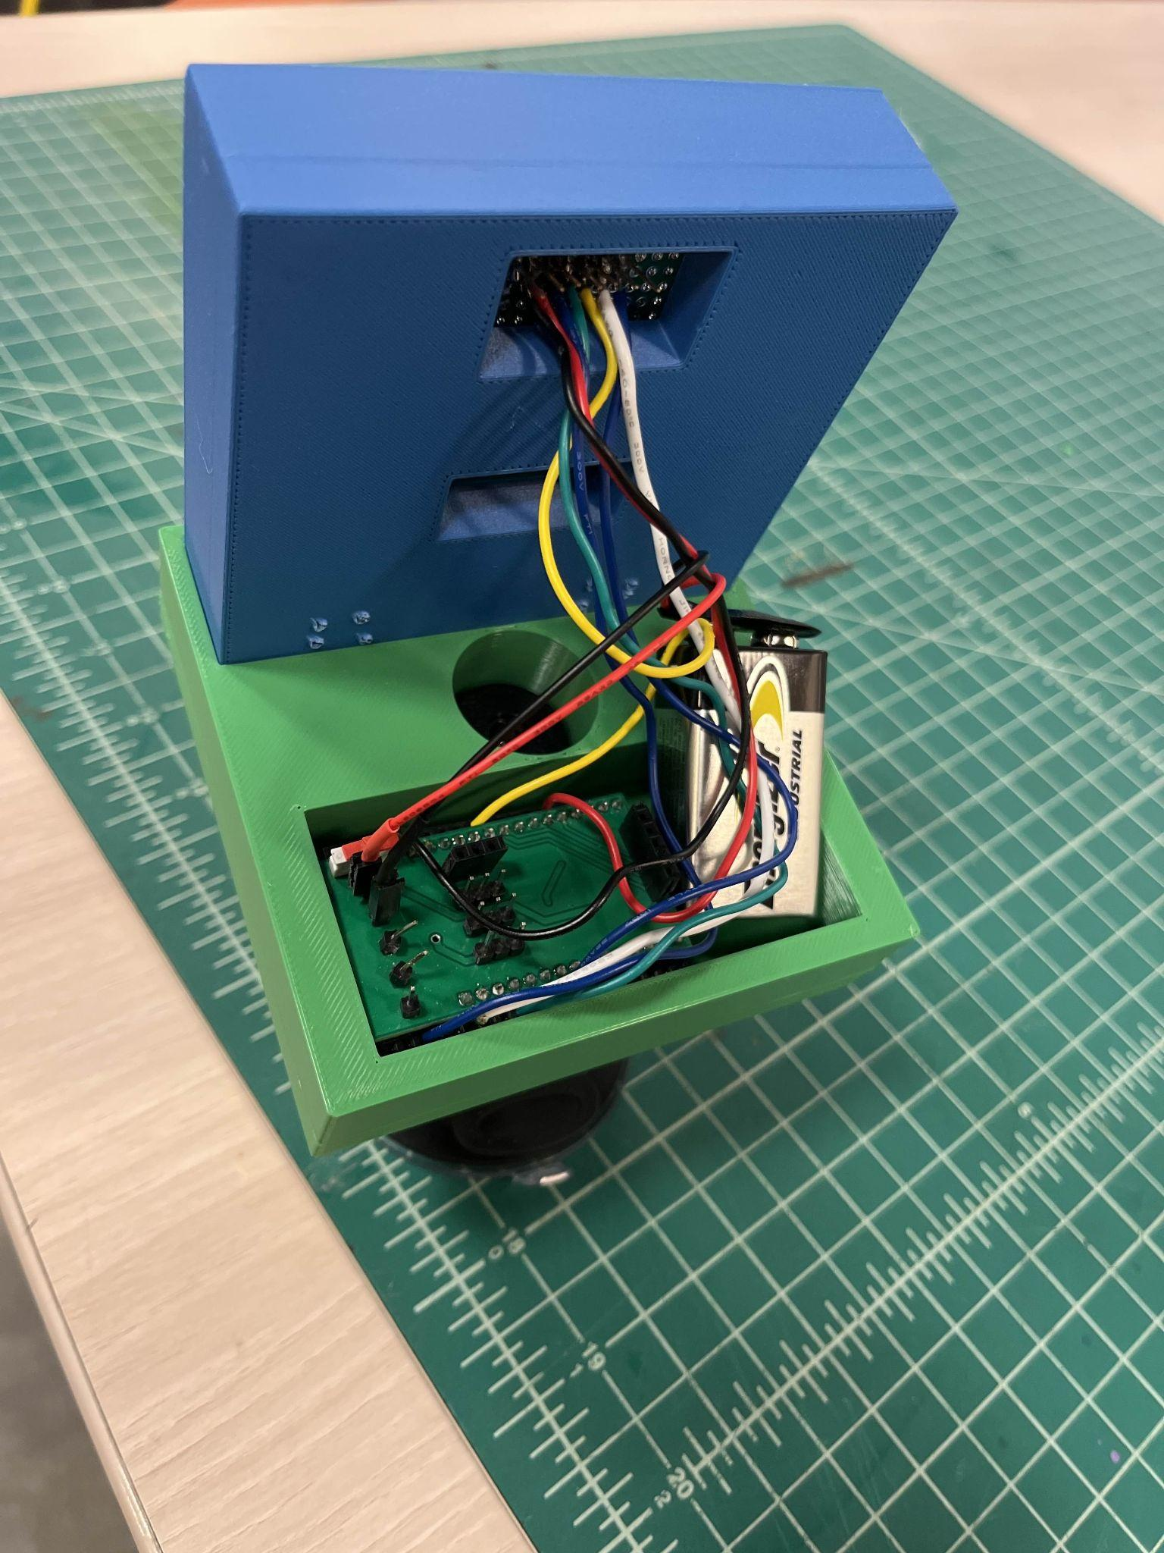
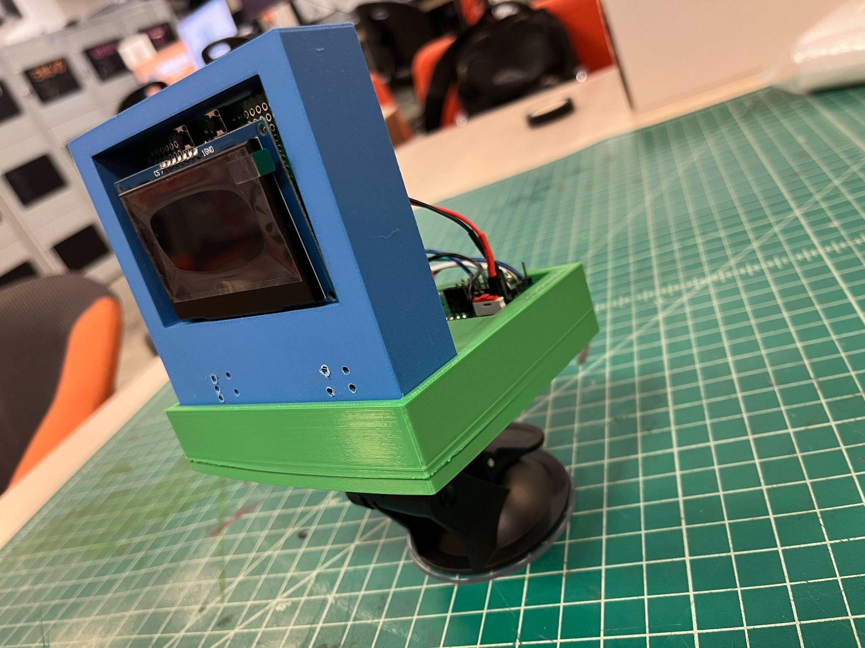
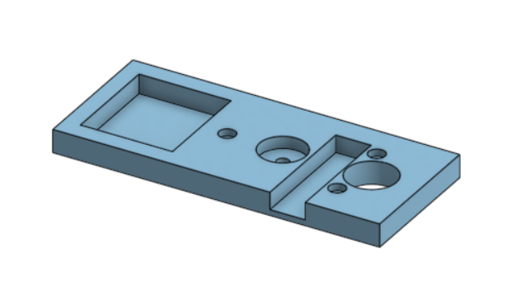
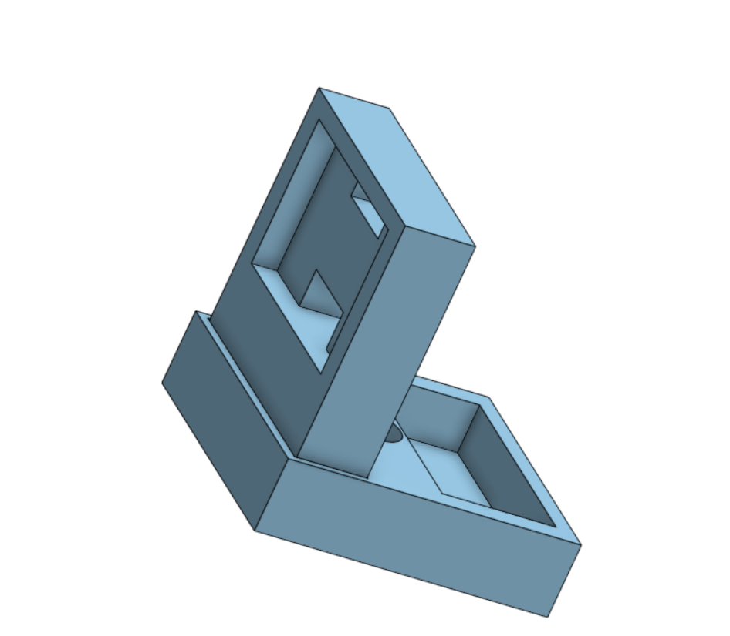
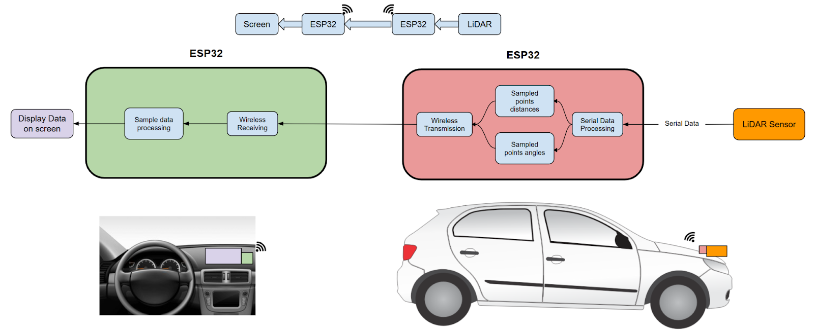
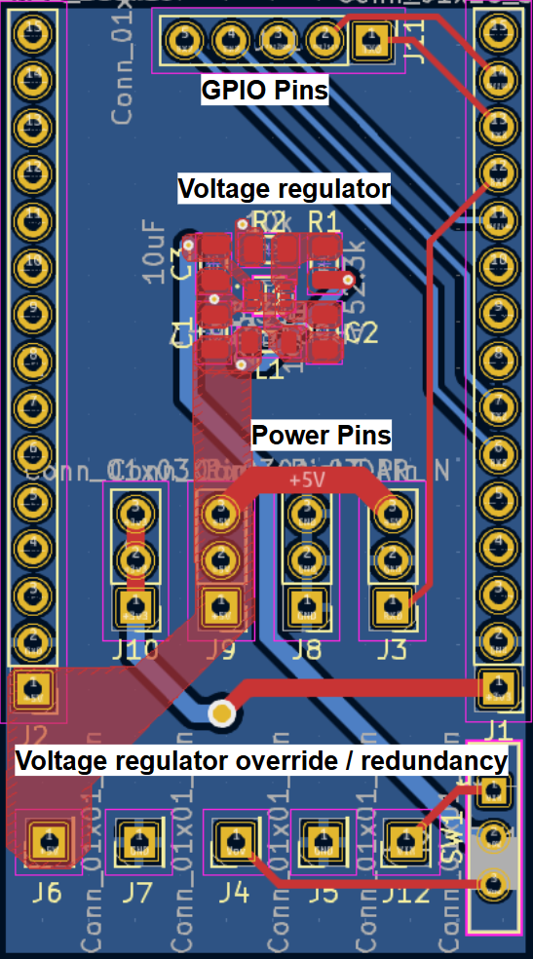
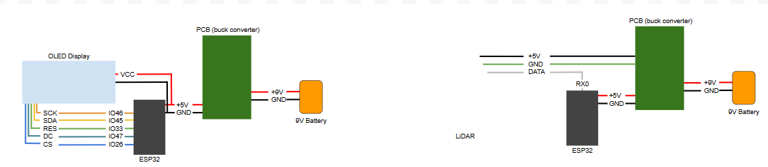
Parking Assistant
ECE 196 Fall 2024
Aria Mottaghi, Danny Wu, Cleavant Yang
https://sites.google.com/ucsd.edu/team-12/home
ECE 196 2024 Fall
Problem
Prototype
Drivers often encounter parking spots that are to compact to comfortably park into.
Our design consists of two parts, the screen part goes inside the car and show the driver data
This parking space is too narrow…
Battery for powering
Testable Hypothesis: The lidar sensor correctly measures distances of nearby obstacles, display dots on the screen representing obstacles so the driver knows there are obstacles too close to the car.
The lidar sensor for distance measures
ESP32 drivingunder the PCB for both designs
PCB bulk converters for lowering battery voltage
The screen for displays
Angle adjustable suction cup for stabling
Design:
Screen Mount
LiDAR Mount
PCB Bulk Converter Layout
Results
Wiring Diagram
Check website for tutorials and more

