Slide 1
MESI ISC Coherency Protocol Design and VER
TEAM MEMBERS:
Koushik Seggari koushik@pdx.edu
Venkat Sahith reddy Cheedu cheedu@pdx.edu
Srikanth Sigicherla sigicher@pdx.edu
Venkat reddy lakkireddy lakki@pdx.edu
ECE 571
Introduction to System Verilog for design and Verification Venkatesh Patil & Brian Cruikshank
Electrical and Computer Engineering Department Maseeh College of Engineering and Computer Science

Slide 2
MESI_ISC Coherency Protocol Design and VER

Slide 3
Work Distribution by Team:
Design | mesi_isc_define.sv mesi_isc_broad_cntl.sv mesi_isc_broad.sv mesi_isc.sv | Koushik, Venkat Sahith Reddy.
 | mesi_isc_define.sv mesi_isc_breq_fifo.sv mesi_isc_breq_fifo_cntl.sv | Venkat Sahith Reddy , Srikanth.
Test Bench | mesi_isc_tb.sv mesi_isc_tb_cpu.sv mesi_isc_tb_define.sv | Venkat Reddy , Koushik.
Synthesis | Done Synthesis for all the blocks in DC and Genus and taken all the QOR reports. | Venkat Reddy , Srikanth.

Slide 4
Introduction
This project is focused on the design and verification of the MESI_ISC (Intersection Controller) Coherency Protocol, which is a variant or an extension of the traditional MESI protocol used to manage cache coherency in distributed systems. The primary goal of this project is to ensure that multiple processing units or components, such as cores in a multi-core processor or controllers in a distributed system like an Intersection Controller, operate coherently and maintain data consistency across all units.
MESI Protocol Design:
The MESI (Modified, Exclusive, Shared, Invalid) protocol is a cache coherency protocol that ensures consistency between multiple caches by defining states for each cache line. In traditional systems, it is used to manage shared data across different caches in a multiprocessor environment.
ISC(IntersectionController):
The Intersection Controller (ISC) component is likely a system or controller that coordinates data flow or traffic at a specific intersection in a network (such as a multi-core processor or a physical intersection in a traffic system). It plays a vital role in ensuring that data or resources from different sources do not conflict or become inconsistent.

Slide 5
Coherency Protocol Design (MESI_ISC):
The design of the MESI_ISC Coherency Protocol focuses on how to apply the MESI protocol specifically within the context of an intersection controller system. This involve extending or modifying the states of the MESI protocol to meet the specific needs of the ISC, ensuring that data flowing through the system (such as control signals, processing states, or shared data) remains consistent and synchronized across all units involved.
Verification(VER):
Verification is a critical step to ensure that the MESI_ISC protocol operates as expected. This process involves testing the protocol for correctness, including functional testing, timing analysis, and the identification of any corner cases or race conditions that could result in data inconsistencies or errors. The ultimate objective of this project is to design an efficient, reliable, and scalable MESI_ISC Coherency Protocol that maintains system integrity and optimizes data flow and resource management within the intersection controller framework, whether in multi-core processors, distributed systems, or traffic control systems.

Slide 6
How it fits into the Digital Design Environment:
The MESI_ISC (Intersection Controller) Coherency Protocol Design fits into the Digital Design Environment by ensuring data consistency and synchronization across components in distributed systems like smart traffic management or autonomous vehicles. It integrates into the environment through:
System-Level Architecture: Implemented in HDLs (Verilog /System Verilog) for system-on-chip (SoC) or distributed system designs, ensuring coherent data exchange between controllers and subsystems.
Simulation and Verification: Verified using tools like Questa Sim to ensure functional correctness and performance under real-world conditions.
Hardware Implementation: Synthesized into hardware using tools like Genus and DC for ASIC-based design, followed by testing on prototypes.
Post-Implementation Testing: Monitored and adjusted in real-time for effective operation under dynamic conditions.
This process ensures the protocol is scalable, reliable, and efficient for complex, real-time systems.

Slide 7
Applications of MESI ISC Coherency Protocol Design and VAR
Where is it Used?
Smart Traffic Management Systems
Autonomous Vehicles
Distributed Control Systems
Urban Infrastructure Management
Importance of this Coherencey protocol:
Improves system reliability by maintaining data consistency.
Enhances performance in real-time systems where multiple controllers interact.
Critical for safety and efficiency in autonomous vehicle systems and smart city infrastructure.
Facilitates scalability in large-scale distributed systems.

Slide 8
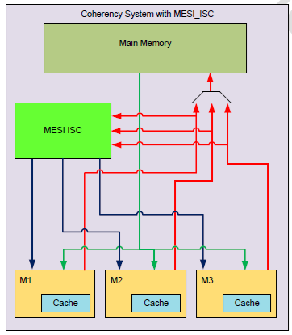
Fig: Describes a coherence system with MESI_ISC
Modified: A particular cache contains data modified by its processor and thus is inconsistent with the main memory.
Exclusive: The cache data is only present in the current cache and it matches main memory, it may be changed to a shared state at any time in response to read requests from any other processors
Shared: The cache contains unmodified data and thus appears in one of the other CPU cache.
Invalid: Cache’s data is invalidated because some other processor wrote to their cache updating the value which is also shared by a particular line

Slide 9
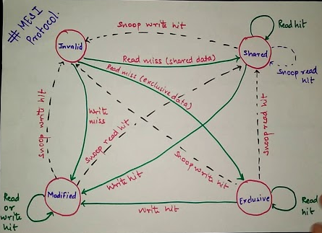
Process Workflow for MESI ISC Coherency Protocol Design and VER
Define protocol specifications for ISC systems.
Develop the state machine for MESI protocol (Modified, Exclusive, Shared, Invalid states).
Customize MESI for ISC environments, considering unique storage and computation needs.
Implement the MESI protocol in RTL or high-level modeling language. For each block

Slide 10
Initially implemented MESI_ISC:
The MESI cache coherence protocol is designed for interconnect systems to coordinate communication between the main bus (mbus) and the coherence bus (cbus). It manages commands, addresses, and acknowledgments, with configurable widths to suit different system setups. The module includes two submodules: mesi_isc_broad, which broadcasts coherence commands and addresses, and mesi_isc_breq_fifos, which buffers and sequences bus requests. This design enables smooth communication and synchronization among processors in shared-memory systems.
Basic FIFO:
This code defines a basic FIFO (First-In-First-Out) buffer module, mesi_isc_basic_fifo, used in the MESI cache coherence system. The module supports parameterized data width and size, making it flexible for various configurations. It includes logic to handle data writing, reading, and managing full and empty states of the FIFO. The design uses cyclic pointers for write and read operations, ensuring efficient use of memory. Debugging features are also incorporated, with sticky flags to detect overflow and underflow conditions. The FIFO is resettable and integrates seamlessly with clocked systems, enabling reliable buffering in shared-memory architectures.

Slide 11
Request FIFO:
This Verilog code defines the mesi_isc_breq_fifos module, which is part of the MESI (Modified, Exclusive, Shared, Invalid) Invalidation-based Snoop Coherence (ISC) protocol project. The module manages a set of broadcast request (Breq) FIFOs, which temporarily store snoop transactions until a CPU processes them. It uses multiple parameterized FIFO instances (mesi_isc_basic_fifo) to handle concurrent requests from up to four buses. Each FIFO manages data such as memory addresses, broadcast types, and transaction identifiers. Additionally, the module includes a control block (mesi_isc_breq_fifos_cntl) to synchronize FIFO operations and interface with a broadcast FIFO. The design emphasizes modularity and scalability, supporting parameterized data and FIFO sizes to adapt to different system requirements.
MESI_ISC Broad:
This Verilog code implements a broadcast module (mesi_isc_broad) as part of the MESI cache coherence protocol. It coordinates communication between CPUs over a coherence bus by managing broadcast requests and their responses. The module includes a FIFO buffer for queuing broadcast requests and handles their attributes, such as addresses, types, CPU IDs, and request IDs. A control submodule (mesi_isc_broad_cntl) processes acknowledgments from the coherence bus and generates corresponding commands. The FIFO buffer is implemented using the mesi_isc_basic_fifo module, which efficiently queues and retrieves broadcast requests while monitoring its full and empty statuses. Overall, this design facilitates synchronization and data consistency among multiple CPUs in a shared-memory multiprocessor system.

Slide 12
mesi_isc_broad_cntl:
Module mesi_isc_broad_cntl, which is part of a cache coherence protocol for a multiprocessor system. The module manages the broadcast control for snoop requests and enables the communication between multiple CPUs. It coordinates the sending of read or write snoop requests (broadcasts) to all CPUs and waits for their acknowledgment. Once all CPUs acknowledge, it sends an enable access command to the initiator CPU. The process is managed across several stages, where different states of the broadcast and acknowledgment are tracked using various registers and arrays. The module ensures that each CPU properly participates in the broadcast process and that the initiator receives the necessary enable signal to proceed. The code also integrates a FIFO mechanism to manage the broadcast requests and their corresponding responses.
Broadcast Request FIFOs Control Module:
Inputs:
Clock & Reset:
clk: System clock.
rst: Active-high reset.
Commands & Status:
mbus_cmd_array_i: Array of main bus commands for each FIFO.
fifo_status_empty_array_i, fifo_status_full_array_i: FIFO status indicators.
broad_fifo_status_full_i: Indicates if the broadcast FIFO is full.

Slide 13
Broadcast Data:
broad_addr_array_i, broad_type_array_i, broad_id_array_i: Broadcast data from each FIFO.
Outputs
Control Signals:
mbus_ack_array_o: Acknowledgments for the mbus.
fifo_wr_array_o, fifo_rd_array_o: FIFO write/read controls.
broad_fifo_wr_o: Write enable for the broadcast FIFO.
Broadcast Outputs:
broad_addr_o, broad_type_o, broad_cpu_id_o, broad_id_o: Data output to the broadcast FIFO.
FIFO Manipulation:
breq_type_array_o: Modified types of requests.
breq_cpu_id_array_o, breq_id_array_o: CPU IDs and unique request IDs.

Slide 14
Key Design Components
Round-Robin Arbitration:
A priority register (fifos_priority) determines which FIFO has the highest priority.
This priority rotates whenever a broadcast request is written to the broadcast FIFO.
Barrel shifters (fifos_priority_barrel_shiftl_X) calculate rotated priorities.
FIFO Selection:
The fifo_select_oh signal uses the priority to select the FIFO that will supply data to the broadcast FIFO.
Logic ensures that only non-empty FIFOs are selected.
Acknowledge Generation:
Each FIFO sends an acknowledgment when a broadcast request is successfully stored.
Acknowledgment conditions:
FIFO is not full.
Valid broadcast commands (WR_BROAD, RD_BROAD) are received.

Slide 15
4. Unique Broadcast IDs:
Each request has a unique ID (breq_id_array_o).
IDs are cyclically assigned using a base value (breq_id_base) incremented with every broadcast cycle.
5. Data Muxing:
Multiplexes the appropriate FIFO's data to the broadcast FIFO outputs (broad_*_o).

Slide 16
Code Snippets:
always_ff @(posedge clk or posedge rst) begin
if (rst) begin
stat_cpu_access_nop <= '{default:'0};
stat_cpu_access_rd <= '{default:'0};
stat_cpu_access_wr <= '{default:'0};
end else begin
for (p = 0; p < 4; p++) begin
if (tb_ins_ack[p])
begin
temp =$past(tb_ins_array,1);
//$display("temp= %p, tb_ins_array[%d]= %d", temp,p,$past(tb_ins_array[p],1));
case (temp[p])
`MESI_ISC_TB_INS_NOP:
stat_cpu_access_nop[p]++;
`MESI_ISC_TB_INS_WR:
stat_cpu_access_wr[p]++;
`MESI_ISC_TB_INS_RD:
stat_cpu_access_rd[p]++;
endcase
end
end
end
end
mesi_isc_tb.sv
task automatic sanity_check_rule1_rule2(
input logic [3:0] cpu_id,
input logic [ADDR_WIDTH-1:0] mbus_addr,
input logic [DATA_WIDTH-1:0] mbus_wr_data
);
logic [DATA_WIDTH-1:0] cur_mem_data;
`ifdef messages
$display("Message: check err 7. time:%d", $time);
`endif
cur_mem_data = mem[mbus_addr];
if (cur_mem_data[(3+1)*8-1 : 3*8] > mbus_wr_data[(3+1)*8-1 : 3*8] ||
cur_mem_data[(2+1)*8-1 : 2*8] > mbus_wr_data[(2+1)*8-1 : 2*8] ||
cur_mem_data[(1+1)*8-1 : 1*8] > mbus_wr_data[(1+1)*8-1 : 1*8] ||
cur_mem_data[(0+1)*8-1 : 0*8] > mbus_wr_data[(0+1)*8-1 : 0*8])
begin
$display("ERROR 7. The current memory data is bigger than the written data");
$display(" CPU: %h, Cur data: %h, Written data: %h, Address: %h, time:%d",
cpu_id,
cur_mem_data,
mbus_wr_data,
mbus_addr,
$time);
@(negedge clk) $finish();
end
endtask

Slide 17
mesi_isc.sv
package mesi_isc_pkg;
parameter CBUS_CMD_WIDTH = 3;
parameter ADDR_WIDTH = 32;
parameter BROAD_TYPE_WIDTH = 2;
parameter BROAD_ID_WIDTH = 5;
parameter BROAD_REQ_FIFO_SIZE = 4;
parameter BROAD_REQ_FIFO_SIZE_LOG2 = 2; parameter MBUS_CMD_WIDTH = 3;
parameter BREQ_FIFO_SIZE = 2;
parameter BREQ_FIFO_SIZE_LOG2 = 1;
endpackage
Port style connections
mesi_isc_tb_cpu #( .CBUS_CMD_WIDTH(CBUS_CMD_WIDTH), .ADDR_WIDTH(ADDR_WIDTH), .DATA_WIDTH(DATA_WIDTH), .BROAD_TYPE_WIDTH(BROAD_TYPE_WIDTH), .BROAD_ID_WIDTH(BROAD_ID_WIDTH), .BROAD_REQ_FIFO_SIZE(BROAD_REQ_FIFO_SIZE), .BROAD_REQ_FIFO_SIZE_LOG2(BROAD_REQ_FIFO_SIZE_LOG2), .MBUS_CMD_WIDTH(MBUS_CMD_WIDTH), .BREQ_FIFO_SIZE(BREQ_FIFO_SIZE), .BREQ_FIFO_SIZE_LOG2(BREQ_FIFO_SIZE_LOG2)
) gen_cpu_tb2 (
.clk(clk),
.rst(rst),
.cbus_addr_i(cbus_addr),
.cbus_cmd_i(cbus_cmd2),
.mbus_data_i(mbus_data_rd),
.mbus_ack_i(mbus_ack[2]),
.cpu_id_i(2'd2),
.tb_ins_i(tb_ins_array[2]), .tb_ins_addr_i(tb_ins_addr_array[2]), .mbus_cmd_o(mbus_cmd_array[2]), .mbus_addr_o(mbus_addr_array[2]), .mbus_data_o(mbus_data_wr_array[2]), .cbus_ack_o(cbus_ack2),
.tb_ins_ack_o(tb_ins_ack[2])
);
mesi_isc_broad_cntl.sv
typedef enum logic [CBUS_CMD_WIDTH-1:0] {
CBUS_CMD_NOP = `MESI_ISC_CBUS_CMD_NOP,
CBUS_CMD_WR_SNOOP = `MESI_ISC_CBUS_CMD_WR_SNOOP, CBUS_CMD_RD_SNOOP = `MESI_ISC_CBUS_CMD_RD_SNOOP, CBUS_CMD_EN_WR = `MESI_ISC_CBUS_CMD_EN_WR,
CBUS_CMD_EN_RD = `MESI_ISC_CBUS_CMD_EN_RD
} cbus_cmd_t;

Slide 18

Synthesis:
In addition to designing and verifying the MESI_ISC (Intersection Controller) Coherency Protocol, we performed synthesis to translate the high-level hardware description into a gate-level netlist, which is optimized for a specific technology library.
These are the seven blocks we have:
mesi_isc_define.sv
mesi_isc_broad_cntl.sv
mesi_isc_broad.sv
mesi_isc.sv
mesi_isc_define.sv
mesi_isc_breq_fifo.sv
mesi_isc_breq_fifo_cntl.sv
Some sub-modules are instantiated in other modules. All codes are linked together so we define `include in all the files

Slide 19
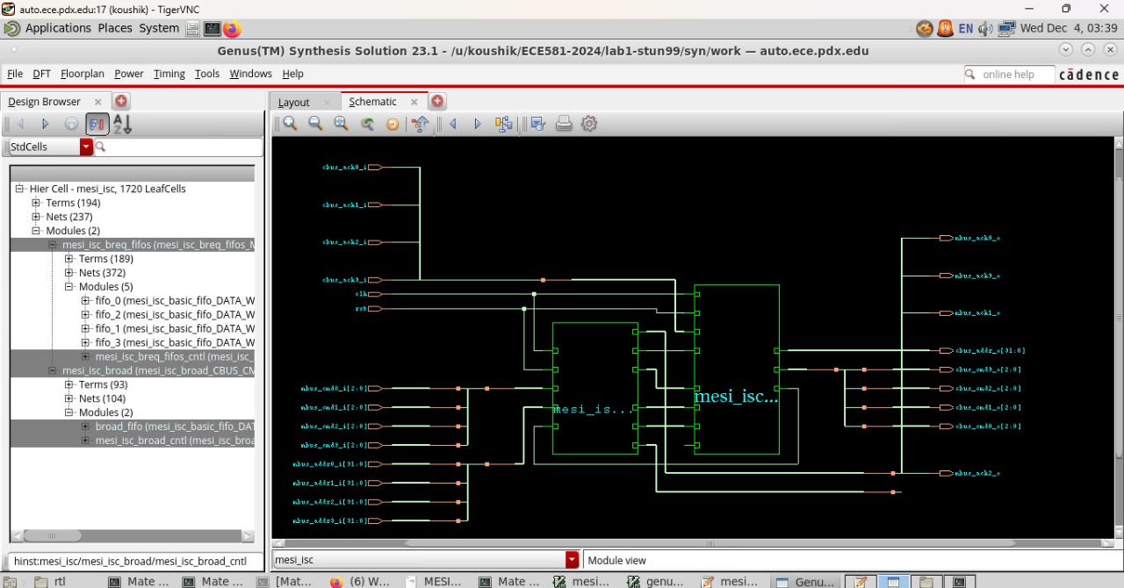
Schematic of MESI_ISC After Synthesis:

Slide 20
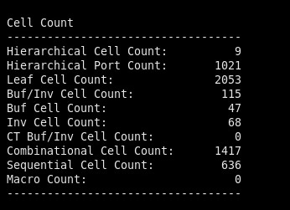
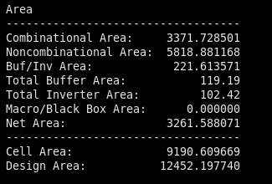
Cell Count
Area

Slide 21
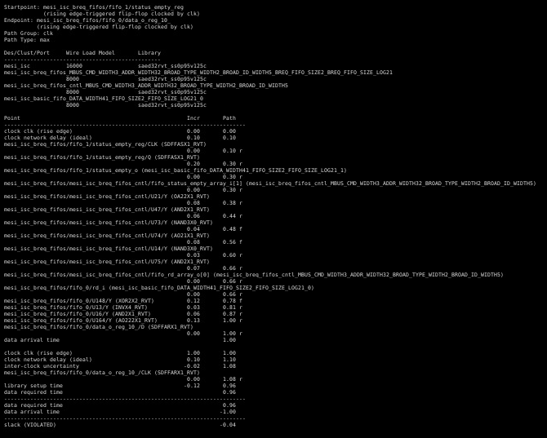
Timing Report:

Slide 22
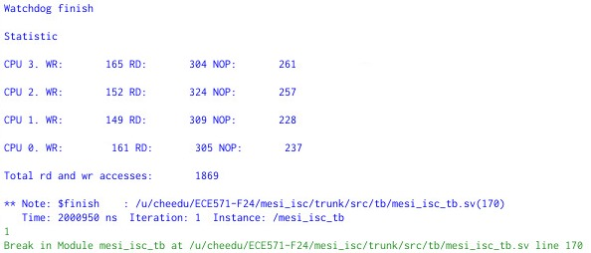
Results:

Slide 23
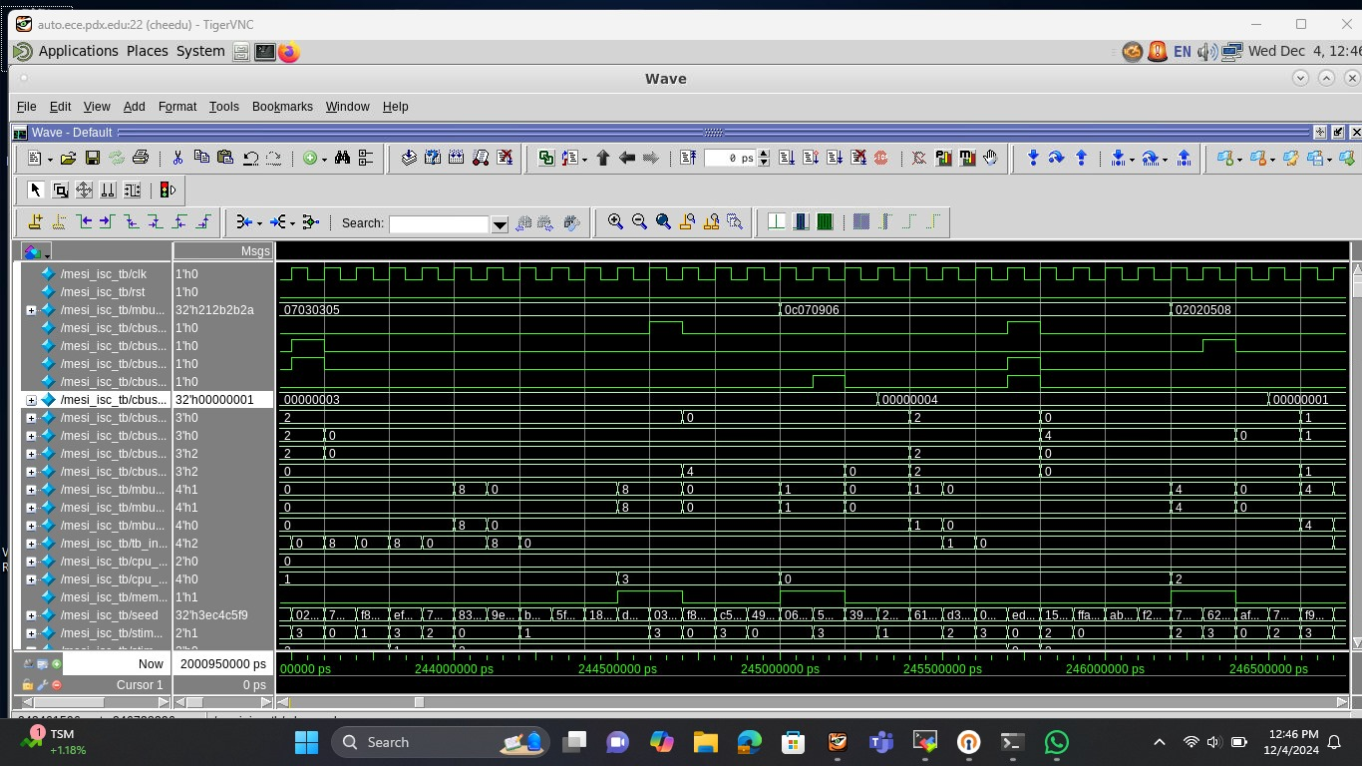
Wave Form:

Slide 24
Challenges:
While simulating the code we were getting the output as “0” for number of read access and write access for each cpu.
To problem was, after each cpu completed its operation the respective bit in the tb_ins_array is becoming 0, hence when it is entering into case statement, it is always entering into NOP state.
Hence if we want to count the number of write and read operations performed, we need t capture the data in the previous clock cycle and send it into the case statement for counting the number of read and write access.
temp =$past(tb_ins_array,1);
case (temp[p])
`MESI_ISC_TB_INS_NOP:
stat_cpu_access_nop[p]++;
`MESI_ISC_TB_INS_WR:
stat_cpu_access_wr[p]++;
`MESI_ISC_TB_INS_RD:
stat_cpu_access_rd[p]++;
endcase

Slide 25
Another challenge we faced was during synthesis,
If we want to synthesis the main design, there we two submodules instantiated in it, if we synthesize the default code we were getting the two submodules as unresolved references and there was some more modules which were instantiated in the two submodules, hence we were not able to correctly synthesize the design.
To address this we have added the `include module file which will be instantiated in the main module. This process we have done for all the design files.
Hence were able to correctly synthesize the design, which has all the submodules.

Slide 26
Thank you

