Slide 1
Multi Robot Localization Update
An update on what progress has been made and what is planned
By Caleb Lu

Slide 2
Outline
Summary of project/task
Current Progress
Current Issues
Planned Work
Questions

Slide 3
Summary

Slide 4
Summary
The Goal of the assignment is to use:
BeagleBone Blue Board (BBB)
(Currently) 3 XS2C Xbee/Zigbee Boards
To simulate indoor localization using trilateration

Slide 5
Zigbee/XBee Setup
The Xbee boards are going to be set up into two configurations.
Coordinator
Endpoint
The Robot/BBB will be connected to the XBee module that is set up as the Coordinator
The beacons will be set up as endpoints.
This configuration will allow for Indoor trilateration.

Slide 6
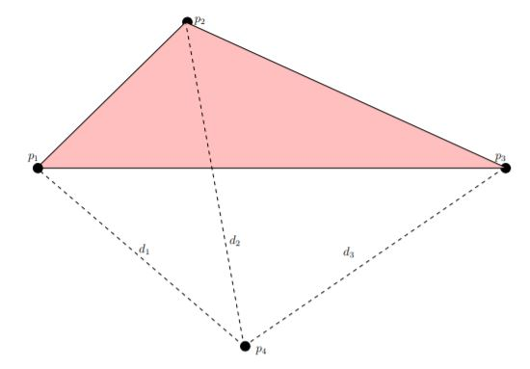

Slide 7
Current Progress

Slide 8
Current Progress
Current progress is that 1 of the board is setup to be the coordinator. This is the one setup to be on the robot/BBB.
Tested/other 2 XBee boards are having issuing interfacing with the XCTU interface program
Currently doing some troubleshooting
Started looking into resources to bingin programming a file to connect read the XBee board from the BBB.
Have not decided on what language to use. Currently looking into C++ or Python based on the resources found
Connected with the BBB over PuTTY to ensure communication is working

Slide 9
Current Issues

Slide 10
Broken Components
Issue Tier List: Yellow = Light | Orange = Medium | Red = Servere
BeagleBone Blue has damage/two encoder inputs are coming off
XBee/Zigbee S2C Boards - ⅔ of them do not connect to the XCTU Program. Meaning I can only interact and format one of the boards

Slide 11
Additional Components needed
Issue Tier List: Yellow = Light | Orange = Medium | Red = Servere
XBee interface Board
XBee/Zigbee S2C Boards - 1
Both are needed for a bare minimum test for communication. This is urgent but needs to be solved in a week to a week and a half.

Slide 12
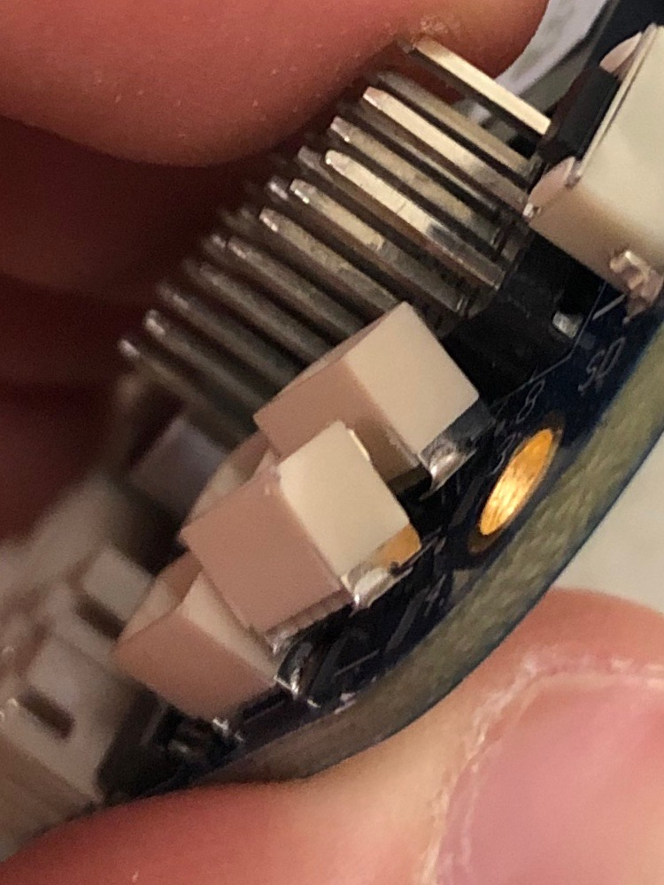
BBB Damage
Damage found on the BBB
The 2 of the Encoder Inputs are damaged
Unsure where this happened but reporting the damage just in case there is a future issue.
Has little to no impact to me and what I’m doing so severity level is low.

Slide 13
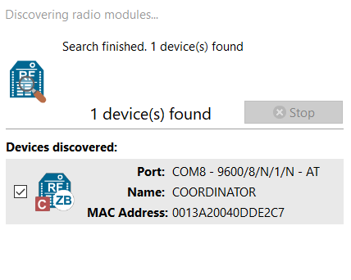
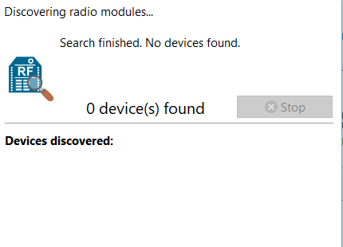
Communication Issues
Found XBee Module

Slide 14
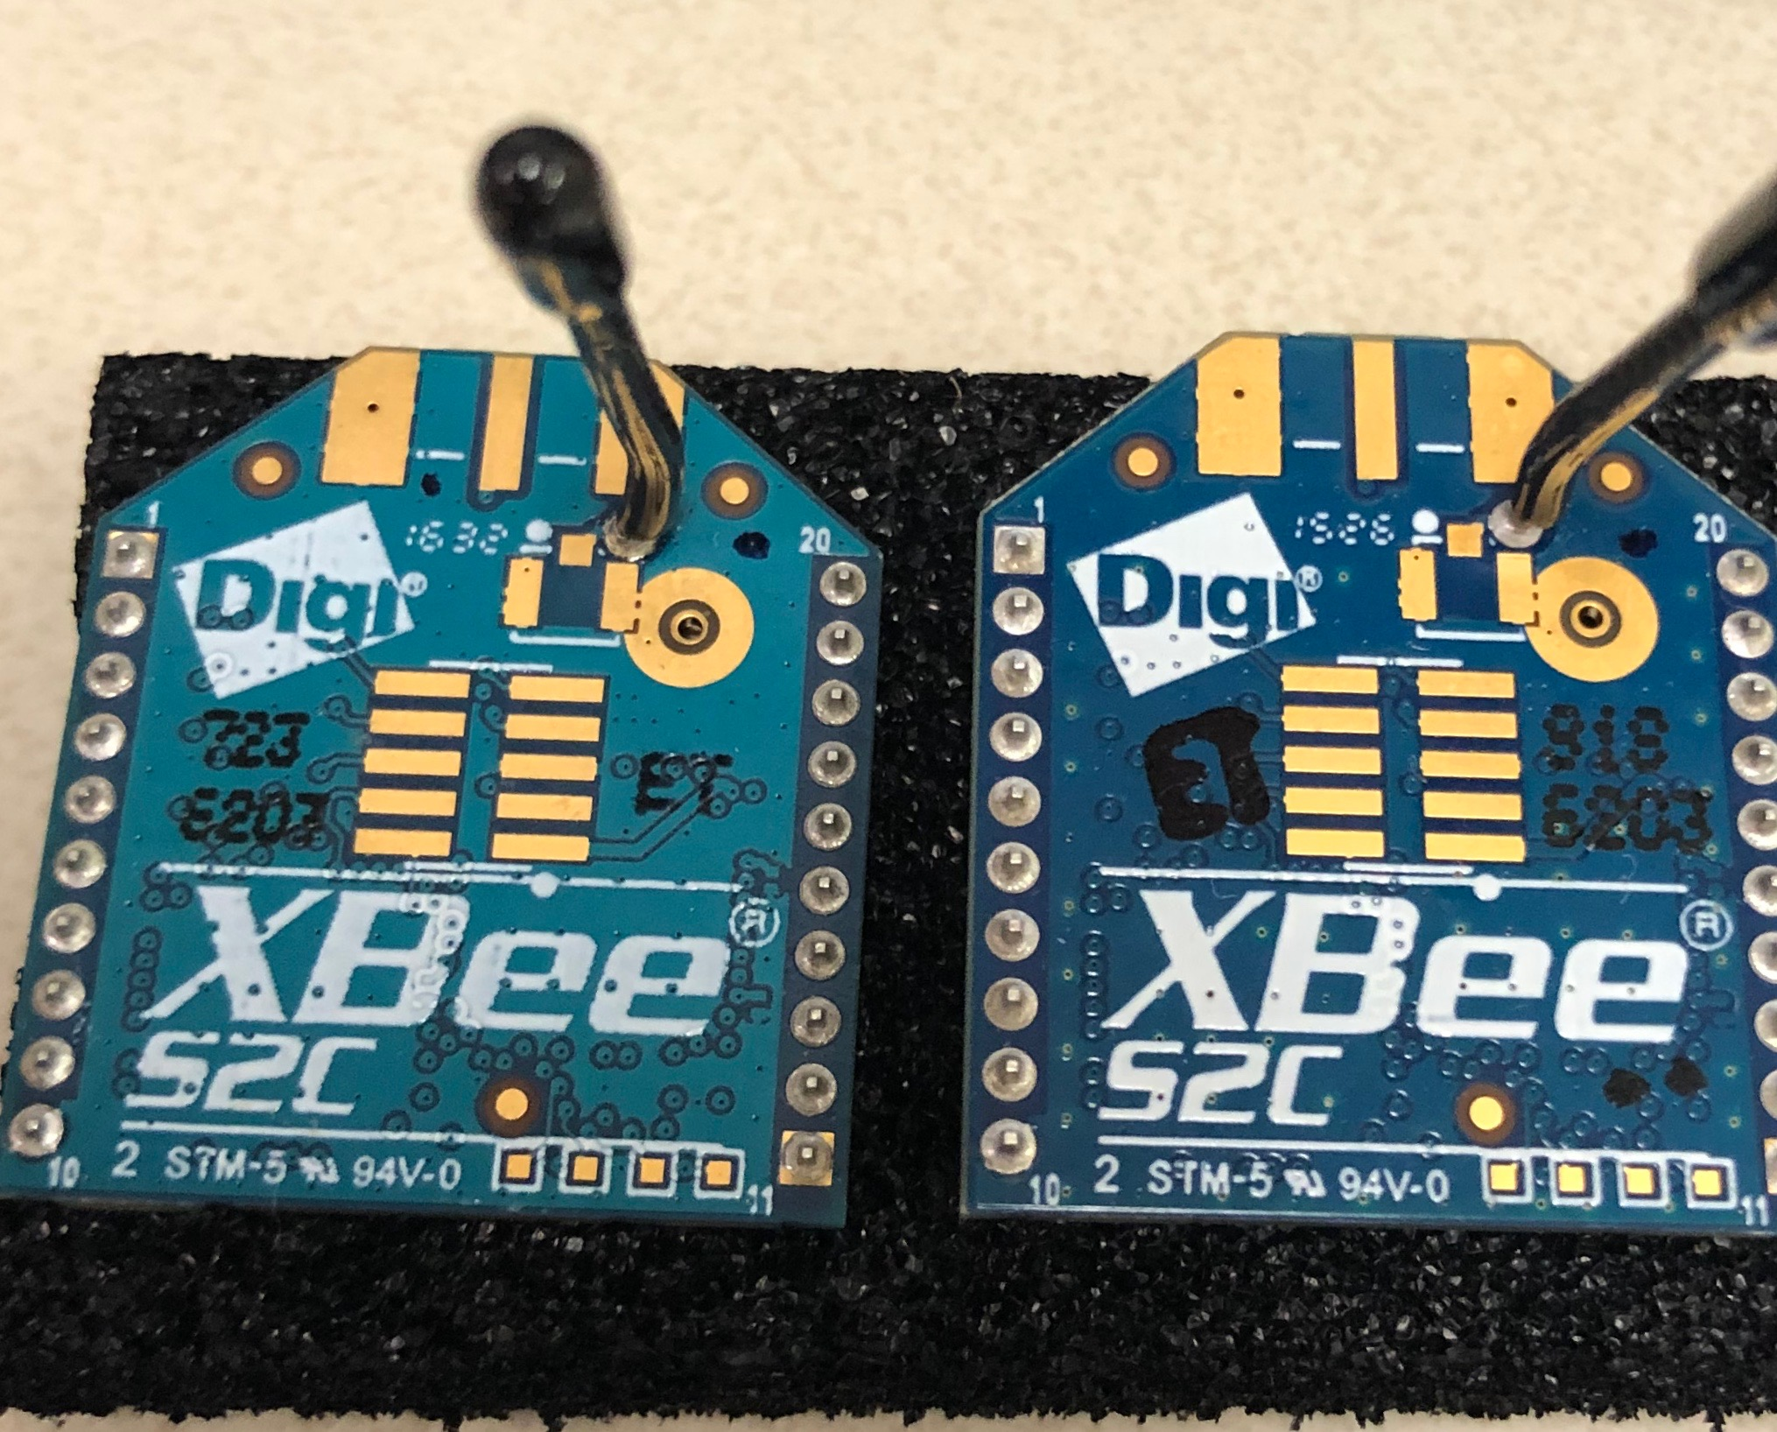
XBee Module Difference
Non-Working on the Left,
Working one on the Right

Slide 15
Planned Work

Slide 16
Plan for the coming week - Documentation
Update Lab Notebook/Documentation
Transfer to Latex Presentation

Slide 17
Plan for the coming week - Technical
Test XBee boards - ensure broken
Write program for reading XBee from BBB
Test if program connects/receives data from XBee board connected to BBB

Slide 18
Progress Walls
Need extra XBee interface board
Need extra XBee Module/radio and cable

Slide 19
Overall work that needs to be done
Short term time frame:
XBee Configurations
BBB Configurations
BBB to XBee program
Long term time frame:
4 XBee Modules/radios
4 micro-USB cables
RSS and RFID Reading
Trilateration algorithm

Slide 20
Questions?

Slide 21
References
Images:
Sites:

