Slide 1
Multi-Robot Localization Update
Caleb Lu

Slide 2
Outline
Goals from Last Meeting
Goals Achieved
Issues
Goals for Next Week
Specific Actions
Zigbee
BBB
Repairs
Priority List
Questions

Slide 3
Goals from Last Meeting
Setting up Zigbee boards for communication
Getting the Beagle Bone communicate to the Zigbee board over the Zigbee USB interface.
Low Priority
Trouble shoot why certain boards don’t works

Slide 4
Goals Achieved
Was able to get the Zigbee boards to work through XCTU.
Working on getting the Beagle Bone to communicate to the USB interface.

Slide 5
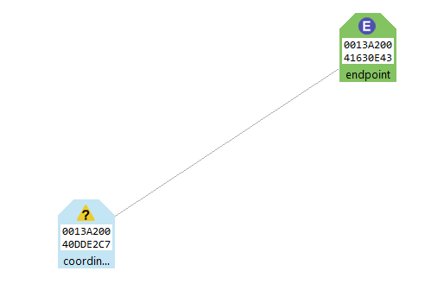
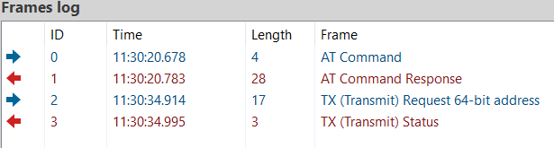
Issues/Pictures
Figure 1: Network Topology
Figure 2: Frame Log of Connection

Slide 6
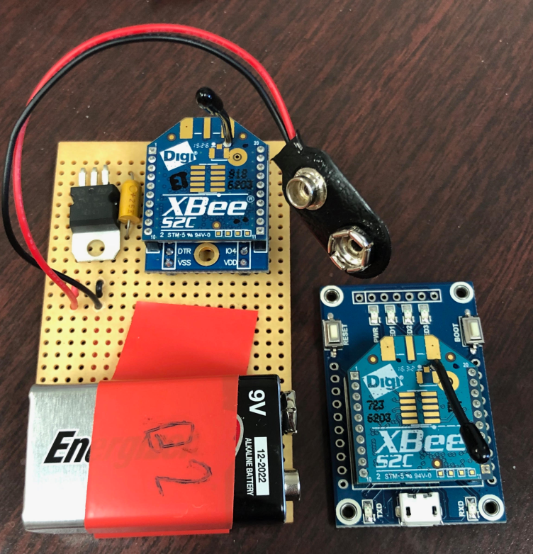
Issues/Pictures
Need another board set up for the third Zigbee board
BBB
IP configurations aren’t working and need to download files for interface

Slide 7
Goals for Next Week
Get the PC to read the Zigbee boards
Get the Beagle Bone connected to the USB interface and reading information
Get three Zigbee boards connected in a network and communicating properly
Optional/least priority:
Determining why the other Zigbee boards aren’t working

Slide 8
Specific Actions – Zigbee
Zigbee boards have two general settings, transparent and API. Setting to API for remote communication (API mode is more oriented for remote communication).
Figure out how to send remote commends from PC to Zigbee board to read data

Slide 9
Specific Actions - BBB
BBB Connection: Found a source that has python tool for working with Xbee, will try to download that and get that working.
Currently having some IP configuration issues
Need to get Zigbee Boards to send the information I want. Will look into how API mode works and what messages to send

Slide 10

Specific Actions - Repair
Will try to force a firmware update through XCTU to forcibly reset the boards that don’t connect.
Image: DIGI XCTU Logo, refer to References for source

Slide 11
Priority List
PC to Zigbee board communication.
Zigbee network setup
BBB to Zigbee
Investigate the other boards to see why they didn’t connect.

Slide 12
Questions?

Slide 13
References
Images:
XCTU Logo: https://www.digi.com/resources/documentation/digidocs/90001458-13/default.htm

