Slide 1
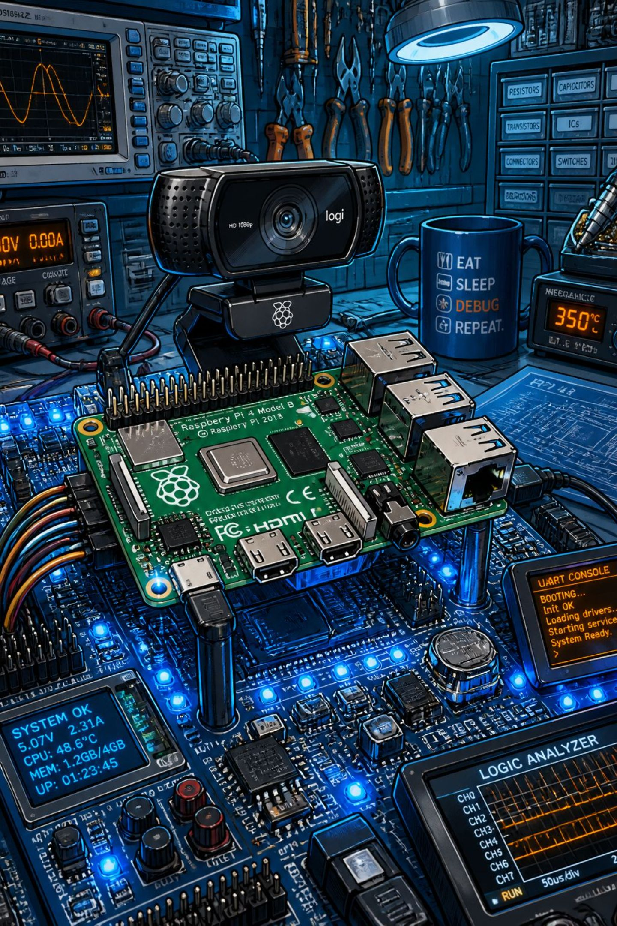




AI-Powered Real-Time Object Detection & Intelligent Surveillance System
Department of Electronics & Communication Engineering · B.Tech
OPENCV
YOLOV8
IOT
EDGE AI

Slide 2
Project Guide: MR.M.CHEENYA
(ASSISTANT PROFESSOR)
TEAM MEMEBERS:
Gaurav Sai. V (24P81A0462)
Anand. T (24P81A0456)
Gnaneshwar. S (24P81A0452)
Chanti. V (24P81A0458)
Bhavika .R (24P81A0446)

Slide 3
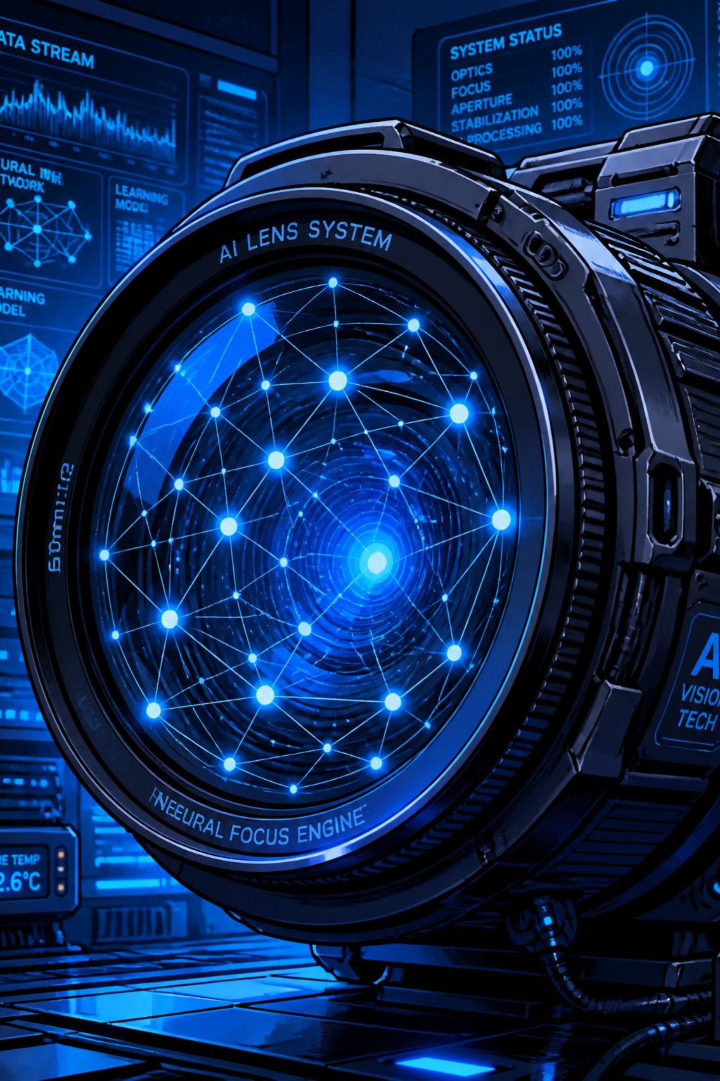
Introduction
This project sits at the intersection of four transformative technologies, enabling intelligent, autonomous surveillance at the network edge.
Artificial Intelligence
Enables machines to perceive, learn, and make decisions from visual data.
Computer Vision
Extracts meaningful information from images and video streams in real time.
Internet of Things
Connects physical devices to cloud platforms for remote monitoring and control.
Edge Computing
Processes data locally on the Raspberry Pi, reducing latency and bandwidth.

Slide 4
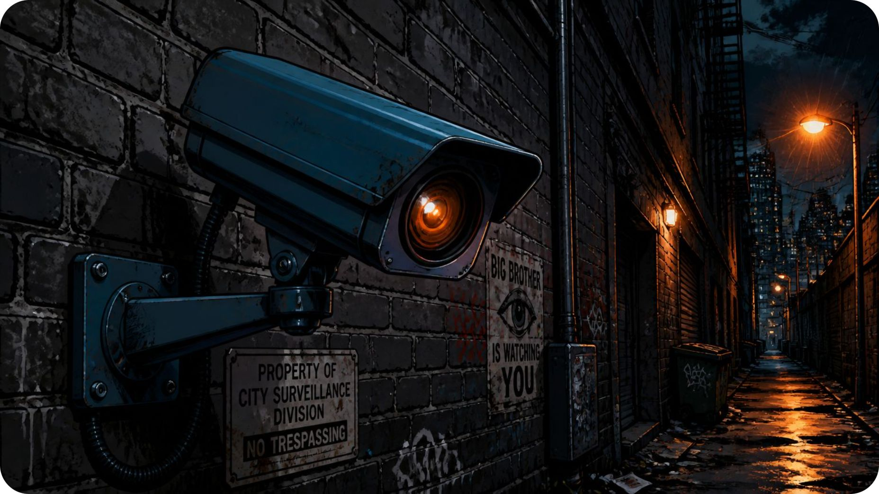
Problem Statement
Limitations of Traditional Surveillance
Conventional systems rely on passive recording and human monitoring — a model that is slow, error-prone, and costly at scale.
Human Dependency
Delayed Response
No Intelligent Analysis
Continuous manual monitoring is impractical and prone to fatigue-induced errors.
Incidents are detected only after review, not in real time.
Traditional cameras record but cannot classify or interpret what they see.

Slide 5
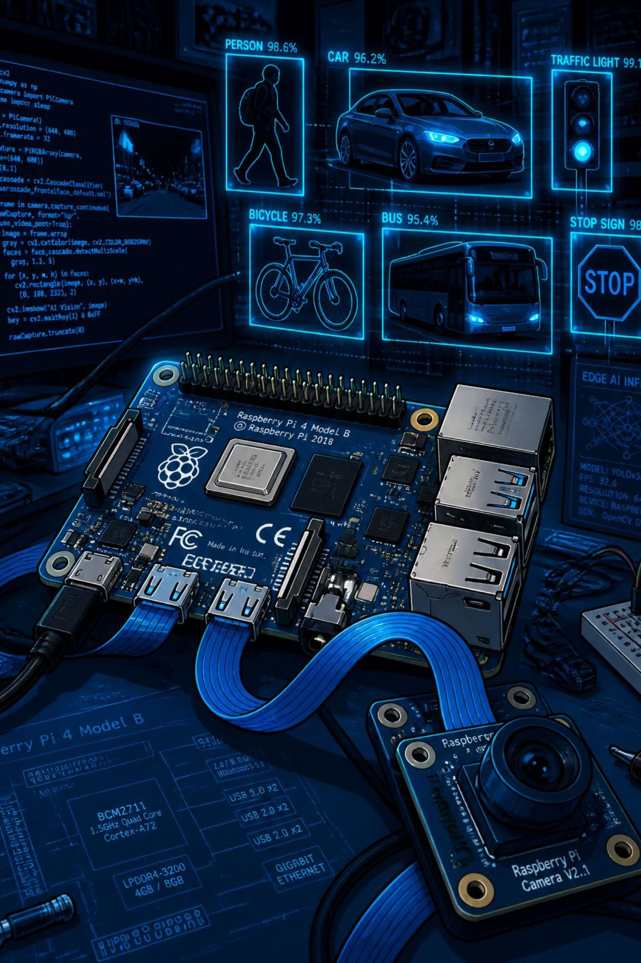
Project Objectives
Real-Time Detection
Detect and classify objects in live video frames with minimal latency.
OpenCV + YOLO Integration
Leverage OpenCV for image processing and YOLOv8 for high-accuracy detection.
Edge Processing on Raspberry Pi
Execute all inference locally, eliminating cloud dependency for core detection.
IoT Cloud Upload
Transmit detection metadata to a cloud dashboard via MQTT/HTTP for remote monitoring.

Slide 6
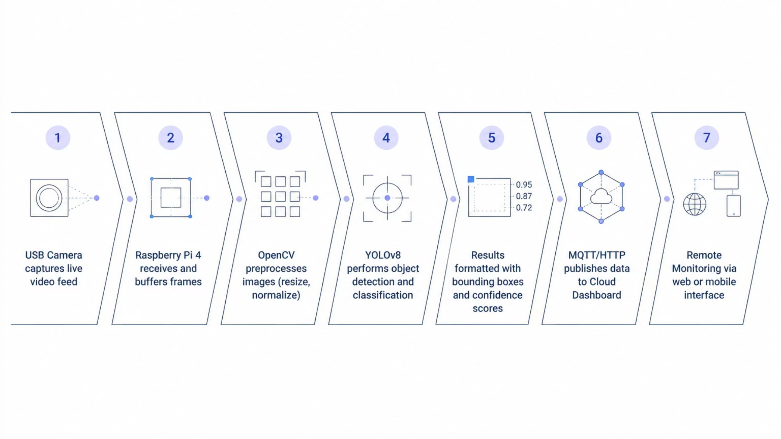
Proposed System Architecture
The end-to-end pipeline captures live video, processes it on the Raspberry Pi edge device, and streams detection results to a cloud dashboard for remote access.

Slide 7
Hardware & Software Stack
Hardware Components
Software Components
Component
Specification
Raspberry Pi
4GB RAM, 1.5GHz Quad-core
USB Webcam
720p/1080p, 30fps
Raspberry Pi OS
Python 3
MicroSD Card
32GB Class 10
Lightweight Linux distro optimized for Pi.
Core programming language for detection pipeline.
Power Adapter
5V / 3A USB-C
Wi-Fi Module
802.11ac Dual-band
OpenCV
YOLOv8
Image processing and frame manipulation library.
State-of-the-art real-time object detection model.
MQTT / NumPy
VS Code
Lightweight IoT protocol + numerical computing.
Development environment with remote SSH support.

Slide 8
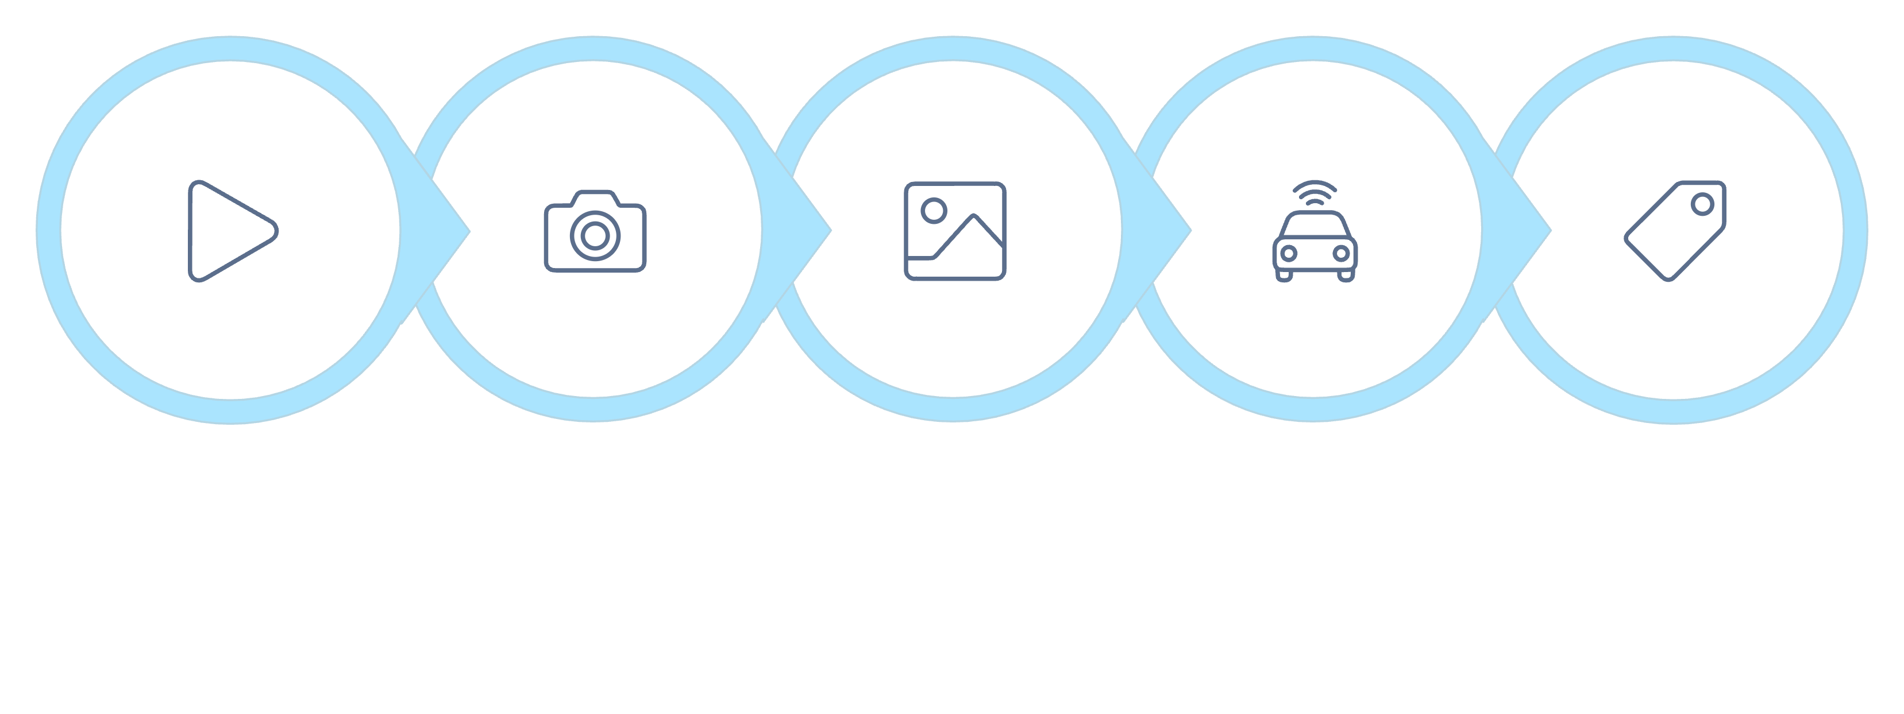
Methodology & Working Principle
Capture Video
Preprocess Frame
Classify Objects
Start
Run YOLOv8
The camera captures a continuous video stream. Each frame is resized and normalized by OpenCV, then fed into the YOLOv8 model running on the Raspberry Pi. Detected objects are annotated with bounding boxes and confidence scores, and metadata is published to the IoT cloud dashboard in real time.

Slide 9
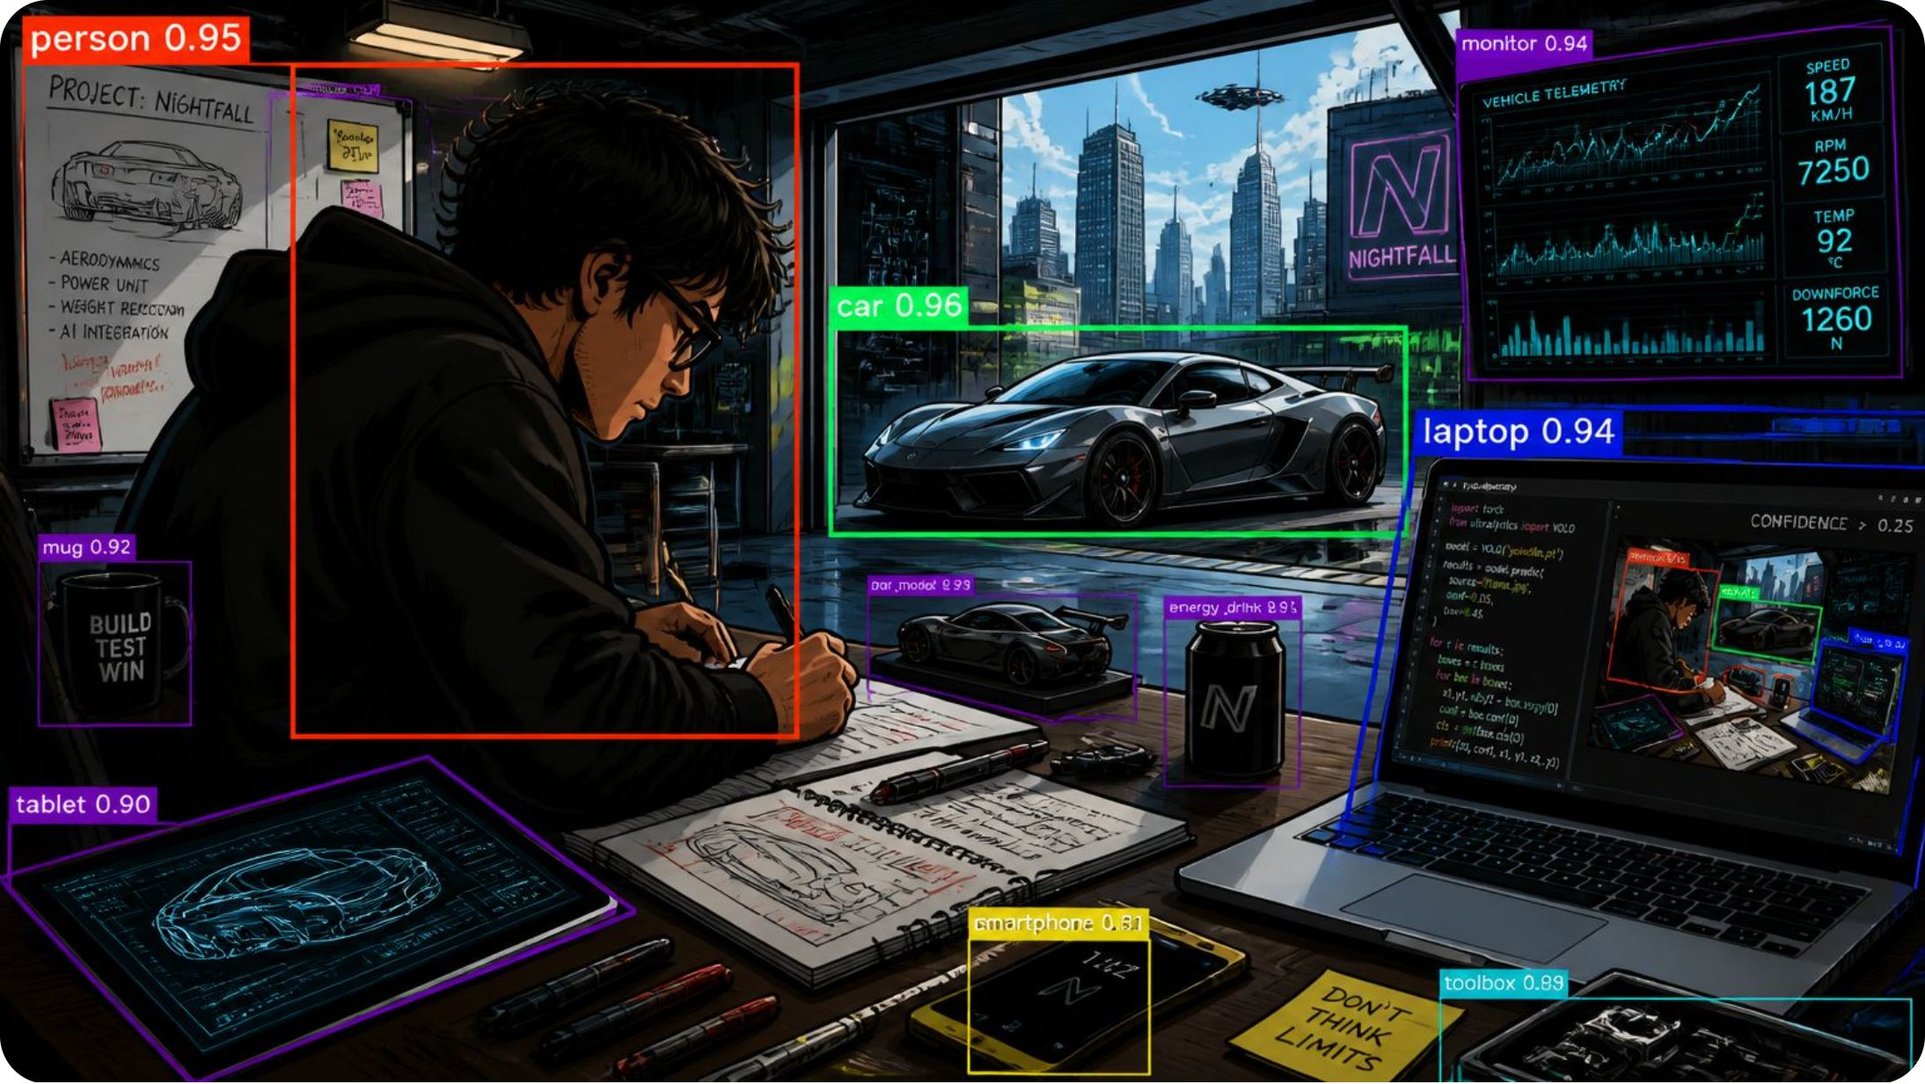
Expected Results
Detection Output
The system overlays colored bounding boxes on detected objects with class labels and confidence percentages.
Multi-Object Detection
Confidence Scores
Cloud Dashboard
Simultaneously detects persons, vehicles, animals, and everyday objects.
Each prediction includes a confidence value (0–100%) indicating detection certainty.
Timestamped alerts and detection logs accessible remotely via web interface.

Slide 10
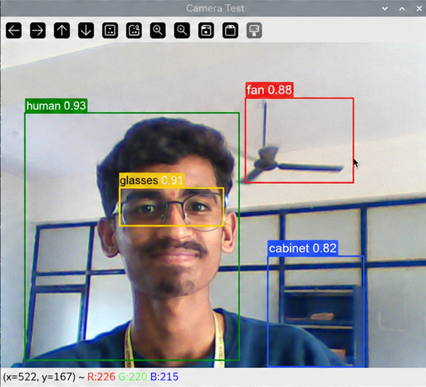
Results (version 1 )
Detection Output
The system overlays colored bounding boxes on detected objects with class labels and confidence percentages.
Multi-Object Detection
Confidence Scores
Cloud Dashboard
Simultaneously detects persons, vehicles, animals, and everyday objects.
Each prediction includes a confidence value (0–100%) indicating detection certainty.
Timestamped alerts and detection logs accessible remotely via web interface.

Slide 11
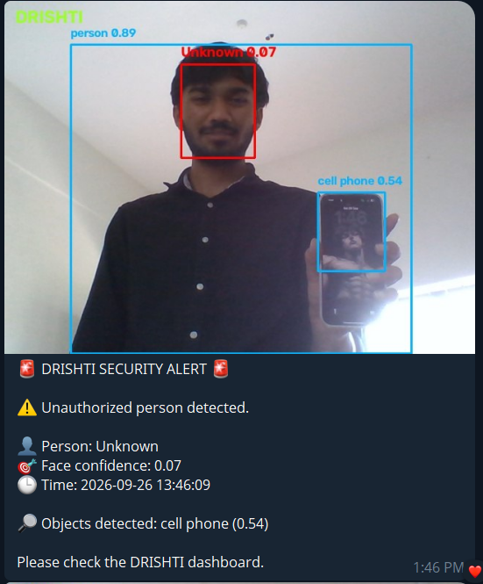
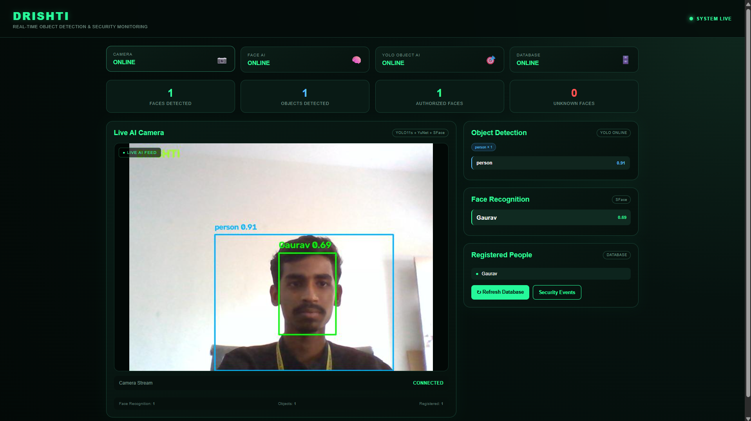
Results (final version )
Web Dashboard
Intrusion Notification
Surveillance Monitoring
Provides a centralized real-time interface for live camera feeds, object detection, face recognition, system status, and security events.
Automatically generates security alerts when an unknown person enters a configured secured zone, including detection details and timestamps.
Enables continuous AI-powered monitoring, combining object detection and face recognition to observe and identify activity within the monitored area.

Slide 12
Applications
Smart Surveillance
Traffic Monitoring
Automated intrusion detection for homes and enterprises.
Vehicle counting, congestion analysis, and incident detection.
Industrial Automation
Retail Analytics
Quality inspection, worker safety, and assembly line monitoring.
Customer flow tracking, shelf monitoring, and behavior analysis.
Agriculture
Smart Cities & Home Security
Crop health monitoring, pest detection, and yield estimation.
Integrated urban monitoring and residential safety systems.

Slide 13

Advantages, Future Scope & Conclusion
Key Advantages
Future Enhancements
Low Cost — Raspberry Pi provides affordable edge compute.
Face & ANPR
Fire & Smoke Detection
Identity and license plate recognition.
Real-Time & Low Latency — On-device inference eliminates cloud round-trip.
Early hazard identification for safety systems.
Portable & Energy Efficient — Compact form factor, minimal power draw.
Gesture Recognition
Advanced Cloud AI
Human-computer interaction via hand gestures.
Deeper analytics and historical trend modeling.
Scalable — Easily deployable across multiple nodes.
Conclusion: This project demonstrates a complete, deployable edge-AI pipeline — integrating Raspberry Pi, OpenCV, YOLOv8, and IoT cloud — delivering real-time, intelligent object detection with clear practical applications and a strong roadmap for future expansion.

