Slide 1
Nerd Box
Group 11
Charles Nasser, Cesar Ordaz-Coronel, Anthony Bruno
Notes:
Intro slide
Have KiCAD with schematic, board, GitHub with Code section, BOM, Test Results Document,

Slide 2
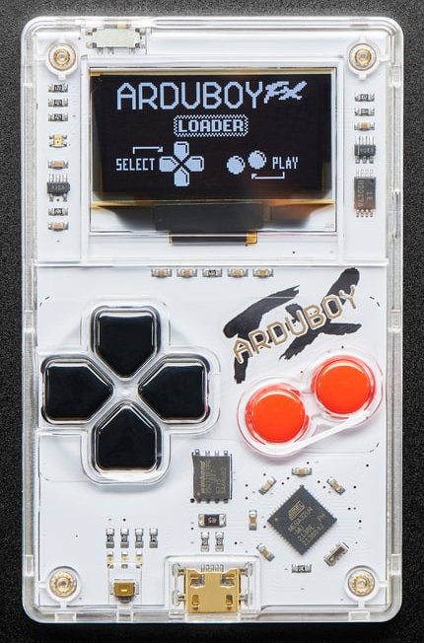
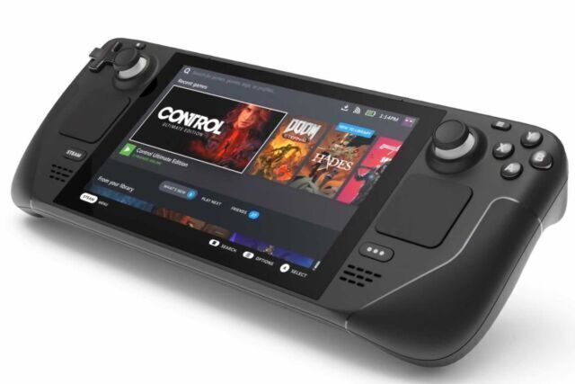
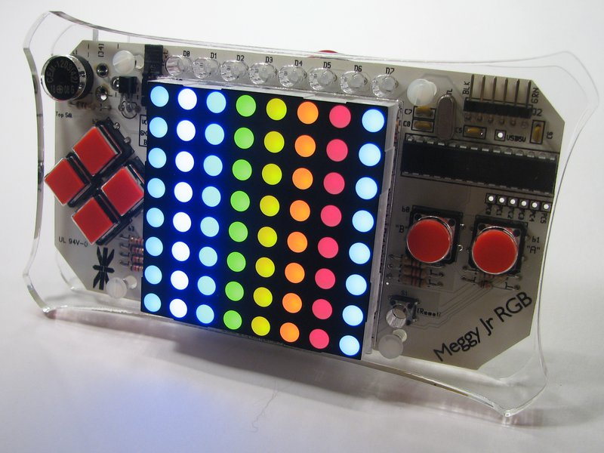
Background
The issue addressed:
Portable Gaming + Open Source Hardware + Game Creation = One Solution
Values of a Solution: Educational, Creativity, Enjoyment
Today’s Solutions
High-end solutions = $$$ for individual, Discontinued, moves quickly
Low-end solutions = Discontinued, sold out, Outdated, other
ArduBoy - Too small form factor
Steam Deck Retail: $400 starting
Meggy Jr RGB - Outdated HW

Slide 3
Our Approach
Concept of Operations:
User Input: device buttons, QWIIC (I2C) sensors
Microcontroller: translates inputs to programmed outputs
MVP Device Output: Display game animations/graphics
Device programmed using Arduino IDE or Scratch programming
USB for charging the battery
Objective: Deliver an open source hardware handheld, programmable gaming console to the video game console market that enables game development/creation and game hardware modification.

Slide 4
Requirements (Approach continued….)
MUSTS:
Be Handheld, Portable
Battery Powered
User Interface (UI)
Display Response to inputs
Menu/Navigation
Programmable for games
SHOULDS:
Non-button/switch input (motion, CV, etc.)
3D Printed Enclosure
Other non-display outputs (sound, rumble)
Battery charging
MAYS:
Memory device for storage of user settings, more memory-heavy games
Battery Level LED indicators
Use another monitor to display games on larger displays

Slide 5
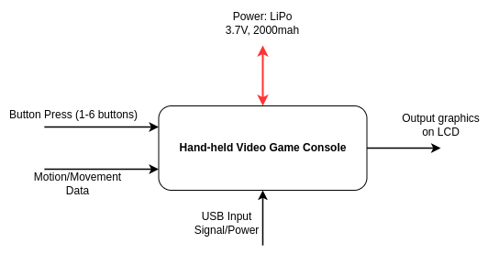
Design Overview - L0

Slide 6
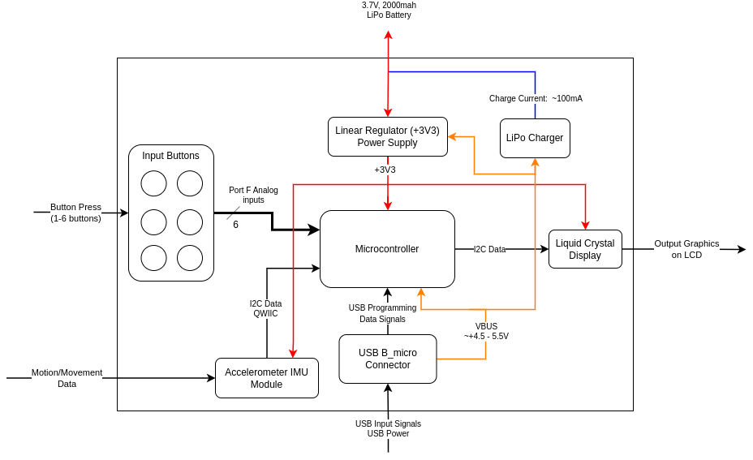
Design Overview Continued…. L1

Slide 7
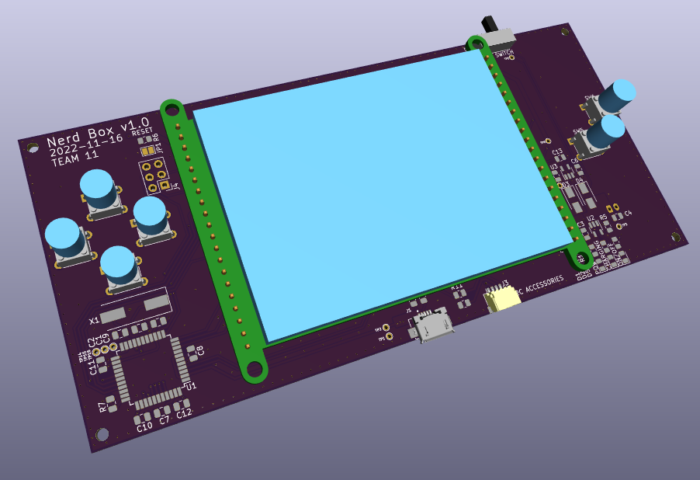
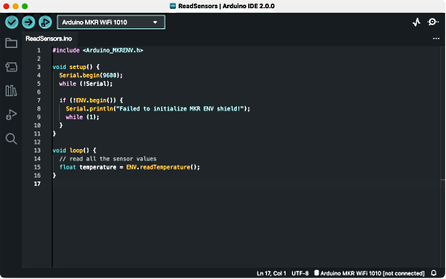
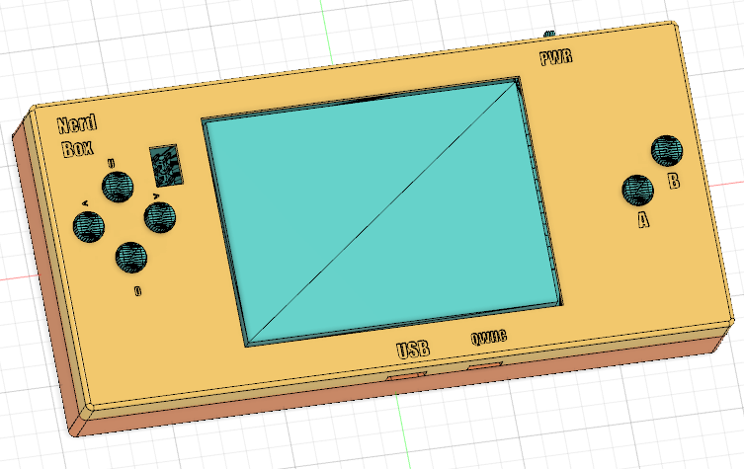
Implementation
Look at Design Schematics
Look at Design Board
Look at Code
Tools: Arduino IDE, Fusion 360, kiCAD
Look at BOM - Bill of Materials

Slide 8
IP License & Existing Work
License Chosen: Creative Commons Zero V1.0 Universal
Other IP used:
Based on Arduino Leonardo, Lilypad, Andrew Greenberg’s Example schematic (ATmega32U4 µC interface) - For Hardware
Adafruit library documentation - For code
Based on example game coded in processing - Example code reference

Slide 9
Testing
In Design/Pre-test setup
Placement of Test Points (TP), ~ 16 TP
Code simple test software (Serial monitor printing, button presses, etc.)
Assembly Testing
Solder [section] + Run with either Bench supply or Battery + measure TPs OR software testing
Section Order:
device power supply, LiPo charger, Microcontroller, USB, Display/buttons
Take video of tests
Running the Test Plans → Show in the GDrive

Slide 10
Results (for the PROJECT)
What Worked for us
The output of the regulator showed +3V3
Device display showing programmed graphics
Device PASSED written test plans
What didn’t Work well for us
Bootloader failure → switched to +5V from +3V3
Display wasn’t functioning properly → Solder/close some pads on the 2.8” TFT display board to use SPI mode
Problem accessing pins in software → Fixed pin naming in Arduino IDE

Slide 11
Results (for the TEAM)
What worked for us
Group communication messaging system (Discord)
Regular scheduled meetings that fits with our schedules
Checking each other’s work
What didn’t work so well for us
Group of 3 (4 is better)
Working on deliverable assignments day-before due date
Extra meetings, difficult to schedule

Slide 12
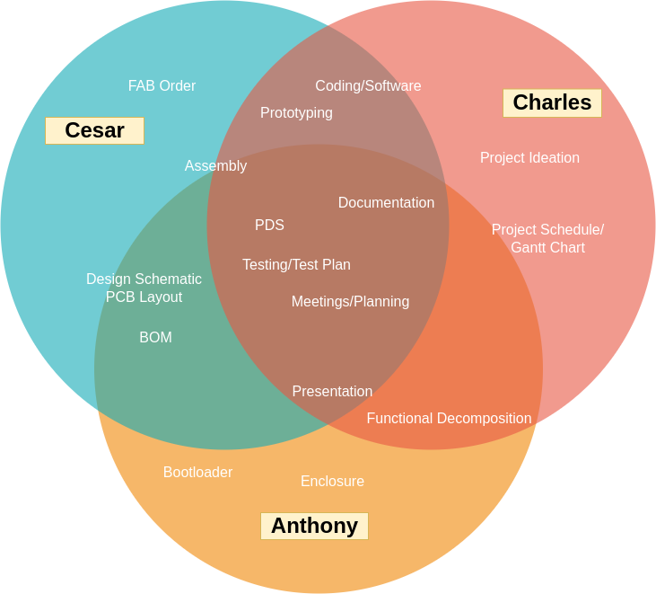
Contributions
Notes:
Use a venn diagram with each of our names and contributions

Slide 13
Lessons Learned
Communication in a project with a short development time is CRITICAL
Help check each other’s work to verify
Prototype early, Prototype with better parts
Time Machine - done differently……
Add more memory w/ a different microcontroller
Add more output features such as sound
Add a battery indicator to the LCD
Easier interface for users to add their code

Slide 14

Alright….. Let’s Demo
Demo Video if necessary

Slide 15
Let’s look at the Collaboration site
Link Here

