Slide 1
Speed Demon Speedometer
Team15
Andrew Capatina, Zachary Stamler
Nathaniel Dusciuc, Linyi Hong

Slide 2
Problem/Need
A simple effective way of measuring speed on a human powered device
No off-the-shelf alternatives for skateboards or longboards
Cyclists and skateboarders like to measure their own performance and want a device that can do this easily.

Slide 3
Motivation
Device allows the user to know their speed
Dedicated device frees up hands for rider safety
Allows installation on bicycle, skateboard, longboard, or any other wheeled conveyance
One device can be used for multiple vehicles

Slide 4
Objective
A working prototype that serves as a proof of concept and allows testing of device functionality

Slide 5
Alternatives
GPS
Dependant on GPS signal
Often inaccurate at low speeds
Require expensive device or smartphone
Bicycle speedometers
Off-the-shelf speedometers exist for bicycles but they are not compatible with skateboards or other vehicles

Slide 6
Requirements
Device measures wheel rotations and displays speed on a screen
User can set wheel size for use with different vehicles
User can choose different units for displayed speed
Device is battery powered

Slide 7
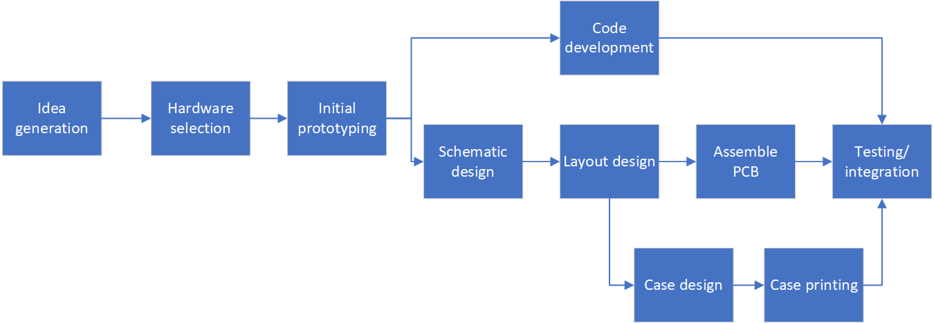
Approach

Slide 8
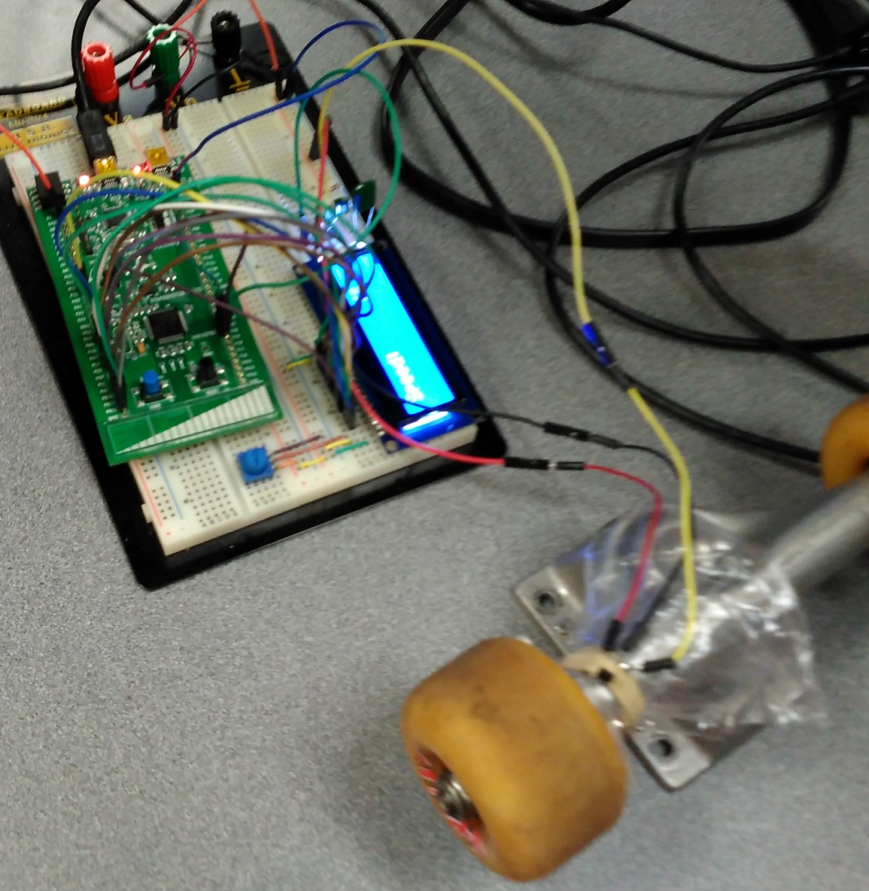
Software Development Test Rig

Slide 9
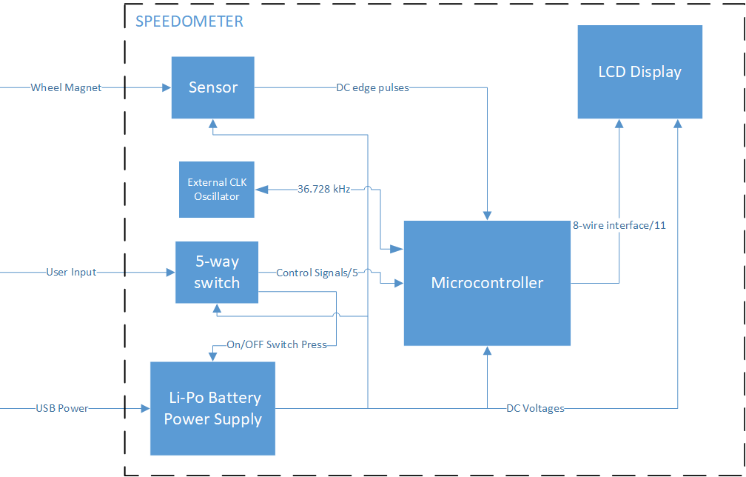
Design
Hardware

Slide 10
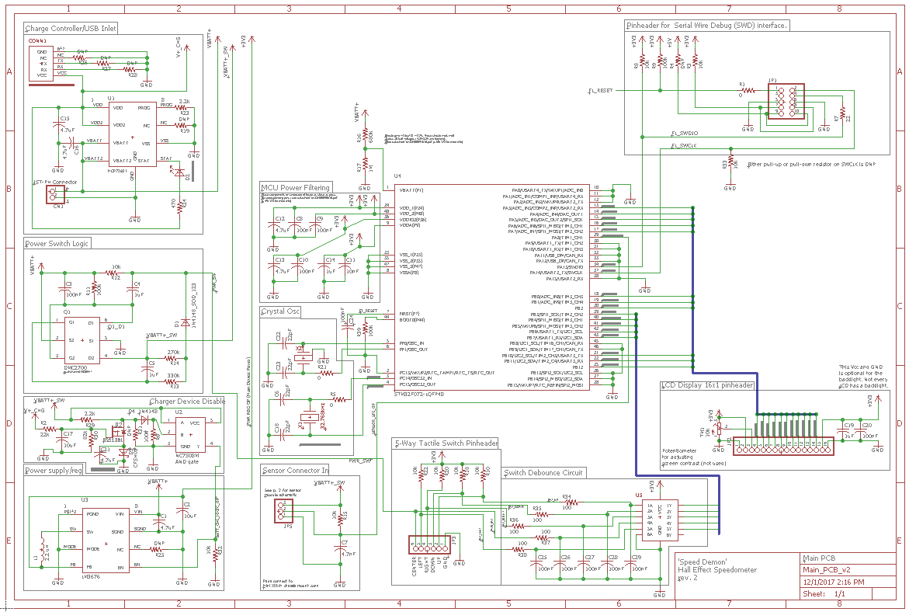
Schematic

Slide 11
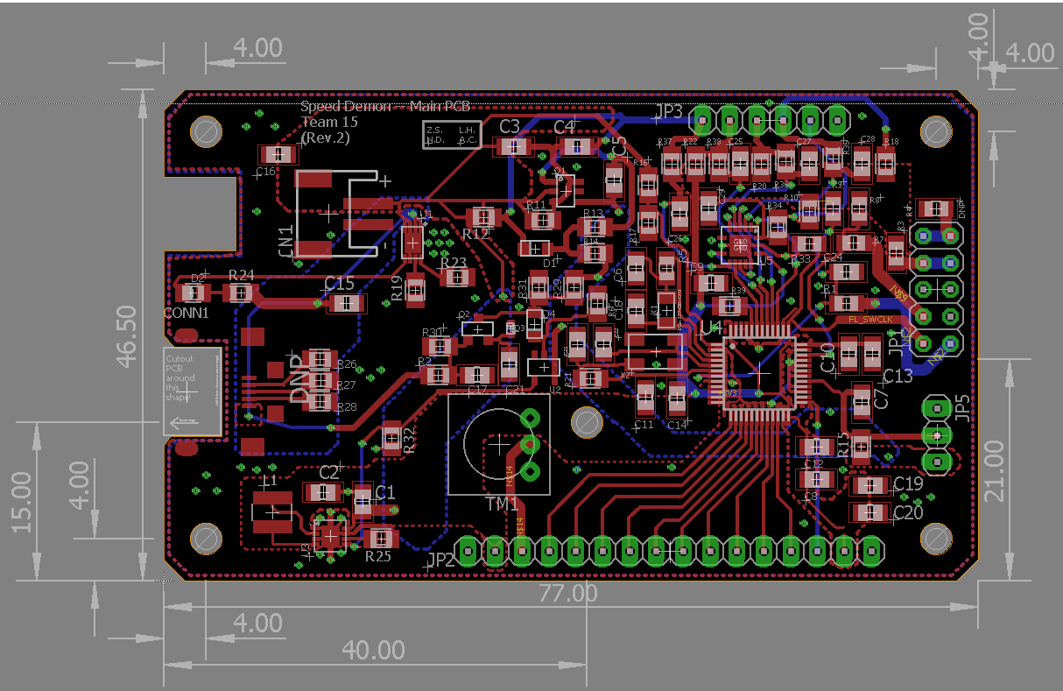
Layout

Slide 12
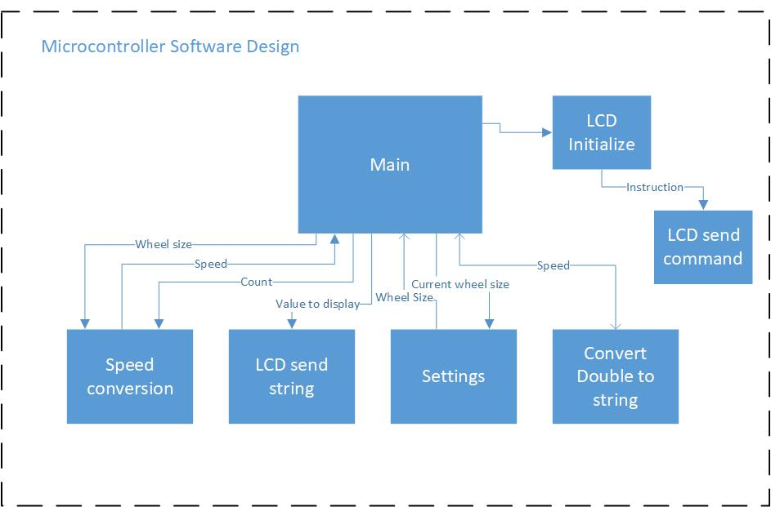
Software

Slide 13
Software continued…

Slide 14
Bill of Materials…

Slide 15
Testing
Bring up sub-circuits in sequence and verify correct functionality of each.
Interface MCU and test dummy code.
Integrate hardware modules with fully functioning code.

Slide 16
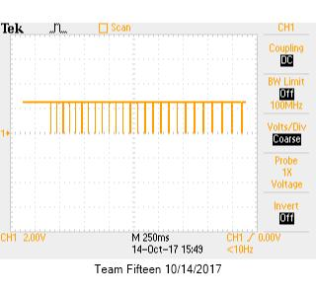
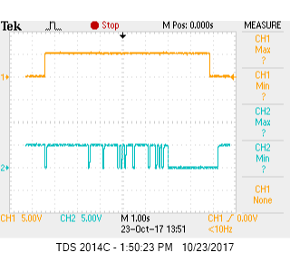
Results
Hall effect sensor prototyping
On-button prototyping

Slide 17
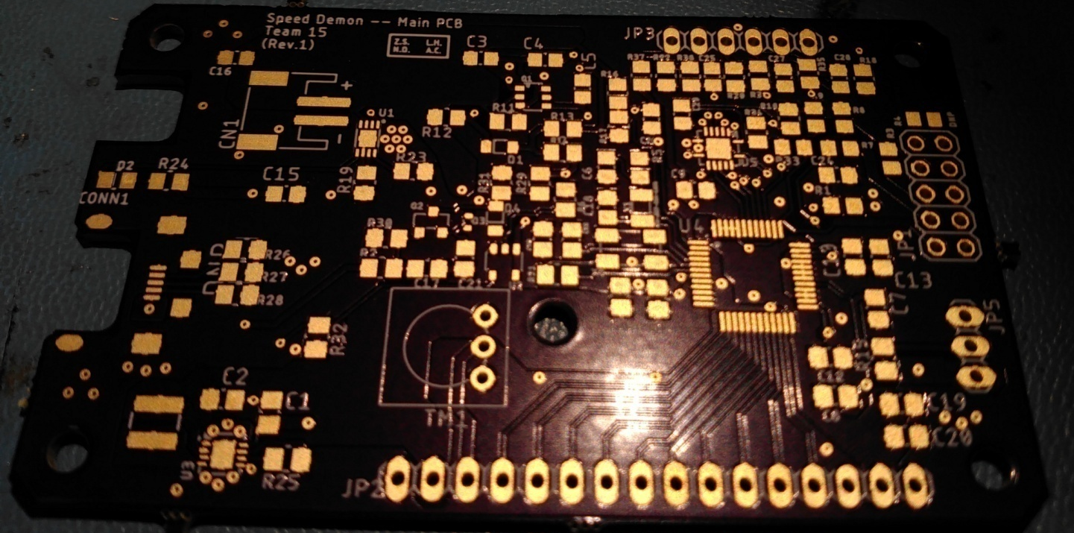
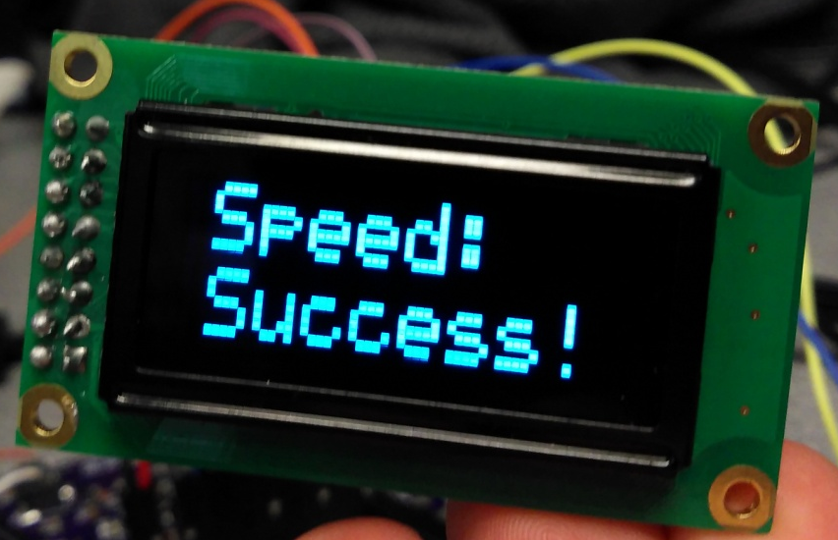

Slide 18
Contributions
N.D.
Hardware design
Schematic and layout
Part sourcing
Testing
Board bring up
Z.S.
Hardware design
Schematic and layout
EagleCAD custom parts
Part sourcing
Testing
Board bring up
A.C.
L.H.

Slide 19
Lessons Learned?

