Slide 1
Speed Demon Speedometer
Team15
Andrew Capatina, Zachary Stamler
Nathaniel Dusciuc, Linyi Hong

Slide 2
Problem/Need
A simple effective way of measuring speed on a human powered device
No off-the-shelf alternatives for skateboards or longboards
Cyclists and skateboarders like to measure their own performance and want a device that can do this easily.
To speak: Nathan

Slide 3
Motivation
Device allows the user to know their speed
Dedicated device frees up hands for rider safety
Allows installation on bicycle, skateboard, longboard, or any other wheeled conveyance
One device can be used for multiple vehicles
To speak: Nathan

Slide 4
Objective
A working prototype that serves as a proof of concept and allows testing of device functionality
To speak: Nathan

Slide 5
Alternatives
GPS
Dependant on GPS signal
Often inaccurate at low speeds
Require expensive device or smartphone
Bicycle speedometers
Off-the-shelf speedometers exist for bicycles but they are not compatible with skateboards or other vehicles
To speak: Nathan

Slide 6
Requirements
Device measures wheel rotations and displays speed on a screen
User can choose different units for displayed speed
User can set wheel size for use with different vehicles
Device is battery powered
To speak: Nathan

Slide 7
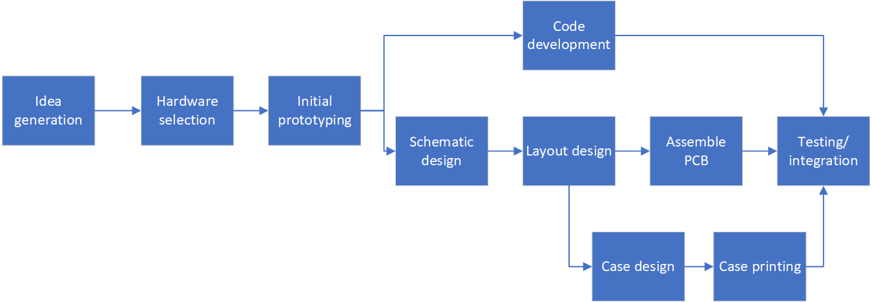
Approach
To speak: Nathan

Slide 8
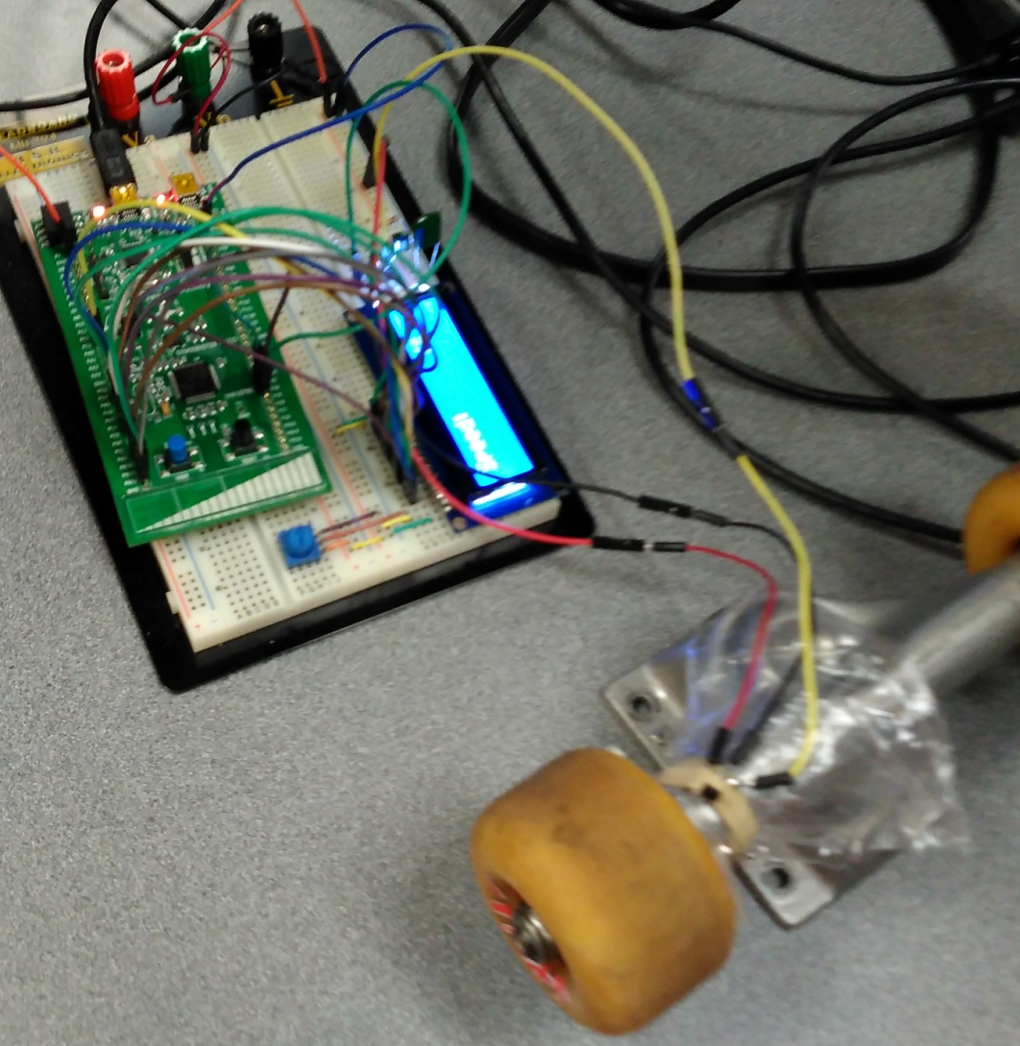
Prototyping
To speak: Nathan

Slide 9
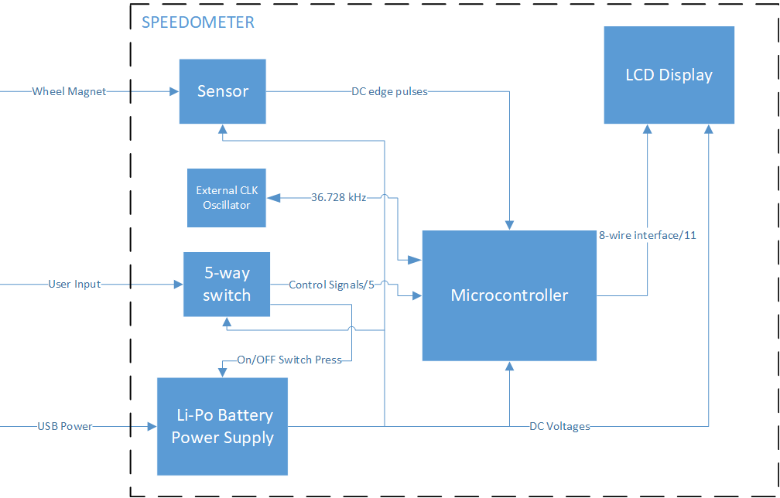
Design - Hardware
To speak: Zach

Slide 10
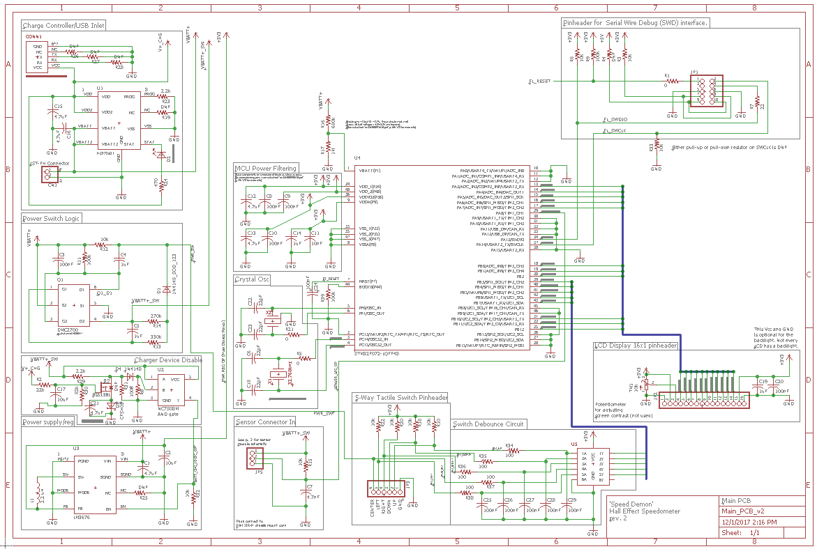
Schematic
To speak: Zach

Slide 11
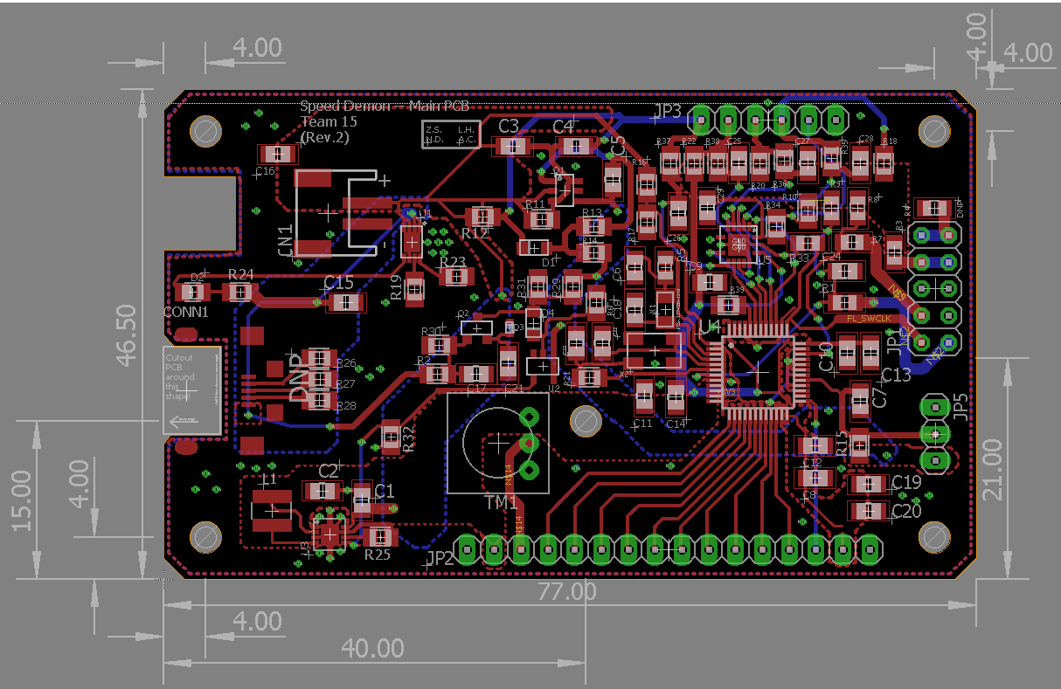
Hardware PCB Layout
To speak: Zach

Slide 12
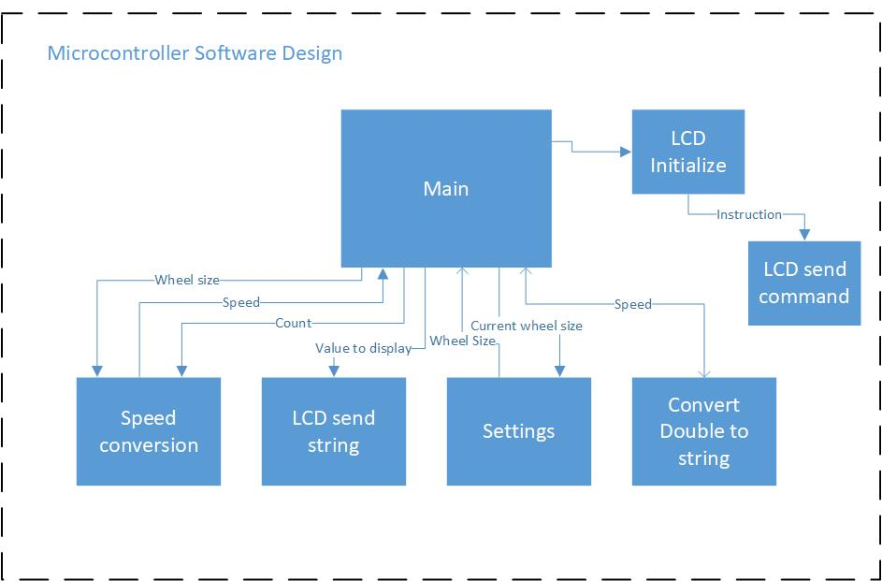
High Level Software Implementation
To speak: Andrew

Slide 13
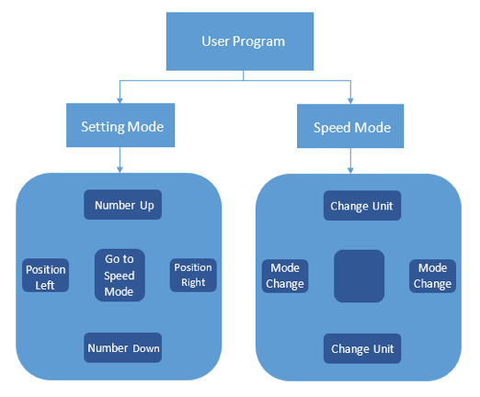
Software Implementation - User Program
To speak: Andrew

Slide 14
Design Alternatives?
Module | Option 1 | Option 2
Speed Conversion | Polling Hall Effect Sensor Input | Interrupts (input capture)
Settings | Polling button inputs | Interrupts
What are the tradeoffs?
Polling requires extra effort for timing
Not utilizing available resources as well
Decisions Made:
Speed Conversion: option 2
Settings: option 2
To speak: Andrew

Slide 15
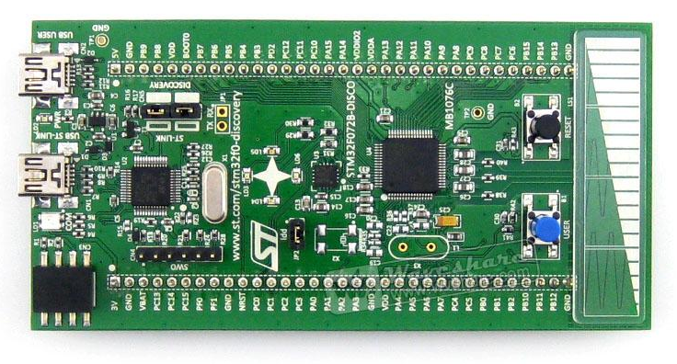
Software Development Tools
MCU hardware configuration:
STM32CubeMX
Compiler/debugger
Keil uVision IDE.
Development Board
STM32F072B-DISCOVERY
To speak: Andrew

Slide 16
Work referenced for Software
Patrick Hood-Daniel
Provided program structure for OLED program.
Le Tan Phuc
Provided tutorial on how to initialize input capture.
Links:
https://letanphuc.net/2015/06/stm32f0-timer-tutorial-and-counter-tutorial/
https://www.youtube.com/watch?v=micDbBN9s9k&list=PL6PplMTH29SHbfyqpSqn-2gyJZtuwzEqs
To speak: Andrew

Slide 17
Bill of Materials…
To speak: Linyi

Slide 18
Testing
Bring up sub-circuits in sequence and verify correct functionality of each.
Interface MCU and test dummy code.
Integrate hardware modules with fully functioning code.
To speak: Linyi

Slide 19
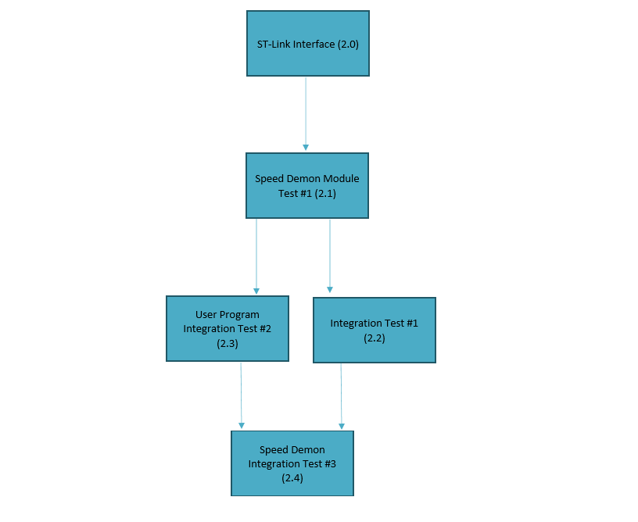
Software Test Plan
To speak: Linyi

Slide 20
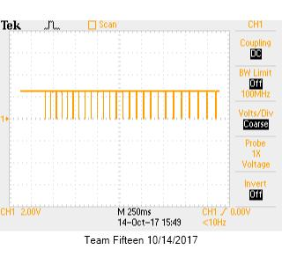
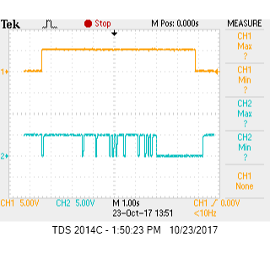
Results
Hall effect sensor prototyping
On-button prototyping
To speak: Linyi

Slide 21
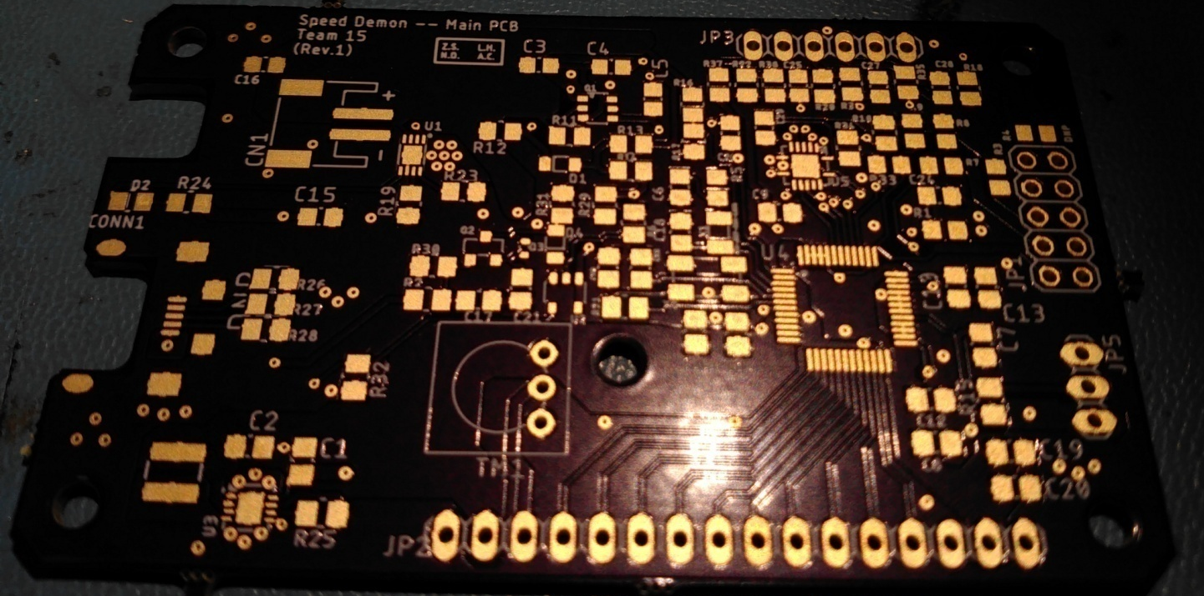
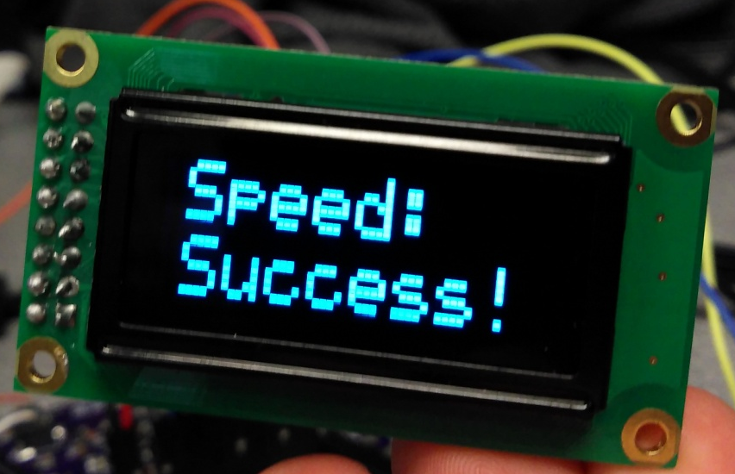
To speak: Linyi

Slide 22
Contributions
N.D.
Hardware design
Schematic and layout
Part sourcing
Testing
Board bring up
Z.S.
Hardware design
Schematic and layout
EagleCAD custom parts
Part sourcing
Testing
Board bring up
A.C.
Software Design
Part sourcing
Testing software
speedDemon software integration
L.H.
Software design
Testing software
Hardware design
Case design
To speak: Linyi

Slide 23
Lessons Learned?
To speak: All

