Slide 1
EE 445L – Embedded System Design Lab
Threshold Detection
For more information read Section 8.2.3 in the book

Slide 2
Threshold Detection
No feedback (no hysteresis)
EE 445L – Bard, McDermott, Valvano

Slide 3
Threshold Detection (2)
Positive feedback (Hysteresis)
EE 445L – Bard, McDermott, Valvano

Slide 4
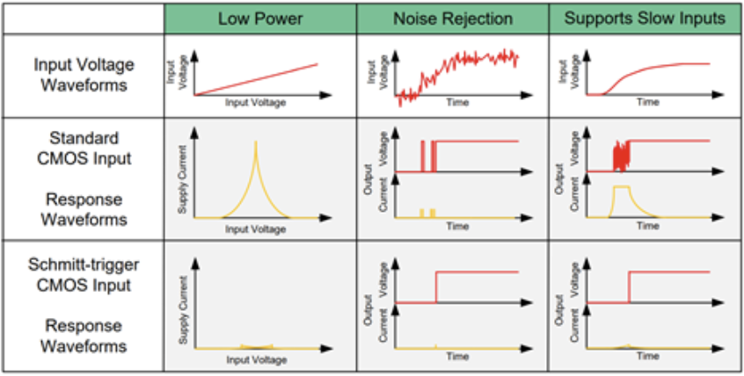
Benefits of hysteresis inputs
https://www.ti.com/lit/an/scea046/scea046.pdf?ts=1666189063259

Slide 5
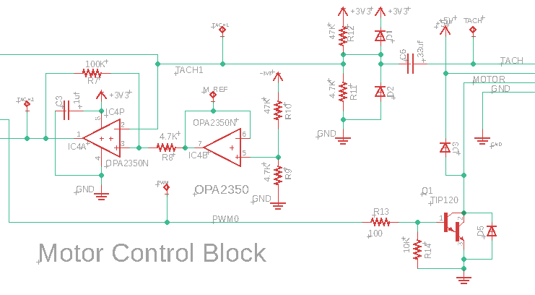
Threshold Detection (3)
EE 445L – Bard, McDermott, Valvano

Slide 6
Summary
Positive/no feedback
Hysteresis
Rail to rail

