Slide 1
ECE 492 Capstone Design: Multi-Functional Wireless Guitar
Group 4: Aaron Arnason, Byron Maroney, Edrick de Guzman

Slide 2
Project Overview
The project has 4 main aspects:
Digital Signal Processing
Interfacing with Bluetooth Modules
Live-streaming over TCP/IP sockets
Power Amplifier with Passive Filtration (coming soon…)
Motivation
Wireless Guitar Adapters are pricey
No commercial solution that incorporates the functionality listed above

Slide 3
What we’ve done so far…
Aaron
Performed testing with the Guitar Signals
Designed the architecture of the Main DSP
Byron
Interfaced the Audio Circuitry with the NIOS II Processor
Integration testing with the DSP
Researched I2S protocol
Edrick
Implemented Distortion effect in VHDL
Tested the Distortion component in MATLAB and ModelSim
Testing Reverberation effect in MATLAB

Slide 4
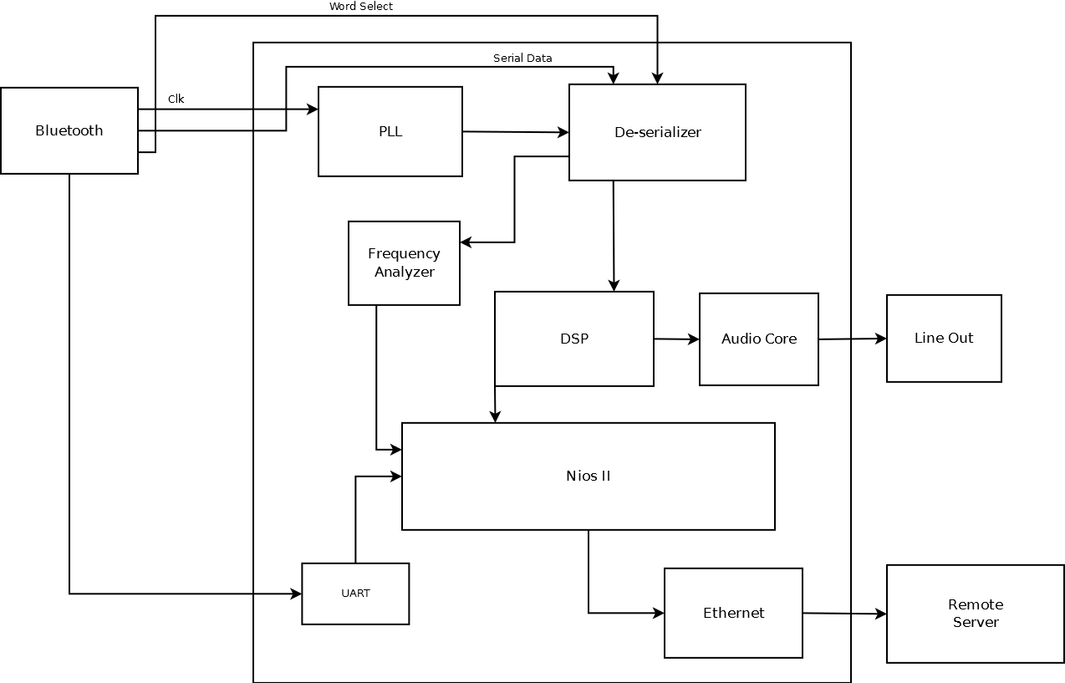
Functionality: Hardware
DE2

Slide 5
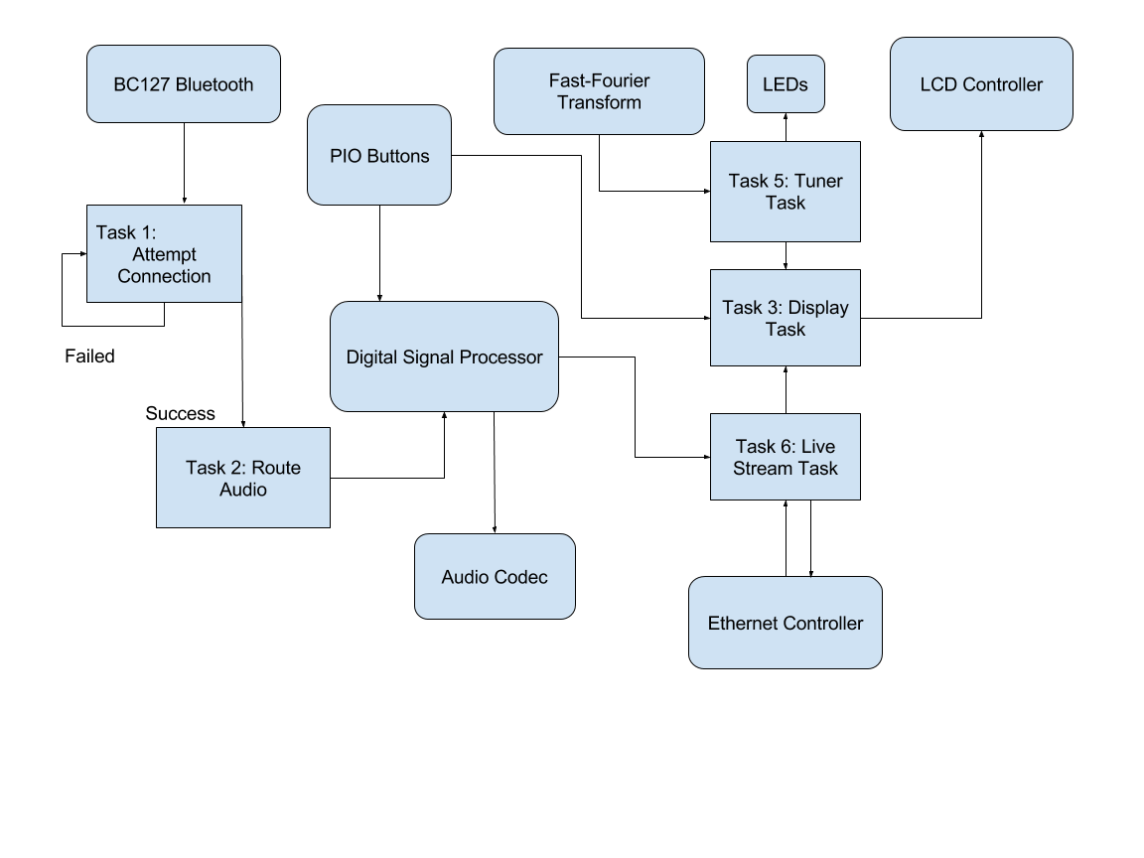
Functionality: Software

Slide 6
Functionality
DSP
The DSP can perform 3 effects
1: Distortion (Clipping)
2: Delay (Time-shifting)
3: Reverberation (Adding dampened echoes)

Slide 7
Functionality
Frequency Analyzer
Required to implement the guitar tuner
We need to find the fundamental frequency to determine the notes being played
Can be accomplished using a Fast-Fourier Transform
Mapping the frequencies to the notes will be done in software
Need to use fixed-point arithmetic
String | Frequency | Scientific pitch notation
1 (E) | 329.63 Hz | E4
2 (B) | 246.94 Hz | B3
3 (G) | 196.00 Hz | G3
4 (D) | 146.83 Hz | D3
5 (A) | 110.00 Hz | A2
6 (E) | 82.41 Hz | E2

Slide 8
Functionality
Bluetooth Module
Transmits audio using A2DP (for high-quality audio) and AVRCP to select what effects we’re using
Repurpose AVCRP signals
Communicates with the Audio Codec (on the DE2) via I2S protocol
The Bluetooth module is managed by the DE2 via the UART
One of the modules will need to be pre-programmed

Slide 9
Functionality
Web Server
Audio data will be sent to remote web server using sockets over HTTP protocol
Remote server will have to buffer the input
Remote Web Server Implementation
Not a design constraint (many web technology stacks exist)
Currently favoring MEAN (MongoDB, Express, AngularJS, Node) Stack
Easy to design, but mediocre performance

Slide 10
Challenges
Buffering
The data sent from the Bluetooth module uses I2S protocol.
I2S is a continuous protocol (uses a single data line)
The DSP input requires de-serialized data coming from the Bluetooth module
DSP requires data to be re-serialized when sent to the Audio Codec
Web server needs to buffer the audio stream to prevent “glitches”
Latency
It’s difficult to play guitar if there’s a lot of latency
Solution: Limit software, increase hardware usage
Load Balancing the Web Server

Slide 11
Components List
Bluetooth Module
Frequency Analyzer
UART
DSP
Audio Codec
De-Serializer/Serializer
NIOS II
Ethernet MAC

Slide 12
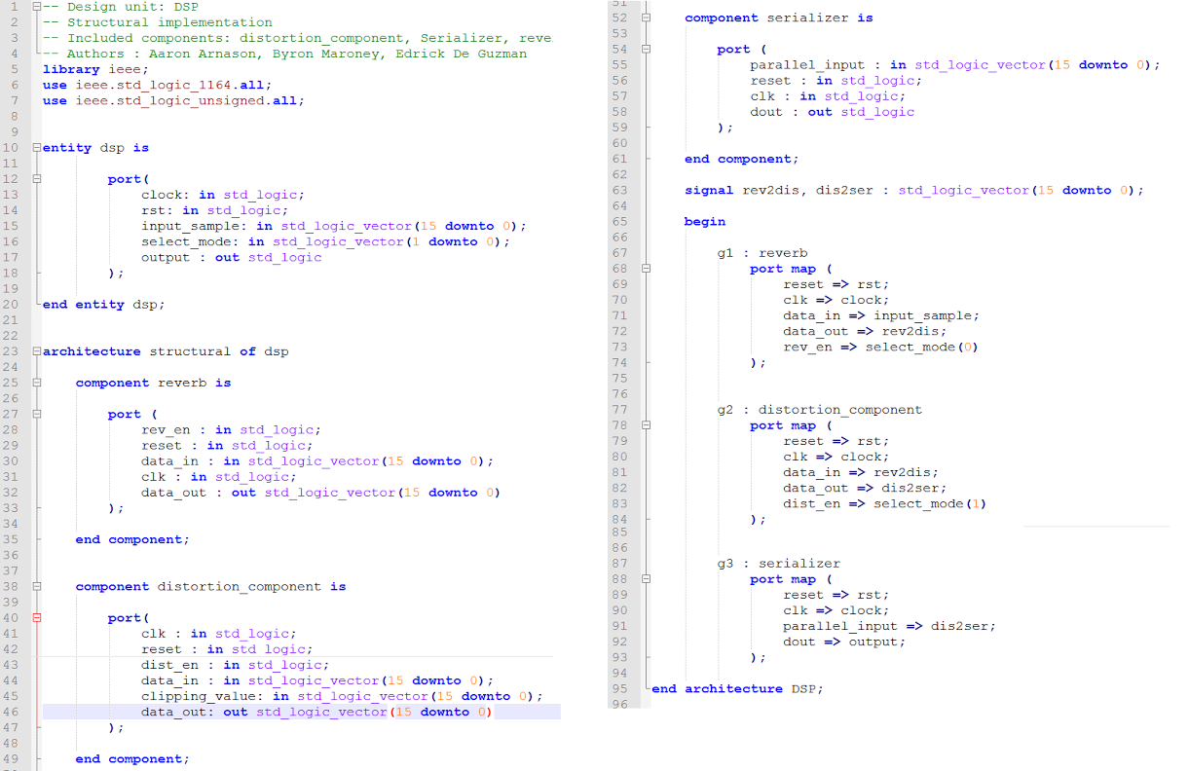
Code Example: DSP

Slide 13
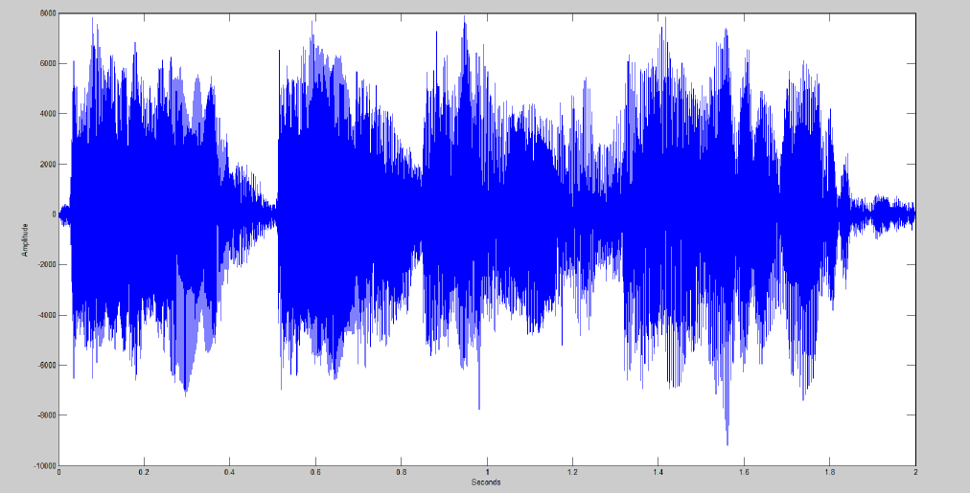
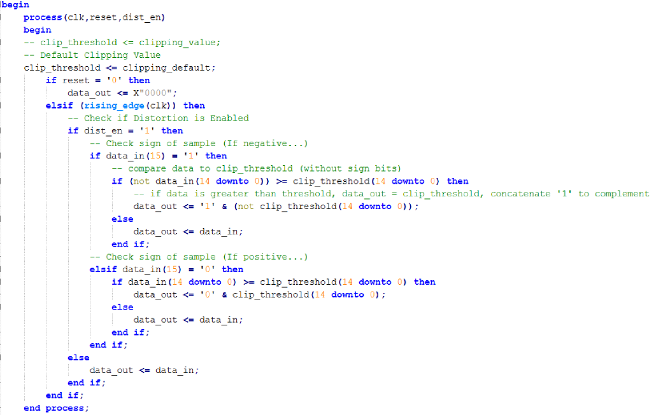
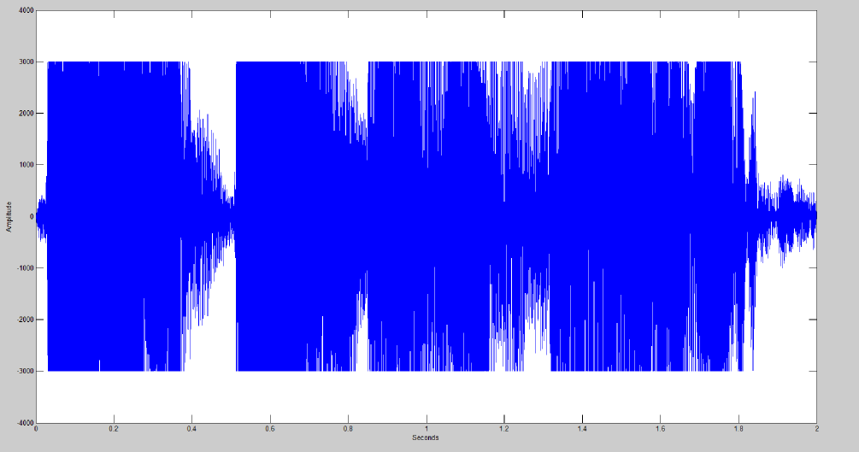
Code Example
Distortion Component

Slide 14
Test Plan
Make sure audio core works
Make sure Guitar outputs at Line level
Test individual DSP components
Distortion
Reverberation
Serializer/De-serializer
Test implementation of I2S Protocol by directly interfacing with the audio codec
Make sure Bluetooth Component works
Test Master/Slave Bluetooth configuration (ignore DE2)
Test guitar signal over Bluetooth
Test guitar tuner(sufficient resolution required)
Test guitar effects
Streaming
Test streaming audio over sockets (ignore Nios II)
Test streaming audio over sockets (with Nios II)

Slide 15
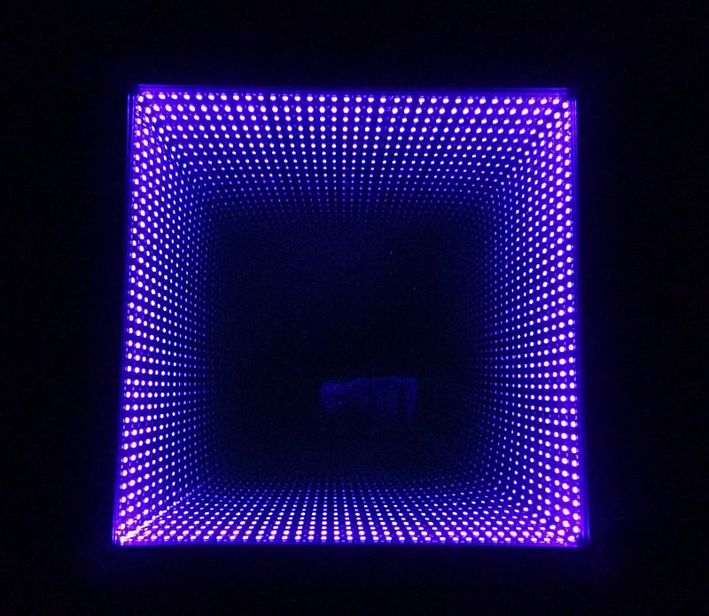
Optional Features
Automatic Tuning
Automatic Guitar Tab Generator
More Effects:
Chorus
Acoustic Simulator
Equalizer
Infinity Mirror (Visualizer) [1] - https://en.wikipedia.org/wiki/Infinity_mirror#/media/File:Ultraviolet_infinity_mirro.jpg

Slide 16

Questions
http://vignette3.wikia.nocookie.net/spore/images/6/6c/Question-mark.png/revision/latest?cb=20110427230528

