Slide 1
Cloud-based Home Automation System
Atharva Mahindrakar
Deepak Mohan

Slide 2
Home Automation
Remote Monitoring and Control
Automatic activities
Improve energy efficiency
Security
Ease of use

Slide 3
Features
Remote monitoring using Android Application
Intruder detection
Autonomous control of peripherals
Cloud based user authentication and location awareness

Slide 4
System Overview
Phone
Firebase
Phone
AP
Raspberry Pi
PIR 2
Light 1
Light 2
Fan 1
Fan 2
PIR1
Room 1
Room 2

Slide 5
Solution Overview
Android Things
Android application
Network services
Location services
Firebase backend
Raspberry Pi
Sensors
Peripherals

Slide 6
Mobile Application
Firebase authentication & Database services
Geo location services and Network information services
Fragments

Slide 7
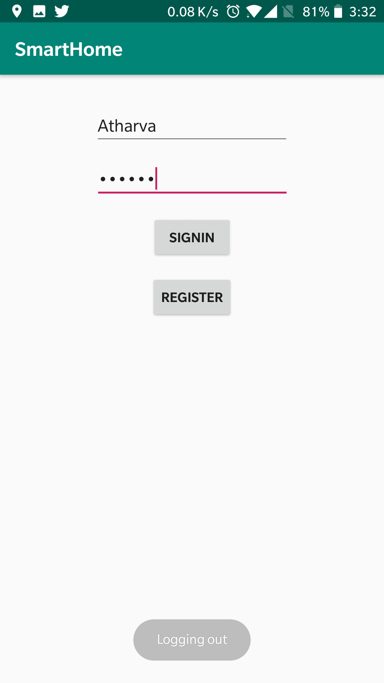
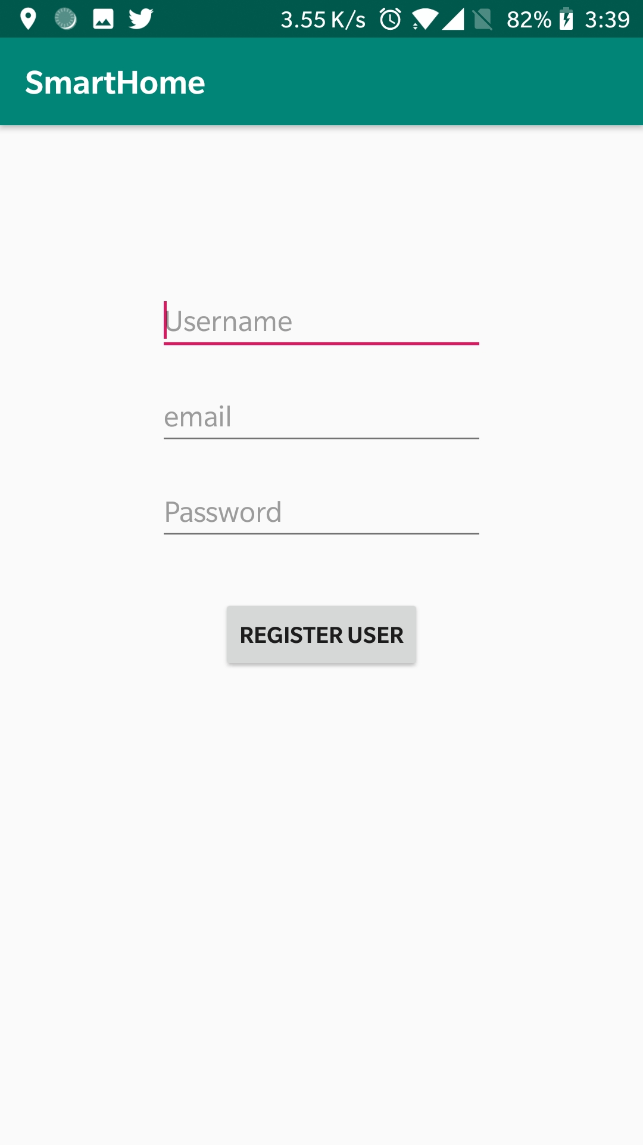
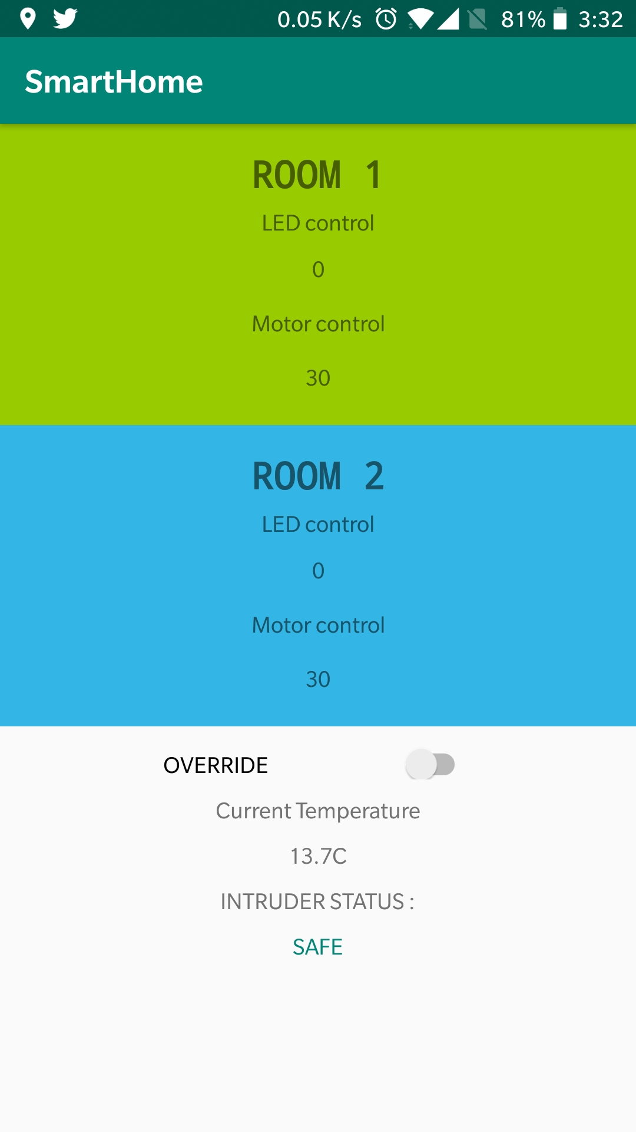
Mobile Application

Slide 8
Android Things Application
Firebase Database
UART & I2C protocols
GPIOs
Interfacing of Motor, LEDs & PIR, LDR, Temperature sensors.

Slide 9
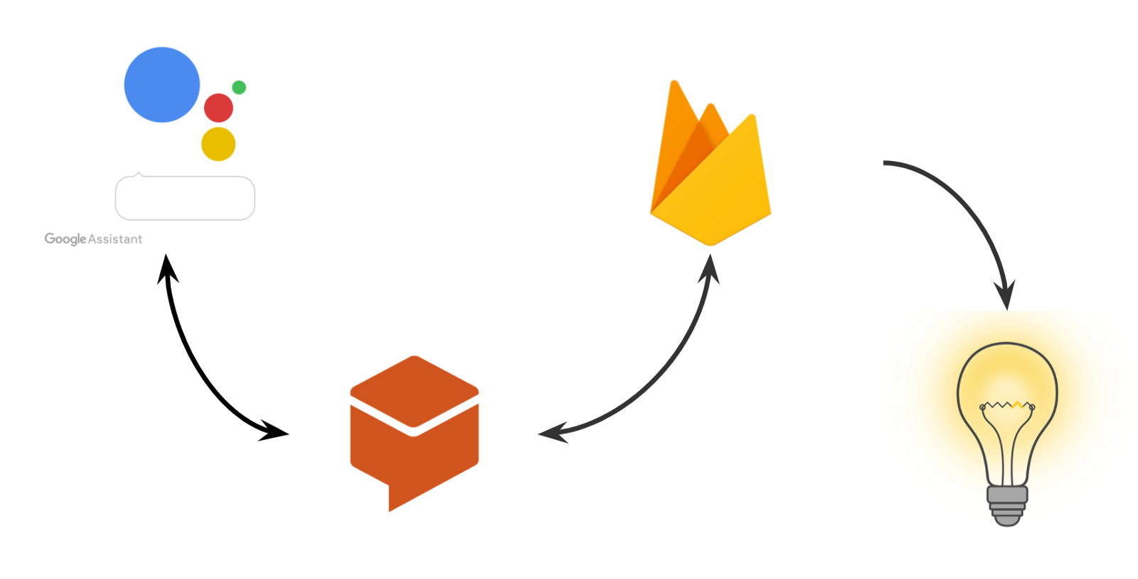
Google Assistant Integration

Slide 10
Future Scope
Tracking individual User’s locations to create multi user system.
Giving option of Network based location detection.
Complete integration with Google Assistant.
Performing Analytics on Power consumption of all peripherals.

Slide 11
References
https://developer.android.com/index.html
https://www.firebase.com/
Stackoverflow.com
https://androidthings.withgoogle.com

Slide 12
THANK YOU

