Slide 1

Introduction to CAD Through ONshape

Slide 2
AGENDA
Creating an Account
Navigation
Sketches
3D Parts
Assemblies

Slide 3
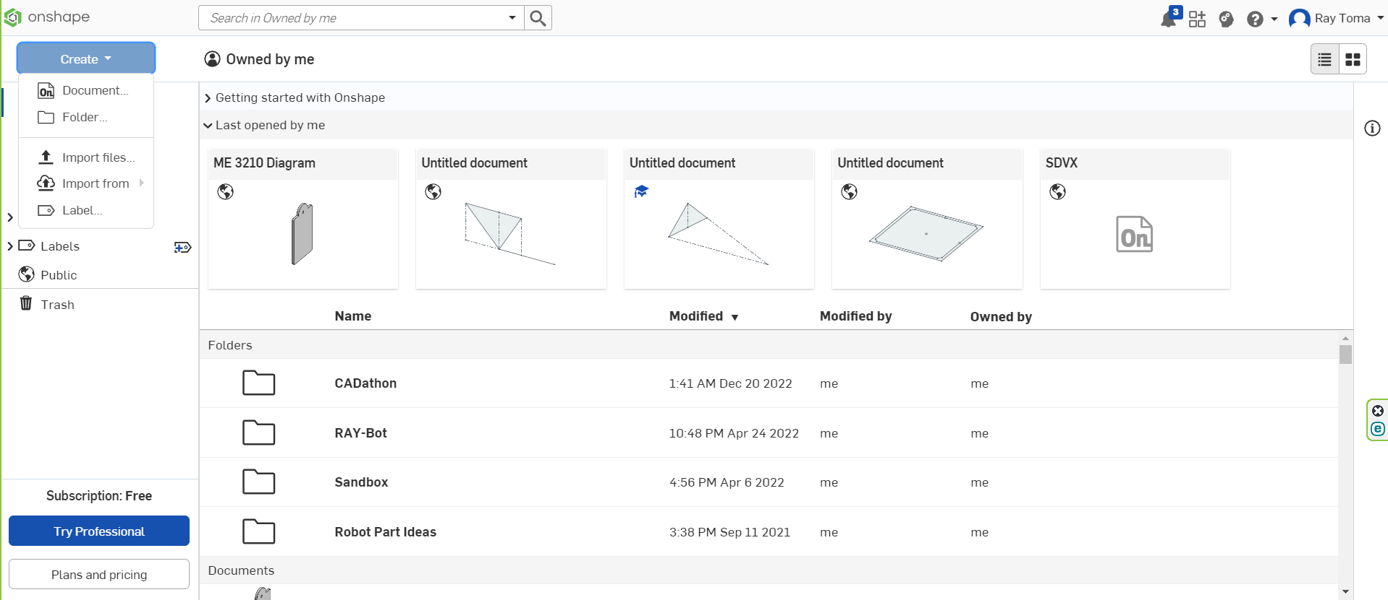
Create (top left) -> Document

Slide 4
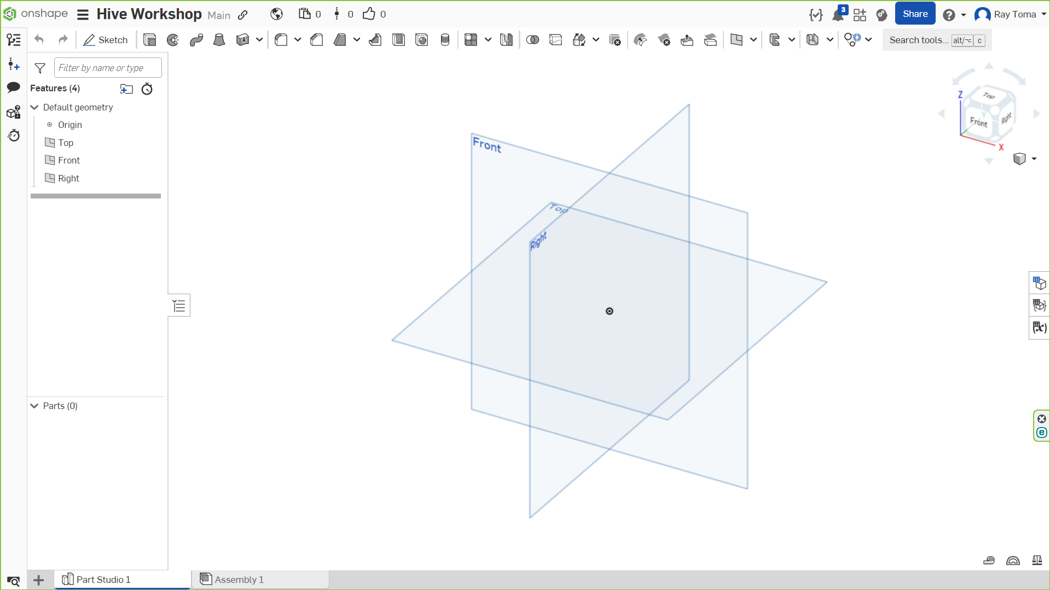
Menu
Reference
Cube
Feature List
Main Screen
Parts List
File Menu

Slide 5
Navigation Controls
Control | Function
Left Click | Select (esc or click out to deselect)
Left Click + Drag | Multi Select
Right Click + Drag | Rotate
Scroll Wheel + Drag | Pan

Slide 6
2D Sketches
3D Parts
3D Assembly
General Workflow

Slide 7
Assembly
Part 1
Sketch/Feature 1
Sketch/Feature 2
Part 2
Sketch/Feature 3
Assembly
Parts
Sketches/
Features

Slide 8
Sketches

Slide 9
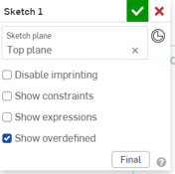
Starting a sketch
Sketches can be made on any plane or flat faces of parts
Click “Sketch” on top left of Part Studio
Select a plane or face to draw sketch
Add entities to sketch (lines, shapes, etc.)
Confirm Sketch (or Onshape won’t keep sketch)

Slide 10




basic tools
Icon | Tool | Shortcut | Function
 | Line | l | Creates a straight line
 | Rectangle | g (corner) or r (center) | Creates a rectangle
 | Circle | c | Creates a circle
 | Dimension | d | “Dimensions set entities” (set lengths, distances, angles, etc.)

Slide 11
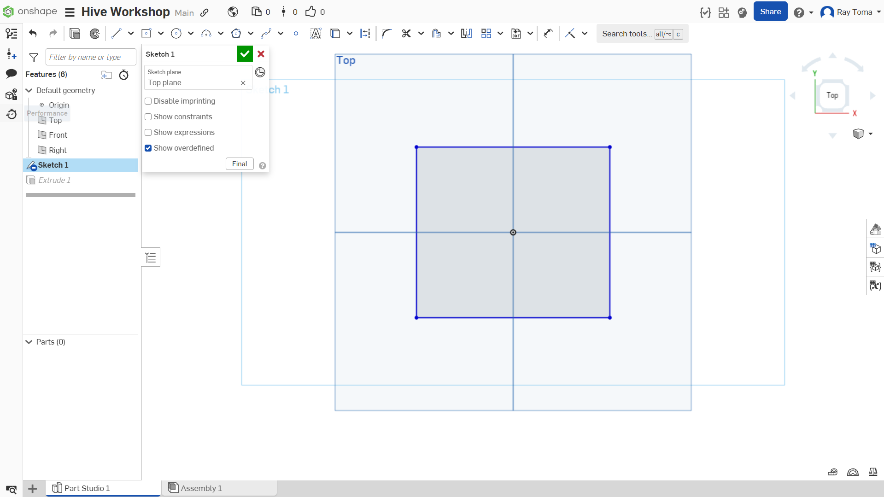

Slide 12
Sketch Relations (constraints)
Used to relate sketch objects to each other ​
Needed to make a sketch defined​ (you want your sketch to be fully defined)
Helps sketches stay consistent when​ changing dimensions

Slide 13
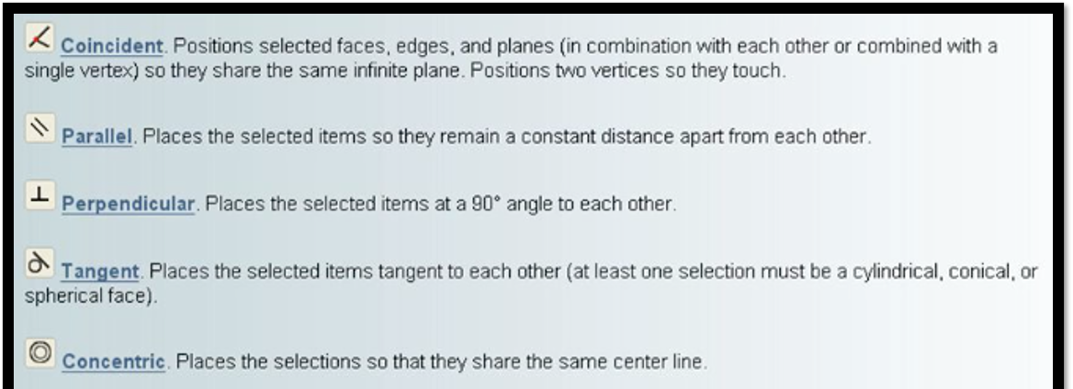

Slide 14
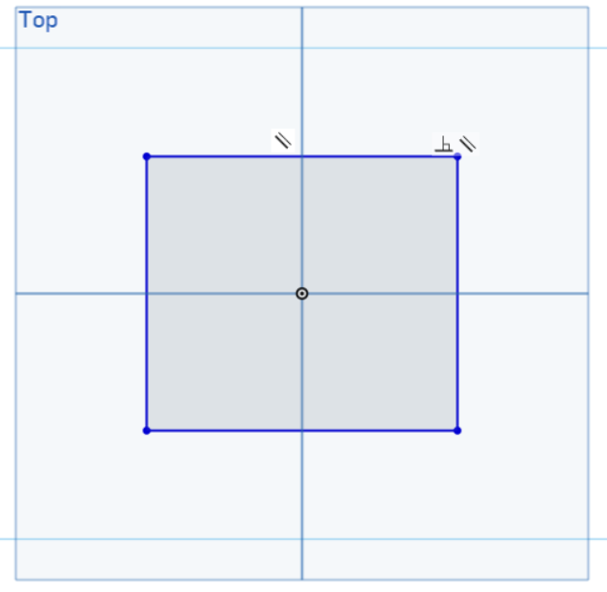
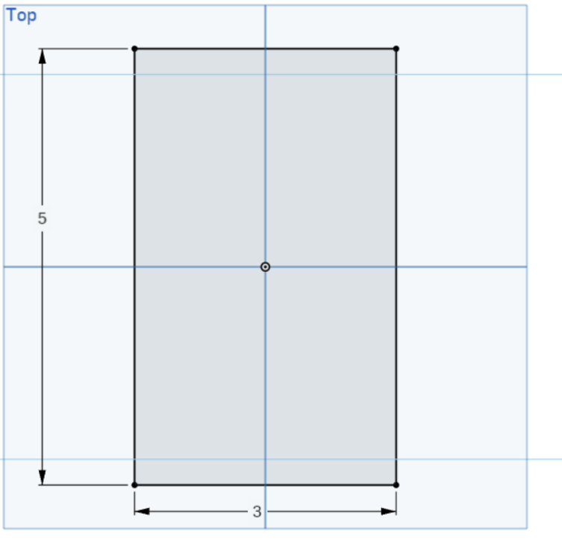
bad
Good

Slide 15
Demonstration

Slide 16
3D Parts

Slide 17
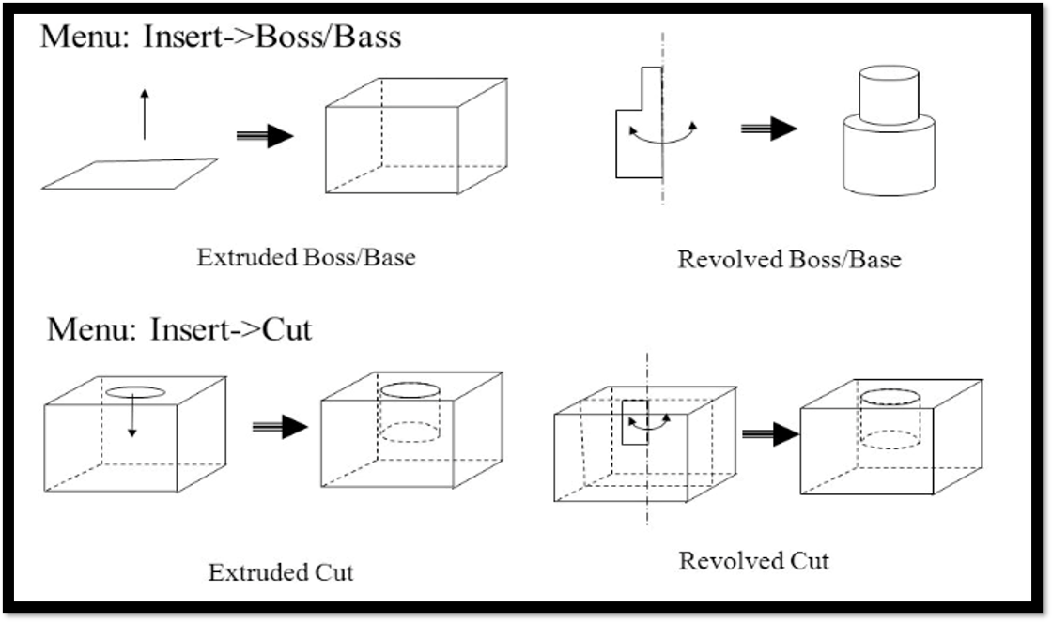
Introduction to Features
Features convert 2D sketches to a 3D Part, or modifies existing parts
Depending on the selection of features, the 2D sketch will be utilized in a different way

Slide 18
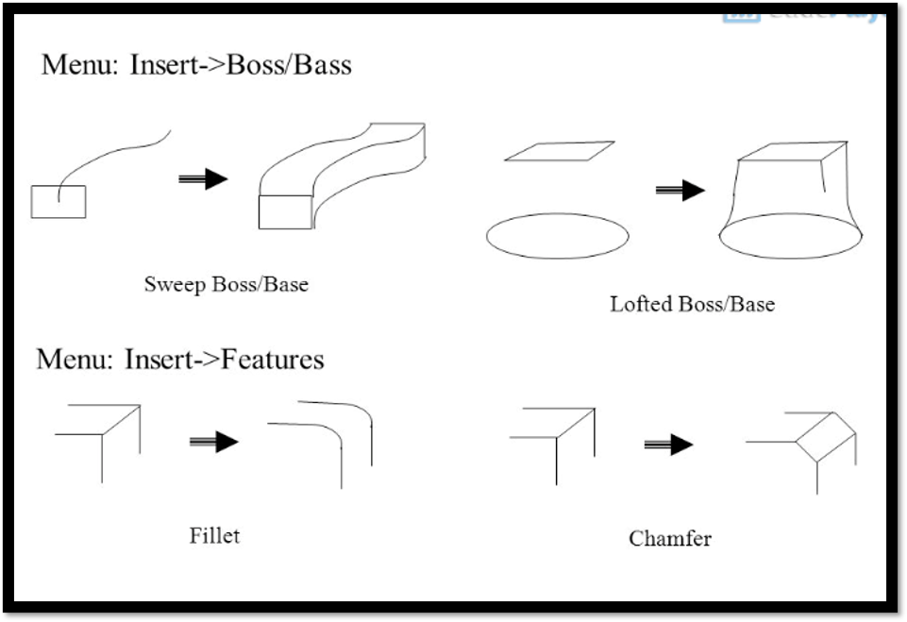

Slide 19
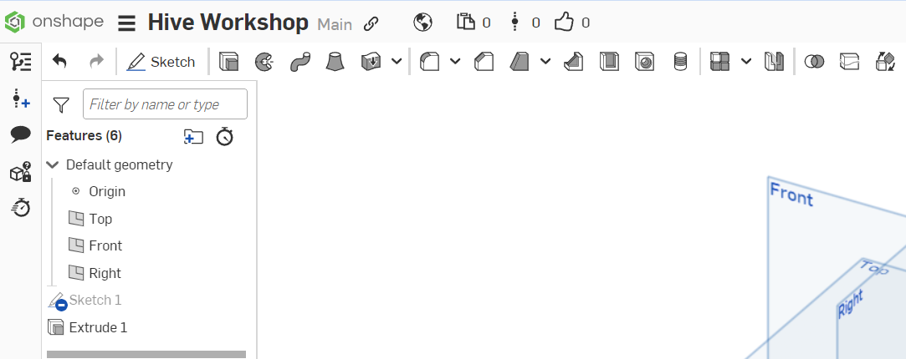
Extrude
Revolve
Fillet
Chamfer

Slide 20
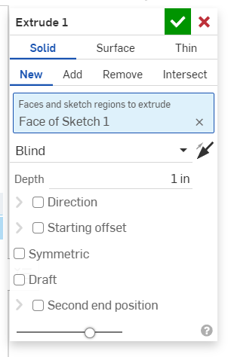
Feature Menu
New: Create a part
Add: Add feature to an existing part
Remove (Cut): Cut out feature from existing part
Sketch selection
Type of evaluation
How much to extrude

Slide 21
Demonstration

Slide 22
Practice

Slide 23
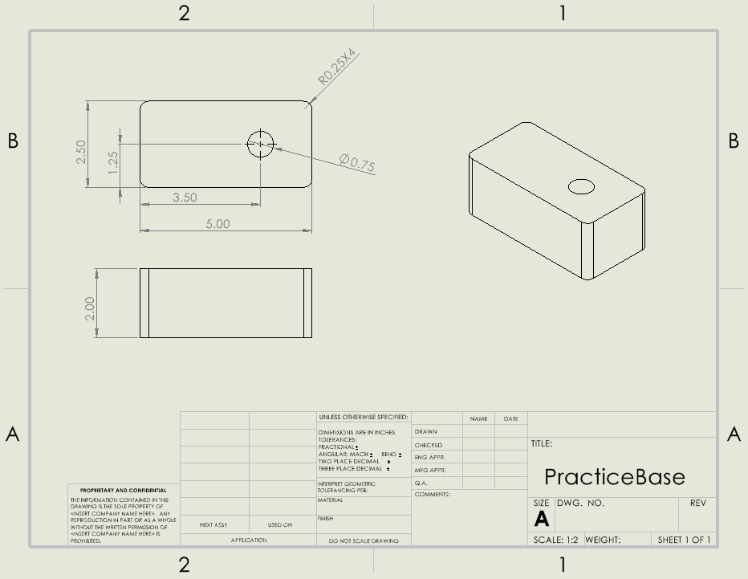

Slide 24
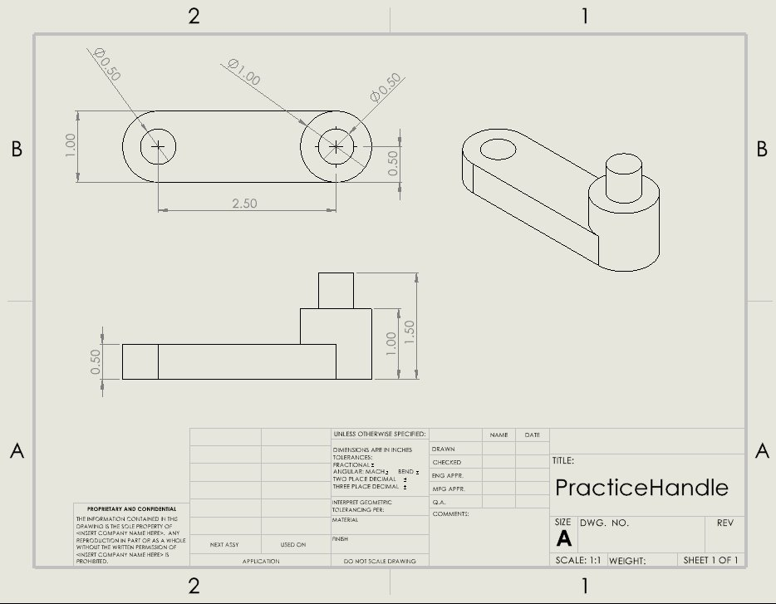

Slide 25
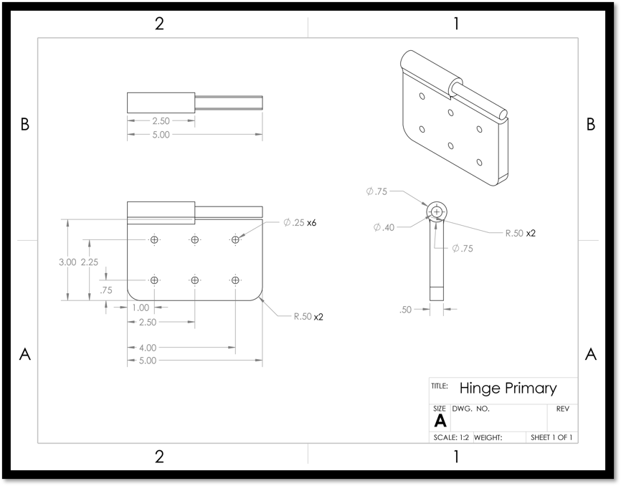

Slide 26
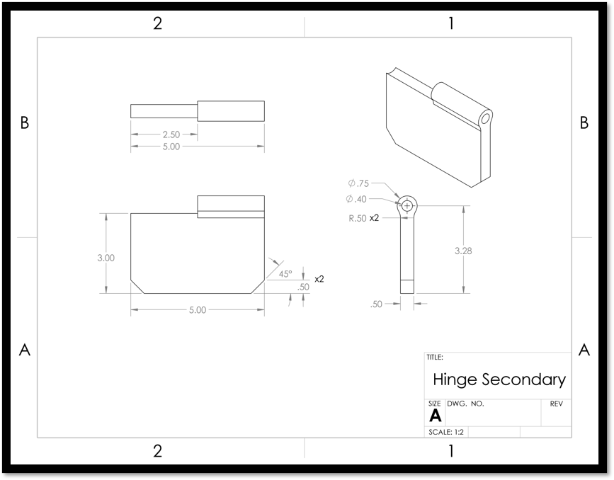

Slide 27
Assemblies

Slide 28
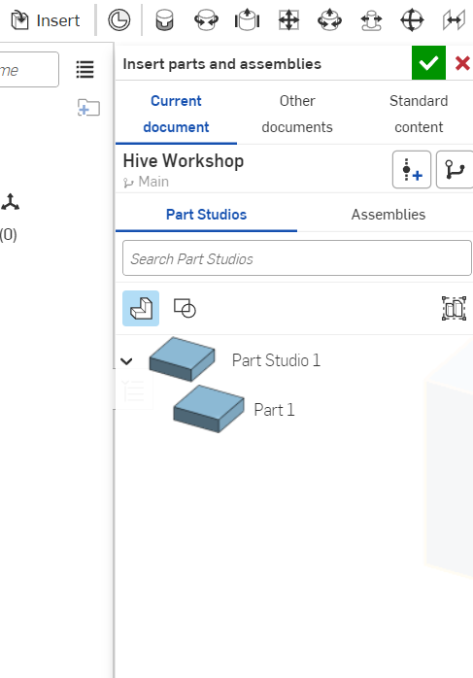
Creating an Assembly
From the bottom file menu, click “Assembly 1”
To Insert a part, click “Insert”, and you should see a screen similar to the one on the right

Slide 29

How to Define parts together?
Using Mates
Mates, similar to constraints, define relations between parts
You can select Points, Edges, Faces to Mate
Common Mates​
Fastened: Overlaps Points, Edges, or Faces (be careful with orientation of selected entities)
Planar: Overlaps two flat faces together
Cylindrical: For two circular surfaces, aligns the center axis
Mate Connector:
A point on part in which a mate is taken

Slide 30
Practice:
Mate the Base and Handle
Use 1 Planar, 1 Cylindrical Mate

Slide 31
Extra Practice:
Mate the Hinges together
Bonus: Limit the angle of rotation

Slide 32
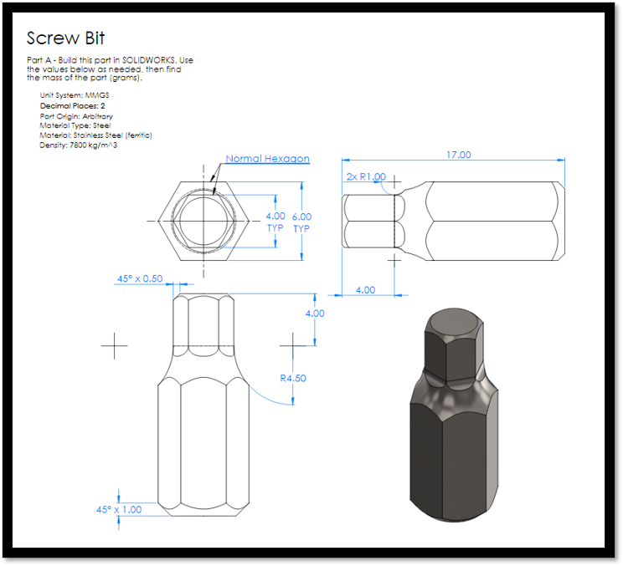

Slide 33
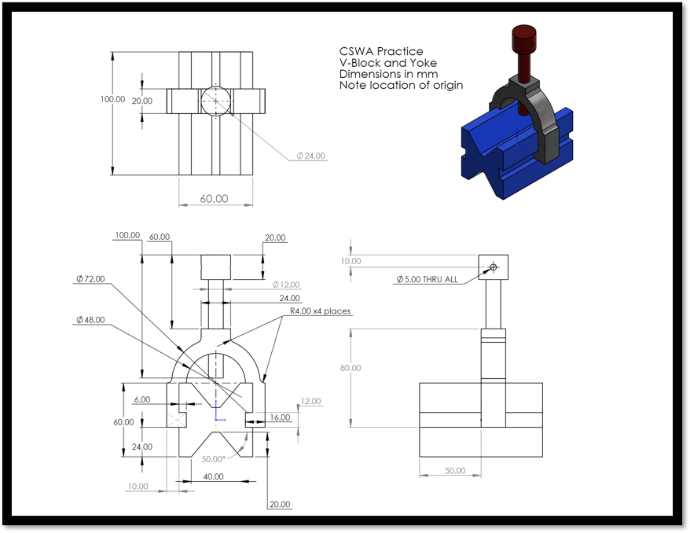

Slide 34
THANK YOU for coming!

Slide 35
Additional Information
Solidworks Course
If you ever want to 3D print a part:
Primary Link to Canvas Course: https://gatech.instructure.com/enroll/DTCD39
Secondary Link to Post (has some other info): https://www.reddit.com/r/gatech/comments/14bdixi/free_solidworks_cswa_cswp_course_and_unlimited/
Right click on the part studio or specific part
Click on export
Specify format as STL
As long as you have the STL file, the Hive will help you slice and print the part!

