Slide 1
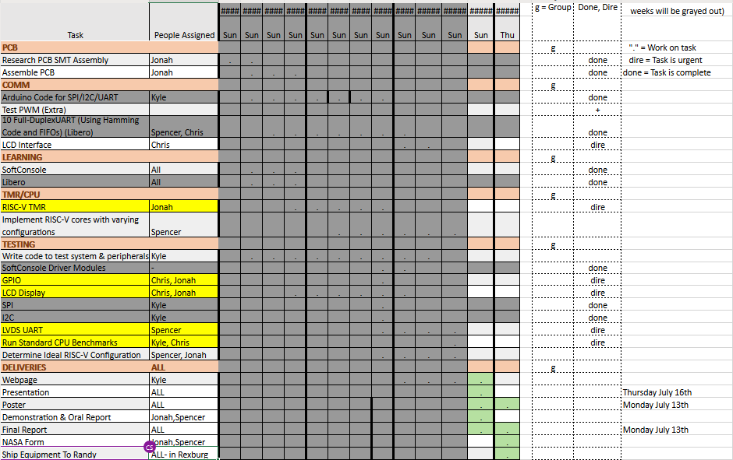
Week 11

Slide 2
Week 11 (30-Jun to 6-Jul) Chris Porter
Goal/Task | % Done | Hours (Act.)
Meetings |  | 1.5
Leadership Training |  | 1
Test Peripherals | 90% | 8
LVDS UART | 95% | 4
CPU_Testbench | 80% | 0.5
Hours on task during the week (On track ≥ 10 / wk) | 15
Total hours on task so far this semester (On track ≥ 135 hrs) | 125.5

Slide 3
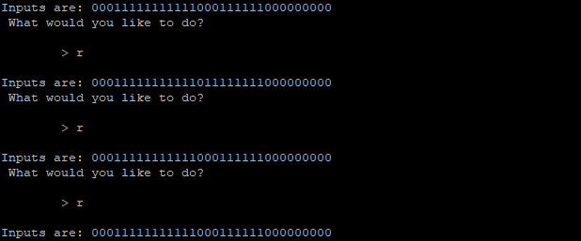
Progress made during the week (Log) (What I did)
GPIO TEST
GPIO Write does not change any LEDS on the PCB.
GPIO Read gives us something now, and it changes as we change switches.
LVDS UART
Transmit signals are just 111MHz clock (see Spencer's Slides)
LCD Screen
No output.
Chip select is correct.
Clock turns on.
Chip select turns on for each command...

Slide 4
Difficulties encountered during the week (What I did not do and why)
Inconsistencies between SoftConsole and PCB Documentation. Mostly that there are only 3 SPI devices on the PCB.
ADC
LCD
External SPI
Accelerometer is set up for I2C, but SoftConsole includes it as a SPI device

Slide 5
Goals for this coming week (Ones that move the project forward the most)
Goal/Task | Stop Date (Est.) | Hours (Est.)
Test Peripherals | July 13 | 10
LVDS UART | July 13 | 3
CPU_Testbench | July 13 | 2
Estimated time needed to work on goals for this coming week (typ. 13 hrs) | 15

Slide 6
How can we help you achieve your goals?
Will this project be done another semester?

Slide 7
Week 11 (30-Jun to 6-Jul) Jonah Boe
Goal/Task | % Done | Hours (Act.)
Worked on debugging GPIO and LCD | 40% | 9.5
Leadership Training | - | 1
Other Class Material | - | 1
Hours on task during the week (On track ≥ 10 / wk) | 11.5
Total hours on task so far this semester (On track ≥ 135 hrs) | 135

Slide 8
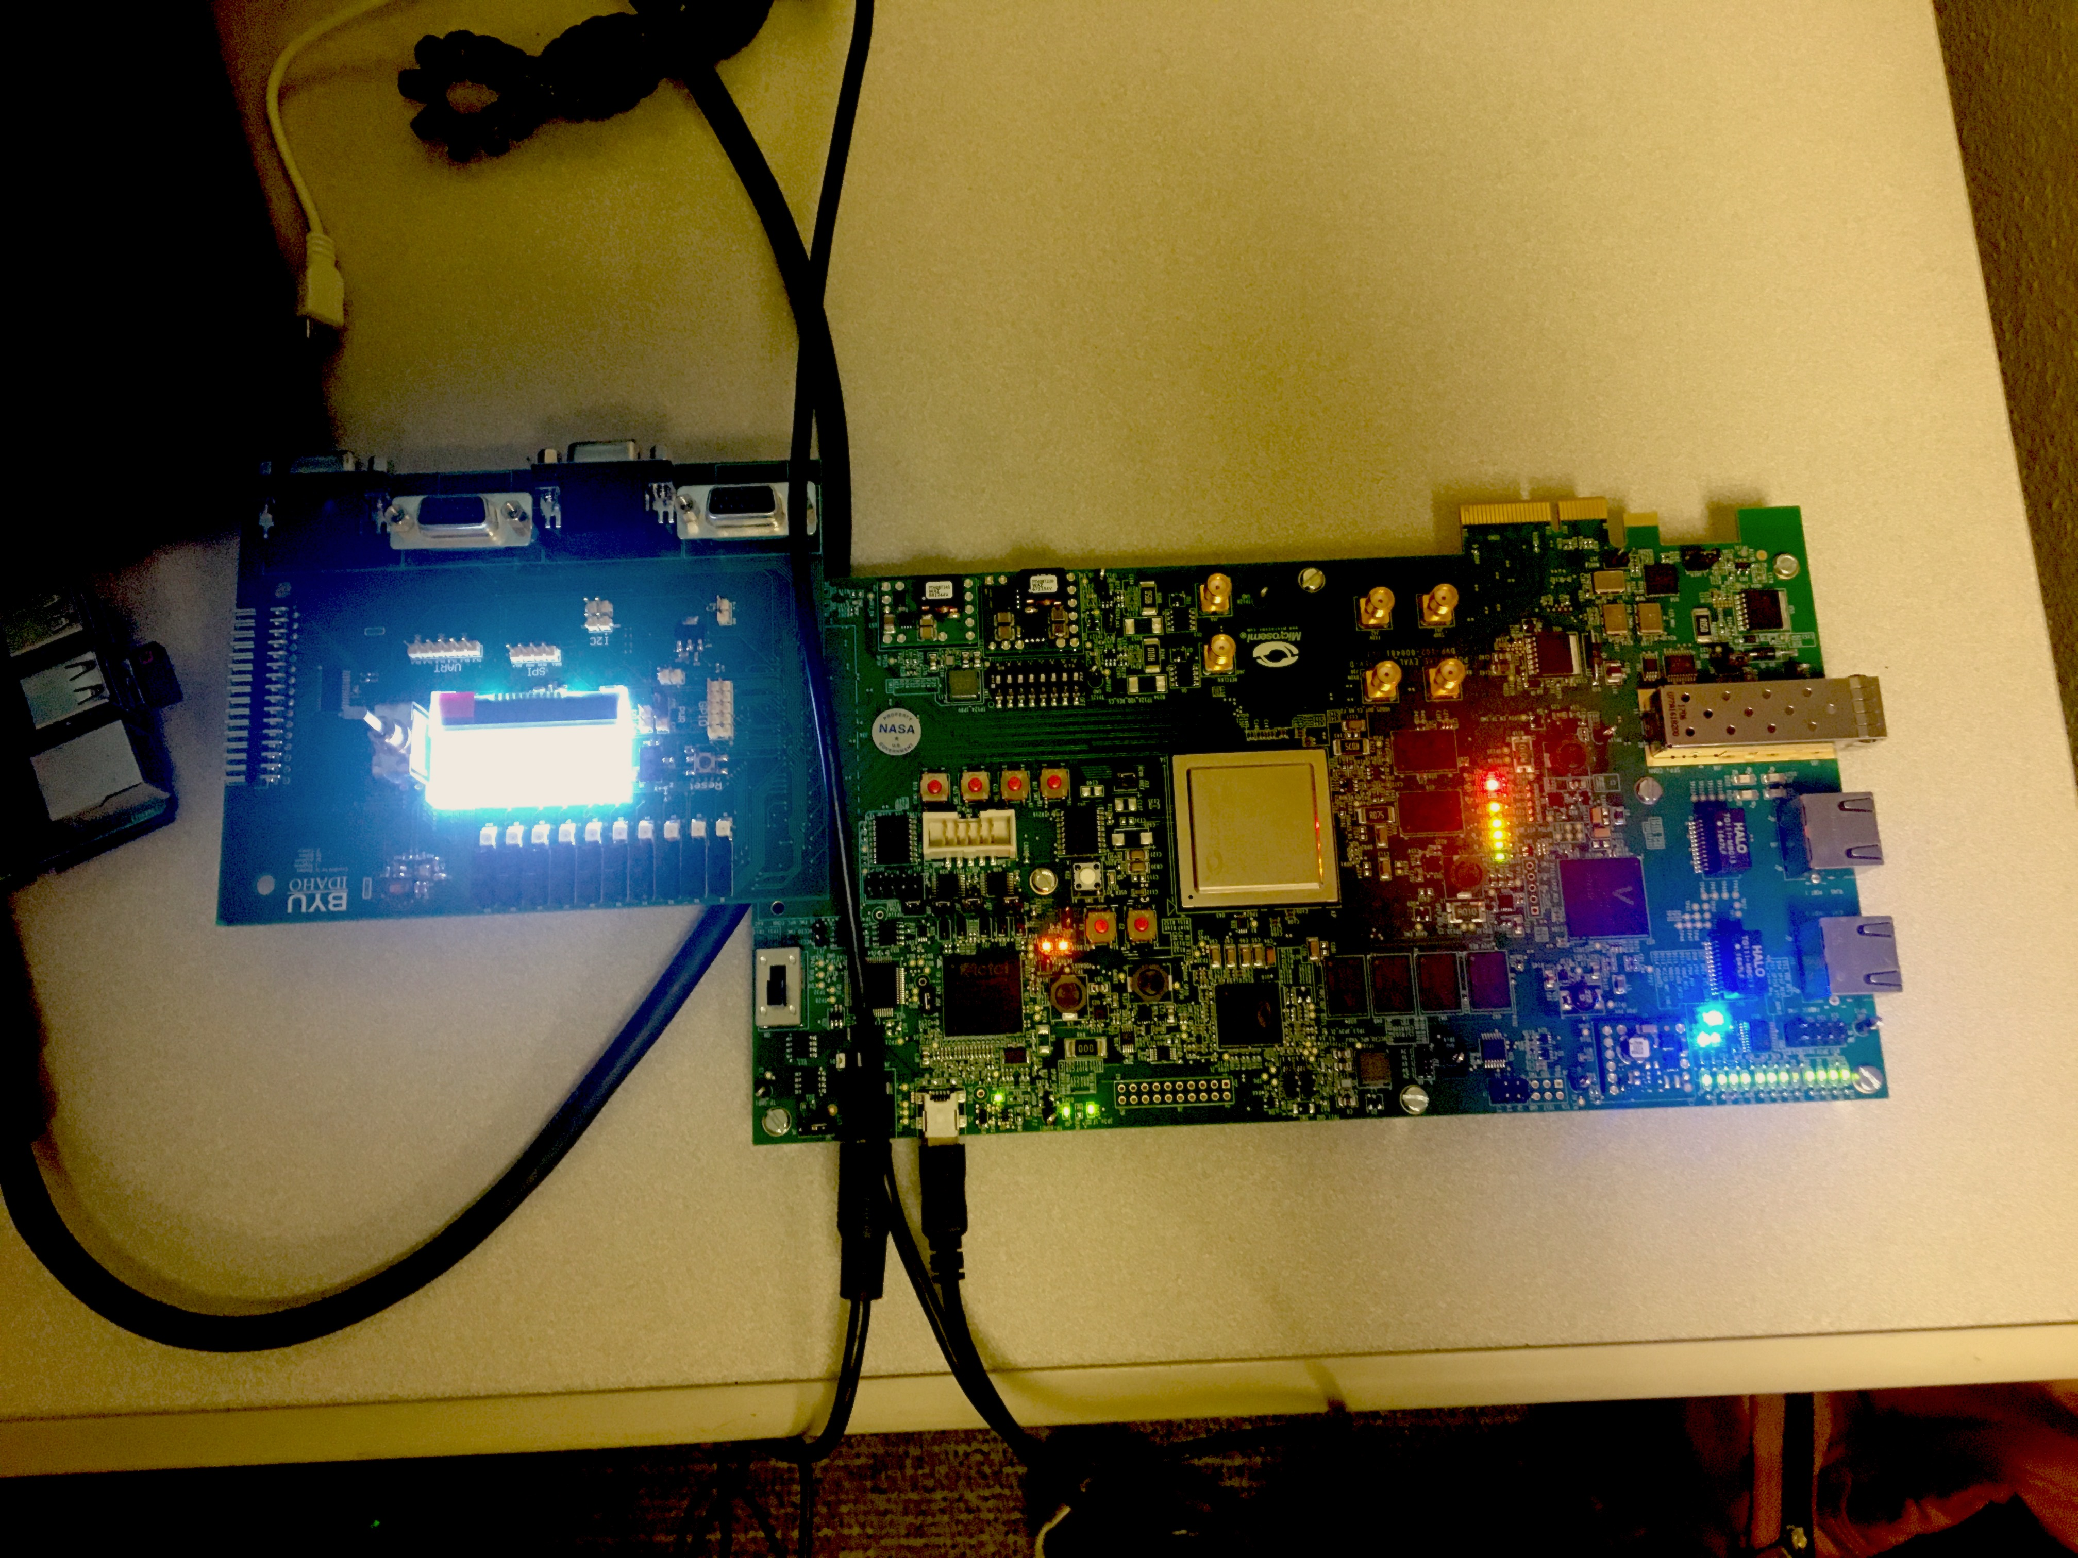
Progress made during the week (Log) (What I did)
We got the PCB connected finally and nothing fried

Slide 9
Difficulties encountered during the week (What I did not do and why)
GPIO does work but we are seeing odd behavior on inputs
LCD is receiving correct commands but not displaying

Slide 10
Goals for this coming week (Ones that move the project forward the most)
Goal/Task | Stop Date (Est.) | Hours (Est.)
Debug the GPIO a little more | July 14, 2020 | 3
Start testing RISC-V configurations | July 14, 2020 | 8.5
Other class material | - | 1.5
Estimated time needed to work on goals for this coming week (typ. 13 hrs) | 13

Slide 11
How can we help you achieve your goals?
NA

Slide 12
Week 11 (30-Jun to 6-Jul) Spencer Cheney
Goal/Task | % Done | Hours (Act.)
Tested Full Duplex UART | 100% | 4.5
We are generating a differential signal | 100% | 5
Hours on task during the week (On track ≥ 10 / wk) | 9.5
Total hours on task so far this semester (On track ≥ 135 hrs) | 138

Slide 13
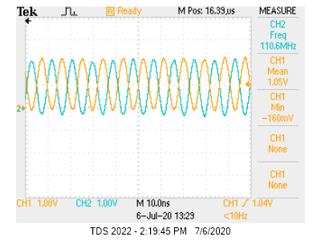
Progress made during the week (Log) (What I did)
For example: Resources found (links, manuals), Designs created, Decisions made and corresponding rational, Photos of prototype progress, etc.
UART is generating a clock differential signal
Full-duplex UART was tested and is working

Slide 14
Difficulties encountered during the week (What I did not do and why)
Confusion about LVDS module

Slide 15
Goals for this coming week (Ones that move the project forward the most)
Goal/Task | Stop Date (Est.) | Hours (Est.)
Send UART data from differential signal | 6/9 | 6
Turn differential signal into LVDS | 6/10 | 7
Estimated time needed to work on goals for this coming week (typ. 13 hrs)

Slide 16
How can we help you achieve your goals?
.

Slide 17
Week 11 (30-Jun to 6-Jul) Kyle
Goal/Task | % Done | Hours (Act.)
Microsemi |  | 3.75
WIGS/Meeting |  | 5.25
Leadership |  | 2
Webpage |  | .5
Hours on task during the week (On track ≥ 10 / wk) | 11.3
Total hours on task so far this semester (On track ≥ 135 hrs) | 136

Slide 18
Progress made during the week (Log) (What I did)
For example: Resources found (links, manuals), Designs created, Decisions made and corresponding rational, Photos of prototype progress, etc.
Leadership – pages
Looked into Benchmark test

Slide 19
Difficulties encountered during the week (What I did not do and why)
NA

Slide 20
Goals for this coming week (Ones that move the project forward the most)
Goal/Task | Stop Date (Est.) | Hours (Est.)
Leadership | - | 1.25
Leadership test | 7/7 | 2
WIGS/Meetings | - | 3.75
Webpage | 7/16 | 2.5
Deliverables | 7/16 | 3.5
Benchmark – case statement | 7/14 | 1
Estimated time needed to work on goals for this coming week (typ. 13 hrs) | 14

Slide 21
How can we help you achieve your goals?
What do we put for the executive summaries?
What is in the Final Report?
What's the difference between Final Report and Executive summaries?
What is the NASA Form?
Where do we send the equipment?
Can the Poster be the first page of the Webpage?

Slide 22
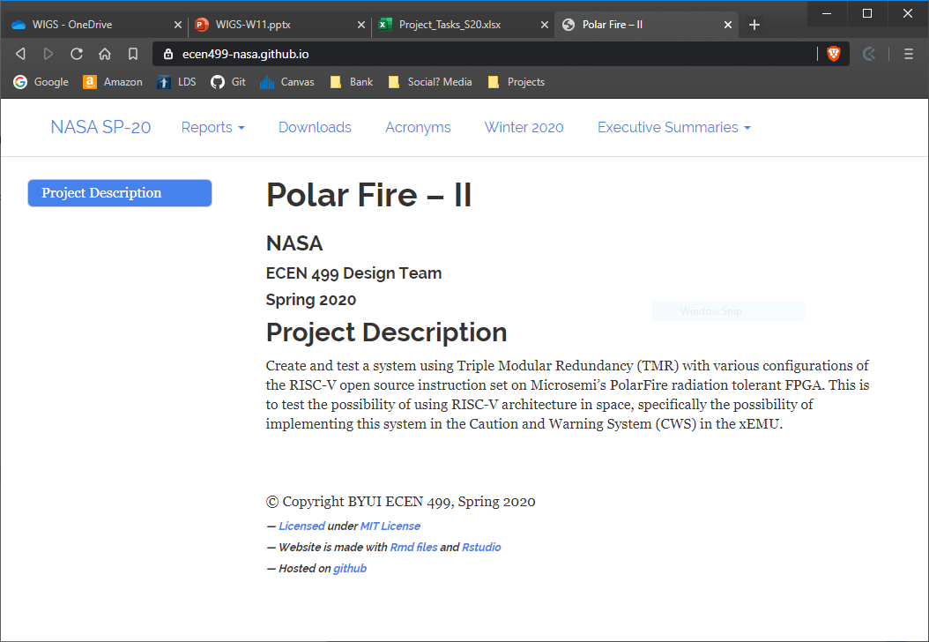
Suggested Index page
Poster

Slide 23
Notes:
Taken from Elder Bednar’s address: http://www2.byui.edu/Presentations/Transcripts/Devotionals/2006_10_31_Bednar.htm

