Slide 1
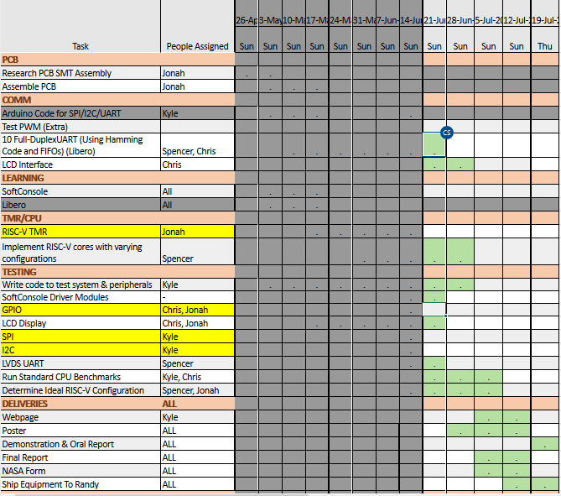

Slide 2
Week 8 (9-Jun to 15-Jun) Chris Porter
Goal/Task | % Done | Hours (Act.)
Scheduling | 100% | 0.75
Meetings |  | 0.5
Leadership Training |  | 1
GPIO Test |  | 10.7
Hours on task during the week (On track ≥ 13 / wk) | 13
Total hours on task so far this semester (On track ≥ 99 hrs) | 80.5

Slide 3
Progress made during the week (Log) (What I did)
For example: Resources found (links, manuals), Designs created, Decisions made and corresponding rational, Photos of prototype progress, etc.
Git is working, thanks to the GIT Gurus.
GPIO Test file in Softconsole.
Base address only needed for GPIO_init(). The GPIO_core.h file takes care of everything else.
Data bus is 32 bit. (I'm pretty sure) From MI-V Tutorial.
STC159L01 is now VPN accessible.

Slide 4
Difficulties encountered during the week (What I did not do and why)
Not Savvy with writing C++

Slide 5
Goals for this coming week (Ones that move the project forward the most)
Goal/Task | Stop Date (Est.) | Hours (Est.)
GPIO | 06/14/2020 | 8
LCD | 6/21/2020 | 3
UART or CPU Benchmark | 6/21 or 07/5 | 7
Estimated time needed to work on goals for this coming week (typ. 13 hrs) | 18

Slide 6
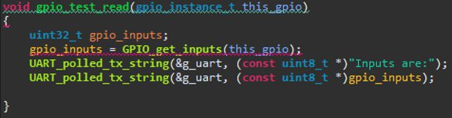
How can we help you achieve your goals?
UART_polled_tx_string(&g_uart, …...)

Slide 7
Week 8 (9-Jun to 15-Jun) Jonah Boe
Goal/Task | % Done | Hours (Act.)
Working with Libero to get the initial test working | - | 3
Finishing reading the tutorial | 100% | 2
Leadership | - | 1
Team debriefing | - | .5
Hours on task during the week (On track ≥ 13 / wk) | 6.5
Total hours on task so far this semester (On track ≥ 99 hrs) | 95.69

Slide 8
Progress made during the week (Log) (What I did)
Just trying to get things working in Libero again.

Slide 9
Difficulties encountered during the week (What I did not do and why)
Just busy in other classes

Slide 10
Goals for this coming week (Ones that move the project forward the most)
Goal/Task | Stop Date (Est.) | Hours (Est.)
Re-soldier ADC (per request) | June 20, 2020 | 1
Get project working in Libero | June 20, 2020 | 9
Work on Soft Console code | June 29, 2020 | 3
Leadership training | - | 1
Other class material | - | .5
Estimated time needed to work on goals for this coming week (typ. 13 hrs) | 14.5

Slide 11
How can we help you achieve your goals?
NA

Slide 12
Week 8 (9-Jun to 15-Jun) Spencer Cheney
Goal/Task | % Done | Hours (Act.)
Finish UART test | 100% | 7
Debug UART test | 50% | 6
Read through pin map documentation | 100% | 2
Read through libero code | 20% | 4
Hours on task during the week (On track ≥ 13 / wk) | 13
Total hours on task so far this semester (On track ≥ 99 hrs) | 94.5

Slide 13
Progress made during the week (Log) (What I did)
For example: Resources found (links, manuals), Designs created, Decisions made and corresponding rational, Photos of prototype progress, etc.
Possibly get a working UART test

Slide 14
Difficulties encountered during the week (What I did not do and why)
I couldn't run the UART test because I still don't understand the Libero workflow, and how each of the modules work
It appears you need a solid understand of verilog and VHDL to understand each of the modules.

Slide 15
Goals for this coming week (Ones that move the project forward the most)
Goal/Task | Stop Date (Est.) | Hours (Est.)
Work through Libero workflow | 6/23 | 6
Review Verilog and VHDL | 6/23 | 2
Debug UART section of Libero | 6/30 | 5
Estimated time needed to work on goals for this coming week (typ. 13 hrs) | 13

Slide 16
How can we help you achieve your goals?
.

Slide 17
Week 8 (9-Jun to 15-Jun) Kyle Tolliver
Goal/Task | % Done | Hours (Act.)
WIGS/Meeting | -- | 5.75
Leadership | -- | 1.25
Microsemi | -- | 3.5
COM | 99 | 1.25
Hours on task during the week (On track ≥ 13 / wk) | 13
Total hours on task so far this semester (On track ≥ 99 hrs) | 92.5

Slide 18

Progress made during the week (Log) (What I did)
For example: Resources found (links, manuals), Designs created, Decisions made and corresponding rational, Photos of prototype progress, etc.
Finished the COM tests

Slide 19
Difficulties encountered during the week (What I did not do and why)
Look through main.c didn't have remote access
Got remote and admin fixed

Slide 20
Goals for this coming week (Ones that move the project forward the most)
Goal/Task | Stop Date (Est.) | Hours (Est.)
WIGS/Meeting |  | 6
Leadership |  | 1.25
Main.c and periphals (PM) | 6/22 | 2.5
Github |  | .75
Webpage | 7/20 | 1.5
Estimated time needed to work on goals for this coming week (typ. 13 hrs) | 13

Slide 21
How can we help you achieve your goals?
NA

Slide 22
Notes:
Taken from Elder Bednar’s address: http://www2.byui.edu/Presentations/Transcripts/Devotionals/2006_10_31_Bednar.htm

