Slide 1
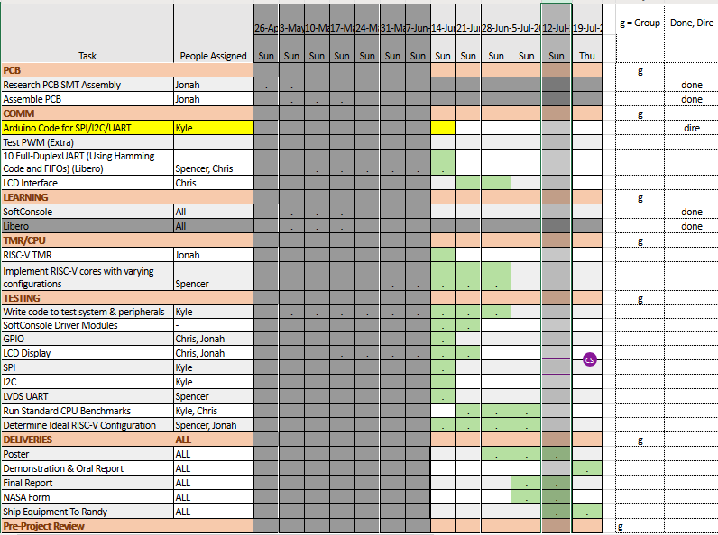
NASA PolarFire Team E Schedule

Slide 2
Week 7 (2-Jun to 8-Jun) Chris Porter
Goal/Task | % Done | Hours (Act.)
Meetings |  | 2.25
LCD Screen Test | 50% | 1.5
GPIO Test | 20% | 4.75
Libero/SoftConsole | 90% | 3.5
Leadership Training |  | 1
Hours on task during the week (On track ≥ 13 / wk) | 13
Total hours on task so far this semester (On track ≥ 86 hrs) | 67.5

Slide 3
Progress made during the week (Log) (What I did)
For example: Resources found (links, manuals), Designs created, Decisions made and corresponding rational, Photos of prototype progress, etc.
* LCD test cannot be finished until we understand GPIO
* Tasks reviewed and rescheduled. (Needs to be adjusted again)
* Better understanding of SoftConsole and Libero
* GPIO Test Documents started.

Slide 4
Difficulties encountered during the week (What I did not do and why)
Addresses and connecting to pins is more complex than we initially thought.
GPIO has not been tested, so that needs to happen first.

Slide 5
Goals for this coming week (Ones that move the project forward the most)
Goal/Task | Stop Date (Est.) | Hours (Est.)
Test System/Peripherals: GPIO Test | 06/14 | 8
Test System/Peripherals: LCD Test | 06/14 | 6
Estimated time needed to work on goals for this coming week (typ. 13 hrs) | 14

Slide 6
How can we help you achieve your goals?
Poster?

Slide 7
Week 7 (2-Jun to 8-Jun) Jonah Boe
Goal/Task | % Done | Hours (Act.)
Working with Libero to get system ready for programming in SoftConsole | 90% | 9
Reviewing SoftConsole code | - | 1
Going over tutorial to understand how the system has been designed | 80% | 2
Other Meetings | - | 2
Leadership training | - | 1
Hours on task during the week (On track ≥ 13 / wk) | 15
Total hours on task so far this semester (On track ≥ 86 hrs) | 89.8

Slide 8
Progress made during the week (Log) (What I did)
Understanding how the Libero and SoftConsole code are coupled has been difficult. This became the focus of my week. This will allow me to be more successful in the long run.

Slide 9
Difficulties encountered during the week (What I did not do and why)
NA

Slide 10
Goals for this coming week (Ones that move the project forward the most)
Goal/Task | Stop Date (Est.) | Hours (Est.)
Get the FPGA connected with the PCB we made and communicating in at least one format (i.e. I2C) | June 15, 2020 | 10
Leadership training | - | 1
Other team meetings | - | 2
Estimated time needed to work on goals for this coming week (typ. 13 hrs) | 13

Slide 11
How can we help you achieve your goals?
Just sharing what we've learned with one another

Slide 12
Week 7 (2-Jun to 8-Jun) Spencer Cheney
Goal/Task | % Done | Hours (Act.)
Got UART test ready for testing | 100% | 8
Loading working solution onto FPGA | 90% | 2
Researched Pin Mapping for Libero | 50% | 3
Hours on task during the week (On track ≥ 13 / wk) | 13
Total hours on task so far this semester (On track ≥ 86 hrs) | 81.5

Slide 13
Progress made during the week (Log) (What I did)
For example: Resources found (links, manuals), Designs created, Decisions made and corresponding rational, Photos of prototype progress, etc.
Was able to figure out address for LVDS UART module and get a working version set up in softconsole.

Slide 14
Difficulties encountered during the week (What I did not do and why)
.

Slide 15
Goals for this coming week (Ones that move the project forward the most)
Goal/Task | Stop Date (Est.) | Hours (Est.)
Test UART module | 6/15 | 6
Research how to map UART pins to the UART connectors on the PCB | 6/22 | 5
Get started on setting up other TMR processors | 6/29 | 2
Estimated time needed to work on goals for this coming week (typ. 13 hrs) | 13

Slide 16
How can we help you achieve your goals?
.

Slide 17
Week 7 (2-Jun to 8-Jun) Kyle Tolliver
Goal/Task | % Done | Hours (Act.)
COM | 90 | 2.5
Microcontroller | 10 | .5
Meeting/WIGS | -- | 6.5
Hours on task during the week (On track ≥ 13 / wk)
Total hours on task so far this semester (On track ≥ 86 hrs)

Slide 18
Progress made during the week (Log) (What I did)
For example: Resources found (links, manuals), Designs created, Decisions made and corresponding rational, Photos of prototype progress, etc.
Worked on communication code

Slide 19
Difficulties encountered during the week (What I did not do and why)
I was visiting my family
Due to my parents' house being on the Market

Slide 20
Goals for this coming week (Ones that move the project forward the most)
Goal/Task | Stop Date (Est.) | Hours (Est.)
WIGS/Meeting |  | 4
COM | 6/12 | 6
Microsemi | 6/16 | 1.5
Leadership | 6/11 | 1.5
Estimated time needed to work on goals for this coming week (typ. 13 hrs) | 21

Slide 21
How can we help you achieve your goals?
Remote Access for L01
Leadership Quiz (Wed., June 19 to Fri., June 21, 2019 - In the Testing Center {No notes, No calculator}) --- What is this assignment?

Slide 22
Notes:
Taken from Elder Bednar’s address: http://www2.byui.edu/Presentations/Transcripts/Devotionals/2006_10_31_Bednar.htm

