Slide 1
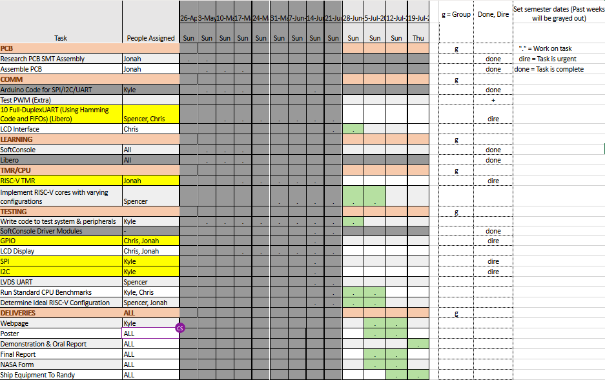

Slide 2
Week 9 (16-Jun to 22-Jun) Chris Porter
Goal/Task | % Done | Hours (Act.)
GPIO | 90% | 6
LVDS UART (Libero) | 50% | 7.25
Meetings |  | 1.5
Leadership Training |  | 1
Hours on task during the week (On track ≥ 13 / wk) | 15.75
Total hours on task so far this semester (On track ≥ 112 hrs) | 96.2

Slide 3
Progress made during the week (Log) (What I did)
GPIO Test is nearly complete.
Details
Troubleshooting (turns out you cannot include .c files without A LOT of issues).
LVDS – discovered that current implementation is far from working.

Slide 4
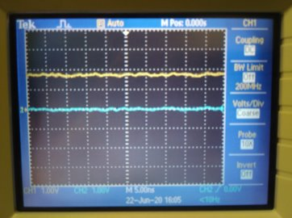
Difficulties encountered during the week (What I did not do and why)
Not an LVDS Signal...
UART is not setup for LVDS.
Scrap LVDS and just do differential pairs
Easier to test with Arduino/MSP432
Hopefully, easier to implement
To implement LVDS, we would need a data rate of >1MHz, which could create EMI issues in the PCB
Implement LVDS using LVDS Module
LVDS has a module, so also easy to implement
Design specs (What NASA wants)

Slide 5
Goals for this coming week (Ones that move the project forward the most)
Goal/Task | Stop Date (Est.) | Hours (Est.)
GPIO | 06/14/2020 | 4
LVDS UART | 06/21/2020 | 10
LCD Test | 06/21/2020 | 3
CPU Benchmark |  | 1
Estimated time needed to work on goals for this coming week (typ. 13 hrs) | 18

Slide 6
How can we help you achieve your goals?
.

Slide 7
Week 9 (16-Jun to 22-Jun) Jonah Boe
Goal/Task | % Done | Hours (Act.)
Re-soldier the ADC and humidity sensor | 50% | 2
Fix problems with board assembly | 10% | 3
Get LCD test programmed | 90% | 3
Help configure LVDS UART | - | 4
Leadership Training | - | 1
Other class material | - | 1
Hours on task during the week (On track ≥ 13 / wk) | 13.4
Total hours on task so far this semester (On track ≥ 112 hrs) | 109.7

Slide 8
Progress made during the week (Log) (What I did)
While testing powering the board, I realized that there was a shorting problem under the humidity sensor. I've been testing to make sure that that is the source of the problem, as that wasn't happening right after soldiering it.
I also implemented that Hello World program.

Slide 9
Difficulties encountered during the week (What I did not do and why)
I have to re-soldier the board

Slide 10
Goals for this coming week (Ones that move the project forward the most)
Goal/Task | Stop Date (Est.) | Hours (Est.)
Re-soldier the board | June 25, 2020 | 4
Finish implementing the GPIO for controlling the LCD | June 26, 2020 | 3
Help with the LVDS UART | June 26, 2020 | 5
Leadership training | - | 1
Other class material | - | 1
Estimated time needed to work on goals for this coming week (typ. 13 hrs) | 14

Slide 11
How can we help you achieve your goals?
NA

Slide 12
Week 9 (16-Jun to 22-Jun) Spencer Cheney
Goal/Task | % Done | Hours (Act.)
Finish Uart test | 90% | 4
Review libero uart modules | 50% | 4
Team Meeting | 100% | 3
Hours on task during the week (On track ≥ 13 / wk) | 11
Total hours on task so far this semester (On track ≥ 112 hrs) | 105.5

Slide 13
Progress made during the week (Log) (What I did)
For example: Resources found (links, manuals), Designs created, Decisions made and corresponding rational, Photos of prototype progress, etc.
Found problems in Softconsole code for uart, discovered current baud rate of 115200 won't work for LVDS must be 1000000, The current design for uart is only for differential signals and not LVDS

Slide 14
Difficulties encountered during the week (What I did not do and why)
Libero section wasn't even set up for LVDS
The high baud rate might affect other signals in PCB if we implement LVDS rather than just a differential signal
LVDS baud rate = 1000000
DS baud rate = 115200

Slide 15
Goals for this coming week (Ones that move the project forward the most)
Goal/Task | Stop Date (Est.) | Hours (Est.)
Strip down LVDS UART module into just UART | 6/26 | 6
Decide whether to implement LVDS or skip it and just implement a differential signal | 6/27 | 2
Implement differential signal on UART | 6/29 | 4
Implement LVDS on UART | 7/1 | 2
Estimated time needed to work on goals for this coming week (typ. 13 hrs) | 14

Slide 16
How can we help you achieve your goals?
.

Slide 17
Week 9 (16-Jun to 22-Jun) Kyle Tolliver
Goal/Task | % Done | Hours (Act.)
WIGS/Meeting |  | 5.58
Github and Microsemi | 50% | 5.25
Webpage | 50% | 4
COM | 99% | 1
Leadership |  | 1.25
Hours on task during the week (On track ≥ 13 / wk) | 18.5
Total hours on task so far this semester (On track ≥ 112 hrs) | 107

Slide 18
Progress made during the week (Log) (What I did)
For example: Resources found (links, manuals), Designs created, Decisions made and corresponding rational, Photos of prototype progress, etc.
Set up Github on desktop
Framework for Webpage
Difficulties encountered during the week (What I did not do and why)
None

Slide 19
Goals for this coming week (Ones that move the project forward the most)
Goal/Task | Stop Date (Est.) | Hours (Est.)
Softconsole COM |  | 5
Webpage |  | 1.25
WIGS/Meeting |  | 5.5
Leadership |  | 1.25
Estimated time needed to work on goals for this coming week (typ. 13 hrs) | 13

Slide 20
How can we help you achieve your goals?
NA

Slide 21
Notes:
Taken from Elder Bednar’s address: http://www2.byui.edu/Presentations/Transcripts/Devotionals/2006_10_31_Bednar.htm

