Slide 1
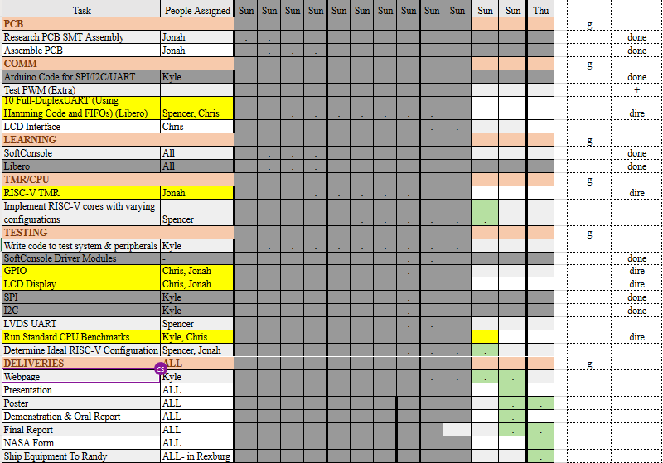
WIGS Project Tasks

Slide 2
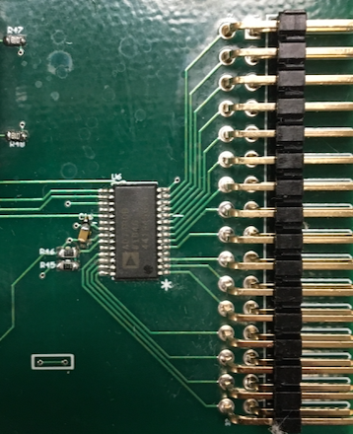
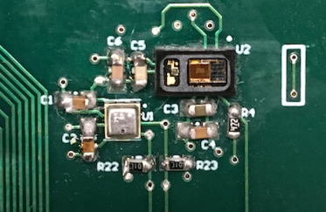
Re-soldering PCB

Slide 3
Week 10 (23-Jun to 29-Jun) Chris Porter
Goal/Task | % Done | Hours (Act.)
LVDS UART | 75% | 6.333
GPIO Test | 95% | 1.416
LCD Test | 90% | 0.25
Test Peripherals (SPI, I2C, GPIO) | 50% | 3
Leadership Training |  | 1
WIGS/Meetings |  | 2.25
Hours on task during the week (On track ≥ 13 / wk) | 14.25
Total hours on task so far this semester (On track ≥ 125 hrs) | 110.5

Slide 4
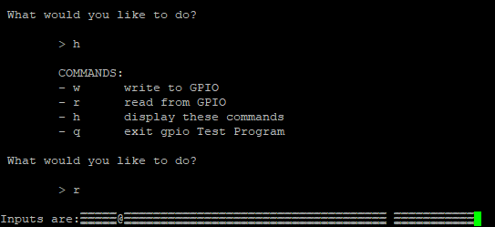
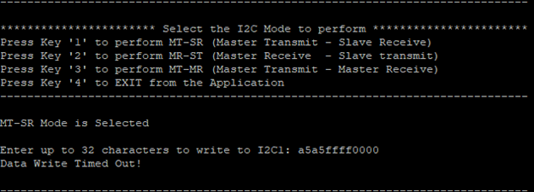
Progress made during the week (Log) (What I did)
Raspberry Pi is fast enough to communicate with FPGA at 1000000 Mbps. However, it cannot do LVDS communication.
Solution: Get Full Duplex UART working separately, then test that the FPGA outputs typical LVDS signals with an Oscilloscope.
Test Peripherals:
GPIO:
Output works
Input does not. Reading fails miserably.
Display of the input looks like the figure.
FPGA gets 'stuck' here, and cannot move on.
GPIO LEDS turned off/dimmed. Doesn't seem good...
SPI:
Send Data works (shows up on Oscilloscope)
Next Step: Read Data from an MSP432
I2C:
Master Transmit – Slave Receive times out. No data shown on Oscilloscope.

Slide 5
Difficulties encountered during the week (What I did not do and why)
Travel Planning.
Availability for Week 13:
Monday Evening (If needed)
Tuesday Class time
Wednesday before 9AM
Thursday Class time + Presentation Time
Phone calls almost any other time (keep me company while I'm driving)
Need PCB for testing

Slide 6
Goals for this coming week (Ones that move the project forward the most)
Goal/Task | Stop Date (Est.) | Hours (Est.)
Test Peripherals (Testing on FPGA, PCB, troubleshooting, and fixing) | 6/28/2020 | 10
LCD Test GPIO / LCD Interface |  | 2
CPU Benchmark |  | 3
Leadership/meetings |  | 2
Estimated time needed to work on goals for this coming week (typ. 13 hrs) | 17

Slide 7
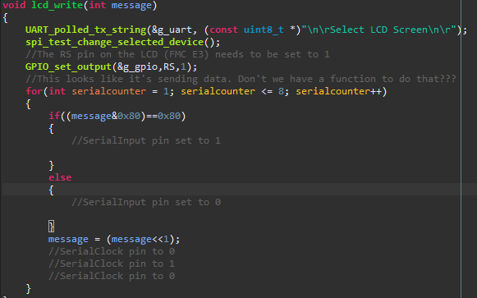
How can we help you achieve your goals?
LCD Communication is done with SPI. There should be code written for that already.

Slide 8
Week 10 (23-Jun to 29-Jun) Jonah Boe
Goal/Task | % Done | Hours (Act.)
Soldier ADC | 100% | 0.5
Fixing other board issues | 100% | 6
Rewriting LCD test for added functionality | 100% | 3.3
Reviewing other test Soft Console tests for better understanding of implementation | - | 2
Leadership training | - | 1
Other Class Material | - | 1
Hours on task during the week (On track ≥ 13 / wk) | 13.8
Total hours on task so far this semester (On track ≥ 125 hrs) | 123.5

Slide 9
Progress made during the week (Log) (What I did)
I fixed problems with shorting occurring across 3.3V external power input and ground.
I fixed problems with shorting occurring across rx and tx of the humidity sensor.
I added a helo world program for LCD and made changes to display user specified text.

Slide 10
Difficulties encountered during the week (What I did not do and why)
Finding the source of the problems with the board was more time consuming than expected.

Slide 11
Goals for this coming week (Ones that move the project forward the most)
Goal/Task | Stop Date (Est.) | Hours (Est.)
Debug the LCD test | July 6, 2020 | 2
Finish implementing the GPIO | July 6, 2020 | 6
Start testing RISC-V configurations | July 10, 2020 | 4
Leadership training | - | 1
Other Class material | - | 1
Estimated time needed to work on goals for this coming week (typ. 13 hrs) | 14

Slide 12
How can we help you achieve your goals?
NA

Slide 13
Week 10 (23-Jun to 29-Jun) Spencer Cheney
Goal/Task | % Done | Hours (Act.)
Rewrite UART Test to transmit and receive properly | 100% | 5
Strip UART module to remove Differential signal functionality to ensure we could transmit UART without a differential signal | 100% | 3
Increased Baud rate to allow future LVDS module | 100% | 4
Research devices to test LVDS UART | 100% | 2
Write UART test for Raspberry Pi since it can keep up with baud rate | 100% | 2
Test and Debug FPGA UART communication with Raspberry pi | 100% | 7
Hours on task during the week (On track ≥ 13 / wk) | 23
Total hours on task so far this semester (On track ≥ 125 hrs) | 128.5

Slide 14
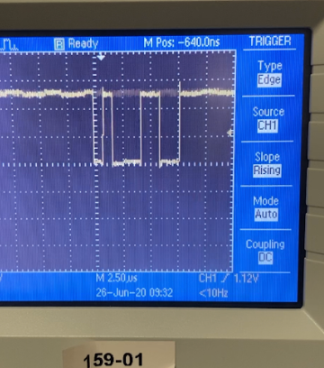
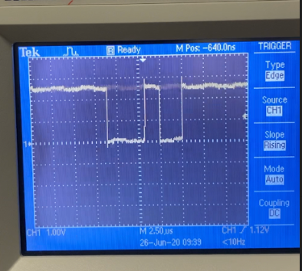
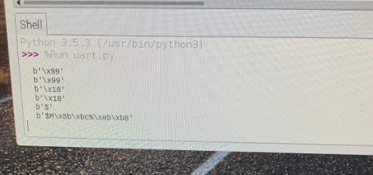
Progress made during the week (Log) (What I did)
For example: Resources found (links, manuals), Designs created, Decisions made and corresponding rational, Photos of prototype progress, etc.
UART is working!!!!
Wrote UART test for Raspberry Pi
Figured out addressing for UART modules

Slide 15
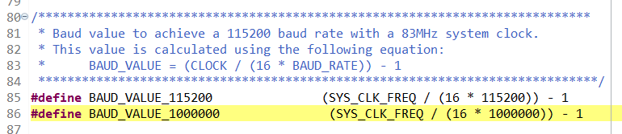
Difficulties encountered during the week (What I did not do and why)
The equation for the FPGA UART baud rate isn't precise at 1 MHz
At 1MHz the Raspberry Pi usually skips the second bit and reads in the parity bit as data when receiving data from FPGA
The FPGA doesn't read fast enough to detect start condition sometimes

Slide 16
Goals for this coming week (Ones that move the project forward the most)
Goal/Task | Stop Date (Est.) | Hours (Est.)
Write test for Full-Duplex UART | 7/1 | 3
Set up LVDS UART module | 7/3 | 6
Research TMR and RISC-V configurations | 7/6 | 4
Estimated time needed to work on goals for this coming week (typ. 13 hrs) | 13

Slide 17
How can we help you achieve your goals?
.

Slide 18
Week 10 (23-Jun to 29-Jun) Kyle Tolliver
Goal/Task | % Done | Hours (Act.)
WIGS/Meeting | - | 5.75
Microsemi/COM/Softconsole | 90 | 10.25
Webpage | 85 | .33
Leadership | - | 1.33
Hours on task during the week (On track ≥ 13 / wk) | 17.75
Total hours on task so far this semester (On track ≥ 125 hrs) | 126

Slide 19
Progress made during the week (Log) (What I did)
For example: Resources found (links, manuals), Designs created, Decisions made and corresponding rational, Photos of prototype progress, etc.
Researched LVDS UART
Looked through and Improved COM soft console code (SPI, I2C and drivers)
Difficulties encountered during the week (What I did not do and why)
NA

Slide 20
Goals for this coming week (Ones that move the project forward the most)
Goal/Task | Stop Date (Est.) | Hours (Est.)
Leadership |  | 1.33
CPU Benchmarks | 7/11 | 4.5
Webpage | 7/16 | 1.66
WIGS/Meetings |  | 4.5
Estimated time needed to work on goals for this coming week (typ. 13 hrs) | 13

Slide 21
How can we help you achieve your goals?
When is the Leadership final?

Slide 22
Notes:
Taken from Elder Bednar’s address: http://www2.byui.edu/Presentations/Transcripts/Devotionals/2006_10_31_Bednar.htm

