Slide 1
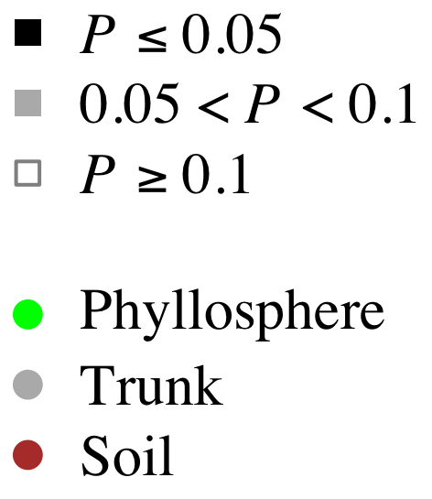
Lichen 2010
Fungal Leaf Pathogens 2010
Ectomycorrhizal Fungi 2006
Fungal Leaf Pathogens 2009
Soil Bacteria 2004
Leaf Modifying Arthropods 2010
Soil Fungi 2004
Twig Endophyes 2006

Slide 2
Lichen 2010
Fungal Leaf Pathogens 2010
Ectomycorrhizal Fungi 2006
Fungal Leaf Pathogens 2009
Soil Bacteria 2004
Leaf Modifying Arthropods 2010
Soil Fungi 2004
Twig Endophyes 2006

