Slide 1
Axis2
2O
1
4O
2D
3O
0.5
2L
5O
3D
3L
1O
4D
0
1L
-1.5
-1
5D
-0.5
0
4L
0.5
1
1D
-0.5
-1
5L
-1.5
-2
-2.5
Notes:
High sites only

Slide 2
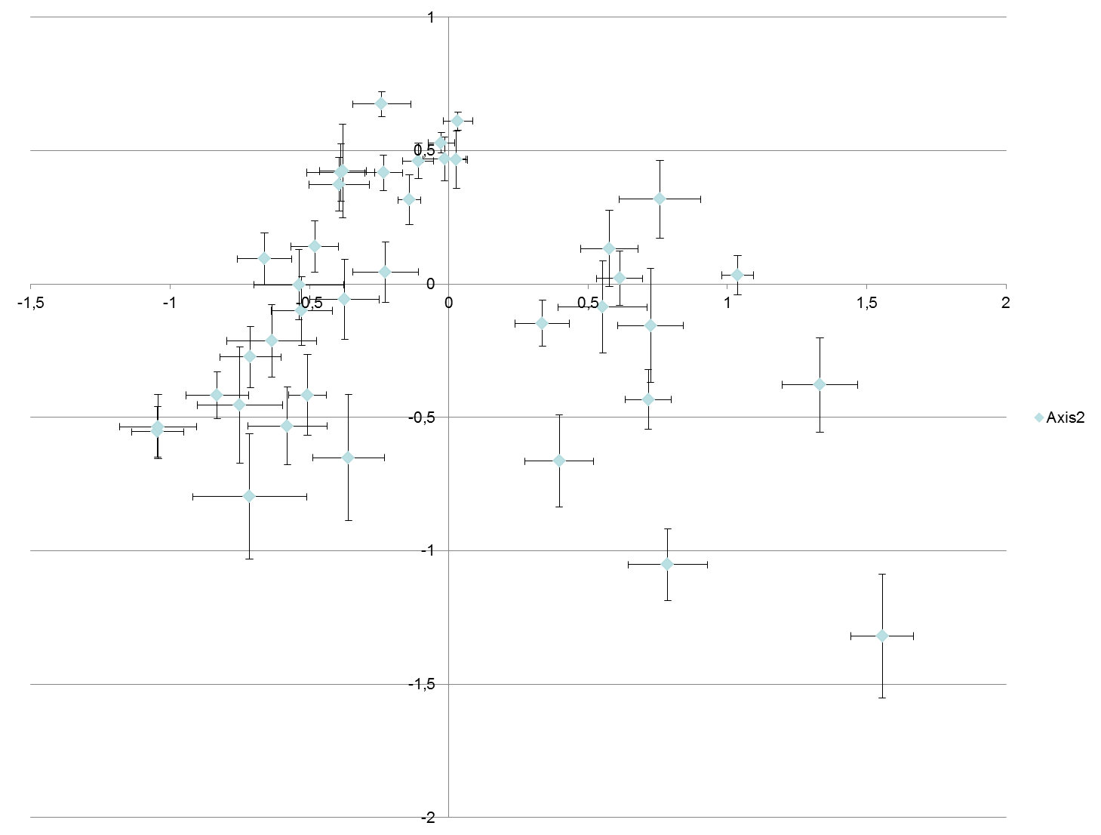
Axis2All
Elevation***
Microhabitat****: La, Db, Oc
EXM*: HL&LL : a, HD&HO&LD : b, LO : c
Axis2Low
Microhabitat****: La, Db, Oc
L6L
H1L
L8L
L4L
H3L
L2L
H1D
H2L
L6D
H1O
L3L
H4L
H3O
H3D
L5L
H4D
H5L
L7L
L1L
L6O
L2D
L3D
L3O
H5D
L4D
L7D
H2O
L8O
L1D
H4O
H2D
L7O
H5O
L8D
Axis1All
Elevation****
Microhabitat****: La, Db, Ob
EXM***: HL#HO
Axis1Low
Grazing*
L4O
L5D
L2O
L5O
L1O
Notes:
High and low sites
First anova is for all plots
Second Anova is for the low elevation plots only

Slide 3
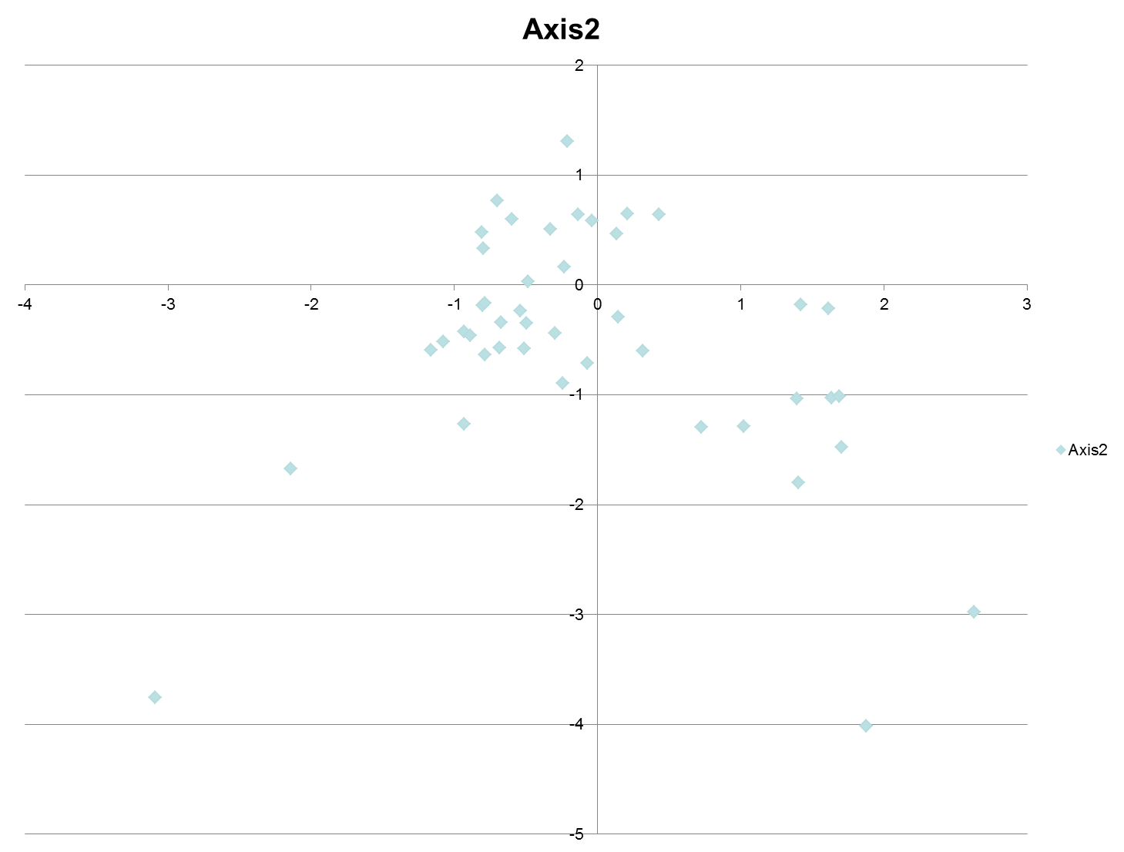
Pimpinella
Dactylis
Green Fescue
Campanula
Centaurea
Asperula
Veronica
Bromus
Cirsium
Corydallis
Marrubium
Apiaceae
Ajuga
Blue Fescue
Crocus
Melica
Galium
Small Cerastium
Prunus
Viola
Thlaspi
Alyssum
Sherardia
Allium
Lamium
Lilliaceae
Cerastium
Geranium
Myosotis
Sonchus
Torilis
Spiny Centaurea
Scorzonera
Bromus Intermedius
Paronychia
Crepis
Trigonella
Polygonum
Buffonia

Slide 4
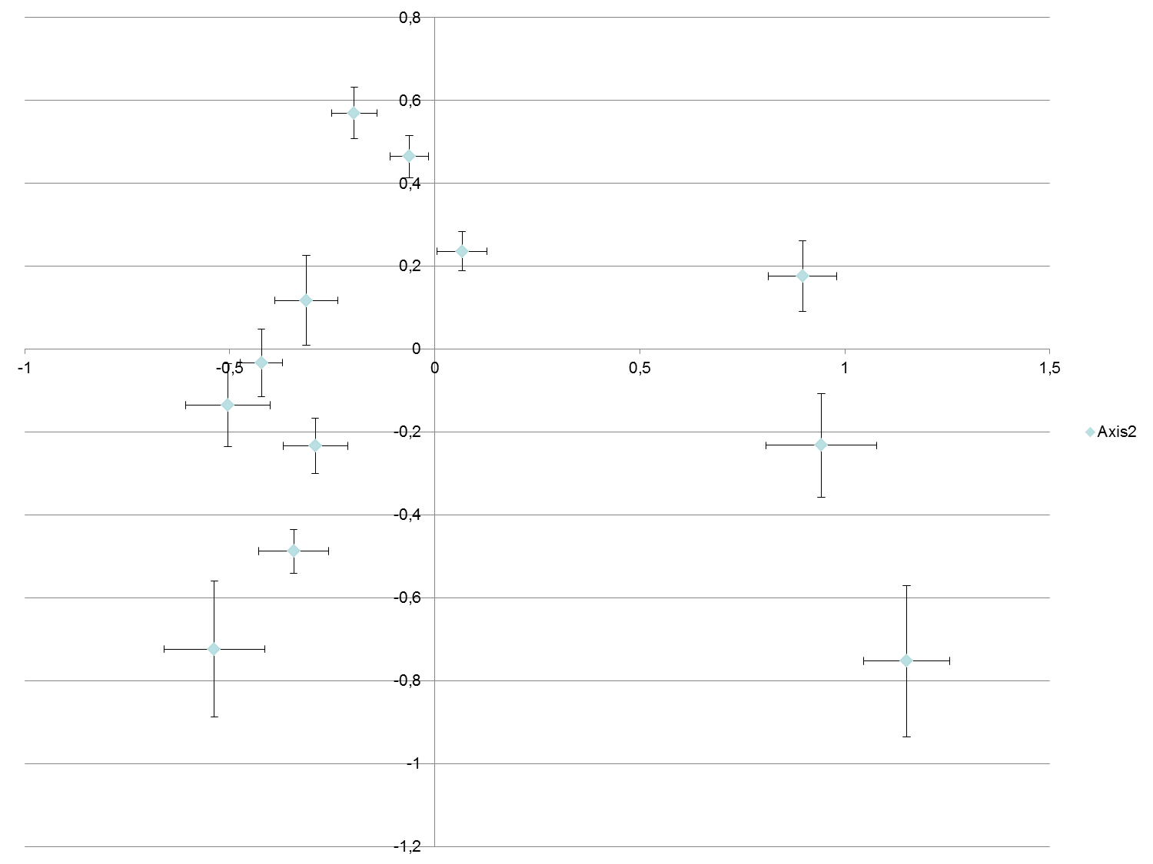


Axis2
Exposure****
Grazing****
Microhabitat****
EXG*
GXM**
North
grazed
loose
North
ungrazed
loose
Axis1
Exposure****
Grazing****
Microhabitat***
EXG****
GXM**
EXM(*)
EXGXM***
South
grazed
loose
South
ungrazed
loose
North
grazed
tight
North
grazed
open
North
ungrazed
tight
South
ungrazed
tight
South
grazed
tight
South
grazed
open
North
ungrazed
open
South
ungrazed
open
Notes:
Elevation replaced by exposure.

