Slide 1
Main Results:
Only analyzing 2009
Removing Pemphigus betae alters the interaction network structure between conttonwood trees and the associated arthropod community
Modularity = the degree to which the network is broken into groups
Exclusion treatment network is significantly modular (modularity = 0.2, p = 0.001),
While the control network is not (modularity = 0.17, p = 0.91).
Pemphigus reduces modularity of the network, and removing it reduces its impact on network structure
Contribution to modularity (z) measures the effect that randomizing (controlling for both the total abundance of the species and the abundance of arthropods on trees) a node’s connections has on the modularity of the network; where negative values indicate suppresion of modularity and positive values indicate that a node increases modularity
Control: z = -0.65, Exclusion: z = -0.13
Tree contribution to modularity is positively correlated with the effect of Pemphigus betae removal (i.e., control PB – exclusion PB)
r = 0.33, p = 0.037

Slide 2
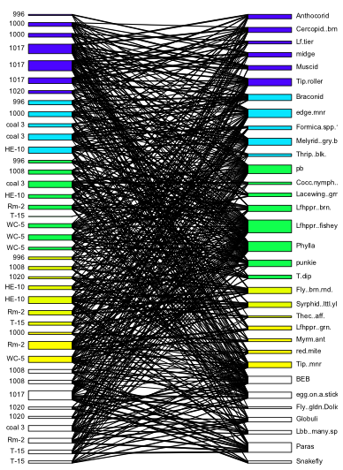
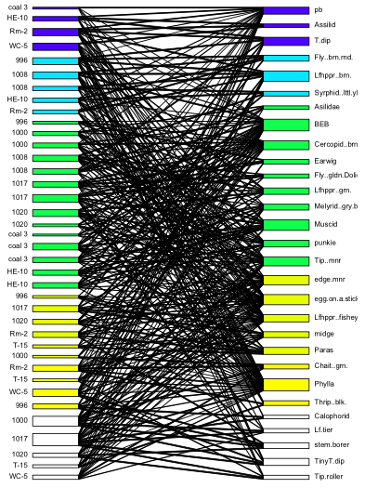
Control
Exclusion

